Slide 1
SoftHier Progress Update
Chi Zhang chizhang@iis.ee.ethz.ch Luca Colagrande colluca@iis.ee.ethz.ch
Thomas Benz tbenz@iis.ee.ethz.ch

Slide 2
Cluster DMA (old model) performance Testing
Key DMA parameters
Burst Length
Num Outstanding Burst
Test settings
Cluster (@1GHz) DMA transfer 1MB from DRAM to TCDM
LPDDR4 @1.6GHz – Max 6.4GB/s
DDR4-DIMM@993MHz – Max 15GB/s
HBM channel @1GHz – Max 32GB/s
Varying: Burst Length & Num Outstanding Burst
DMA saturate DRAM BW
BL=512 Bytes
#Outstanding = 256
PULP
Cluster
Req: BL = 64B
CTRL
+
DRAM
DMA
#Outstanding
64B
64B
64B
Resp:
Latency

Slide 3
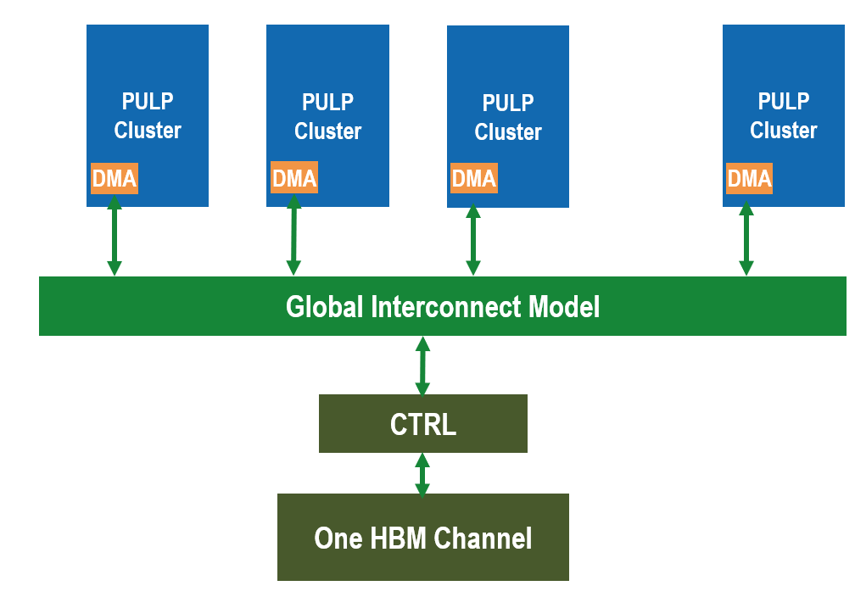
Develop and test interconnect in GVSoC
built a scale-out system in GVSoC
Test: every Cluster’s DMA is continue transferring data from HBM channel to Cluster TCDM
We can model traffic with interconnect in GVSoC
DMA:BL = 256bytes, #Outstanding=256
DMA:BL = 512bytes, #Outstanding=256

Slide 4
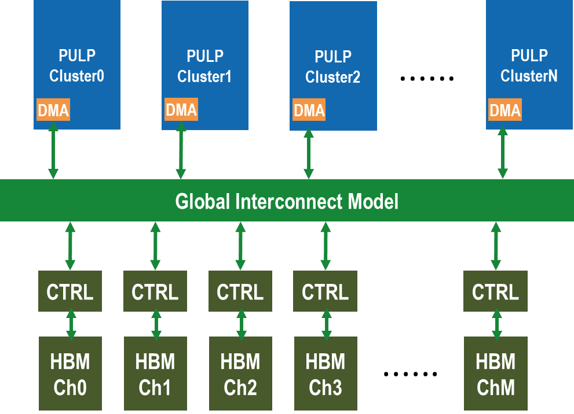
Next step
On going:
Modeling & Testing Multi-Cluster & Multi-HBM channel interconnected system

Slide 5
iDMA Update
iDMA model is almost finished
Timing accurate
Arbitrary 1D transfers
Model is expandable
Will implement features beneficial in scaled-out systems
Agile transfer launch and synchronization
iDMA is updated in Snitch, Update in Occamy pending
Hardware is in, verification outstanding

Slide 6
SoftHier Progress Update
Luca Colagrande colluca@iis.ee.ethz.ch

Slide 7
Current Progress
A lot of maintenance and bug-fixing work in the last two weeks:
PRs #99, #97, #32, #61, #100, #94, #83, #52, #62, #93, #92, #91, #87
Big efforts still ongoing:
PRs #90, #102, #104
Efforts to port Snitch runtime to GVSoC will commence soon, as the Occamy model is developed

