Slide 1
SoftHier Progress Update
Chi Zhang chizhang@iis.ee.ethz.ch
Thomas Benz tbenz@iis.ee.ethz.ch
Luca Colagrande colluca@iis.ee.ethz.ch

Slide 2
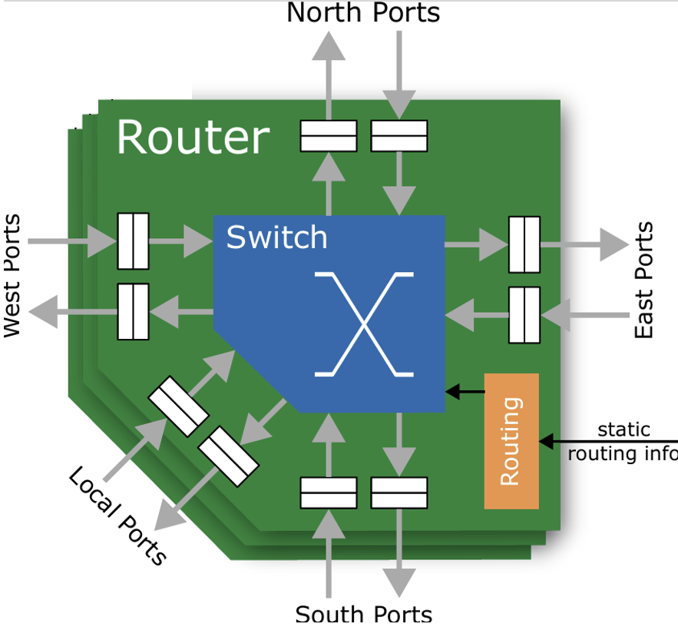
NoC Modeling in GVSoC
Chi came back from holiday on 18th June
Finished 1st version of NoC model in GVSoC
Simple Router
Packet FIFOs + 5x5 Xbar
XY routing algorithm
Functional testing passed
Currently doing
Evaluate performance of the NoC model
Calibrate with Floonoc (RTL)
R
R
R
R
R
R
R
R
R
R
R
R
R
R
R
R

Slide 3
On-Going: Modeling NoC-Based Scalable System
Modeling Features
Use Mesh NoC model to connect clusters
Enable inter-cluster communication
Developing auto-generation script to Model system with different parameters
RedMule config
L1 (TCDM) size
#Clusters and #HBM channels
NoC link BW
HBM2E Stack0
HBM2E Stack1
R
R
R
R
R
R
R
R
C
C
C
C
C
C
C
C
C
C
C
C
C
C
C
C
R
R
R
R
R
R
R
R
C
C
C
C
C
C
C
C
R
R
R
R
R
R
R
R
C
C
C
C
C
C
C
C
R
R
R
R
R
R
R
R
HBM2E Stack2
HBM2E Stack3

Slide 4
Publication Plan: Design Space Exploration
Goal: Explore efficient memory hierarchy architecture for scalable acceleration using cube unit (RedMule here)
Variables: RedMule config, TCDM(L1 size), Cluster interconnect and topology, memory hierarchy
Metrics: RedMule Utilization, FLOPs/SRAM, FLOPs/mm2, FLOPs/Watt
Design Space Exploration Methodology: bottom-up
Inside Cluster:
Relationship between RedMule Config and TCDM size and requirement on TCDM BW
Find an optimal cluster configuration
We need more data here
Cluster interconnect topology and dataflow mapping for various kernels (mainly LLM kernels: MHA, MLP)
Flatten clusters with NoC mesh connection, or Hierarchical organize clusters with Xbar connection
L1 (TCDM) only, or L2/L3 Cache/Buffers
Enable or disable inter-clusters L1(TCDM) communication
We need parametrizable auto-generation script to model different system designs

Slide 5
Other Progress update
Snitch runtime
Luca C. recently back from holidays
Integrating GVSOC in Snitch cluster CI #142
Thomas was busy on EFCL summer school, currently at home sick

