Slide 1
SoftHier Progress Update
Chi Zhang chizhang@iis.ee.ethz.ch

Slide 2
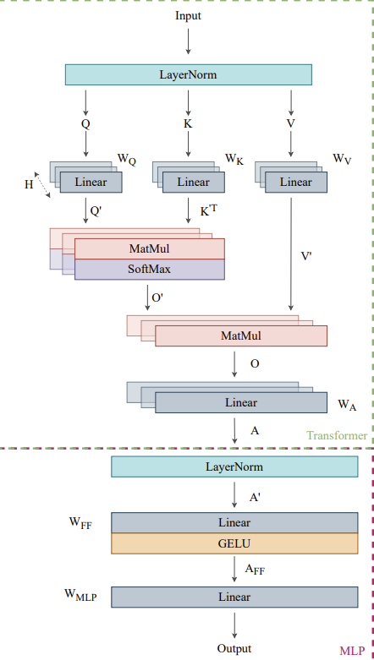
General Update on SoftHier Simulator
We benchmarked the proposed FlattenAttention on SoftHier
Introduce Vector Engine for Each Cluster
For softmax operations (max(V), sum(V), sub(V,s), exp(V), div(V,a))
A simple performance model
The execution time is estimated based on the dataset size and TCDM bandwidth
Estimate row-wise or column-wise broadcast and reduction on the NoC
Calculate the runtime as the runtime for one neighbor cluster DMA transfer plus tail latency
Results and Discussion
Start
End
Infinite Instruction Mem
CTRL
REG
Core 0
RedMule
Vector
Engine
iDMA
Core 0
…
Core n
Interconnect
TCDM
Cluster

Slide 3
Disable/Enable NoC with Collective Operation
Disabled
Enabled

Slide 4

FlattenAtt Step: QK Matmul
K₀
_{h3}
K₁
_{h3}
K₂
_{h3}
K₃
_{h3}
K₀
_{h2}
K₁
_{h2}
K₂
_{h2}
K₂
_{h2}
Note
After QKV projection, following steps focus only on one head and we process every head sequentially
K₀
_{h1}
K₁
_{h1}
K₂
_{h1}
K₃
_{h1}
K₀
_{h0}
K₁
_{h0}
K₂
_{h0}
K₃
_{h0}
V₀
_{h3}
V₀
_{h2}
V₀
_{h1}
V₀
_{h0}
Q₀
_{h3}
Q₀
_{h2}
Q₀
_{h1}
Q₀
_{h0}
V₁
_{h3}
V₁
_{h2}
V₁
_{h1}
V₁
_{h0}
Q₁
_{h3}
Q₁
_{h2}
Q₁
_{h1}
Q₁
_{h0}
V₂
_{h3}
V₂
_{h2}
V₂
_{h1}
V₂
_{h0}
Q₂
_{h3}
Q₂
_{h2}
Q₂
_{h1}
Q₂
_{h0}
V₃
_{h3}
V₃
_{h2}
V₃
_{h1}
V₃
_{h0}
Q₃
_{h3}
Q₃
_{h2}
Q₃
_{h1}
Q₃
_{h0}

Slide 5
FlattenAtt Step: QK Matmul
K₀
_{h3}
K₁
_{h3}
K₂
_{h3}
K₃
_{h3}
K₀
_{h2}
K₁
_{h2}
K₂
_{h2}
K₂
_{h2}
Note
Load and row-wise broadcast Q_{pre} of Head0
K₀
_{h1}
K₁
_{h1}
K₂
_{h1}
K₃
_{h1}
K₀
_{h0}
K₁
_{h0}
K₂
_{h0}
K₃
_{h0}
Q₀
_{h0}
Q₀
_{h0}
Q₀
_{h0}
V₀
_{h3}
V₀
_{h2}
V₀
_{h1}
V₀
_{h0}
Q₀
_{h3}
Q₀
_{h2}
Q₀
_{h1}
Q₀
_{h0}
Q₁
_{h0}
Q₁
_{h0}
Q₁
_{h0}
V₁
_{h3}
V₁
_{h2}
V₁
_{h1}
V₁
_{h0}
Q₁
_{h3}
Q₁
_{h2}
Q₁
_{h1}
Q₁
_{h0}
V₂
_{h3}
Q₂
_{h3}
Q₂
_{h0}
Q₂
_{h0}
Q₂
_{h0}
V₂
_{h2}
V₂
_{h1}
V₂
_{h0}
Q₂
_{h2}
Q₂
_{h1}
Q₂
_{h0}
Q₃
_{h0}
Q₃
_{h0}
Q₃
_{h0}
V₃
_{h3}
V₃
_{h2}
V₃
_{h1}
V₃
_{h0}
Q₃
_{h3}
Q₃
_{h2}
Q₃
_{h1}
Q₃
_{h0}

Slide 6
FlattenAtt Step: QK Matmul
K₀
_{h3}
K₁
_{h3}
K₂
_{h3}
K₃
_{h3}
K₀
_{h2}
K₁
_{h2}
K₂
_{h2}
K₂
_{h2}
Note
Load and row-wise broadcast Q_{pre} of Head0
K₀
_{h1}
K₁
_{h1}
K₂
_{h1}
K₃
_{h1}
row-wise broadcast
K₀
_{h0}
K₁
_{h0}
K₂
_{h0}
K₃
_{h0}
V₀
_{h3}
V₀
_{h2}
V₀
_{h1}
V₀
_{h0}
Q₀
_{h3}
Q₀
_{h2}
Q₀
_{h1}
Q₀
_{h0}
Q₀
_{h0}
Q₀
_{h0}
Q₀
_{h0}
V₁
_{h3}
V₁
_{h2}
V₁
_{h1}
V₁
_{h0}
Q₁
_{h3}
Q₁
_{h2}
Q₁
_{h1}
Q₁
_{h0}
Q₁
_{h0}
Q₁
_{h0}
Q₁
_{h0}
V₂
_{h3}
V₂
_{h2}
V₂
_{h1}
V₂
_{h0}
Q₂
_{h3}
Q₂
_{h2}
Q₂
_{h1}
Q₂
_{h0}
Q₂
_{h0}
Q₂
_{h0}
Q₂
_{h0}
V₃
_{h3}
V₃
_{h2}
V₃
_{h1}
V₃
_{h0}
Q₃
_{h3}
Q₃
_{h2}
Q₃
_{h1}
Q₃
_{h0}
Q₃
_{h0}
Q₃
_{h0}
Q₃
_{h0}

Slide 7
FlattenAtt Step: QK Matmul
K₀
_{h3}
K₁
_{h3}
K₂
_{h3}
K₃
_{h3}
K₀
_{h2}
K₁
_{h2}
K₂
_{h2}
K₂
_{h2}
Note
Load and column-wise broadcast K_{pre} of Head0
K₀
_{h1}
K₁
_{h1}
K₂
_{h1}
K₃
_{h1}
Q₀
_{h0}
K₀
_{h0}
K₀
_{h0}
K₀
_{h0}
K₀
_{h0}
Q₀
_{h0}
K₁
_{h0}
K₁
_{h0}
K₁
_{h0}
K₁
_{h0}
Q₀
_{h0}
K₂
_{h0}
K₂
_{h0}
K₂
_{h0}
K₂
_{h0}
Q₀
_{h0}
K₃
_{h0}
K₃
_{h0}
K₃
_{h0}
V₀
_{h3}
V₀
_{h2}
V₀
_{h1}
V₀
_{h0}
Q₀
_{h3}
Q₀
_{h2}
Q₀
_{h1}
K₃
_{h0}
V₁
_{h3}
V₁
_{h2}
V₁
_{h1}
V₁
_{h0}
Q₁
_{h3}
Q₁
_{h2}
Q₁
_{h1}
Q₁
_{h0}
Q₁
_{h0}
Q₁
_{h0}
Q₁
_{h0}
V₂
_{h3}
V₂
_{h2}
V₂
_{h1}
V₂
_{h0}
Q₂
_{h3}
Q₂
_{h2}
Q₂
_{h1}
Q₂
_{h0}
Q₂
_{h0}
Q₂
_{h0}
Q₂
_{h0}
V₃
_{h3}
V₃
_{h2}
V₃
_{h1}
V₃
_{h0}
Q₃
_{h3}
Q₃
_{h2}
Q₃
_{h1}
Q₃
_{h0}
Q₃
_{h0}
Q₃
_{h0}
Q₃
_{h0}

Slide 8
FlattenAtt Step: QK Matmul
K₀
_{h3}
K₁
_{h3}
K₂
_{h3}
K₃
_{h3}
K₀
_{h2}
K₁
_{h2}
K₂
_{h2}
K₂
_{h2}
Note
Load and column-wise broadcast K_{pre} of Head0
K₀
_{h1}
K₁
_{h1}
K₂
_{h1}
K₃
_{h1}
column-wise broadcast
V₀
_{h3}
V₀
_{h2}
V₀
_{h1}
V₀
_{h0}
Q₀
_{h3}
Q₀
_{h2}
Q₀
_{h1}
Q₀
_{h0}
K₀
_{h0}
Q₀
_{h0}
K₁
_{h0}
Q₀
_{h0}
K₂
_{h0}
Q₀
_{h0}
K₃
_{h0}
V₁
_{h3}
V₁
_{h2}
V₁
_{h1}
V₁
_{h0}
Q₁
_{h3}
Q₁
_{h2}
Q₁
_{h1}
Q₁
_{h0}
K₀
_{h0}
Q₁
_{h0}
K₁
_{h0}
Q₁
_{h0}
K₂
_{h0}
Q₁
_{h0}
K₃
_{h0}
V₂
_{h3}
V₂
_{h2}
V₂
_{h1}
V₂
_{h0}
Q₂
_{h3}
Q₂
_{h2}
Q₂
_{h1}
Q₂
_{h0}
K₀
_{h0}
Q₂
_{h0}
K₁
_{h0}
Q₂
_{h0}
K₂
_{h0}
Q₂
_{h0}
K₃
_{h0}
V₃
_{h3}
V₃
_{h2}
V₃
_{h1}
V₃
_{h0}
Q₃
_{h3}
Q₃
_{h2}
Q₃
_{h1}
Q₃
_{h0}
K₀
_{h0}
Q₃
_{h0}
K₁
_{h0}
Q₃
_{h0}
K₂
_{h0}
Q₃
_{h0}
K₃
_{h0}

Slide 9
FlattenAtt Step: QK Matmul
K₀
_{h3}
K₁
_{h3}
K₂
_{h3}
K₃
_{h3}
K₀
_{h2}
K₁
_{h2}
K₂
_{h2}
K₂
_{h2}
Note
Transpose K_{pre} tiles in each cluster
K₀
_{h1}
K₁
_{h1}
K₂
_{h1}
K₃
_{h1}
K₀
_{h0}
K₁
_{h0}
K₂
_{h0}
K₃
_{h0}
V₀
_{h3}
V₀
_{h2}
V₀
_{h1}
V₀
_{h0}
Q₀
_{h3}
Q₀
_{h2}
Q₀
_{h1}
Q₀
_{h0}
Q₀
_{h0}
Q₀
_{h0}
Q₀
_{h0}
K₀
_{h0}
K₁
_{h0}
K₂
_{h0}
K₃
_{h0}
V₁
_{h3}
V₁
_{h2}
V₁
_{h1}
V₁
_{h0}
Q₁
_{h3}
Q₁
_{h2}
Q₁
_{h1}
Q₁
_{h0}
Q₁
_{h0}
Q₁
_{h0}
Q₁
_{h0}
K₀
_{h0}
K₁
_{h0}
K₂
_{h0}
K₃
_{h0}
V₂
_{h3}
V₂
_{h2}
V₂
_{h1}
V₂
_{h0}
Q₂
_{h3}
Q₂
_{h2}
Q₂
_{h1}
Q₂
_{h0}
Q₂
_{h0}
Q₂
_{h0}
Q₂
_{h0}
K₀
_{h0}
K₁
_{h0}
K₂
_{h0}
K₃
_{h0}
V₃
_{h3}
V₃
_{h2}
V₃
_{h1}
V₃
_{h0}
Q₃
_{h3}
Q₃
_{h2}
Q₃
_{h1}
Q₃
_{h0}
Q₃
_{h0}
Q₃
_{h0}
Q₃
_{h0}

Slide 10
FlattenAtt Step: QK Matmul
K₀
_{h3}
K₁
_{h3}
K₂
_{h3}
K₃
_{h3}
K₀
_{h2}
K₁
_{h2}
K₂
_{h2}
K₂
_{h2}
Note
MatMal (Q_{pre} * K^{T}_{pre}) compute attention matrix tiles of Head0 in each cluster
K₀
_{h1}
K₁
_{h1}
K₂
_{h1}
K₃
_{h1}
K₀
_{h0}
K₁
_{h0}
K₂
_{h0}
K₃
_{h0}
V₀
_{h3}
V₀
_{h2}
V₀
_{h1}
V₀
_{h0}
Q₀
_{h3}
Q₀
_{h2}
Q₀
_{h1}
Q₀
_{h0}
Att₀₀
Q₀
_{h0}
Att₀₁
Q₀
_{h0}
Att₀₂
Q₀
_{h0}
Att₀₃
K₀
_{h0}
K₁
_{h0}
K₂
_{h0}
K₃
_{h0}
V₁
_{h3}
V₁
_{h2}
V₁
_{h1}
V₁
_{h0}
Q₁
_{h3}
Q₁
_{h2}
Q₁
_{h1}
Q₁
_{h0}
Att₁₀
Q₁
_{h0}
Att₀₁
Q₁
_{h0}
Att₁₂
Q₁
_{h0}
Att₁₃
K₀
_{h0}
K₁
_{h0}
K₂
_{h0}
K₃
_{h0}
V₂
_{h3}
V₂
_{h2}
V₂
_{h1}
V₂
_{h0}
Q₂
_{h3}
Q₂
_{h2}
Q₂
_{h1}
Q₂
_{h0}
Att₂₀
Q₂
_{h0}
Att₂₁
Q₂
_{h0}
Att₂₂
Q₂
_{h0}
Att₂₃
K₀
_{h0}
K₁
_{h0}
K₂
_{h0}
K₃
_{h0}
V₃
_{h3}
V₃
_{h2}
V₃
_{h1}
V₃
_{h0}
Q₃
_{h3}
Q₃
_{h2}
Q₃
_{h1}
Q₃
_{h0}
Att₃₀
Q₃
_{h0}
Att₃₁
Q₃
_{h0}
Att₃₂
Q₃
_{h0}
Att₃₃

Slide 11
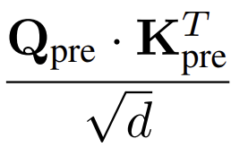
FlattenAtt Step: Scaling
K₀
_{h3}
K₁
_{h3}
K₂
_{h3}
K₃
_{h3}
K₀
_{h2}
K₁
_{h2}
K₂
_{h2}
K₂
_{h2}
Note
Element-wise division on attention matrix
K₀
_{h1}
K₁
_{h1}
K₂
_{h1}
K₃
_{h1}
V₀
_{h3}
V₀
_{h2}
V₀
_{h1}
V₀
_{h0}
Q₀
_{h3}
Q₀
_{h2}
Q₀
_{h1}
Att₀₀
Att₀₁
Att₀₂
Att₀₃
V₁
_{h3}
V₁
_{h2}
V₁
_{h1}
V₁
_{h0}
Q₁
_{h3}
Q₁
_{h2}
Q₁
_{h1}
Att₁₀
Att₀₁
Att₁₂
Att₁₃
V₂
_{h3}
V₂
_{h2}
V₂
_{h1}
V₂
_{h0}
Q₂
_{h3}
Q₂
_{h2}
Q₂
_{h1}
Att₂₀
Att₂₁
Att₂₂
Att₂₃
V₃
_{h3}
V₃
_{h2}
V₃
_{h1}
V₃
_{h0}
Q₃
_{h3}
Q₃
_{h2}
Q₃
_{h1}
Att₃₀
Att₃₁
Att₃₂
Att₃₃

Slide 12
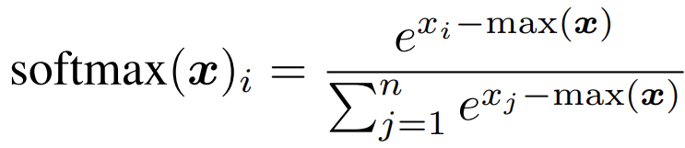
FlattenAtt Step: SoftMax
K₀
_{h3}
K₁
_{h3}
K₂
_{h3}
K₃
_{h3}
K₀
_{h2}
K₁
_{h2}
K₂
_{h2}
K₂
_{h2}
Note
Each cluster calculates their local partial max(x)
K₀
_{h1}
K₁
_{h1}
K₂
_{h1}
K₃
_{h1}
Max_{L}
Max_{L}
Max_{L}
Max_{L}
V₀
_{h3}
V₀
_{h2}
V₀
_{h1}
V₀
_{h0}
Q₀
_{h3}
Q₀
_{h2}
Q₀
_{h1}
Att₀₀
Att₀₁
Att₀₂
Att₀₃
Max_{L}
Max_{L}
Max_{L}
Max_{L}
V₁
_{h3}
V₁
_{h2}
V₁
_{h1}
V₁
_{h0}
Q₁
_{h3}
Q₁
_{h2}
Q₁
_{h1}
Att₁₀
Att₀₁
Att₁₂
Att₁₃
Max_{L}
Max_{L}
Max_{L}
Max_{L}
V₂
_{h3}
V₂
_{h2}
V₂
_{h1}
V₂
_{h0}
Q₂
_{h3}
Q₂
_{h2}
Q₂
_{h1}
Att₂₀
Att₂₁
Att₂₂
Att₂₃
Max_{L}
Max_{L}
Max_{L}
Max_{L}
V₃
_{h3}
V₃
_{h2}
V₃
_{h1}
V₃
_{h0}
Q₃
_{h3}
Q₃
_{h2}
Q₃
_{h1}
Att₃₀
Att₃₁
Att₃₂
Att₃₃

Slide 13
FlattenAtt Step: SoftMax
K₀
_{h3}
K₁
_{h3}
K₂
_{h3}
K₃
_{h3}
K₀
_{h2}
K₁
_{h2}
K₂
_{h2}
K₂
_{h2}
Note
Row-wise reduction of local partial max(x) to get real max(x)
K₀
_{h1}
K₁
_{h1}
K₂
_{h1}
K₃
_{h1}
row-wise reduction
Max_{L}
Max_{L}
Max_{L}
Max_{L}
Max
V₀
_{h3}
V₀
_{h2}
V₀
_{h1}
V₀
_{h0}
Q₀
_{h3}
Q₀
_{h2}
Q₀
_{h1}
Att₀₀
Att₀₁
Att₀₂
Att₀₃
Max_{L}
Max_{L}
Max_{L}
Max_{L}
Max
V₁
_{h3}
V₁
_{h2}
V₁
_{h1}
V₁
_{h0}
Q₁
_{h3}
Q₁
_{h2}
Q₁
_{h1}
Att₁₀
Att₀₁
Att₁₂
Att₁₃
Max_{L}
Max_{L}
Max_{L}
Max_{L}
Max
V₂
_{h3}
V₂
_{h2}
V₂
_{h1}
V₂
_{h0}
Q₂
_{h3}
Q₂
_{h2}
Q₂
_{h1}
Att₂₀
Att₂₁
Att₂₂
Att₂₃
Max_{L}
Max_{L}
Max_{L}
Max_{L}
Max
V₃
_{h3}
V₃
_{h2}
V₃
_{h1}
V₃
_{h0}
Q₃
_{h3}
Q₃
_{h2}
Q₃
_{h1}
Att₃₀
Att₃₁
Att₃₂
Att₃₃

Slide 14
FlattenAtt Step: SoftMax
K₀
_{h3}
K₁
_{h3}
K₂
_{h3}
K₃
_{h3}
K₀
_{h2}
K₁
_{h2}
K₂
_{h2}
K₂
_{h2}
Note
Row-wise broadcast real max(x) to each cluster
K₀
_{h1}
K₁
_{h1}
K₂
_{h1}
K₃
_{h1}
row-wise broadcast
Max
Max
Max
Max
V₀
_{h3}
V₀
_{h2}
V₀
_{h1}
V₀
_{h0}
Q₀
_{h3}
Q₀
_{h2}
Q₀
_{h1}
Att₀₀
Att₀₁
Att₀₂
Att₀₃
Max
Max
Max
Max
V₁
_{h3}
V₁
_{h2}
V₁
_{h1}
V₁
_{h0}
Q₁
_{h3}
Q₁
_{h2}
Q₁
_{h1}
Att₁₀
Att₀₁
Att₁₂
Att₁₃
Max
Max
Max
Max
V₂
_{h3}
V₂
_{h2}
V₂
_{h1}
V₂
_{h0}
Q₂
_{h3}
Q₂
_{h2}
Q₂
_{h1}
Att₂₀
Att₂₁
Att₂₂
Att₂₃
Max
Max
Max
Max
V₃
_{h3}
V₃
_{h2}
V₃
_{h1}
V₃
_{h0}
Q₃
_{h3}
Q₃
_{h2}
Q₃
_{h1}
Att₃₀
Att₃₁
Att₃₂
Att₃₃

Slide 15
FlattenAtt Step: SoftMax
K₀
_{h3}
K₁
_{h3}
K₂
_{h3}
K₃
_{h3}
Note
Do the same reduction and broadcast for 𝚺𝒆𝒙𝒑(𝒙_𝒊−𝒎𝒂𝒙(𝒙))
Finally finish SoftMax operation on local attention matrix tile of each cluster
K₀
_{h2}
K₁
_{h2}
K₂
_{h2}
K₂
_{h2}
K₀
_{h1}
K₁
_{h1}
K₂
_{h1}
K₃
_{h1}
$$Σexp(x_{i}−max)$$
$$Σexp(x_{i}−max)$$
$$Σexp(x_{i}−max)$$
$$Σexp(x_{i}−max)$$
V₀
_{h3}
V₀
_{h2}
V₀
_{h1}
V₀
_{h0}
Q₀
_{h3}
Q₀
_{h2}
Q₀
_{h1}
Att₀₀
Att₀₁
Att₀₂
Att₀₃
$$Σexp(x_{i}−max)$$
$$Σexp(x_{i}−max)$$
$$Σexp(x_{i}−max)$$
$$Σexp(x_{i}−max)$$
V₁
_{h3}
V₁
_{h2}
V₁
_{h1}
V₁
_{h0}
Q₁
_{h3}
Q₁
_{h2}
Q₁
_{h1}
Att₁₀
Att₀₁
Att₁₂
Att₁₃
$$Σexp(x_{i}−max)$$
$$Σexp(x_{i}−max)$$
$$Σexp(x_{i}−max)$$
$$Σexp(x_{i}−max)$$
V₂
_{h3}
V₂
_{h2}
V₂
_{h1}
V₂
_{h0}
Q₂
_{h3}
Q₂
_{h2}
Q₂
_{h1}
Att₂₀
Att₂₁
Att₂₂
Att₂₃
$$Σexp(x_{i}−max)$$
$$Σexp(x_{i}−max)$$
$$Σexp(x_{i}−max)$$
$$Σexp(x_{i}−max)$$
V₃
_{h3}
V₃
_{h2}
V₃
_{h1}
V₃
_{h0}
Q₃
_{h3}
Q₃
_{h2}
Q₃
_{h1}
Att₃₀
Att₃₁
Att₃₂
Att₃₃

Slide 16
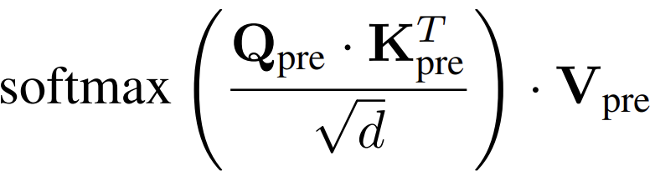
FlattenAtt Step: SV Matmul
K₀
_{h3}
K₁
_{h3}
K₂
_{h3}
K₃
_{h3}
K₀
_{h2}
K₁
_{h2}
K₂
_{h2}
K₂
_{h2}
Note
Load and row-wise broadcast V_{pre} of Head0
K₀
_{h1}
K₁
_{h1}
K₂
_{h1}
K₃
_{h1}
V₀
_{h3}
V₀
_{h2}
V₀
_{h1}
Q₀
_{h3}
Q₀
_{h2}
Q₀
_{h1}
Att₀₀
V₀
_{h0}
Att₀₁
Att₀₂
Att₀₃
V₁
_{h3}
V₁
_{h2}
V₁
_{h1}
Q₁
_{h3}
Q₁
_{h2}
Q₁
_{h1}
Att₁₀
V₁
_{h0}
Att₀₁
Att₁₂
Att₁₃
V₂
_{h3}
V₂
_{h2}
V₂
_{h1}
Q₂
_{h3}
Q₂
_{h2}
Q₂
_{h1}
Att₂₀
V₂
_{h0}
Att₂₁
Att₂₂
Att₂₃
V₃
_{h3}
V₃
_{h2}
V₃
_{h1}
Q₃
_{h3}
Q₃
_{h2}
Q₃
_{h1}
Att₃₀
V₃
_{h0}
Att₃₁
Att₃₂
Att₃₃

Slide 17
FlattenAtt Step: SV Matmul
K₀
_{h3}
K₁
_{h3}
K₂
_{h3}
K₃
_{h3}
K₀
_{h2}
K₁
_{h2}
K₂
_{h2}
K₂
_{h2}
Note
Load and row-wise broadcast V_{pre} of Head0
K₀
_{h1}
K₁
_{h1}
K₂
_{h1}
K₃
_{h1}
row-wise broadcast
V₀
_{h3}
V₀
_{h2}
V₀
_{h1}
Q₀
_{h3}
Q₀
_{h2}
Q₀
_{h1}
Att₀₀
V₀
_{h0}
Att₀₁
V₀
_{h0}
Att₀₂
V₀
_{h0}
Att₀₃
V₀
_{h0}
V₁
_{h3}
V₁
_{h2}
V₁
_{h1}
Q₁
_{h3}
Q₁
_{h2}
Q₁
_{h1}
Att₁₀
V₁
_{h0}
Att₀₁
V₁
_{h0}
Att₁₂
V₁
_{h0}
Att₁₃
V₁
_{h0}
V₂
_{h3}
V₂
_{h2}
V₂
_{h1}
Q₂
_{h3}
Q₂
_{h2}
Q₂
_{h1}
Att₂₀
V₂
_{h0}
Att₂₁
V₂
_{h0}
Att₂₂
V₂
_{h0}
Att₂₃
V₂
_{h0}
V₃
_{h3}
V₃
_{h2}
V₃
_{h1}
Q₃
_{h3}
Q₃
_{h2}
Q₃
_{h1}
Att₃₀
V₃
_{h0}
Att₃₁
V₃
_{h0}
Att₃₂
V₃
_{h0}
Att₃₃
V₃
_{h0}

Slide 18
FlattenAtt Step: SV Matmul
K₀
_{h3}
K₁
_{h3}
K₂
_{h3}
K₃
_{h3}
K₀
_{h2}
K₁
_{h2}
K₂
_{h2}
K₂
_{h2}
Note
Each cluster calculate partial result of output
K₀
_{h1}
K₁
_{h1}
K₂
_{h1}
K₃
_{h1}
V₀
_{h3}
V₀
_{h2}
V₀
_{h1}
Q₀
_{h3}
Q₀
_{h2}
Q₀
_{h1}
O₀
_{h0}
_{part}
Att₀₀
V₀
_{h0}
O₀
_{h0}
_{part}
Att₀₁
V₀
_{h0}
O₀
_{h0}
_{part}
Att₀₂
V₀
_{h0}
O₀
_{h0}
_{part}
Att₀₃
V₀
_{h0}
V₁
_{h3}
V₁
_{h2}
V₁
_{h1}
Q₁
_{h3}
Q₁
_{h2}
Q₁
_{h1}
O₁
_{h0}
_{part}
Att₁₀
V₁
_{h0}
O₁
_{h0}
_{part}
Att₀₁
V₁
_{h0}
O₁
_{h0}
_{part}
Att₁₂
V₁
_{h0}
O₁
_{h0}
_{part}
Att₁₃
V₁
_{h0}
V₂
_{h3}
V₂
_{h2}
V₂
_{h1}
Q₂
_{h3}
Q₂
_{h2}
Q₂
_{h1}
O₂
_{h0}
_{part}
Att₂₀
V₂
_{h0}
O₂
_{h0}
_{part}
Att₂₁
V₂
_{h0}
O₂
_{h0}
_{part}
Att₂₂
V₂
_{h0}
O₂
_{h0}
_{part}
Att₂₃
V₂
_{h0}
V₃
_{h3}
V₃
_{h2}
V₃
_{h1}
Q₃
_{h3}
Q₃
_{h2}
Q₃
_{h1}
O₃
_{h0}
_{part}
Att₃₀
V₃
_{h0}
O₃
_{h0}
_{part}
Att₃₁
V₃
_{h0}
O₃
_{h0}
_{part}
Att₃₂
V₃
_{h0}
O₃
_{h0}
_{part}
Att₃₃
V₃
_{h0}

Slide 19
FlattenAtt Step: SV Matmul
K₀
_{h3}
K₁
_{h3}
K₂
_{h3}
K₃
_{h3}
K₀
_{h2}
K₁
_{h2}
K₂
_{h2}
K₂
_{h2}
Note
Row-wise reduction of partial result
K₀
_{h1}
K₁
_{h1}
K₂
_{h1}
K₃
_{h1}
V₀
_{h3}
V₀
_{h2}
V₀
_{h1}
Q₀
_{h3}
Q₀
_{h2}
Q₀
_{h1}
O₀
_{h0}
_{part}
O₀
_{h0}
_{part}
O₀
_{h0}
_{part}
O₀
_{h0}
O₁
_{h0}
_{part}
O₁
_{h0}
_{part}
O₁
_{h0}
_{part}
V₁
_{h3}
V₁
_{h2}
V₁
_{h1}
Q₁
_{h3}
Q₁
_{h2}
Q₁
_{h1}
O₁
_{h0}
O₂
_{h0}
_{part}
O₂
_{h0}
_{part}
O₂
_{h0}
_{part}
V₂
_{h3}
V₂
_{h2}
V₂
_{h1}
Q₂
_{h3}
Q₂
_{h2}
Q₂
_{h1}
O₂
_{h0}
O₃
_{h0}
_{part}
O₃
_{h0}
_{part}
O₃
_{h0}
_{part}
V₃
_{h3}
V₃
_{h2}
V₃
_{h1}
Q₃
_{h3}
Q₃
_{h2}
Q₃
_{h1}
O₃
_{h0}

Slide 20
FlattenAtt Step: SV Matmul
K₀
_{h3}
K₁
_{h3}
K₂
_{h3}
K₃
_{h3}
K₀
_{h2}
K₁
_{h2}
K₂
_{h2}
K₂
_{h2}
Note
Store tiles of output to HBM
K₀
_{h1}
K₁
_{h1}
K₂
_{h1}
K₃
_{h1}
O₀
_{h0}
_{part}
O₀
_{h0}
_{part}
O₀
_{h0}
_{part}
O₀
_{h0}
V₀
_{h3}
V₀
_{h2}
V₀
_{h1}
Q₀
_{h3}
Q₀
_{h2}
Q₀
_{h1}
O₁
_{h0}
_{part}
O₁
_{h0}
_{part}
O₁
_{h0}
_{part}
O₁
_{h0}
V₁
_{h3}
V₁
_{h2}
V₁
_{h1}
Q₁
_{h3}
Q₁
_{h2}
Q₁
_{h1}
O₂
_{h0}
_{part}
O₂
_{h0}
_{part}
O₂
_{h0}
_{part}
O₂
_{h0}
V₂
_{h3}
V₂
_{h2}
V₂
_{h1}
Q₂
_{h3}
Q₂
_{h2}
Q₂
_{h1}
O₃
_{h0}
_{part}
O₃
_{h0}
_{part}
O₃
_{h0}
_{part}
O₃
_{h0}
V₃
_{h3}
V₃
_{h2}
V₃
_{h1}
Q₃
_{h3}
Q₃
_{h2}
Q₃
_{h1}

Slide 21
Benchmark FlattenAttention on SoftHier
SoftHier Architecture Description:
Each Cluster:
8TFLOPS RedMule(128x32 CE array)
512GFLOPs Vector Engine
512GB/s TCDM L1 BW
256KB TCDM L1 size
16x16 Mesh NoC – 256 Clusters
2048 TFLOPs (Peak)
64MB On-Chip Storage
16x2 HBM2e Channels (2TB/s)
MHA workload description
One layer of MHA in llama3-70B: Eeb.Leng=4096, Head.Dim=128, Num.Head=32
Prefill stage, Batch.Size=8, Seq.Leng=4096
HBM2e Stack
HBM2e Stack

Slide 22
How you do Attention
FlashAttention on each cluster for each head
FlattenAttention: All Cluster for one head
_{For Head 0}
_{For Head 1}
_{For Head 2}
_{For Head 3}
_{For Head 0}
_{Attention}
_{tile 00}
_{For Head 0}
_{Attention}
_{tile 01}
_{For Head 0}
_{Attention}
_{tile 02}
_{For Head 0}
_{Attention}
_{tile 03}
_{For Head 4}
_{For Head 5}
_{For Head 6}
_{For Head 7}
_{For Head 0}
_{Attention}
_{tile 10}
_{For Head 0}
_{Attention}
_{tile 11}
_{For Head 0}
_{Attention}
_{tile 12}
_{For Head 0}
_{Attention}
_{tile 13}
_{For Head 8}
_{For Head 9}
_{For Head 10}
_{For Head 11}
_{For Head 0}
_{Attention}
_{tile 20}
_{For Head 0}
_{Attention}
_{tile 21}
_{For Head 0}
_{Attention}
_{tile 22}
_{For Head 0}
_{Attention}
_{tile 23}
_{For Head 12}
_{For Head 13}
_{For Head 14}
_{For Head 15}
_{For Head 0}
_{Attention}
_{tile 30}
_{For Head 0}
_{Attention}
_{tile 31}
_{For Head 0}
_{Attention}
_{tile 32}
_{For Head 0}
_{Attention}
_{tile 33}

Slide 23
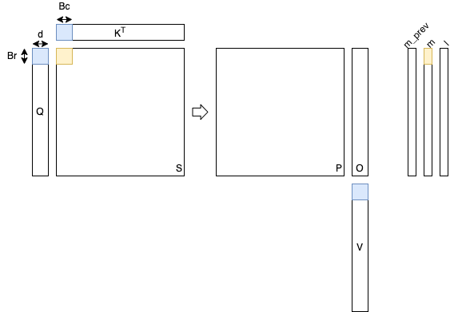
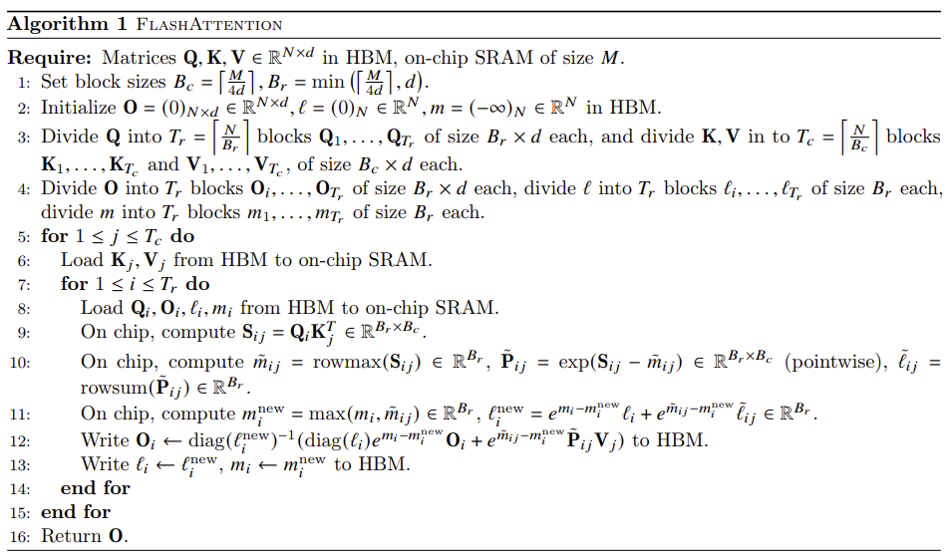
FlashAttention

Slide 24
Data Layout for Baseline (Flash Attention on Each Cluster)
Note
Place QKV tile to corresponding HBM channels of Worker Cluster for each head
Best Layout to minimize traffic
Make a fair comparison with FlatternAttention
K₃
_{h0}
K₃
_{h4}
K₃
_{h8}
K₃
_{h12}
K₃
_{h1}
K₃
_{h5}
K₃
_{h9}
K₃
_{h13}
K₂
_{h0}
K₂
_{h4}
K₂
_{h8}
K₂
_{h12}
K₂
_{h1}
K₂
_{h5}
K₂
_{h9}
K₂
_{h13}
…………
…………
K₁
_{h0}
K₁
_{h4}
K₁
_{h8}
K₁
_{h12}
K₁
_{h1}
K₁
_{h5}
K₁
_{h9}
K₁
_{h13}
K₀
_{h0}
K₀
_{h4}
K₀
_{h8}
K₀
_{h12}
K₀
_{h1}
K₀
_{h5}
K₀
_{h9}
K₀
_{h13}
_{For Head 0}
_{For Head 1}
_{For Head 2}
_{For Head 3}
Q₃
_{h3}
Q₂
_{h3}
Q₁
_{h3}
Q₀
_{h3}
Q₃
_{h2}
Q₂
_{h2}
Q₁
_{h2}
Q₀
_{h2}
Q₃
_{h1}
Q₂
_{h1}
Q₁
_{h1}
Q₀
_{h1}
Q₃
_{h0}
Q₂
_{h0}
Q₁
_{h0}
Q₀
_{h0}
_{For Head 4}
_{For Head 5}
_{For Head 6}
_{For Head 7}
Q₃
_{h7}
Q₂
_{h7}
Q₁
_{h7}
Q₀
_{h7}
Q₃
_{h6}
Q₂
_{h6}
Q₁
_{h6}
Q₀
_{h6}
Q₃
_{h5}
Q₂
_{h5}
Q₁
_{h5}
Q₀
_{h5}
Q₃
_{h4}
Q₂
_{h4}
Q₁
_{h4}
Q₀
_{h4}
_{For Head 8}
_{For Head 9}
_{For Head 10}
_{For Head 11}
…………
_{For Head 12}
_{For Head 13}
_{For Head 14}
_{For Head 15}
…………

Slide 25
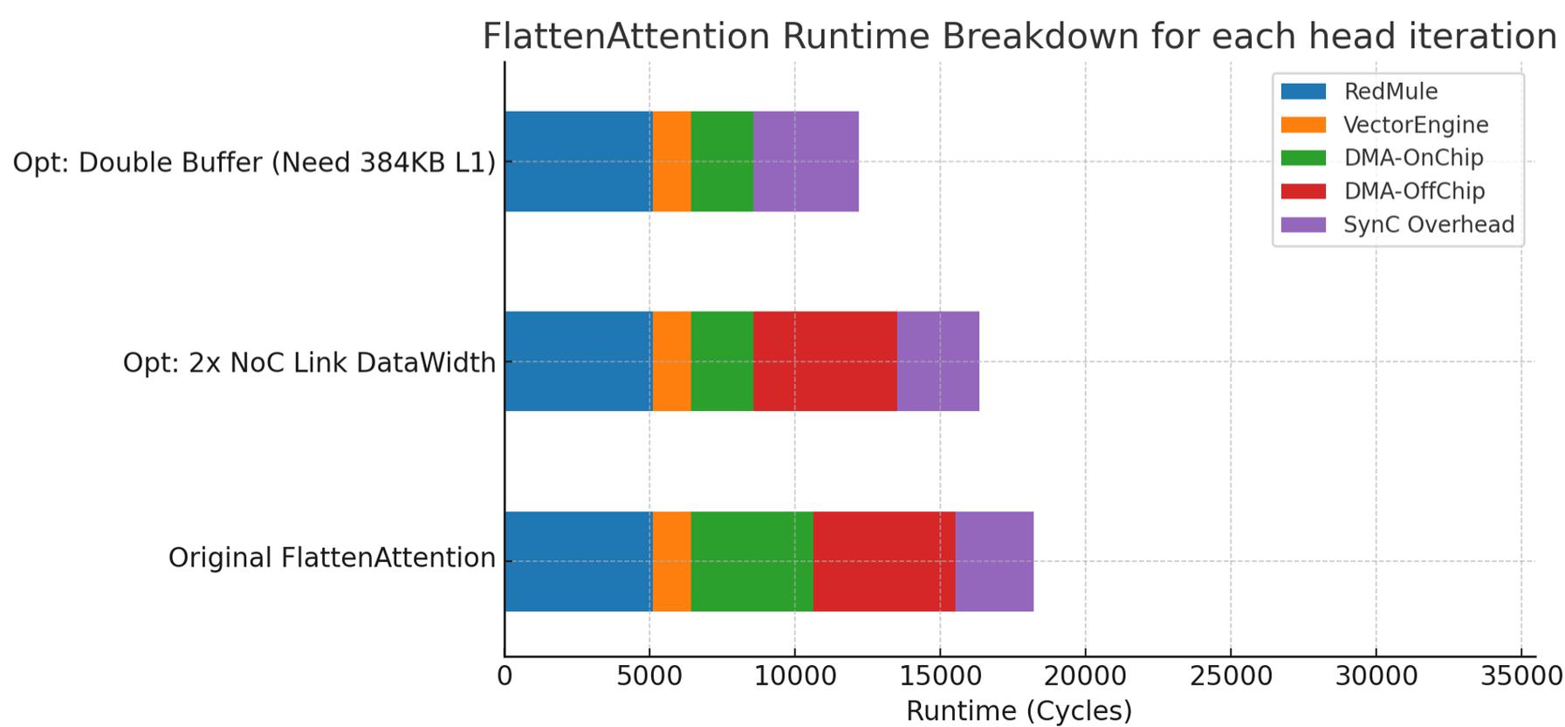
Total Runtime(ms) | Original | +Opt: 2x NoC BW | +Opt: Double Buffer
Baseline: Flash Attention on Each Cluster | 14.41 | 12.78 | -
Flatten Attention (w/o NoC collective) | 17.72 | - | -
Flatten Attention (w/ NoC collective) | 4.66 | 4.16 | 3.12
Results
Comparison with baseline
Flatten Attention introduce lot of on-chip collective data transfer cost
Without a proper inter-cluster broadcast/reduction support, it’s even worse than baseline
With NoC support efficient broadcast/reduction, FlattenAttention shows 3.1x speedup to baseline
Optimization on FlattenAttention
Widden NoC datawidth
Double Buffering off-chip transfers
Hide off-chip transfer
MatMul reach 80% RedMule Uti (1638 TFLOP/s)

Slide 26
SoftHier Progress Update
Thomas Benz tbenz@iis.ee.ethz.ch

Slide 27
Area Modeling
Optimized modeling approach to be more automatized
Configuration files to:
Parse the area and timing reports
Specify user-readable module names, combinations, remnants
Model parameters
Support generate constructs (e.g. in interconnects)
Use regex to parse module paths
Include Interconnect IPs to evaluate the above approach
Modules include generates

