Slide 1
SoftHier Progress Update
Chi Zhang chizhang@iis.ee.ethz.ch
Thomas Benz tbenz@iis.ee.ethz.ch

Slide 2
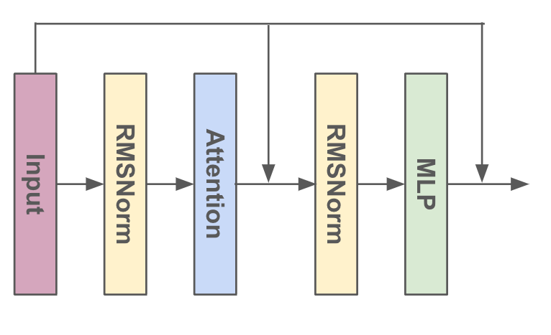
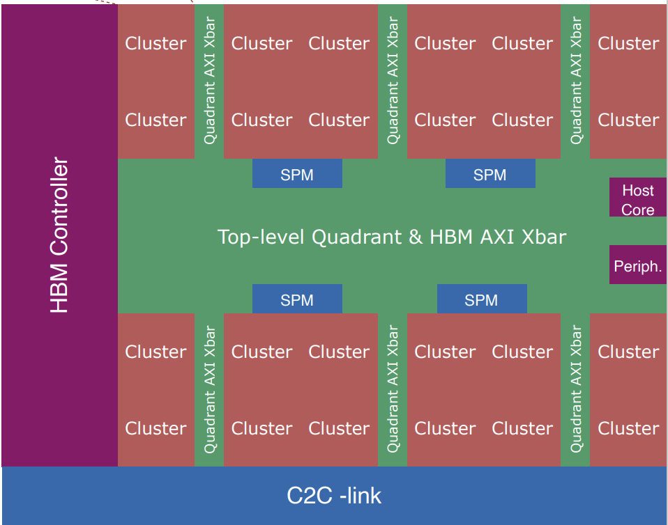
Benchmark LLama2 MLP block
Problem Size
Sequence length x 5120 x 13824
Let the sequence length = 768
Implementation
Clusters take care of different output tiles (384x384).
At each round:
iDMA transfers input matrix tile + weight matrix tile from HBM
RedMule GEMM 384x256x384.
Variables
RedMule Configuration:
48x16 arrays -- 768 MACs/Cycle
96x32 arrays -- 3072 MACs/Cycle
Data format: FP8, FP16
5120
13824
13824
Input
Weight
Output
384
256
384
Sequence length
384
384
256
Sequence length
5120
iDMA
iDMA
x6
iDMA
TCDM
#Banks = 32
Bank Width = 32b
Total Memory = 1MB
64GB/s
128GB/s
Max 384GB/s
RedMule
Xbar
128GB/s
HBM2E: Max 410GB/s
HBM Channel
x8
HBM Channel

Slide 3
Results
End-to-End System Performance
Occamy + 48x16 RedMule, 410 GB/s HBM
FP8: 34.6 TOP/s
FP16: 34.3 TOP/s
Occamy + 96x32 RedMule, 410 GB/s HBM
FP8: 120.9 TOP/s
FP16: 72.3 TOP/s
BW-Bound When:
RedMule 96x32
FP16 GEMM
But in Roofline Model
MLP AI = 637 OP/B
> Roofline Limit 359 OP/B
Improvement:
Inter-Cluster Data Reuses

Slide 4
Leverage Inter-Cluster Data Reuses
Modeling
Previous model only contain Cluster-to-HBM Interconnect
Modeling Cluster-to-Cluster Interconnect
Also triggered by iDMA in each Cluster
Modeling Finished
Current Progress:
New Code for LLama2 MLP Layer
Take Inter-Cluster Transfer into account

Slide 5
iDMA RTL
Busy working on the tapeout (Mid-May)

Slide 6
SoftHier Progress Update
Luca Colagrande colluca@iis.ee.ethz.ch

Slide 7
Snitch Runtime
Mostly busy on “transformers on Occamy” paper
Now occupied on another paper till mid-May
As part of these paper efforts…
Work on some PRs to improve the runtime
Fix various compiler warnings #134
extern declarations to distribute as static library #133
Fix a long-reported bug in printf function #13

