Slide 1
QuantSparse 3D Biweekly 2025-03-25
Integrated Systems Laboratory (ETH Zürich)
Bowen Wang bowwang@iis.ee.ethz.ch Paul Scheffler paulsc@iis.ee.ethz.ch
Luca Benini lbenini@iis.ee.ethz.ch

Slide 2
Agenda
Hardware Architecture
Choosing a compute unit
Implementation status
Literature Review
Low-Precision LLM Quantization
Discussion

Slide 3
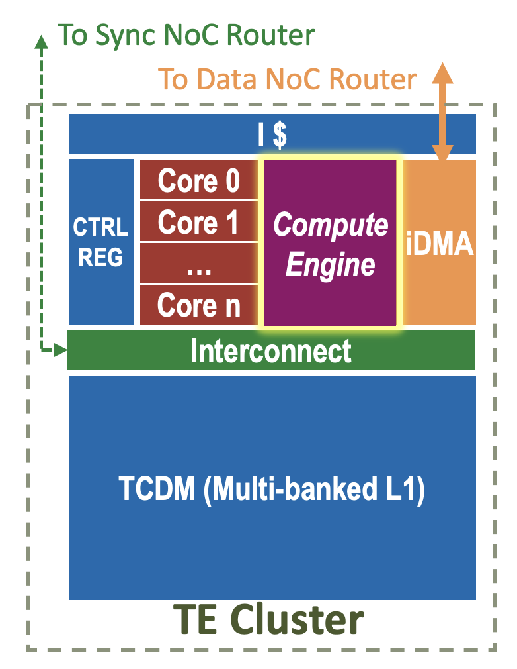
Hardware Architecture – Compute Unit
Two scales to consider
Efficiency: performance and energy cost
Flexibility: adaptability to ML workloads
Matrix engine
Built for high-throughput dense matrix operations
→ best energy efficiency for matrix-heavy workloads
Non-matrix operations, e.g. row activation sparsity, are prone to underutilization
Scalar core
For sequential processing and complex control flow → lower throughput and less energy efficient
Best mapping flexibility

Slide 4
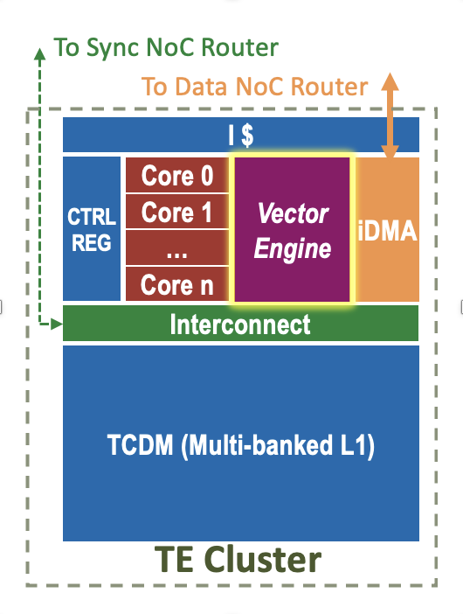
Balancing Efficiency and Flexibility
Vector engine
Computation speedup on vectorizable operations
→ improved energy efficiency w.r.t scalar cores
Compatible with vector-level operations and multi-granularity sparsity (structured and indexed)
+ Matrix ISA extensions
Arm SME^{[6]}, Intel AMX^{[7]}, and IBM MMA^{[8]}
Direct handling of matrix operations → lowering the instruction fetch and setup overhead
Minimizes the bandwidth demand between VRF and the VPUs → reduced energy consumption

Slide 5
Workload Handling
Multi-granularity sparsity
Structured sparsity (N:M, e.g. 2:4) → Vector engine, handled in VRF
Unstructured sparsity in tile → RVV gathers on cluster L1 memory
Unstructured sparsity in NoC → Packed gathers on HBM endpoints
Quantization
Customized Microscaling format handled in the vector engine
Small-group format with shared-scale minifloats and structured sparsity encoding (N:M)
Two-stage sparsity (N:M structured + indexed gathers) bridges gap between low-precision elements and wide NoC / HBM

Slide 6
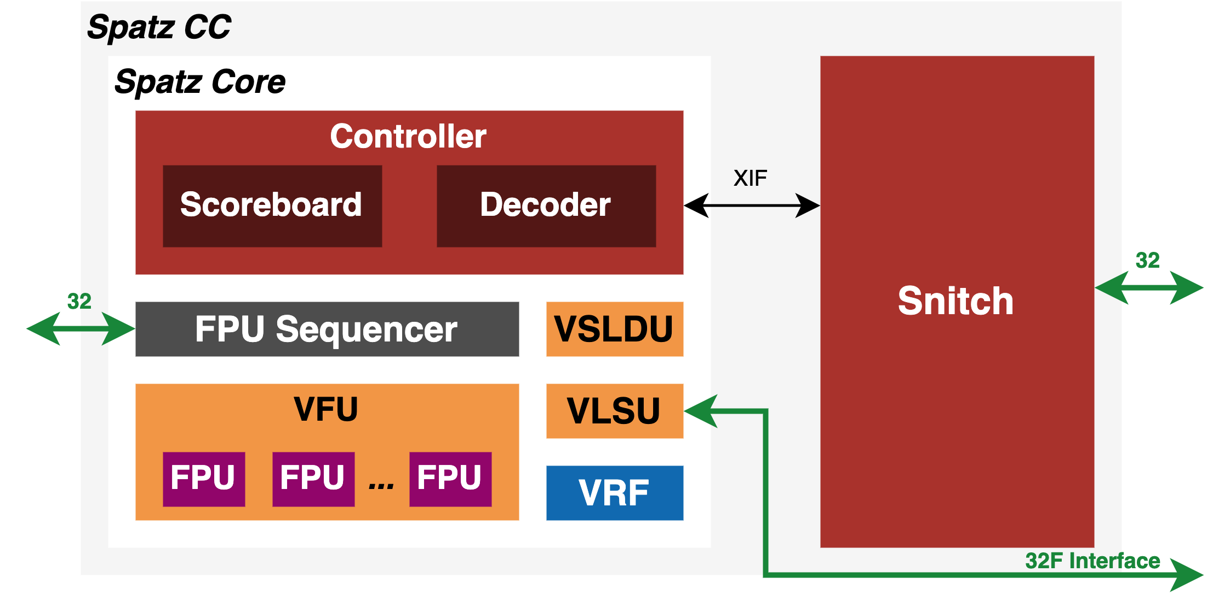
Vector Engine Modeling – Where we are
Preliminary Spatz^{[9]} model
32-bit memory interface
RV32 vector extension (RVV) support

Slide 7
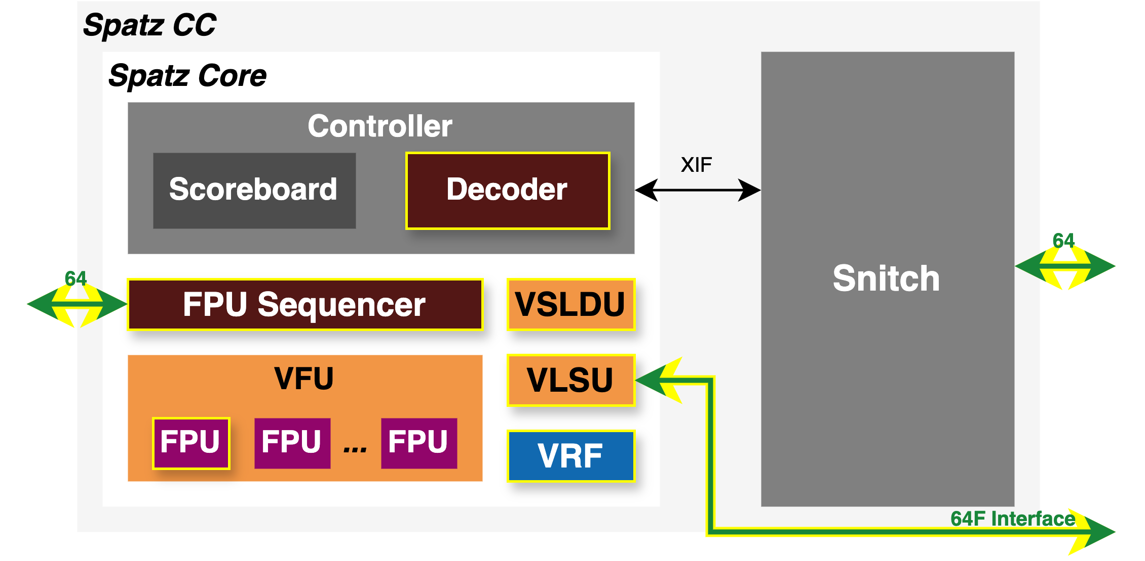
Vector Engine Modeling – What we need
Preliminary Spatz^{[9]} model
32-bit memory interface
RV32 vector extension (RVV) support
Upgraded Spatz model
64-bit memory interface
ISA extension on sparsity handling
ISA extension on Microscaling (MX) handling

Slide 8
Vector Engine Modeling – What we need
Preliminary Spatz^{[9]} model
32-bit memory interface
RV32 vector extension (RVV) support
Upgraded Spatz model
64-bit memory interface
ISA extension on sparsity handling
ISA extension on Microscaling (MX) handling
Implementation status
(In progress) Spatz GVSoC model 64-bit memory interface
(In progress) A student project on RTL implementation of Spatz 2:4 sparsity handling with RVV ISA extension

Slide 9
Literature Review: Low-Precision LLM Quantization
Quantization-aware training prohibitive
Massive training effort (billions of weights)
Focus on post-training quantization (PTQ)
Challenge: outliers in hidden activations
Strong channel-wise spikes
Naïve magnitude-based quantization strongly degrades past ~8-bit weights^{[2]}
Prominent low-precision approaches:
Quant. groups & outlier overlay (e.g. SpQR^{[1]})
Outlier compensation (e.g. SmoothQuant/+^{[2][3]})
Asymmetric shared scales (e.g. AMXFP4^{[4]})
[5]

Slide 10
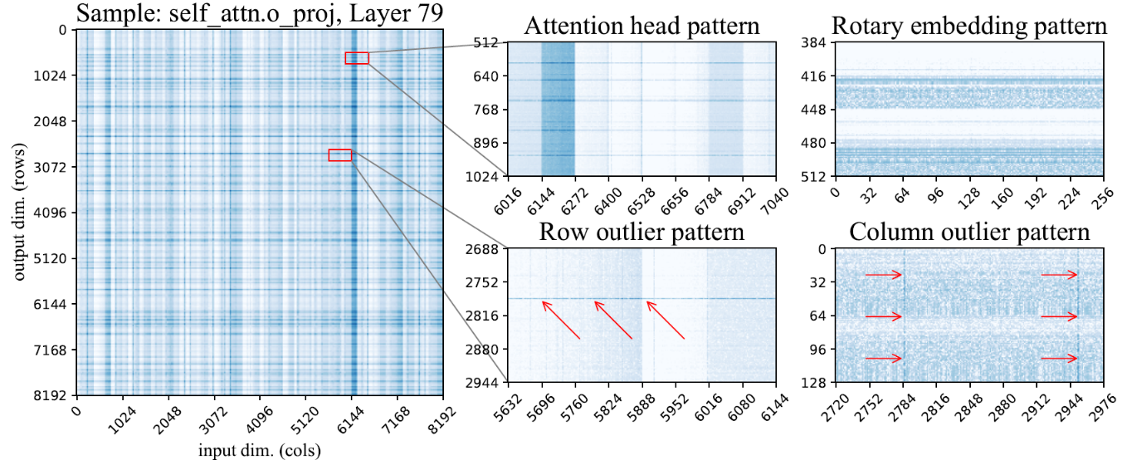
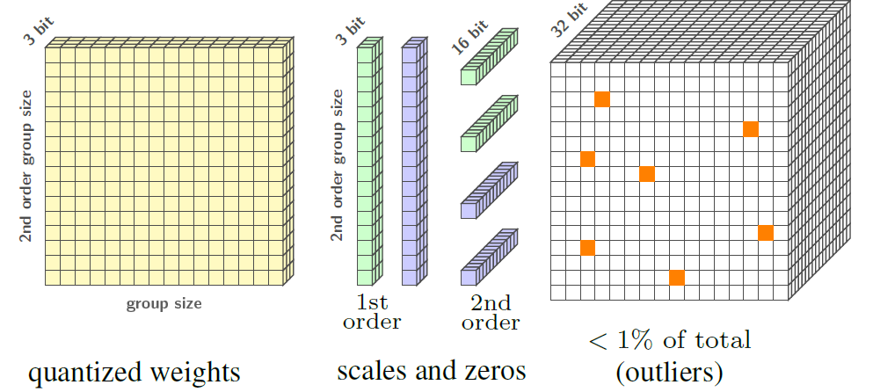
Quantized Groups & Outlier Overlay: SpQR^{[1]}
Identifies multiple magnitude patterns
Row & column (token & channel)
Attention heads & rotary embedding
Unstructured outliers
Small weight groups with custom scales
Quantize ≤32-weight groups to 3-4 bit
Add two-level quantization statistics
<1% unstructured outlier overlay
Full FP16 precision, stored in CSR (indexed)
Notably lower perplexity vs. 4-bit SoA

Slide 11
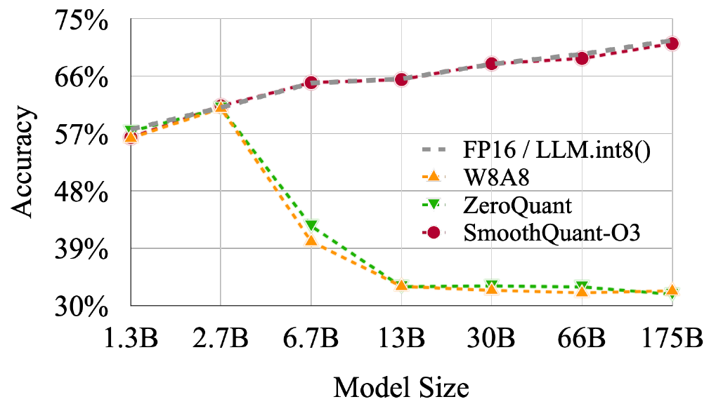
Outlier Compensation: SmoothQuant/+^{[2][3]}
Activation outliers stable per channel
Direct correction is not performant
Add per-channel smoothing s to weights, fuse inverse correction into prior layer
Balance s between ideal weight and activation outlier compensation
SmoothQuant^{[2]}: W8A8
Uses efficient symmetric kernel → fast
Minimal accuracy degradation vs. FP16
Scales well to large models (175B)
SmoothQuant+^{[3]}: scales to W4A16

Slide 12
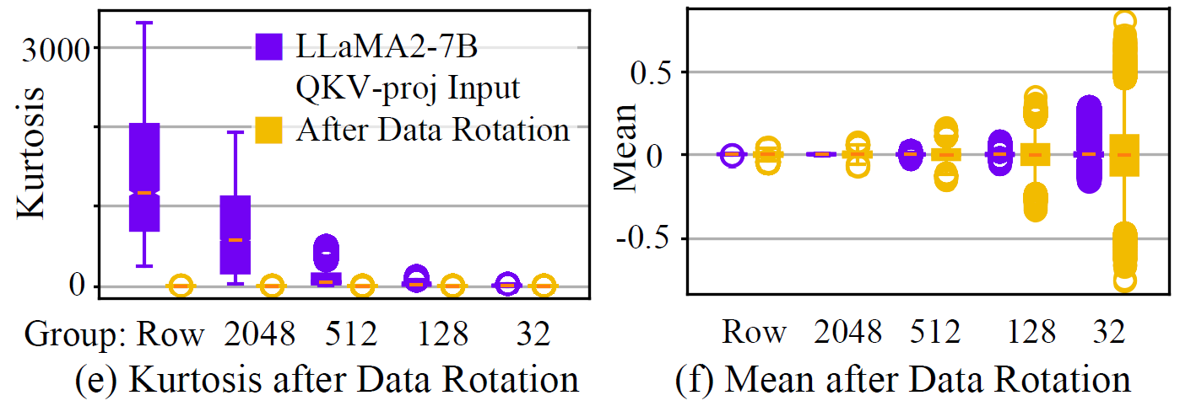
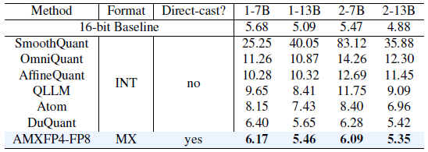
Asymmetric Shared Scales: AMXFP4^{[4]}
MX accuracy degrades past ~FP6
Rotation & small groups insufficient
Issue: shared scales cannot encode nonzero group mean, only elements
Idea: Per-sign asymmetric scales
One for +ve, one for –ve weights
AMXFP4-FP8: asymm. FP8 scales → ~10% compute area overhead
Much closer to FP16 baseline than SoA methods at 4 bit
Direct cast, no calibration!
Still needs smaller groups (e.g. 32)

Slide 13
References
[1] T. Dettmers et al., "SPQR: A sparse-quantized representation for near-lossless LLM weight compression." arXiv:2306.03078 (2023).
[2] G. Xiao et al., "SmoothQuant: Accurate and Efficient Post-Training Quantization for Large Language Models." arXiv:2211.10438 (2022).
[3] J. Pan et al., "SmoothQuant+: Accurate and Efficient 4-bit Post-Training Weight Quantization for LLM." arXiv:2312.03788 (2023).
[4] J. Lee et al., "AMXFP4: Taming Activation Outliers with Asymmetric Microscaling Floating-Point for 4-bit LLM Inference." arXiv:2411.09909 (2024).
[5] S. Liu et al., "LLM-FP4: 4-Bit Floating-Point Quantized Transformers.“ arXiv:2310.16836 (2023).
[6] F. Wilkinson, "An initial evaluation of arm’s scalable matrix extension." IEEE/ACM PMBS (2022).
[7] H. Kim et al., "Exploiting intel® advanced matrix extensions (amx) for large language model inference." IEEE CAL (2024).
[8] J. P. L. de Carvalho., "Compiling for the IBM matrix engine for enterprise workloads." IEEE Micro 42.5 (2022): 34-40.
[9] M. Perotti et al., "Spatz: Clustering Compact RISC-V-Based Vector Units to Maximize Computing Efficiency." arXiv:2309.10137 (2025).

