Slide 1
SoftHier Progress Update
Chi Zhang chizhang@iis.ee.ethz.ch
Thomas Benz tbenz@iis.ee.ethz.ch
Luca Colagrande colluca@iis.ee.ethz.ch

Slide 2
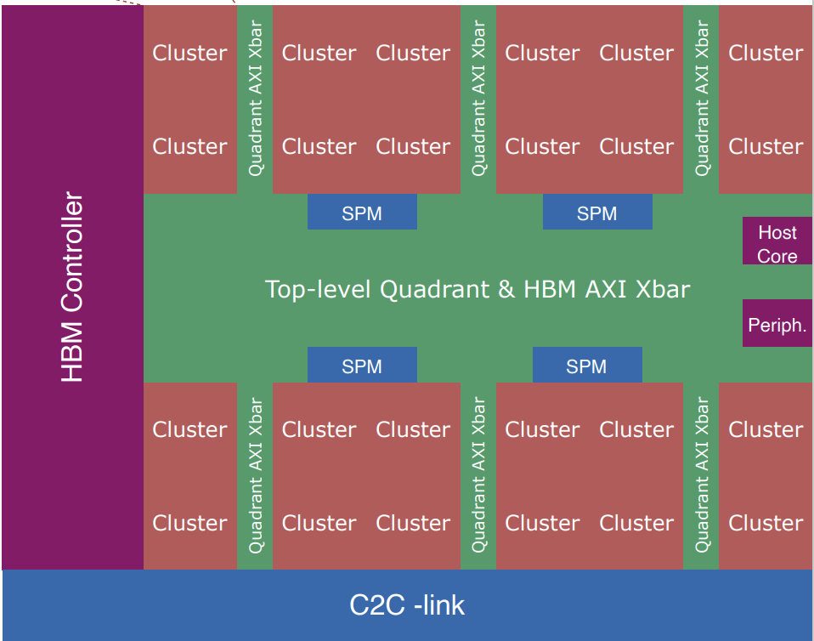
Current Status
Modeling Redmule + Occamy System in GVSoC
Snitch cluster (iDMA equipped) – done
Extending Snitch cluster with RedMule – done
Quadrant modeling – done
Top-level modeling:
Host Core CVA6 & Periphrals – done
HBM & Interconnect – done
SPM & C2C-link– on going
RedMule in Occamy Functional testing – done
Runtime is aligned with previous experiment on Pulp-Cluster
iDMA testing – done, showing results in this meeting

Slide 3
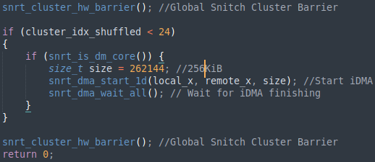
iDMA Bandwidth Testing -- Setup
iDMA
iDMA
HW Configuration
AXI Bus [Cluster, Quadrants, HBM.ch]
Width =512b, Max.BW=64GB/s
6 Quadrants, 4 Clusters per Quadrant
6 Quadrants Max.BW = 384GB/s
8 HBM.ch, 4K address space interleaved
HBM2 total Max.BW = 256GB/s
HBM2E total Max.BW = 410GB/s
iDMA test program
Each cluster transfer 256KiB data from HBM to TCDM
Global barriered before & after iDMA transfer
Enable Clusters in quadrant-interleaving fashion
x6
Max 384GB/s
HBM2: Max 256GB/s
HBM2E: Max 410GB/s
HBM Channel
x8
HBM Channel
#Cluster=1
#Cluster=2
#Cluster=6
#Cluster=7

Slide 4
HBM2E: Max 410GB/s
iDMA Bandwidth Testing -- Results
91% HBM2E Uti
Best HBM BW utilization reached
94% BW uti – HBM2
91% BW uti – HBM2E
When #Cluster = 1
iDMA BW= 53GB/s, 57GB/s
Almost saturate Cluster AXI port Max.BW(64GB/s)
When each Quadrant enable 1 Cluster
HBM2 – 214 GB/s – 83% HBM Uti
HBM2E- 257 GB/s – 62% HBM Uti
Why HBM2E curve is jagged?
Imbalanced workload among Quadrants
HBM2: Max 256GB/s
94% HBM2 Uti

Slide 5
Next Plan
Model L2 Memory (SPM)
Benchmark iDMA + RedMule running LLM’s GEMM

Slide 6
iDMA updates
2 publications completed followed by a week of holidays
Tapeout ongoing (mid May)
iDMA
Newest version integrated in Occamy RTL and GVSoC model
In progress: evaluating transposition engine in Occamy
Verilator testbench soon ready

Slide 7
SoftHier Progress Update
Luca Colagrande colluca@iis.ee.ethz.ch

Slide 8
Snitch runtime updates
Busy full time on a paper: “Transformers on Snitch/Occamy”
Useful for SoftHier:
Insights on latency breakdown of transformers in Occamy and relevant matrix sizes
Snitch runtime developments:
Added bounds check on dynamic L1 heap allocations
Review Germain’s PR #126
Creates a GVSoC-specific Snitch runtime
Required to have a dedicated putchar implementation for OpenOCD semi-hosting

