Slide 1
QuantSparse 3D Biweekly 2025-05-20
Integrated Systems Laboratory (ETH Zürich)
Bowen Wang bowwang@iis.ee.ethz.ch Paul Scheffler paulsc@iis.ee.ethz.ch
Luca Benini lbenini@iis.ee.ethz.ch

Slide 2
Agenda
Progress Update
2.5D/3D packaging SoA
Beyond SoA: 3D and 3.5D opportunities
Timeline
Discussion

Slide 3
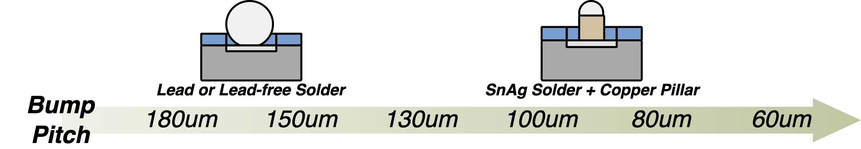
2.5D Packaging
Multiple active semiconductor dies are placed side-by-side on an interposer
Enables the integration of diverse components into a single package
Reduced interconnect length → lower latency, improved power efficiency
Package size reduction
Flip Chip
Flip Chip w/ <100μm pitches
Extremely common
Landing pads on PCB, substrate, or other wafer
Chip placed on top with bump contacts
Involvement is limited to a small number of firms
A flood of different packaging types

Slide 4
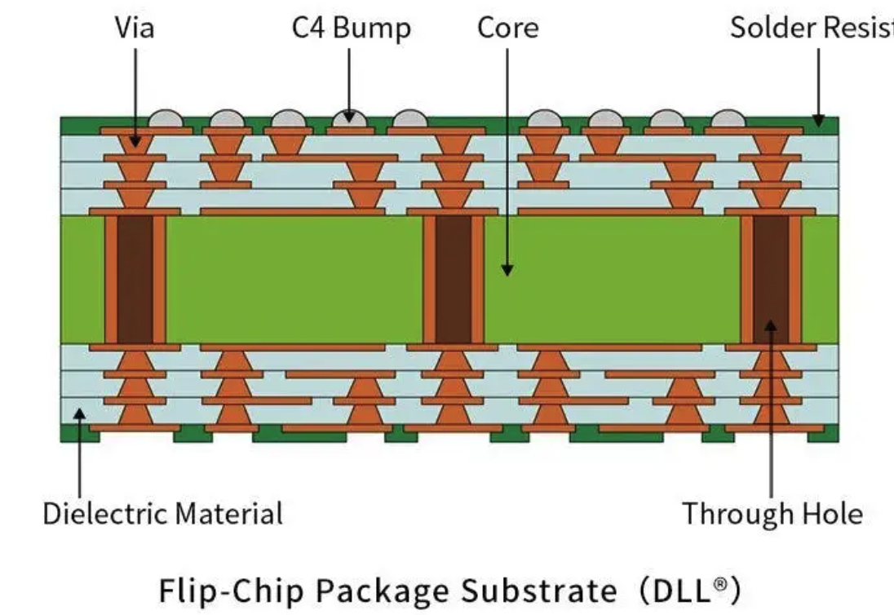

2.5D Packaging
CoWoS-R
Standard
Flip Chip
TSMC InFO-R
InFO-SoIS
Silicon as substrate
High I/O density
Complex routing
Multiple chips
14 RDL → complex interconnect
CoWoS-S
CoWoS-L
InFO-SoW
InFO-L
Apple Sillcon
Fanout size as an entire wafer
Passive silicon interconnect between multiple dies
Tesla Dojo D1
Organic laminate clad with copper
Wires are built around the core, both sides → many layers, redistributing signal and power
Intel EMIB
NVIDIA GPUs
Silicon bridge inside of organic substrate
ASE FoCoS
Samsung FOSiP
Kaby Lake G, FPGAs

Slide 5
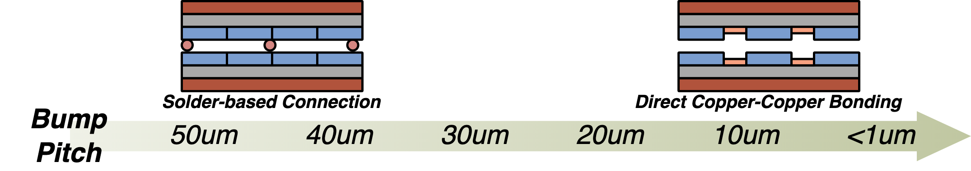
3D Packaging
Stacking multiple active semiconductor dies on top of each other
Further reduces interconnect lengths → minimizing signal delays and power consumption
Micro Bump
Hybrid Bonding
Ponte Vecchio GPU (36um)
Enable denser integration
Lower parasitics (resistance, capacitance)
More complex and higher cost

Slide 6
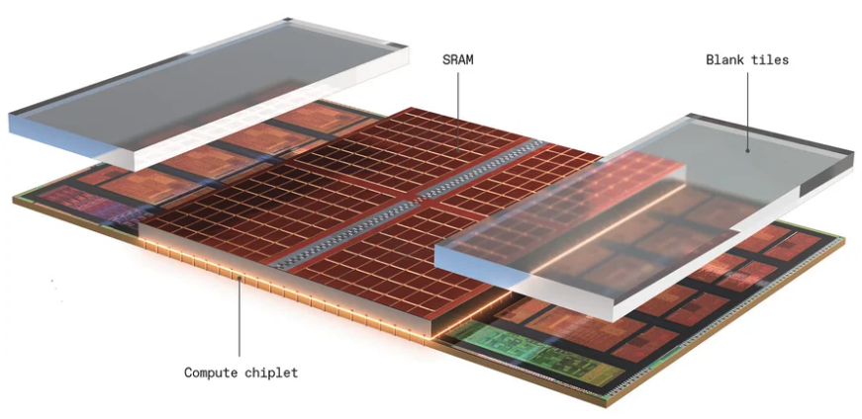
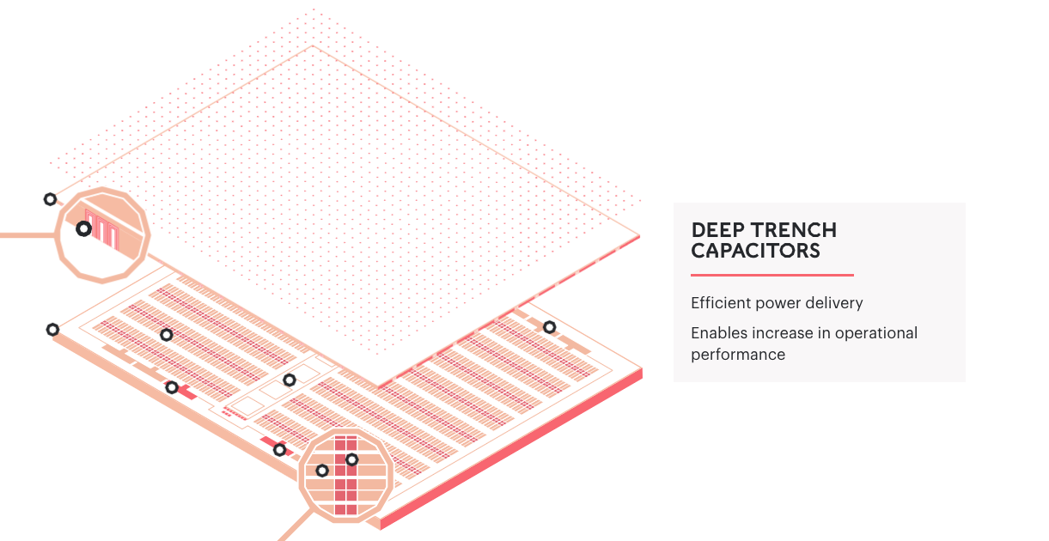
3D Packaging – Hybrid Bonding
TSMC SoIC
AMD Zen 3 (9um)
L3 cache vertically integrated, sits in the middle of compute chiplet
3x cache size, 4 cycles latency
19% perf. Improvement on average
Graphcore BOW
Vertically integrated power-management die
40% faster, 16% less energy consumption
Foveros Direct
Samsung Xcache
Meta 3D-Mem
YMTC Xtacking

Slide 7
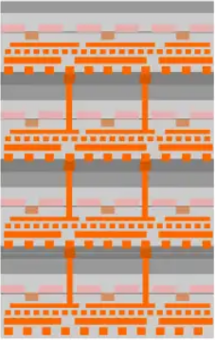
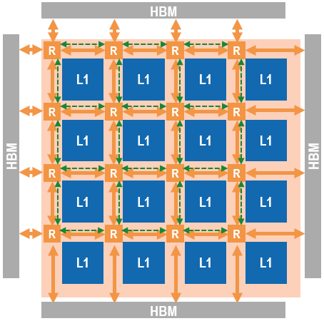
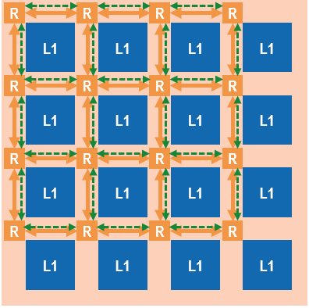
Beyond SoA: 3D and 3.5D Opportunities
F2B (repeatable) hybrid bonding
TSMC SoIC-X: 25µm pitch in 2025^{[1]}
Enables 3D stacks (cubes) of logic and/or SRAM (e.g. 3D V-cache^{[2]})
Can be combined with interposer and HBM stacks
Consider this in 3D explorations
Model multi-layer logic (3D mesh): z-direction links as hybrid bonds
Explore logic-SRAM stacks (L1/L2?)
Consider logic-DRAM (HBM) stacks?
B
HBM
F
HBM
B
HBM
F
HBM
B
HBM
F
HBM
B
HBM
F
HBM
Interposer

Slide 8
References
[1] A. Shilov, “TSMC's 3D Stacked SoIC Packaging Making Quick Progress, Eyeing Ultra-Dense 3μm Pitch In 2027,” 2024
[2] A. Smith et al., "11.1 AMD InstinctTM MI300 Series Modular Chiplet Package – HPC and AI Accelerator for Exa-Class Systems," ISSCC, 2024

