Slide 1
QuantSparse 3D Biweekly 2025-06-03
Integrated Systems Laboratory (ETH Zürich)
Bowen Wang bowwang@iis.ee.ethz.ch Paul Scheffler paulsc@iis.ee.ethz.ch
Luca Benini lbenini@iis.ee.ethz.ch

Slide 2
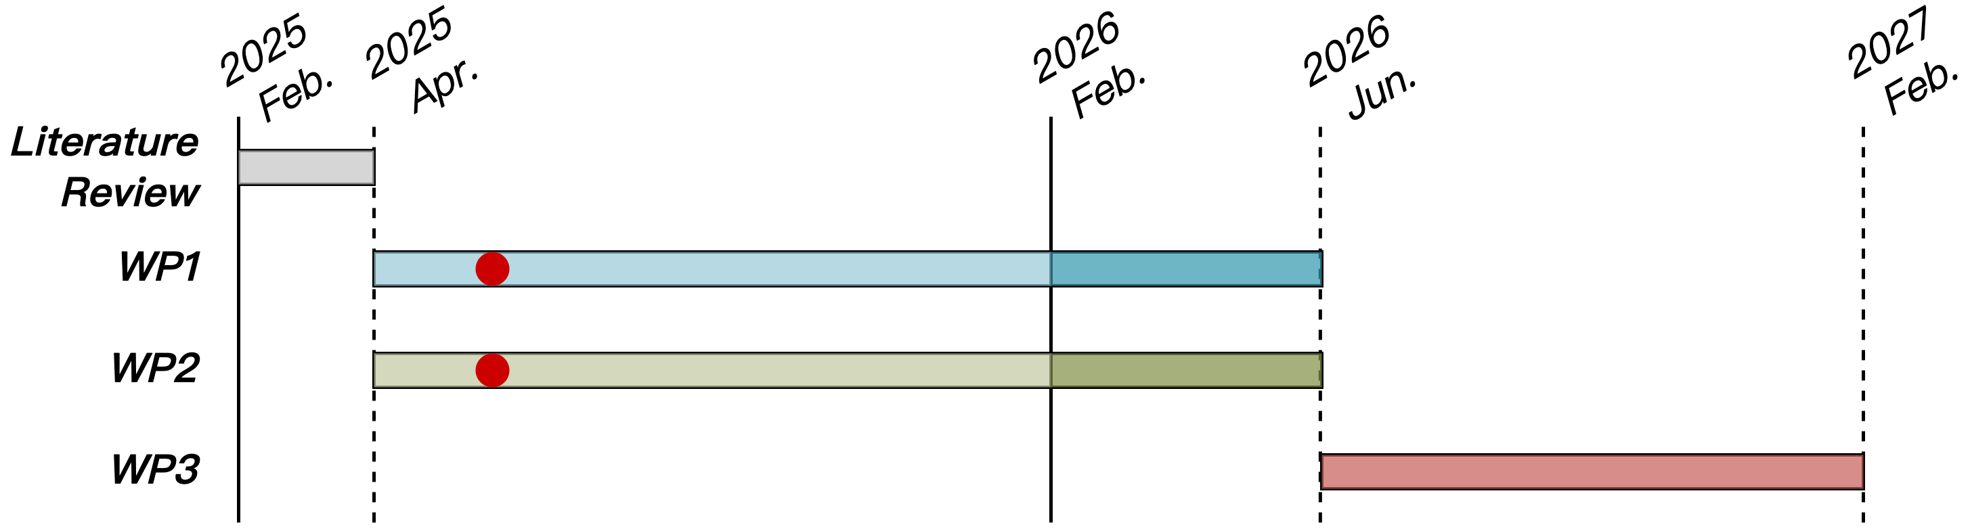
Previous Progress
Literature Review
SoA LLM sparsity, quantization format, and 2.5D/3D advanced packaging tech.
Proposed vector-engine-based multi-cluster architecture
Proposed GVSoC router extension for 3D integration
WP1
Ongoing RTL and GVSoC modeling of HBM endpoint packing scheme
Ongoing RTL and GVSoC modeling of Spatz N:M sparsity handling
Ongoing RTL and GVSoC modeling of Spatz MX format handling
WP2
Memory allocation runtime for model-to-hardware mapping
Ongoing model-to-hardware mapping software environment

Slide 3
Agenda
Progress Update
Spatz N:M sparsity format
Gather operation at VLSU
Gather operation in VRF
Spatz MX format
Baseline kernel implementation and insights
Timeline
Discussion

Slide 4
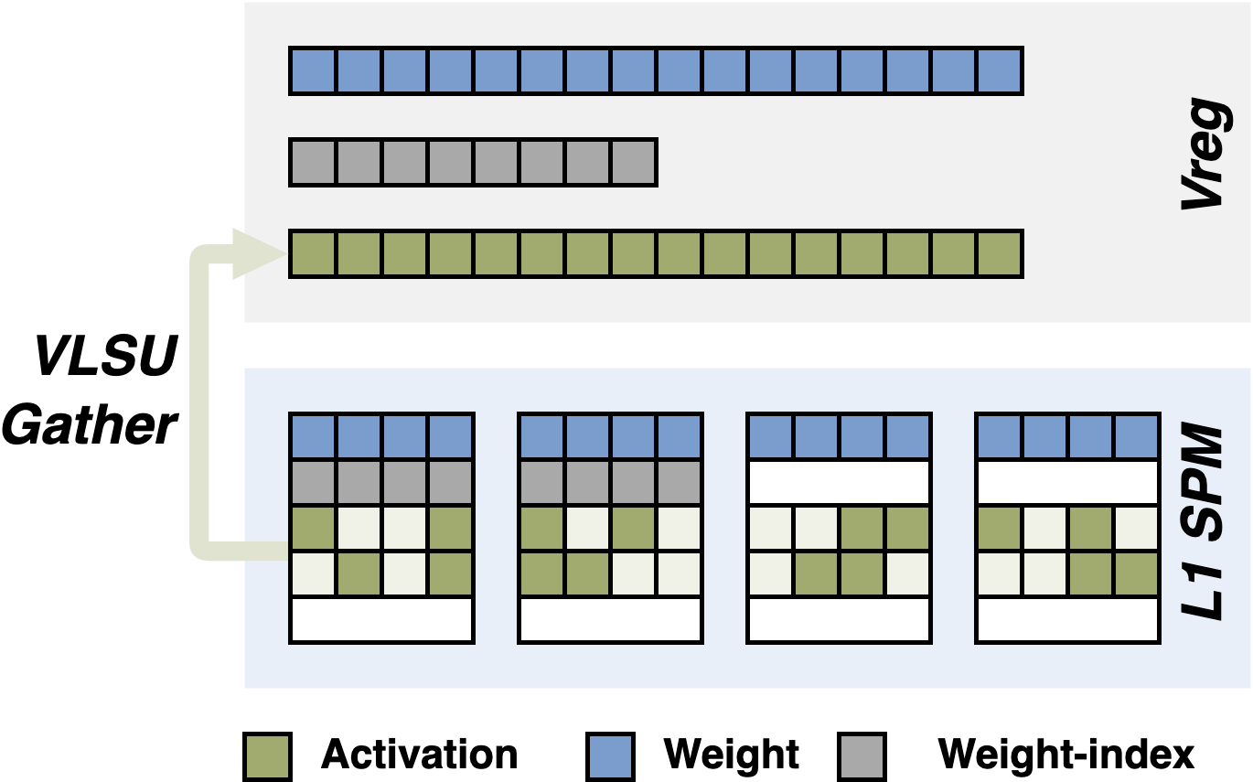
Spatz N:M sparsity: VLSU
Effective elements gathered from L1 to VRF through VLSU
No VRF overhead for ineffective elements storage
Data reuse is impossible across weight rows
Baseline implementation → leverage on RVV indexed load instruction (vluxeiX.v)
Minimum 8-bit indices encoded in the instruction semantics, used in VLSU for address generation → VRF waste
Index tensor used in N:M format has different semantics → Index preprocessing is required
Progress
vluxeiX.v instructions implemented in GVSoC with timing model (PR #124)
RTL implementation ongoing

Slide 5
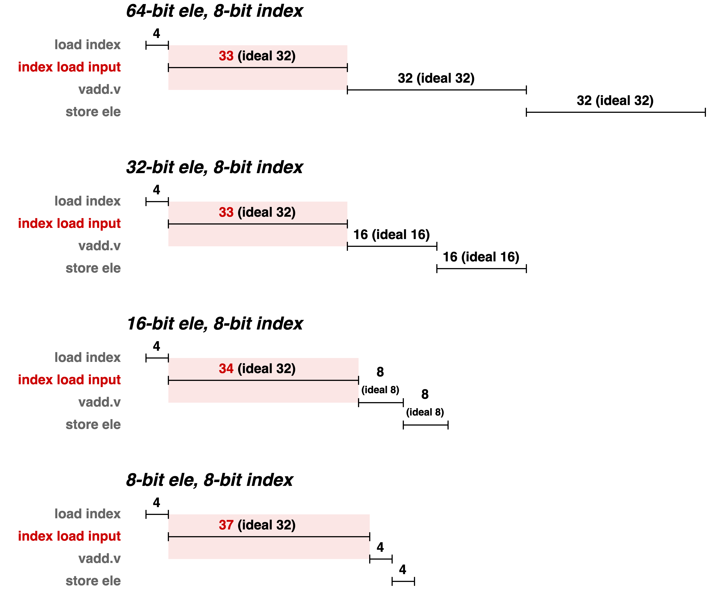
Spatz N:M sparsity: VLSU
Baseline benchmark
Cycles for input load do not scale with element bit-width
Reason: vluxeiX.v does not assume any data storage patterns → loading low precision elements cannot benefit from wide bus-width
Our proposal: customized indexed load instructions
Address generation in VLSU uses N:M index tensor directly
Gather all effective elements per bank read, leveraging on N:M format index patterns

Slide 6
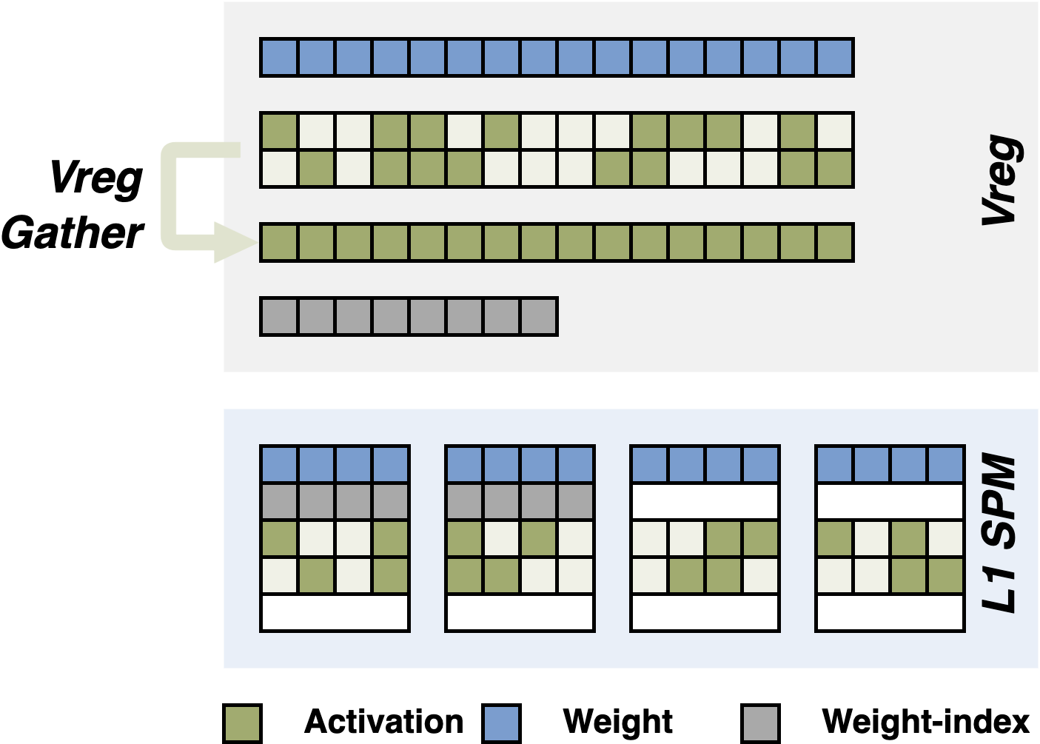
Spatz N:M sparsity: VRF
Effective elements gathered inside VRF with vrgather.v-like instruction
Data reuse is possible across weight rows
Baseline implementation: customized for N:M format, currently with 64-bit element and 2-bit index
Could be extended to support lower precision elements and more N:M formats
Progress
RTL implementation finished and passed function verification
Ongoing SpMV kernel development and benchmark

Slide 7
Spatz N:M sparsity: VRF
Efficient gather handling is the key
Underutilized VRF-to-VFU bandwidth for ineffective element bubbles
Mixed vector length after gather operations → introduces configuration overhead

Slide 8
Spatz N:M sparsity: VRF
Efficient gather handling is the key
Underutilized VRF-to-VFU bandwidth for ineffective element bubbles
Mixed vector length after gather operations → introduces configuration overhead
Potential remedy
vrgather.v utilizes 2 read ports and 1 write port → reuse the third VRF read port, while requires VRF redesign
Mixed vector length instruction set extension^{[1]} through arbitrary register groupings and hardware strip-mining

Slide 9
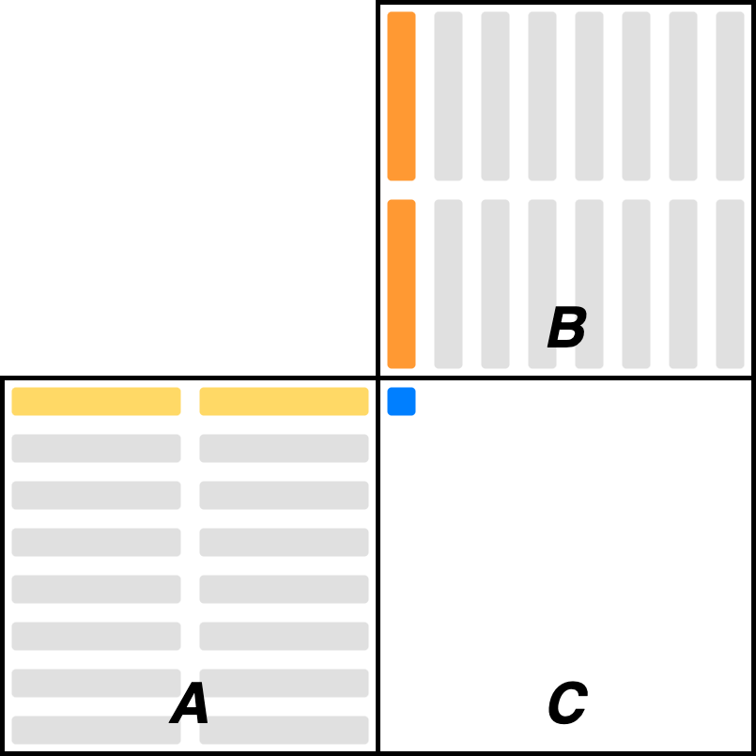
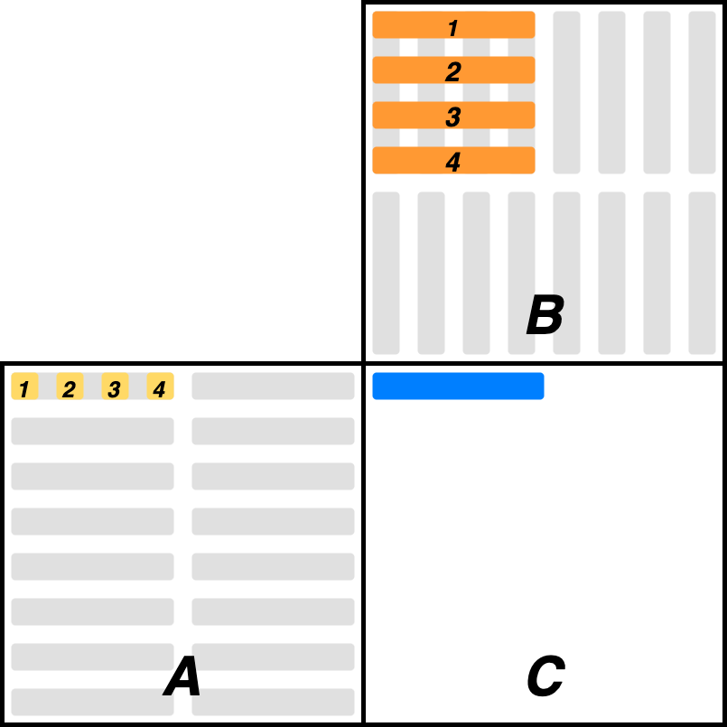
Spatz MX Format
Inner product
Producing one full dot product for each output element per inner loop → requires reduction before each scaling and accumulation
Reduction is slow in Spatz: 75% runtime in reduction
Outer product
Elements from different blocks are produced in parallel
Requires both matrices to be stored in row-major layout (or strided load is required) → may not be applicable (i.e. attention)

Slide 10
Spatz MX Format
Outer product
Elements from different blocks are produced in parallel
Requires both matrices to be stored in row-major layout (or strided load is required) → may not be applicable (i.e. attention)
...
for i in BLOCK:
// load
scalar load a_i, ...
vector load b, ...
// widen
fcvt.h.b a_i
vfwadd.vf b, ...
// comp
vfwmacc.vf c, b, a_i
// load scale
vle.v vd1, ...
ld s1, ..
// apply scale
...
mxfp8_matmul_fp32_outer_lmul4_2x (64 × 64 × 64)

Slide 11
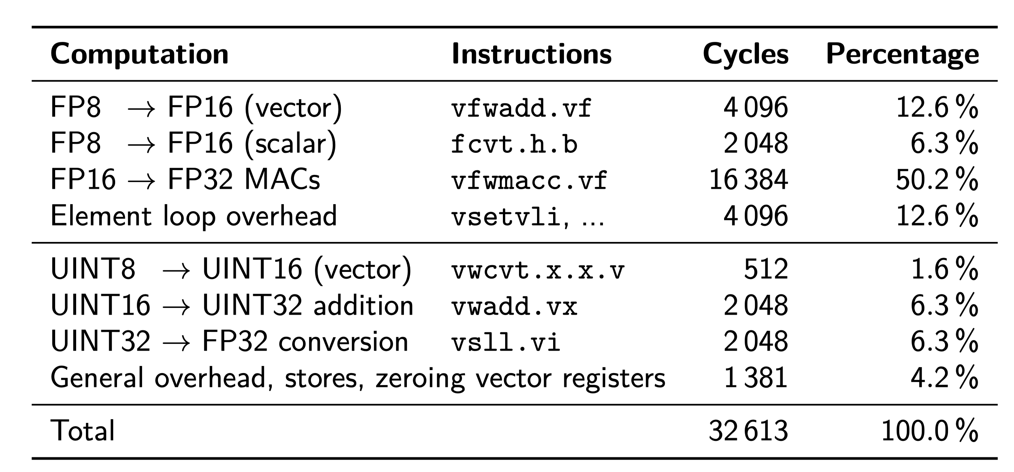
Spatz MX Format
Overhead analysis
~50% cycles for casting format and applying scale
mxfp8_matmul_fp32_outer_lmul4_2x (64 × 64 × 64)
...
for i in BLOCK:
// load
scalar load a_i, ...
vector load b, ...
// widen
fcvt.h.b a_i
vfwadd.vf b, ...
// comp
vfwmacc.vf c, b, a_i
// load scale
vle.v vd1, ...
ld s1, ..
// apply scale
...

Slide 12
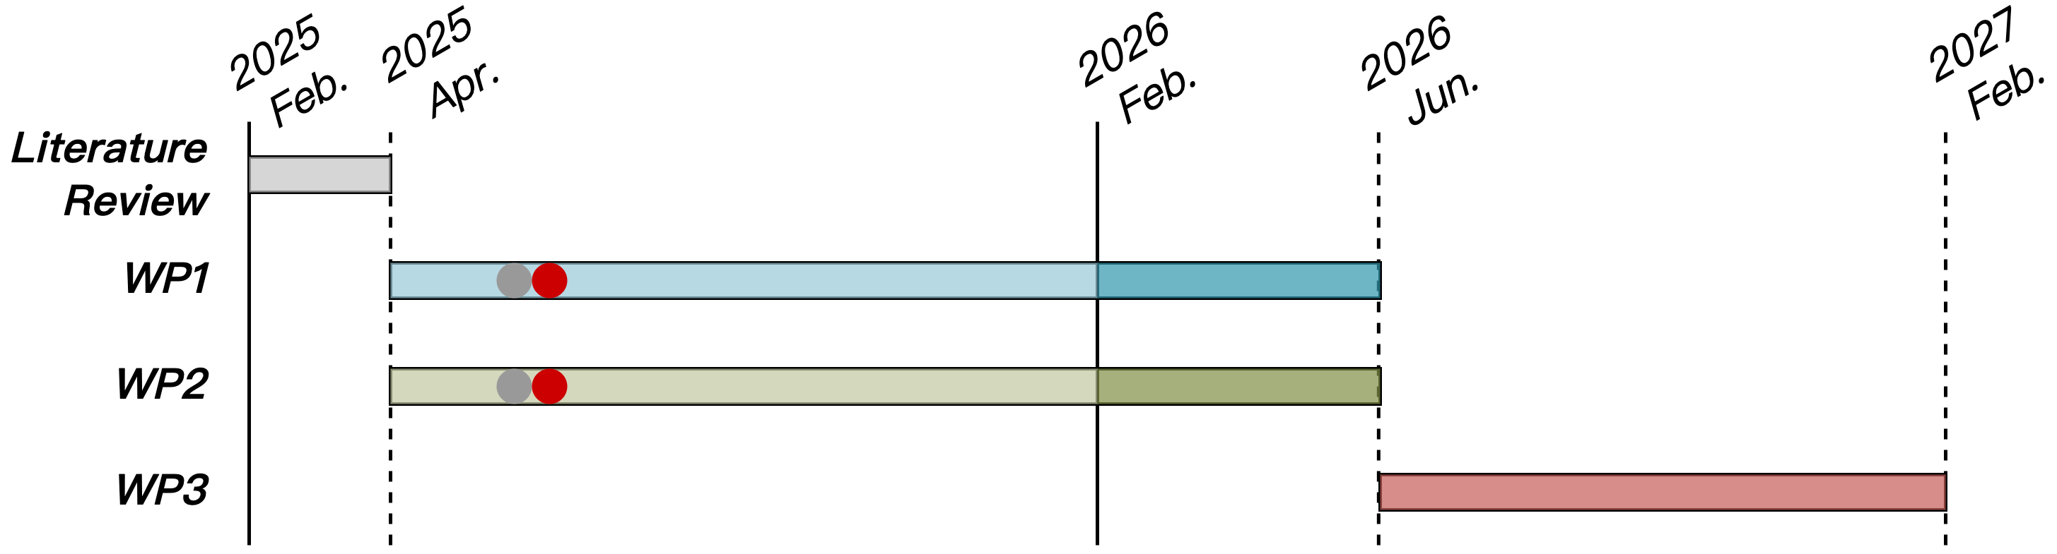
Progress Update
WP1
Spatz vector load instruction modeling in GVSoC + baseline impl. performance analysis
Spatz VRF gather operation RTL implementation and impl. analysis
Spatz MX format baseline kernel implementation + overhead breakdown

Slide 13
References
[1] L. Jiang, “Unlimited Vector Processing for Wireless Baseband Based on RISC-V Extension” 2025, Arxiv Preprint: https://arxiv.org/abs/2504.10832

