Slide 1
QuantSparse 3D Biweekly 2025-06-17
Integrated Systems Laboratory (ETH Zürich)
Bowen Wang bowwang@iis.ee.ethz.ch Paul Scheffler paulsc@iis.ee.ethz.ch
Luca Benini lbenini@iis.ee.ethz.ch

Slide 2
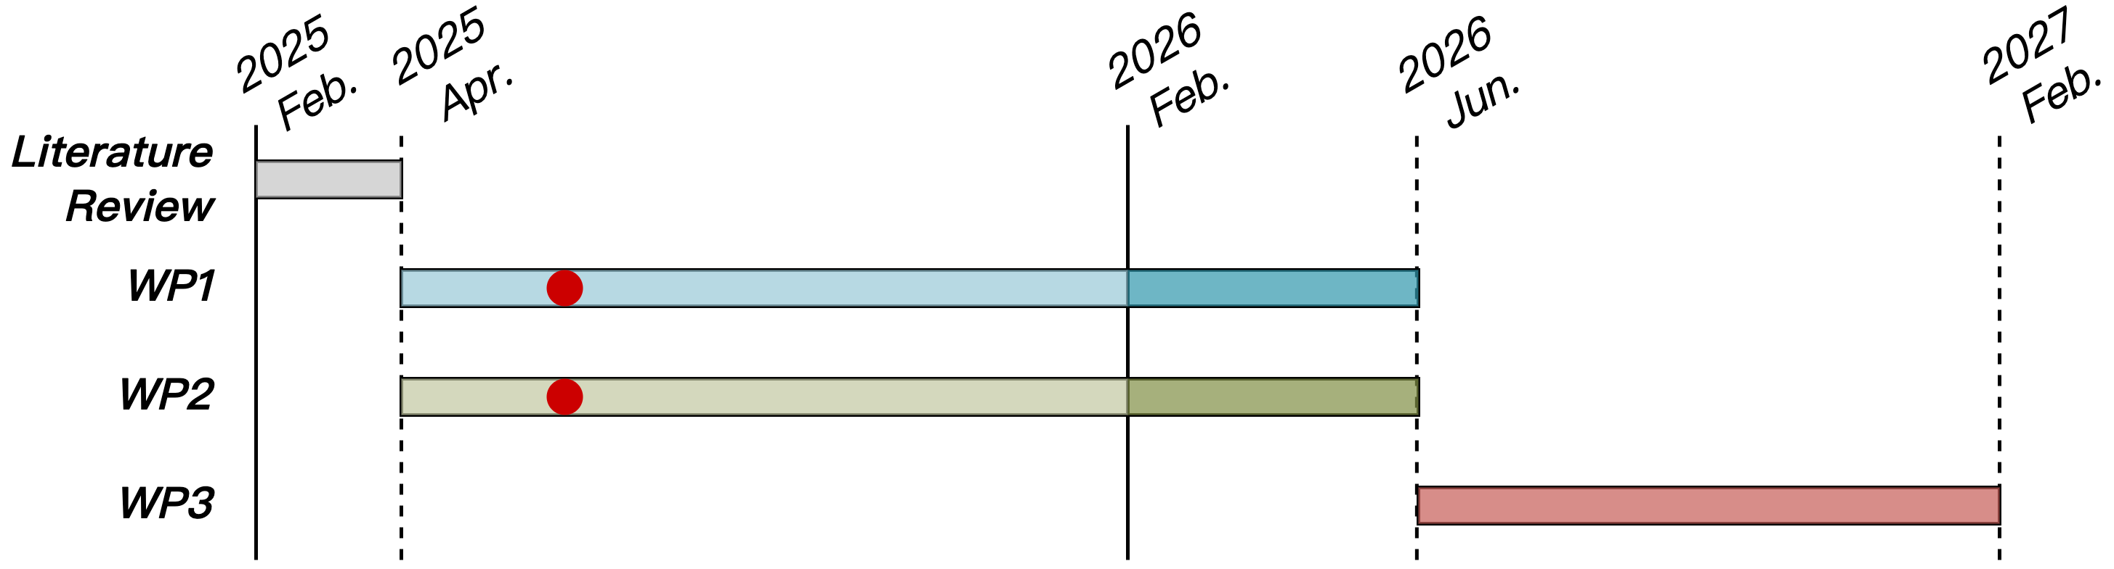
Progress Recap
WP1
Spatz vector load instruction modeling in GVSoC + baseline impl. performance analysis
Spatz VRF gather operation RTL implementation and impl. analysis
Spatz MX format baseline kernel implementation + overhead breakdown

Slide 3
Agenda
Progress Update
Spatz N:M sparsity format
Gustavson’s algorithm for activation sparsity handling
Spatz GVSoC model supports FP8 format + Baseline MatMul implementation
Spatz MX format
Proposed MX-dotp ISA extension
Timeline
Discussion

Slide 4
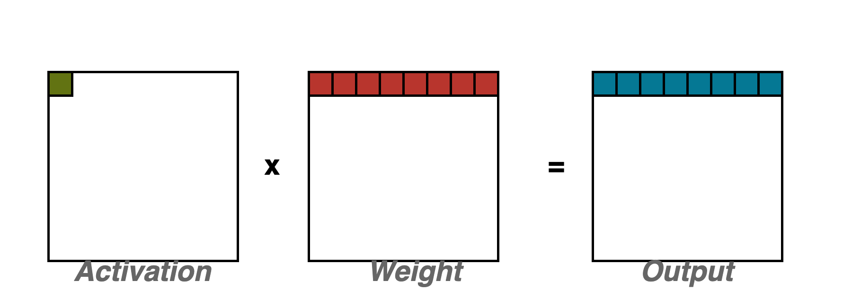
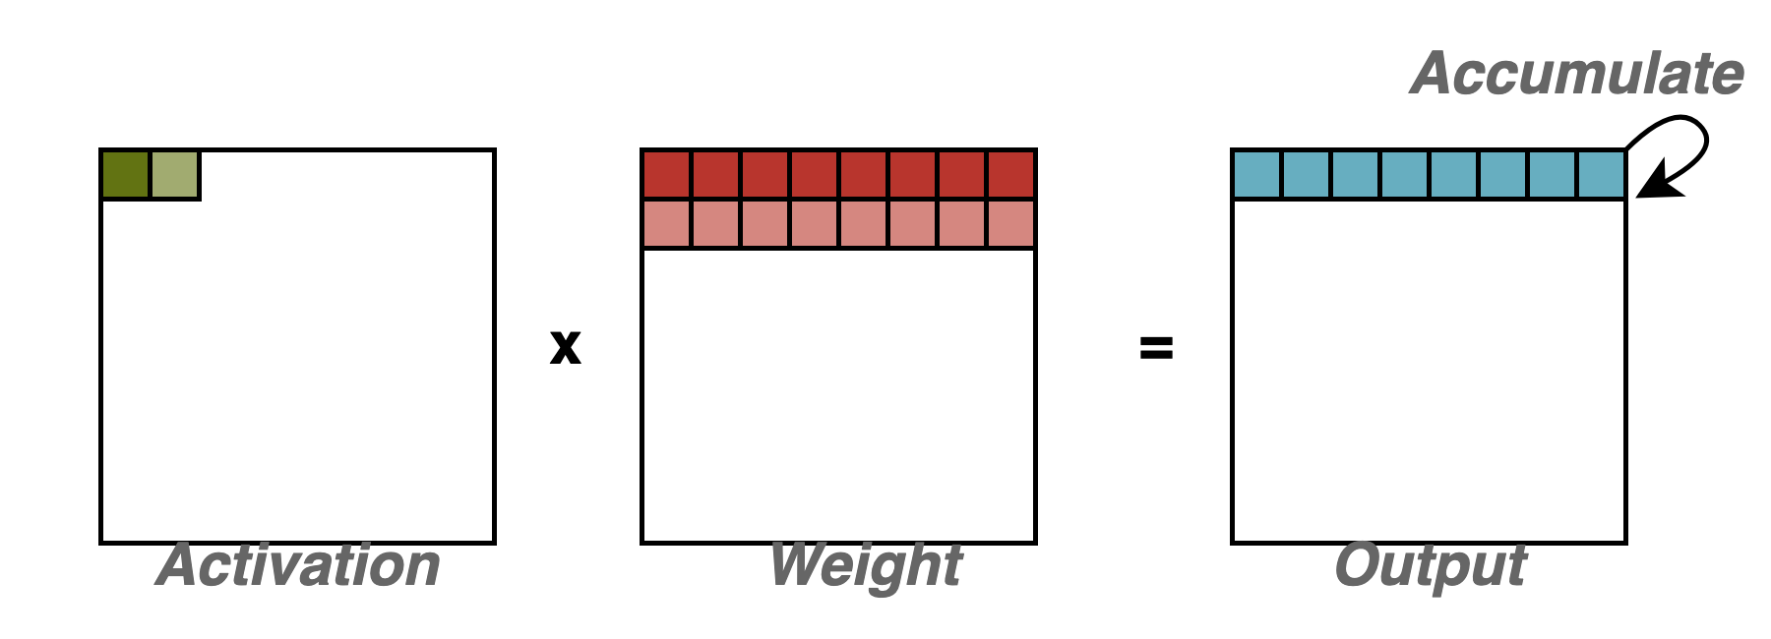
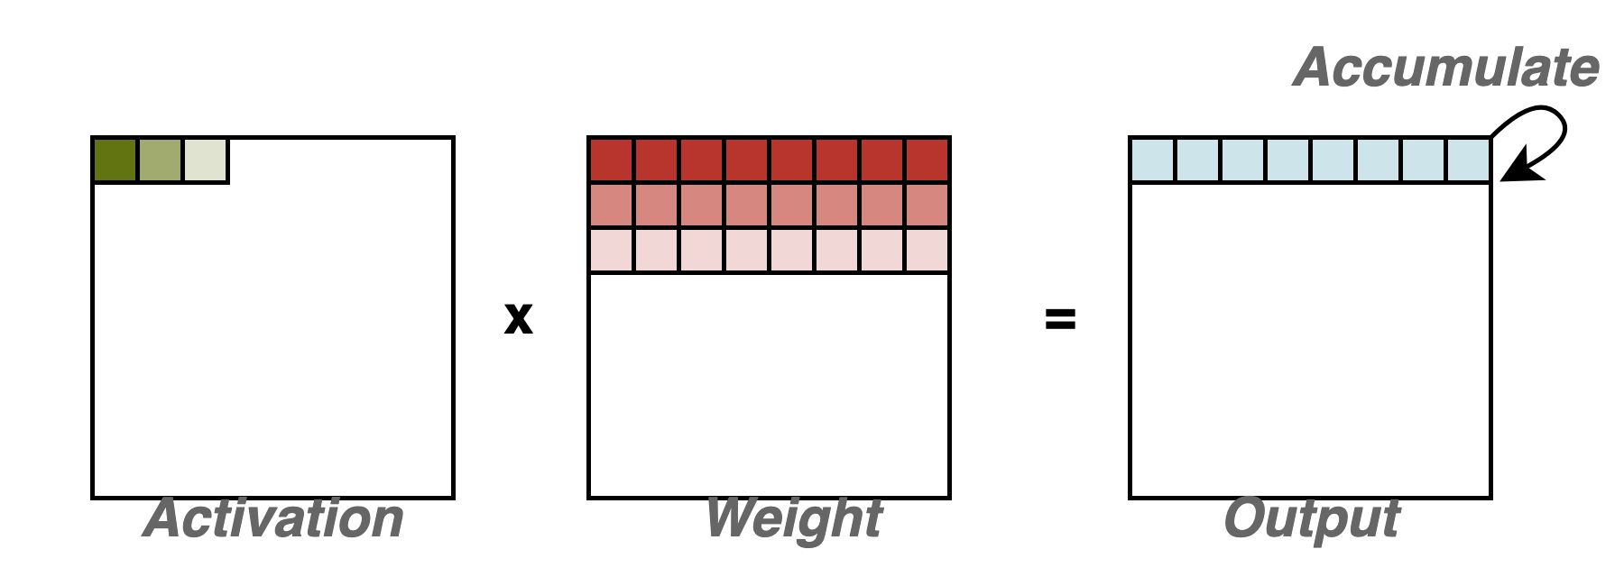
Spatz Activation Sparsity
Gustavson’s algorithm
Scalar-vector multiplication between a single element from the activation tensor and a weight vector, producing a vector of the output tensor
No vector reduction needed

Slide 5
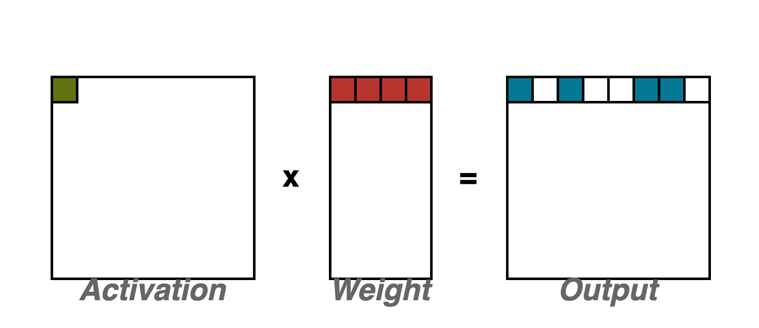
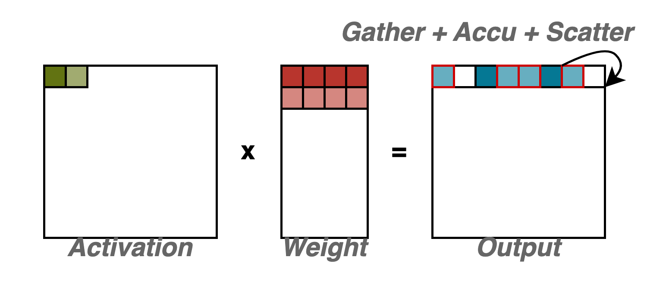
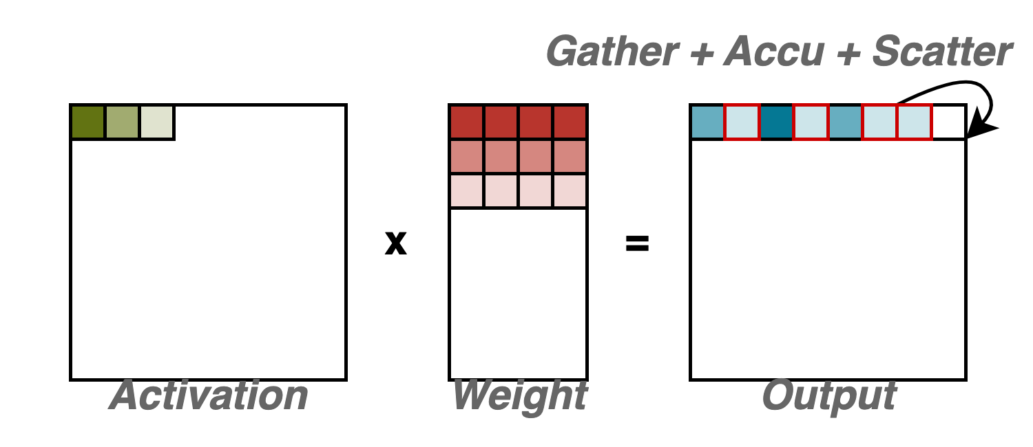
Spatz Activation Sparsity
Gustavson’s algorithm
Scalar-vector multiplication between a single element from the activation tensor and a weight vector, producing a vector of the output tensor
No vector reduction needed
Compatible with weight tensor’s N:M format
The weight tensor is stored in the compact N:M format with the index tensor
Effective elements in the output vector need to be gathered, accumulated, and scattered depending on weight indices

Slide 6
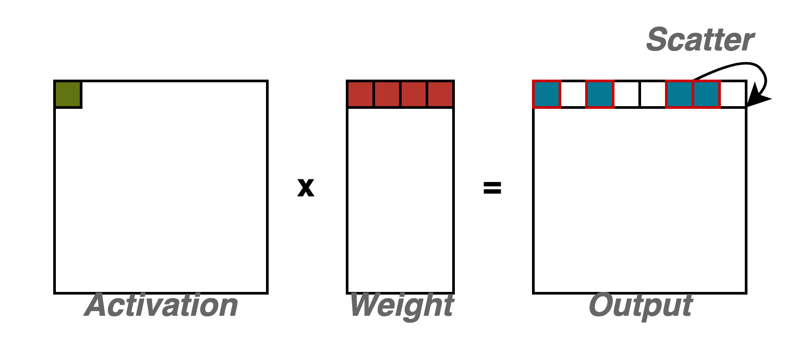
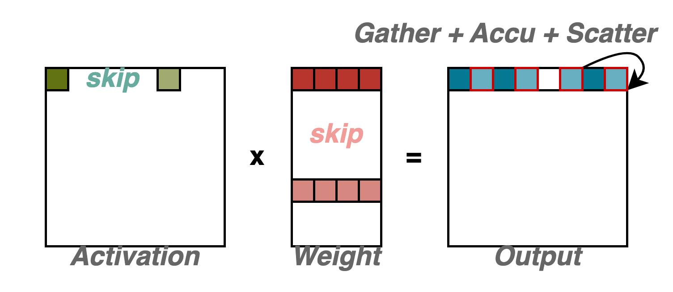
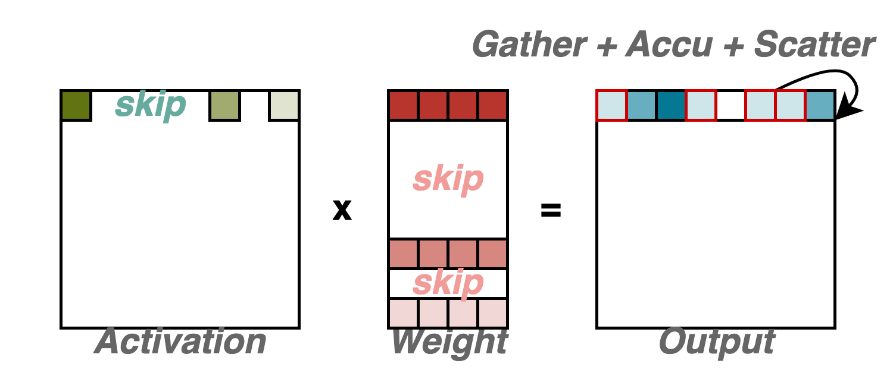
Spatz Activation Sparsity
Gustavson’s algorithm
Scalar-vector multiplication between a single element from the activation tensor and a weight vector, producing a vector of the output tensor
No vector reduction needed
Compatible with weight tensor’s N:M format
The weight tensor is stored in the compact N:M format with the index tensor
Effective elements in the output vector need to be gathered, accumulated, and scattered depending on weight indices
Activation sparsity is natural supported
Skip the entire scalar-vector multiplication
Activation elements become conditions to trigger computation
Compatible with GEMV

Slide 7

Spatz GVSoC Model
Extended with FP8 (E5M2) datapath
Added FP8 unit instruction tests
Implemented FP8 Gustav Matmul baseline kernel (FP8 accumulation, non-sparsity, non-quantization)
Next-step: consider activation and weight sparsity, with performance analysis
https://github.com/gvsoc/gvsoc/tree/soft_hier_release(#129)

Slide 8
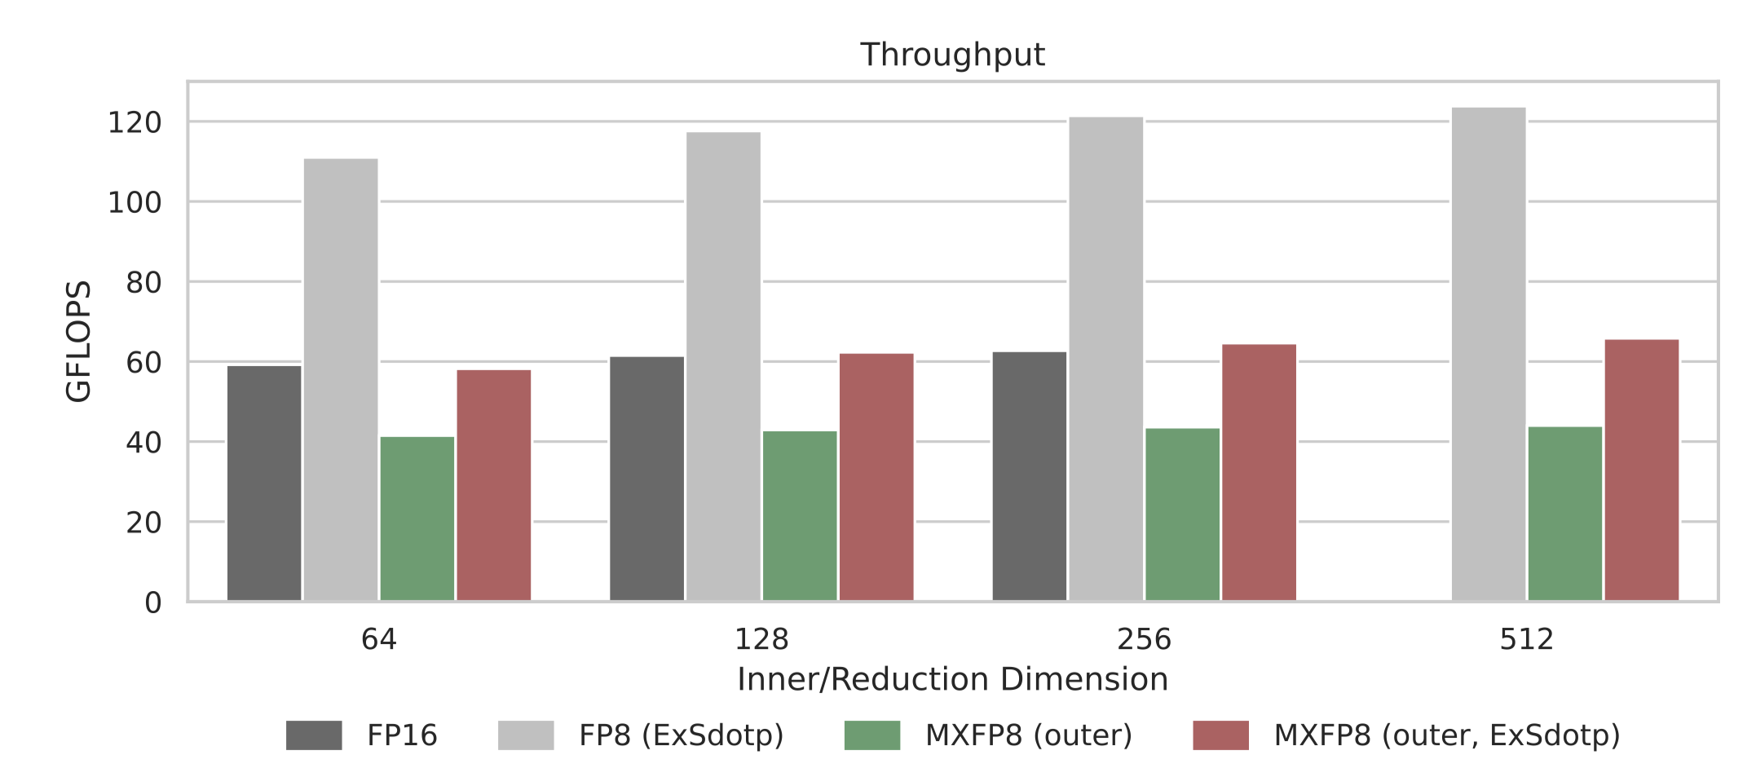
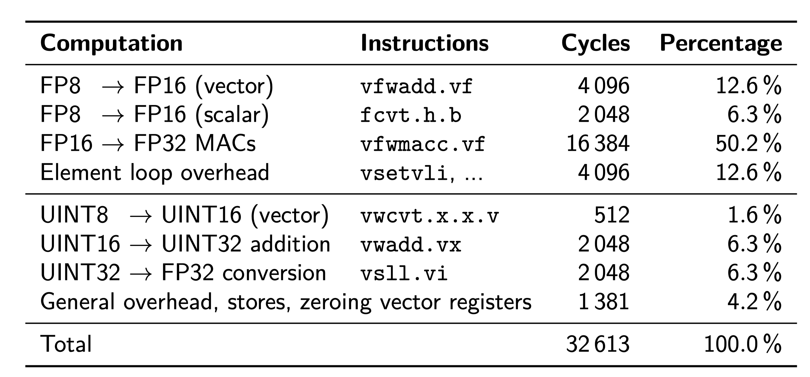
Spatz MX Format
Matmul performance analysis
The inner-product approach is discarded to avoid expensive vector reduction
Benchmarked outer-product approach compared with non-MX baseline (computation scale: 64xNx64)
Low performance of MX8 software kernels
50% of runtime is for ‘useful’ MAC operations
30% for the RVV programming model for mixed precision operations
16% for combining two E8M0 scales, and merging with the accumulated dot product element
Native hardware support via custom ISA extensions → fully utilizes VPU throughput and exploits MX format efficiency

Slide 9
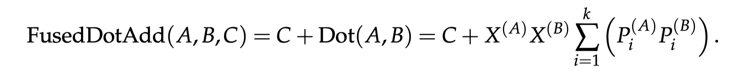
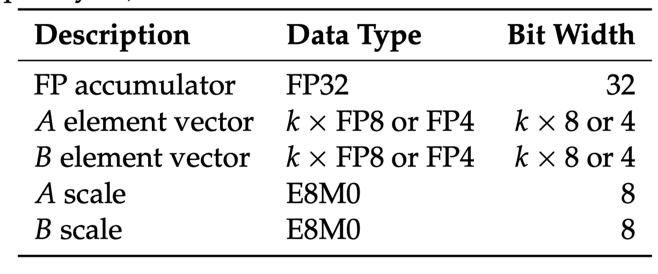
Spatz MX Format
Vmxdotp extension
Computes an MX dot product of block size k and adds it to an FP32 accumulator
Main difficulty: The operation requires 5 different operands, while existing RVV instructions operate on at most three source operands
For proof-of-concept experiment, and keep compatibility with N:M format handling in Gustav, we first focus on a special case:
Accumulator, one element vector, one scale are read from the VRF
The other element vector and scale provided by two scalar registers
Vector-scalar instruction variance
32-bit encodings utilizing reserved opcodes, recommended for experimental extensions

Slide 10
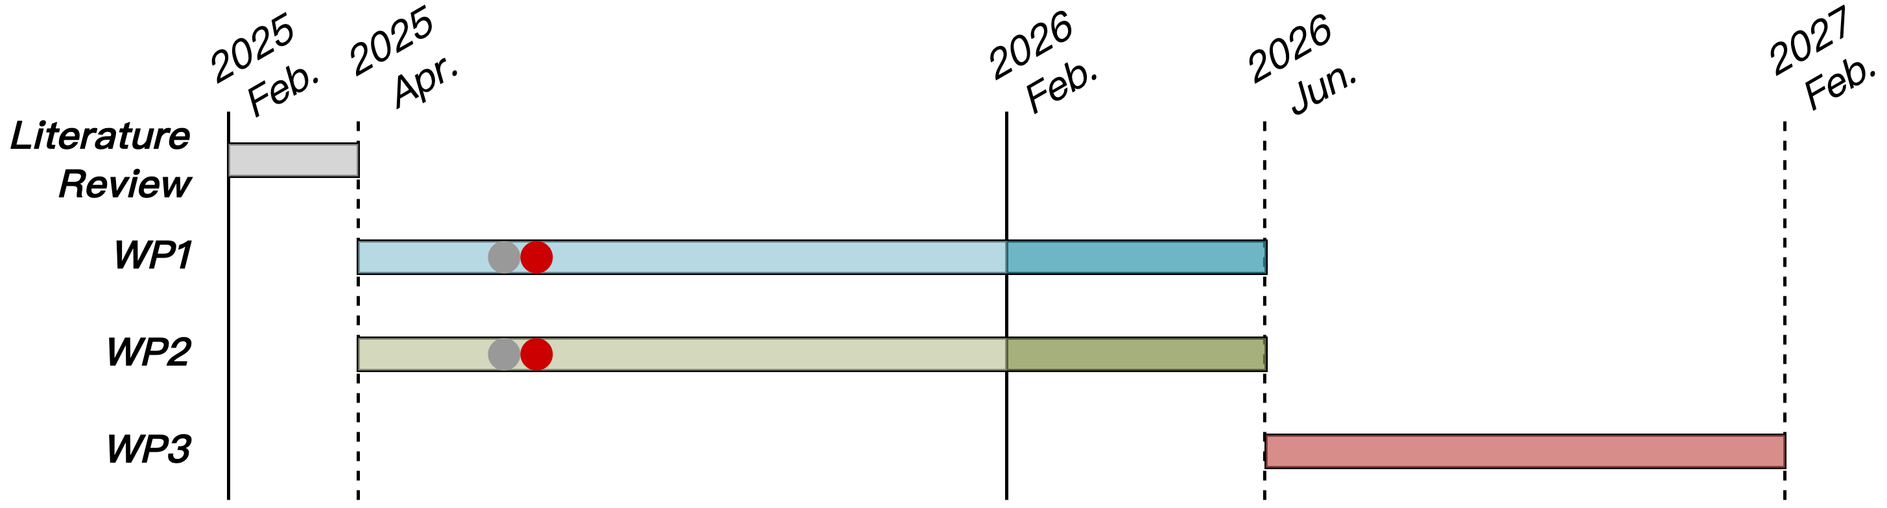
Progress Update
WP1
Gustavson’s algorithm-based activation and weight sparsity handling
Spatz GVSoC model with FP8 datapath, instruction tests, and Gustav MatMul baseline implementation
Spatz MX format ISA extension initial discussion

