Slide 1
QuantSparse 3D Kickoff
Integrated Systems Laboratory (ETH Zürich)
Bowen Wang bowwang@iis.ee.ethz.ch Paul Scheffler paulsc@iis.ee.ethz.ch
Luca Benini lbenini@iis.ee.ethz.ch

Slide 2


Team Introduction
Bowen Wang
BSc at Harbin Institute of Technology
MSc at ETH Zurich
Research Experience
Manycores
Network-on-Chip
DNN Compiler
Paul Scheffler
BSc & MSc at ETH Zurich
Research Experience
Sparse Workload HW Acceleration
Energy-efficient RISC-V Systems
Manycores and Interconnects
SoC Design

Slide 3
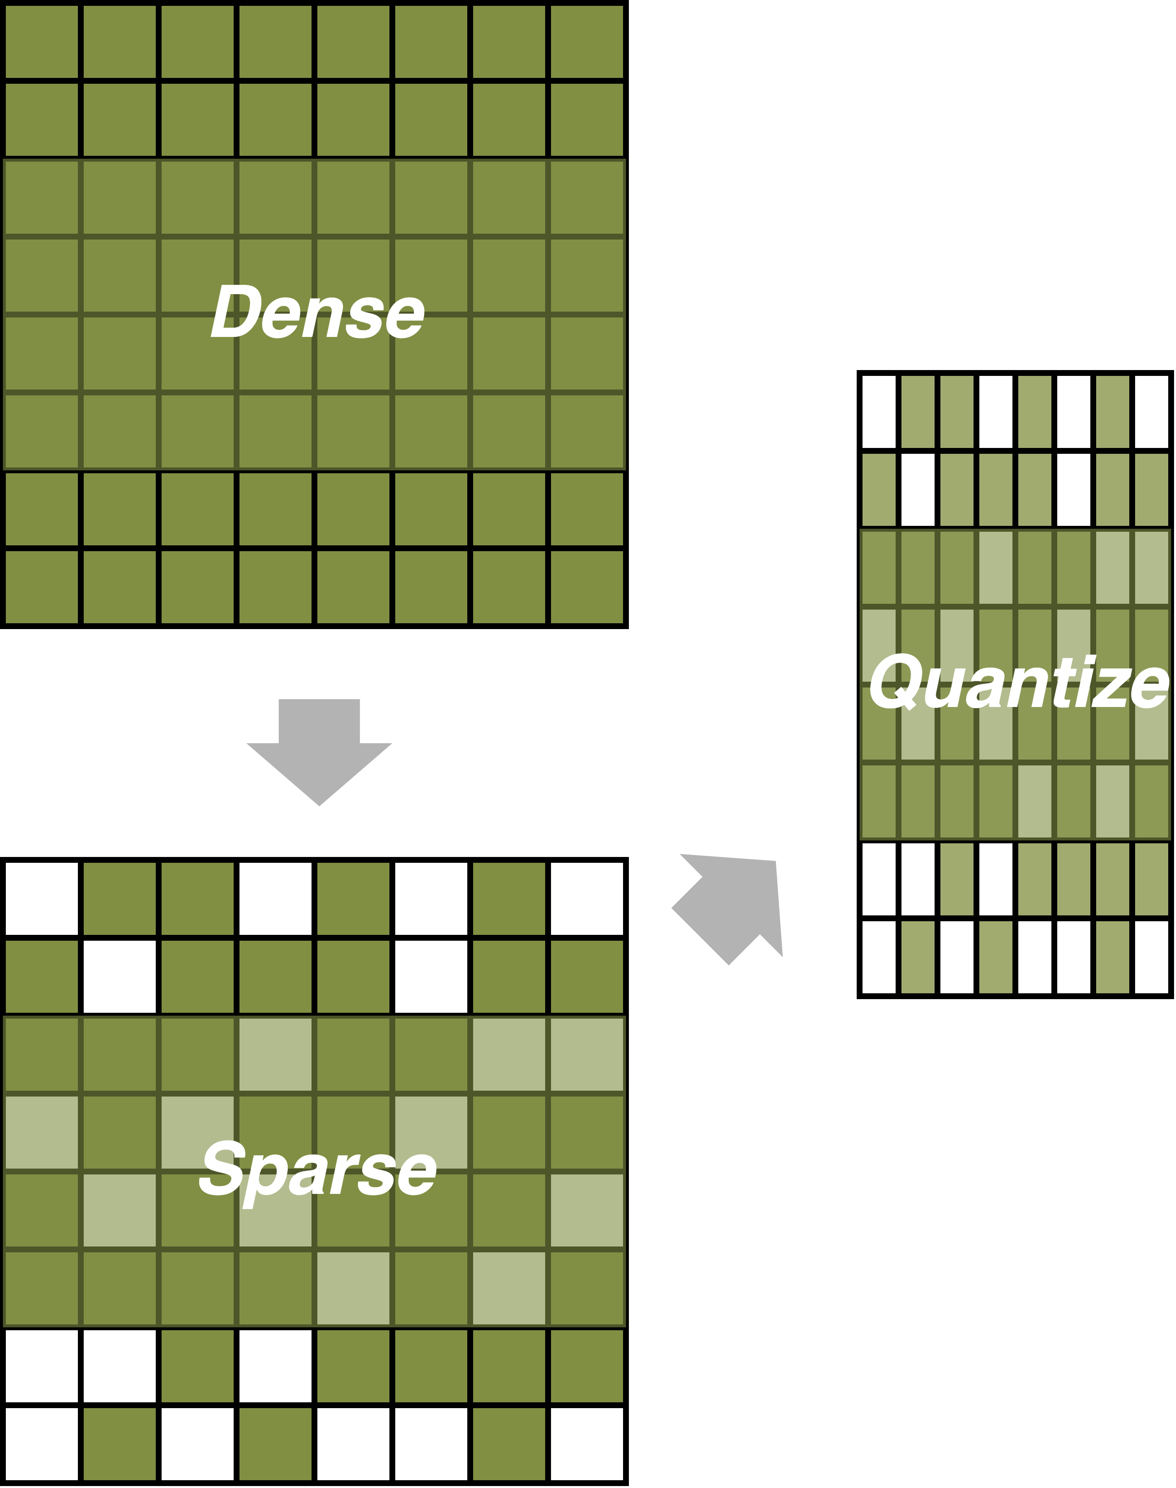
Background
Context and Motivation
Transformers in LLM → Foundation Model paradigm
Energy scaling has lagged behind performance scaling
QuantSparse3D: Aims and Objectives
Mitigate energy bottlenecks by improving performance under power constraints
Sparsity and Quantization – reducing computation, memory footprint, and bandwidth
Computation distribution across memory hierarchy w.r.t. computation intensity
Network mapping, deployment, and fast simulation
Exploit three-dimensional heterogeneous integration technology – from 2.5D-Chiplet to 3D-stacked IC

Slide 4
Project Structure
WP1: Architectural exploration, definition, and sizing at chiplet level
Simulation models of key building blocks
Compute engine, memory hierarchy, on-chip interconnect, and memory endpoint
RTL models of key building blocks for power, performance, and area estimation
Access PPA using post-backend estimations
WP2: System-level modeling and design
Configuration space Exploration
Dimensioning single chiplet, 3D-stacked memories, and scaling to multiple chiplets
Flexible model-to-hardware mapping using standardized high-level specifications
WP3: Integration, benchmarking, and performance tuning
Access performance, energy efficiency, and scalability
Extend models to the emerging technologies
NV memories, 3D-DRAM, and HBM4 with the upcoming 3D stacking options

Slide 5
Milestones
WP1, WP2
Start
Literature Review
WP3 Start
Year 1
Year 2
2025-02
2025-04
2026-02
2026-06
2027-02
WP1
Architectural modeling and design of the chiplet architecture
Build and synthesize parameterized RTL models to assess PPA
WP1 & WP2
Chiplet architecture refinement
Tuning of performance and power models
Software extension to enable end-to-end inference
WP2
System modeling of multi-chiplet fabrics and 3D-stacked memories
Software environment for model-to-hardware mapping with open-sourced environments and specifications
Design space exploration of system configurations using simplified end-to-end models and microkernels
WP3
Performance analysis and efficiency assessment on end-to-end workload
Explore configuration space for a significant mix of workload at different sparsity level and leveraging aggressive quantization

Slide 6
Deliverables
WP1, WP2
Start
Literature Review
WP3 Start
Year 1
Year 2
2025-02
2025-04
2026-02
2026-06
2027-02
Report and open-source release on:
Architectural specification, preliminary design, and PPA efficiency assessment
System-level specification, simulation model, and software
Report and open-source release on:
System model and integrated HW-SW simulation
Benchmark exploration, architectural assessment, and roadmap

Slide 7
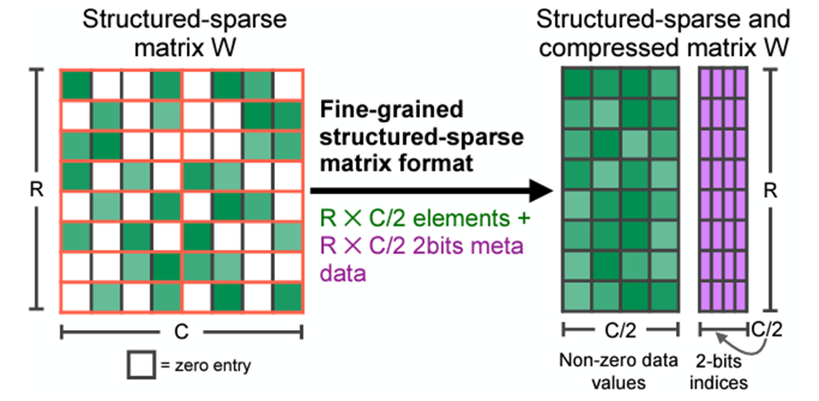
State of the Art: GPUs
[1] Nvidia, “Nvidia A100 Tensor Core GPU Architecture,” Nvidia
[2] B. D. Rouhani et al., “OCP Microscaling Formats (MX) Specification,” OCP
So far: 2:4 structured sparsity ^{[1]} only
Introduced with Nvidia Ampere (2020)
2 values in every 4-block must be zero
Up to 2× smaller & faster than dense
Gradual adoption of low-precision formats
Lower FP precisions every generation
Driven by ML/AI applications
GB100: <8b microscaling (MX) ^{[2]} formats
Blocks of values with shared scale factor
INT and FP formats, varying block sizes
Year | GPU | Low-precision (<32b) Formats | Sparsity
2020 | A100 | FP16, BF16, INT8 | 2:4 structured
2023 | H100 | FP8, FP16, BF16, INT8 | 2:4 structured
2023 | MI300X | FP8, FP16, BF16, INT8, INT16 | 2:4 structured
2025 | GB100 | FP8, FP16, BF16, INT8, MXFP4, MXFP6, MXFP8, MXINT8 | 2:4 structured
^{[1]}

Slide 8
State of the Art: Commercial AI Accelerators
Quantization trend
8-bit quantization dominates AI accelerators
Emerging sub-8-bit and block quantization
Common architectural features
Parallel processing and efficient data movement
Clusters of tensor/vector units
Connected via a 2D NoC mesh
Streaming dataflow model for handling unstructured sparsity
Year | Design | Architectural Highlight | Data Format | Sparsity
2022 | Groq GroqChip | Functional-sliced microarchitecture | FP/INT32, FP/INT16, INT8 | Unstructured
2023 | Microsoft Maia 100 | Tiles of TU, hierarchical 2D NoC mesh | FP32, BF16, MXFP9, MXFP6 | N.A.
2023 | Tenstorrent Blackhole | Cluster of TU, 2D NoC mesh | FP/INT/TF32, INT/BF16, FP8, INT8, Block FP2/4/8 | Unstructured
2024 | SambaNova SN40L | Configurable PE, 2D NoC mesh, Streaming dataflow | FP/INT32, BF16, INT8 | Unstructured
2024 | Furiosa RNGD | Cluster of tensor contraction units, 2D NoC mesh | BF16, INT8, FP8, INT4 | N.A.
2024 | Huawei Ascent 910C | Cluster of cube and vector units, On-chip mesh | FP/INT32, FP16, INT8 | N.A.
2024 | d-Matrix Corsair | CIM , Vector engine, Hierarchical interconnect | MXINT16, MXINT8, MXINT4 | N.A.
2024 | Cerebras WSE-3 | Cluster of TU, 2D NoC mesh, Streaming dataflow | FP/BF16, INT8 | Unstructured

Slide 9
State of the Art: Sparse Accelerators in Research
Target different abstraction levels
Direct ML workload acceleration
Sparse linear/tensor algebra
General-purpose stream operations
Usually target low (ML) precisions
Almost always unstructured
Bitmap or indexed sparse encoding depending on required sparsity range
Trend toward higher flexibility
Less structure, higher range, flexible dataflow, single- and dual-side sparsity
Year | Design | Silicon | Architecture | Function | Sparsity Handling Mechanisms | Data Flow | Data Formats | Sided- ness | Sparse encod. | Sparse range
2019 | Dadu et al.^{[1]} | ✗ | CGRA | General-purpose str. ops | Indirection, Inters., Union | Flexible | FP32, FP64 | Both | Indexed | High
2020 | SIGMA^{[2]} | ✗ | MAC PE Array | Sparse-Sparse Matmul | Distribution Networks | Fixed | BF16 | Dual | Bitmap | Med.
2022 | Huang et al. ^{[3]} | ✓ | Multi-Accelerator | Sp. CNN & GCN infer. | Distribution Networks | Fixed | INT8 | Single | Bitmap | Med.
2023 | Liu et al. ^{[4]} | ✓ | CIM Unit | Sp. transformer infer. | Distribution Networks | Fixed | INT8 | Single | Bitmap | Med.
2023 | Flexagon^{[5]} | ✗ | MAC PE Array | Sparse-Sparse Matmul | Merge-Reduce Trees | Flexible | INT16 | Dual | Indexed | High
2024 | Onyx^{[6]} | ✓ | CGRA | General-purpose str. ops | Indirection, Inters., Union | Flexible | BF16, INT16 | Both | Indexed | High
[1] V. Dadu et al., MICRO ‘52, 2019
[2] E. Qin et al., IEEE HPCA, 2020
[3] W. Huang et al., IEEE VLSI, 2022
[4] S. Liu et al., IEEE ISSCC, 2023
[5] F. Muñoz-Martínez et al., ASPLOS, 2023
[6] K. Koul et al., IEEE VLSI, 2025

Slide 10
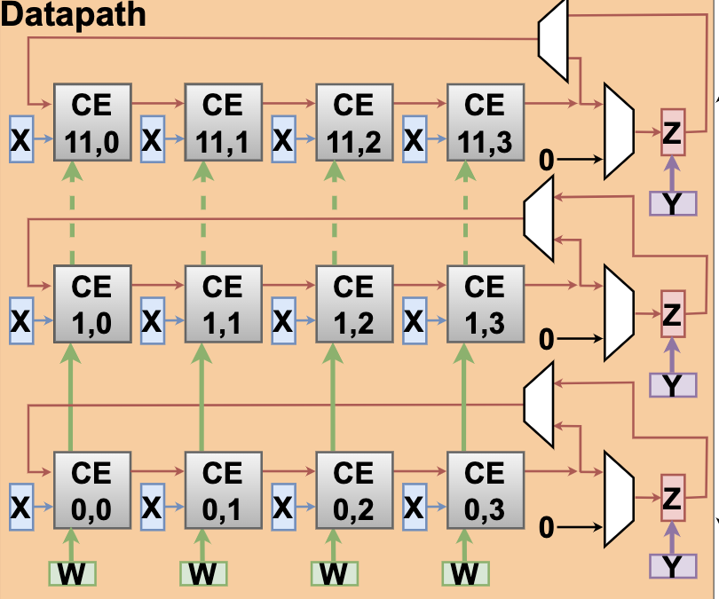
Architecture: Background
Current SoftHier Architecture
System Level
Clusters in 2D-Mesh, HBM as main memory
Clusters and HBM CTRL connected by NoC
Compute Cluster
RedMule Compute Engine
Snitch – RISC-V Core
TCDM Multi-banked L1
iDMA Engine
Compute Engine
Reduced-precision Matrix Multiplication Engine
Mix-precision floating-point arithmetic (FP16/FP8)
2D array of Compute Elements (CEs) arranged in Systolic-like structure
To Sync NoC Router
To Data NoC Router
HBM
I $
R
R
R
R
CTRL
REG
Core 0
Comp. Engine
iDMA
C
C
C
C
Core 0
…
C
C
C
C
Core n
R
R
R
R
Interconnect
HBM
HBM
TCDM (Multi-banked L1)
C
C
C
C
R
R
R
R
C
C
C
C
R
R
R
R
Cluster
HBM
Data NoC Router
R
R
Sync NoC Router

Slide 11
Architecture: Initial Ideas
Build on SoftHier project
Extend architecture to improve LLM inference
Quantization to low precisions
Microscaling-like block quantization
Sparsity support at multiple levels
Block level: sparse quantized blocks
Tile level: sparse L1 streamers
NoC level: packing of narrow requests on wide NoC, coalescing at HBM endpoints
Processing near memory
Offload operations to HBM endpoints to reduce data movement costs
To Sync NoC Router
To Data NoC Router
HBM
I $
CTRL
REG
Core 0
Compute Engine
Compute Engine
iDMA
Compute Engine
iDMA
R
R
R
R
Core 0
C
C
C
C
…
Core n
Interconnect
C
R
Interconnect
R
C
C
C
R
R
R
R
TCDM (Multi-banked L1)
TCDM (Multi-banked L1)
HBM
HBM
HBM
HBM
C
C
C
C
R
R
R
R
TE Cluster
C
C
C
C
R
R
R
R
Data NoC Router
R
R
HBM
Sync NoC Router

Slide 12
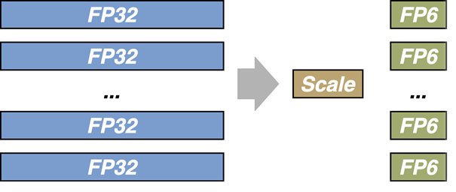
Architecture: Quantization
[1] B. D. Rouhani et al., “OCP Microscaling Formats (MX) Specification,” OCP
Microscaling-like^{[1]} FP block quantization
Quantize elements to low precision (e.g. FP4, FP6)
Form blocks with shared scale factor (e.g. 8 bit)
Quantization handled in compute engine
Extend engine to process quantized blocks
Maximize datapath reuse between formats & operations
Customize block formats to add sparsity
Use small blocks (e.g. 64 bit) to minimize structure constraints
Add metadata to encode block-level sparsity
48b elements
16b scale + sparsity
6 × FP8
scale
sp.
8 × FP6
scale
sp.
12 × FP4
scale
spars.

Slide 13
Architecture: Sparsity in Compute Tile
[1] P. Scheffler et al., “Sparse Stream Semantic Registers: A Lightweight ISA Extension Accelerating General Sparse Linear Algebra,” IEEE TPDS, 2023
Block level: extend quantized FP blocks with fine-grain sparsity
Store lightweight sparsity encoding using additional small field in FP blocks
N:M positional encoding, bit mask, or other low-overhead scheme
Tile level: sparse streaming units (SUs)
Affine or indirect (scatter-gather) streaming of blocks for unstructured sparsity^{[1]}
Use indices (8b, 16b) residing in TCDM
Possibly: index intersection or union between SUs for sparse-sparse workloads
Compute Engine
dense block A
0
e₀
6
e₁
…
…
sparse block B
42
e₇
48
shared scale
56
sparse enc.
TCDM (Multi-banked L1)
SU 0
SU 1
SU 2
data
idcs
addrgen
idx comp.
addrgen
addrgen
Compute Engine

Slide 14
Architecture: Sparsity at NoC Level
[1] S. Liu et al., “Ten Lessons We Have Learned in the New ‘Sparseland’:
A Short Handbook for Sparse Neural Network Researchers,” ICLR 2023
Structured sparsity limits LLMs
Better performance and size achievable^{[1]}
Needs system-wide unstructured sparsity
Problem: unstructured sparsity incurs non-contiguous accesses
NoC and HBMx granularity (256b) much wider than data → low bandwidth utilization
HBM endpoints are distributed
Pack narrow accesses on NoC bus
Clusters pack together accesses per endpoint to improve NoC efficiency
HBM endpoints unpack and coalesce accesses to maximize bandwidth
Cluster
HBM0
How can I use more of my links’ BW?
…
…
64b
64b
unused BW
64b
Cluster
HBM3
…
…
HBM1
64b
wide NoC bus
…
…
HBM Endpoint
HBM2
Cluster
64b
64b
64b
64b
HBM Endpoint
…
…
NoC Router
64b
64b
64b
64b
coalescer
request packer
64b
64b
64b
64b
64b
64b
64b

Slide 15
Architecture: Processing Near Memory
Cluster
Avoid data movement to compute cluster for simple operations
Element-wise operators
Simple reductions (e.g. dot products)
Data reorganization (e.g. transposition)
Extend HBM endpoints with simple compute capabilities
Extend NoC requests with special compute instructions
Response carries result or merely signals operation completion
Reserve cluster compute and BW for more complex tasks
PNM controller
NoC Router
Instr. + args
Resp. (return)
HBM Endpoint
Near-Memory Compute Unit
Access Coalescer
HBM Controller

Slide 16
Block-level Design and Evaluation
Model critical hardware blocks as:
Synthesizable RTL description
Analyze block-level PPA using RTL
Profile in cycle-accurate simulation
Estimate power & area based on logic synthesis and backend (P&R)
Use GVSoC for in-system simulation
System simulator (GVSoC) model
Calibrate using RTL findings
Evaluate block designs based on application performance
Use findings to iterate on designs
refine
Block design
RTL model
GVSoC model
implement
simulate
calibrate
simulate
Block Area
Block
Perf. & Power
In-System Perf. & Power

Slide 17
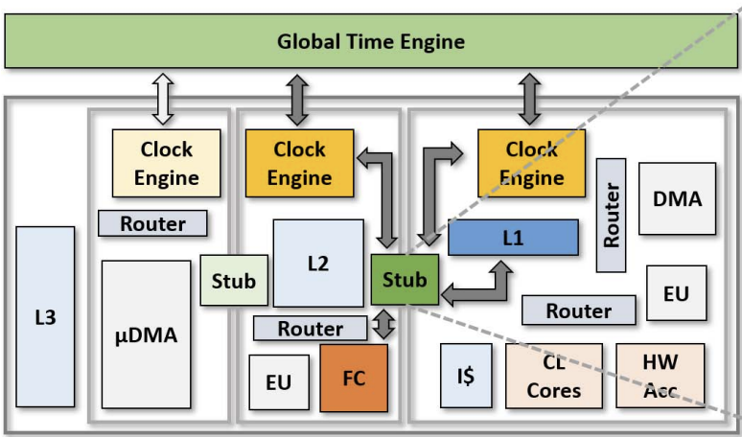
System-level Design and Evaluation
[1] Bruschi, Nazareno, et al. "GVSoC: a highly configurable, fast and accurate full-platform simulator for RISC-V based IoT processors." ICCD 2021.
GVSoC^{[1]}: Fast and Accurate Full-Platform Simulator
Provide accurate timing (<10% runtime deviation vs. FPGA emulation of PULP IPs)
Fast simulation (25 MIPS measured with a 16-core PULP Cluster)
System Calibration
Block-level models integration
Calibrate simulator using RTL-level block findings
Larger workload evaluation
Use GVSoC to evaluate architecture design with end-to-end applications at fast simulation time
GVSoC

Slide 18
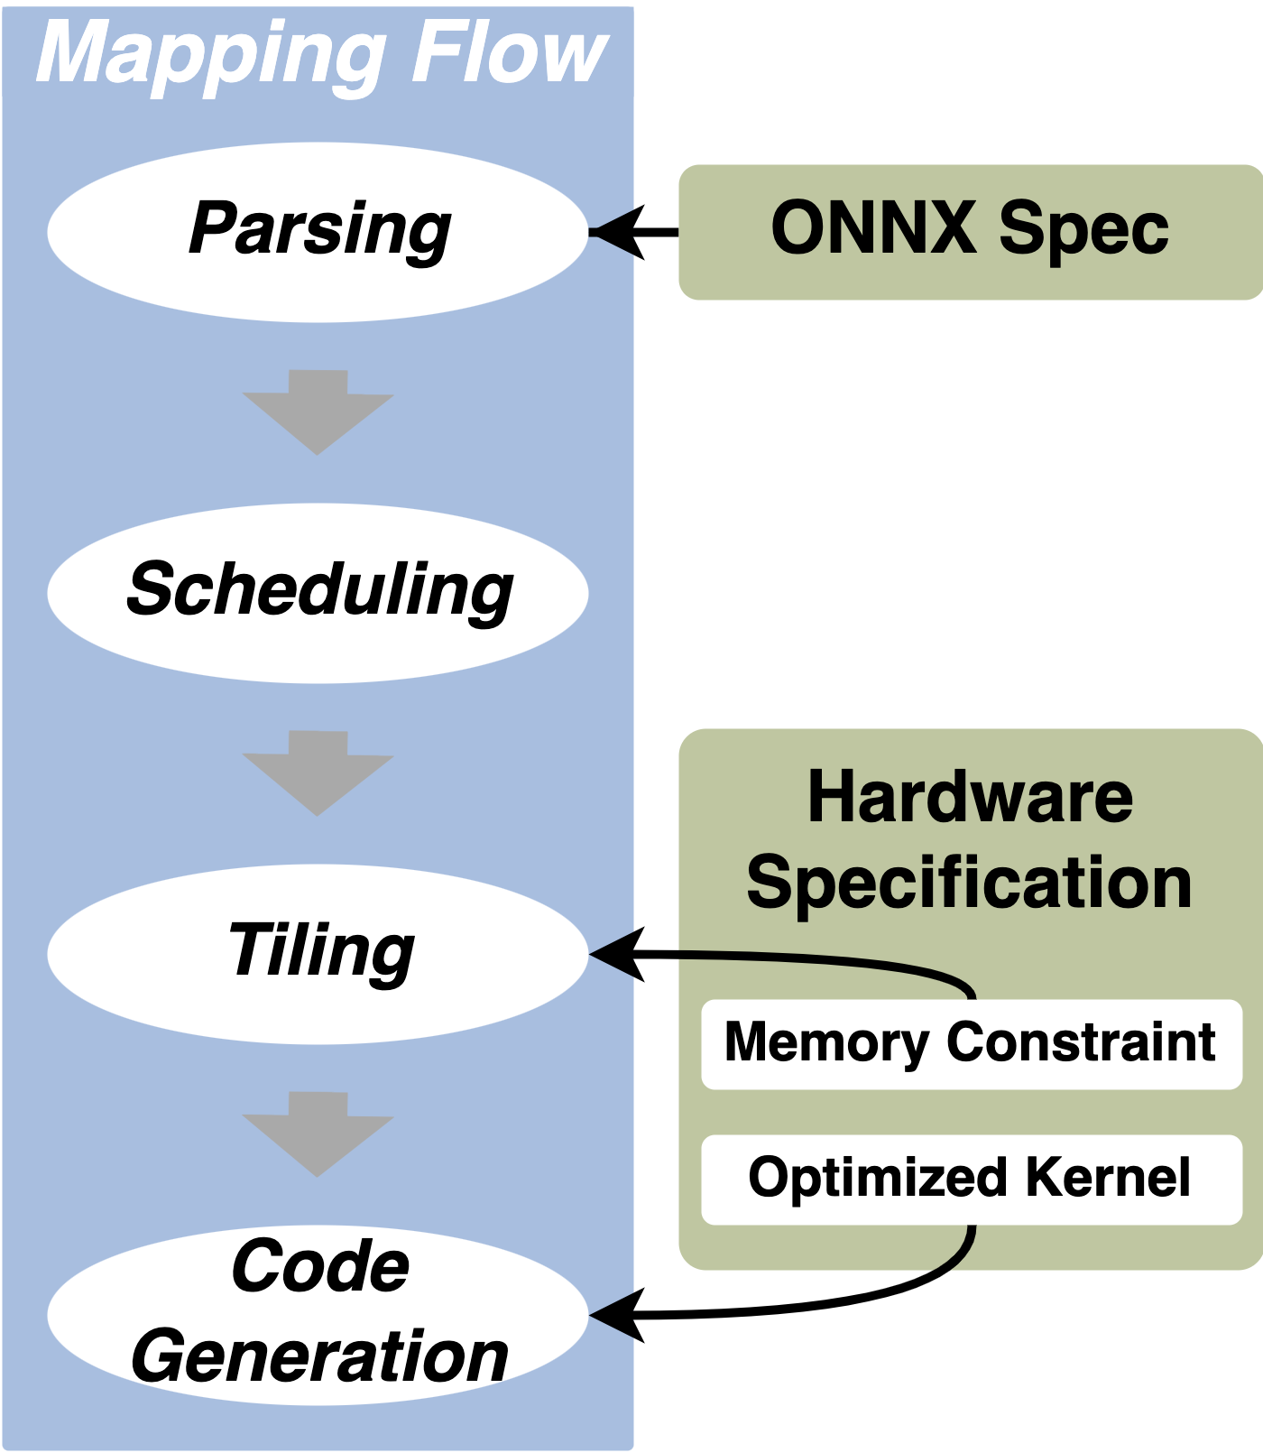
LLM Network Mapping
Explore mapping configuration space
Single-chiplet dimensioning and workload distribution
Data mapping in 3D-stacked memories and data exchange within the multi-level memory hierarchy
Scaling to multi-chiplet
Flexible Model Mapping with Standardized High-Level Specifications
Neural network compiler generates hardware-specific bare-metal C code
Ingesting quantized ONNX graph specification
Workload scheduling and tiling w.r.t. multi-level memory constraints

Slide 19
Tuning for SoA LLM Workload
Architectural evaluation on full real-world workloads
Leverage on GVSoC hardware abstract models and neural network compiler for fast benchmarking
Evaluate performance, energy efficiency, and scalability
Make adaptations to improve performance and efficiency by tuning and benchmarking a collection of models
Extend models to emerging technologies
NV memories, 3D-DRAM with vertical transistors, and HBM4 with 3D-stacked memories
Tracking the evolution of advance AI models

