Slide 1
SoftHier Bi-Weekly Meeting
Chi Zhang chizhang@iis.ee.ethz.ch
Thomas Benz tbenz@iis.ee.ethz.ch
Luca Colagrande colluca@iis.ee.ethz.ch

Slide 2
SoftHier Progress General Updates
FlooNoC RTL Updates
Support collective operations {Multicast + Reduction}
Reduction operation implementation: reuse FPUs of snitch cores
Performance analyze
Calibrate with GVSoC NoC models
Absence Announcement
Chi will take holiday from 22nd Aug to 12nd Sep

Slide 3
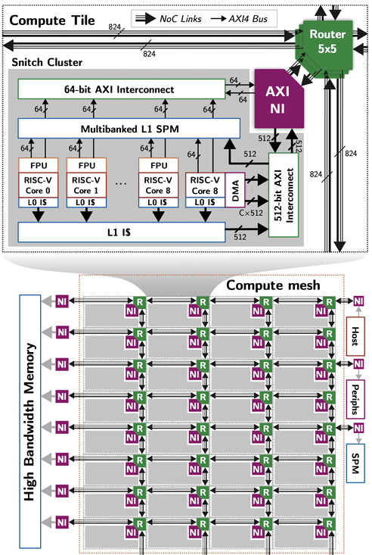
Reduction on FlooNoC
Reduction Extension in Router
Flit extension: Add tag in flit head {OffloadRed, RedOp}
Router Extension:
FSM extension and export offload ports to Snitch FPUs
Execute Reduction in a SIMD way
Pipelined scheduling for best performance
Router
Optype
Operand1
512b
Operand2
512b
Result
512b
Pack & Unpack
/64
/64
/64
/64
/64
/64
/64
/64
FPU
FPU
FPU
FPU
FPU
FPU
FPU
FPU

Slide 4
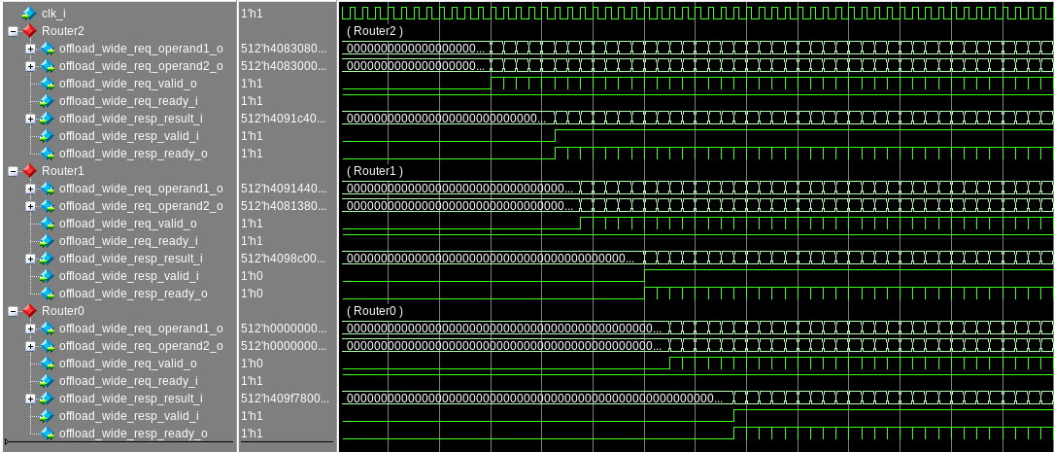
Example: Row-wise Red.Sum in FlatAttention
In RTL Implementation
Row-wise Reduction can be fully pipelined
Router0
Router1
Router2
Router3
FPU
L1
FPU
L1
FPU
L1
FPU
L1
Fully Pipelined
FPU Latency
Hop Latency
FPU Latency
Hop Latency
FPU Latency

Slide 5
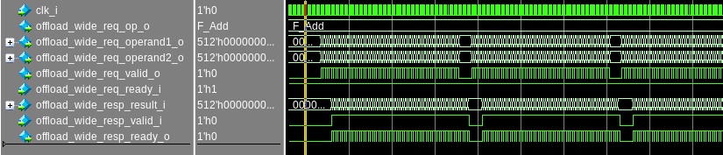
GVSoC Calibration: Row-wise Red.Sum
Calibration
Average Runtime cycle deviation is around 16%
In RTL the DMA generate intervals per 4KB (AXI Page Size) transfer
Fine-tune the GVSoC model for better accuracy

Slide 6
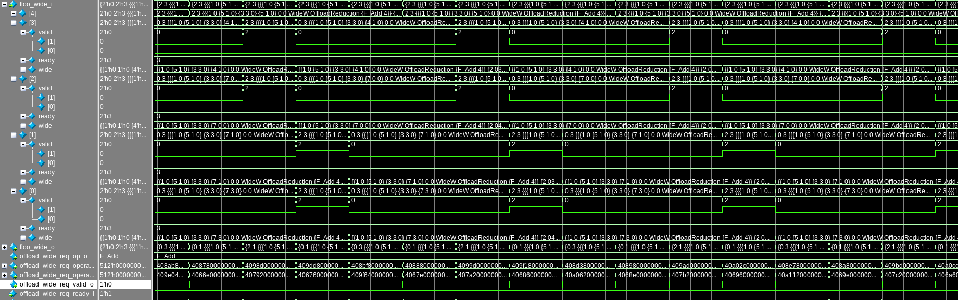
Performance Bottleneck: Router Reduce with >2 inputs
When the reduction path is not on a single chain
For example: reduce from all clusters
Tree-based reduction path
Routers on the merge node need to reduce >2 inputs of flits
Since we did not implement with more FPUs in place (would be very expensive)
Introducing more stalls due to reduction dependency
We are adding these details also in GVSoC model
R
R
R
R
A[i]
R
R
R
R
B[i]
C[i]
R
R
R
R
D[i]
R
R
R
R

Slide 7
Plan For Next
Analyze Power and Area for FlooNoC with Collective Extensions
As this project approaches its conclusion, we need to allocate time to finalize the report and the open-source code for release {GVSoC, RTL}.

