Slide 1
SoftHier Bi-Weekly Meeting
Chi Zhang chizhang@iis.ee.ethz.ch
Thomas Benz tbenz@iis.ee.ethz.ch
Luca Colagrande colluca@iis.ee.ethz.ch

Slide 2
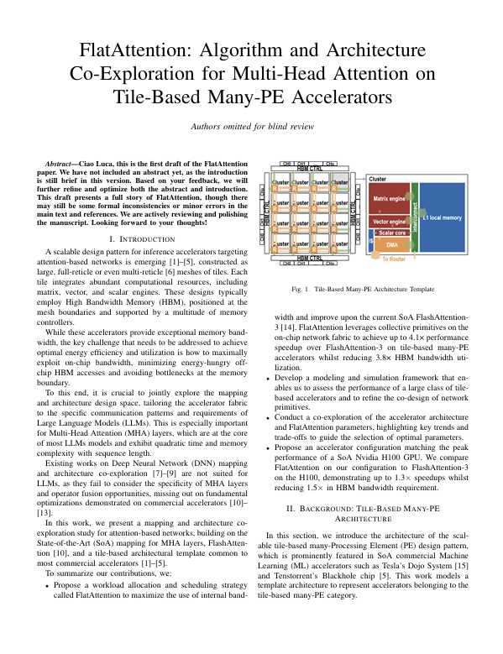
SoftHier Progress General Updates
Working on the Flatten-Attention Paper (Chi, Luca C, Thomas etc.)
Target ISVLSI, DDL postponed to 10th March
We finished the first draft
Further revising and optimization on-going

Slide 3
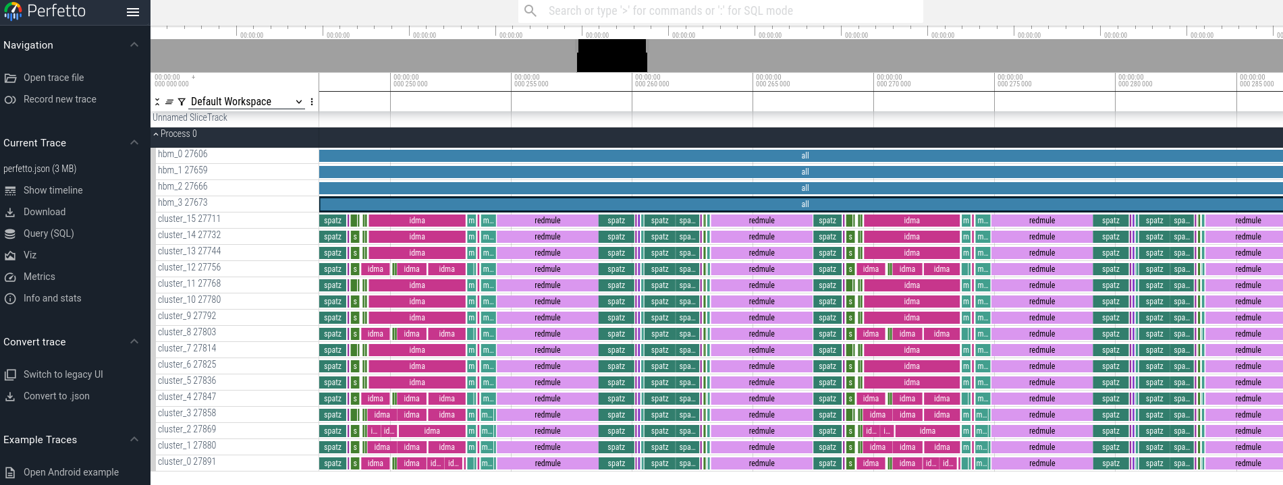
SoftHier Simulator Progress
Uploaded example code of GEMM with HBM-preloading
We show how to preload HBM and check results in SoftHier
The code is actually generated from Dace ;)
Showing traces on Perfetto
An open-source web-based tracing tool
Usage: open https://ui.perfetto.dev/ and load simulation generated trace file sw_build/perfetto.json

Slide 4
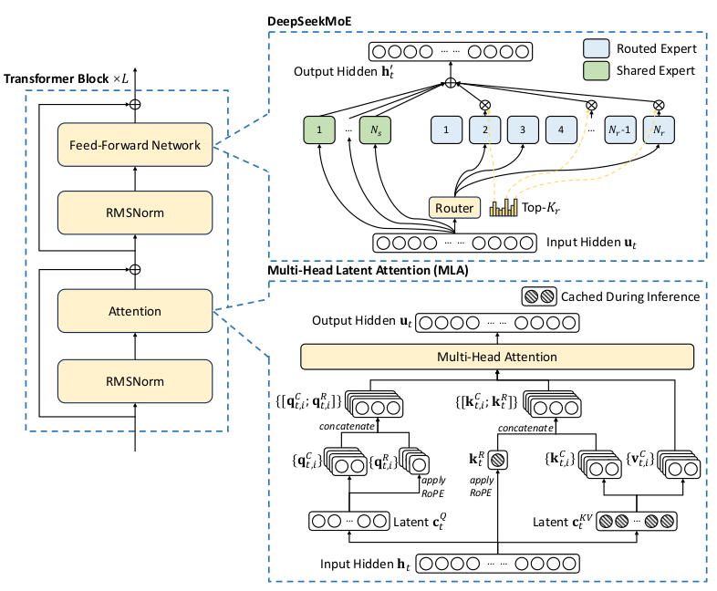
Next Steps
Flatten-Attention Paper Optimization
Support post-load for better way of numerical checking
Start to map end-to-end inferencing of SoA LLM model
Maybe we could focus on DeepSeek (the real SoA)
DeepSeek model is relatively not so complex

