Slide 1
SoftHier Bi-Weekly Meeting
Chi Zhang chizhang@iis.ee.ethz.ch
Thomas Benz tbenz@iis.ee.ethz.ch
Luca Colagrande colluca@iis.ee.ethz.ch

Slide 2
SoftHier Progress General Updates
Working on the Flatten-Attention Paper (Chi, Luca C, Thomas etc.)
Target ISVLSI, DDL Feb 10
More features supported on SoftHier simulator
HBM Preloading:
Python Numpy data array -> SoftHier HBM
Can specify different base address for different Numpy arrays
Partial cluster synchronization
Now support grouping cluster in mesh shape
Simple collective primitives on NoC model
Row/column-wise multicast/reduction
Introduce Spatz model (vector engine)
ISA: RISCV vector extension, offloaded from snitch core
Only vector instruction included for Flatten Attention are timed

Slide 3
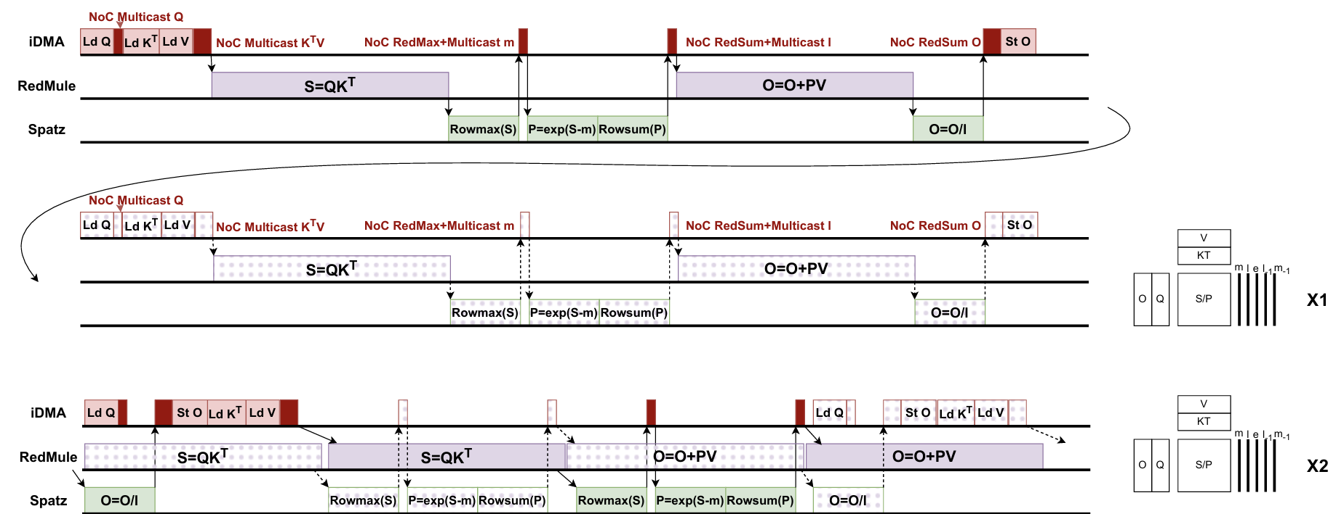
Optimization for Flatten Attention Dataflow
Optimization
Using asynchronization nature of iDMA and RedMule invoking
One cluster dealing with 2 heads concurrently
Overlap the runtime of {iDMA, RedMule, Spatz}
Original
Optimized

Slide 4
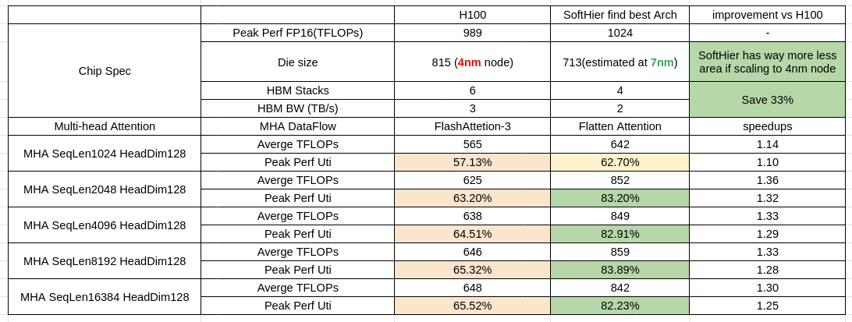
SoftHier + Flatten Attention wins
Directly compare with H100 + FlashAttention-3
SoftHier configuration
32x32 Cluster, 16x2 HBM ch, 1024b NoC link width
Each Cluster: {RedMule 32x16 (1TFLOPS), Spatz FP16(64GFLOPS), 328KB L1, 512GB/s L1 BW}

Slide 5
Next Steps
Focus on Flatten-Attention Paper
DDL in 2 weeks

