Slide 1

Prediction of real estate property prices in Montreal
Nissan Pow Emil Janulewicz L. Dave Liu
Notes:
For our project, we went out and collected a new dataset on real estate properties in Montreal. With the Motivation to help families, especially first time buyers, in Montreal.

Slide 2
Prediction Question
Predict the selling price of properties
Motivations: Suggest appropriate
Selling prices for the sellers
Buying prices for the buyers
Notes:
The key prediction question focused on at the moment is to predict the price of real estate properties using regression analysis.
This relates generally to real estate appraisals and sales price predictions. Traditionally, the property’s price is determined by a professional appraiser, and the appraised value is important for sales, loans, and marketability. The disadvantage is that the human appraiser is biased towards the interest of the lender, mortgage broker, seller, or buyer, and might be costly. Whereas this is free, and is a quick and automated system that uses predictive modeling to perform pattern recognition without human bias.
For the buyers, this system is useful to determine good or bad deals on the market in terms of value and investment.

Slide 3

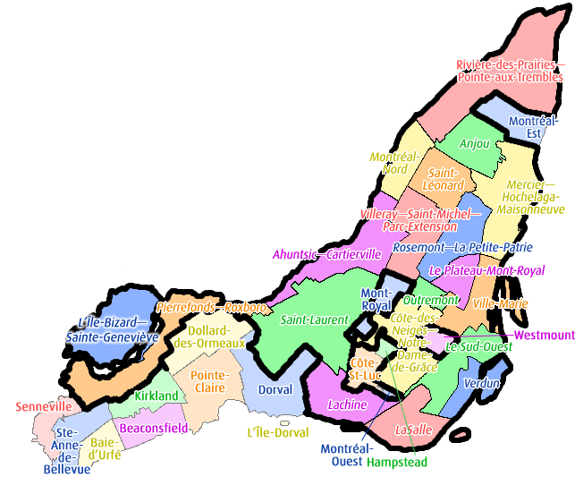
Data sets
1. Property listings in Montreal from real estate website
The targets: Prices
The features: Location, Size, Property type, etc.
2. Bounding polygons from Montreal Open Data
3. Additional demographics from Statistics Canada
The features: Income, Population age, Crime rate, etc.
Notes:
Majority of the dataset were scraped from a real estate listing website, Centris.ca. The targets we are trying to predict are the prices of the properties. The features or attributes of the data were from the listings themselves, examples such as its geographical location, living area, and type of property, whether it is an apartment, townhouse, or detached home, etc.
We plan to include additional geographical features to the listings based on the Montreal borough they belong to. The boroughs are defined by bounding polygons from Montreal open data.
The additional geographical features are from statistics Canada such as income, age of population, crime rate, etc.

Slide 4
Machine learning methods
Regression of the prices
Linear and logistic regressions
Random forest
k-Nearest Neighbours
SVM
Neural Networks (Quinlan 93)
Notes:
The machine learning methods to be applied for the regression of the prices are
Linear and logistic regression
Bagging with decision tree is the best results so far.
kNN is the most similar to the current system used by the brokers. Where we look at neighbouring properties of similar types.
Neural network for regression is something we are working on, but this suppose to have good improvement on other methods.

Slide 5
Preliminary Results
Currently at 0.87 of actual price
Goal: Predict within 0.95. (Caplin et al. 08)
Notes:
Plot the predicted price versus the actual price. The regression model tends to over predict the cheap properties and under predict the expensive properties. Currently, we can predict within 0.87 of the actual price. This prediction is useful, as predicted data points that falls largely overly the unity line are under-valued properties according to our model. Also, the points that are largely under the unity line might be overly priced according to our model.
Our goal is to predict within 0.95 of the selling price as similar performance has been achieve by Yann LeCun’s group on a similar dataset by incorporating more features.

Slide 6
Preliminary Results
Regression analysis of the prices
So far, the living area and the number of rooms (bathrooms) account for the most of the variance in price.
Notes:
For now, the features that account for most of the variance in price for the linear model is the living area and number of rooms (especially the bathrooms). The geographical locations did not have a huge impact so far as we did not incorporate the relevant geographical features besides the absolute location.

Slide 7
Future directions
Incorporate data from Statistics Canada based on the defined Montreal boroughs
Looking at temporal trends pending on the availability of data
Implement additional features such as higher order terms and their interactions (Boston housing price dataset)
Implement neural network for regression (Quinlan 93)
Notes:
This is of course still a work in progress.
As we still need to add the geographical location features into the dataset as mentioned.
Since most of the project was collecting the data and getting the right features, we also plan to look at the price across years if we can get that data.
Some previous work has looked at the expansion of features into higher order terms, and we plan to do so as well.
In terms of the Machine Learning method, we plan to implement neural network for regression, which might further improve performance.

