Slide 1

Prediction of real estate property prices in Montreal
Nissan Pow Emil Janulewicz L. Dave Liu
Notes:
Motivation to help

Slide 2
Prediction Questions
Predict the selling price of properties
Motivations: Suggest accurate
Selling prices for the sellers
Buying prices for the buyers
Predict the Montreal borough that the property is most likely to belong to
Motivation: Suggest buying locations for buyers depending on their circumstances
Notes:
Find good deals for the sellers and the buyers.
Find a good area for the family.

Slide 3

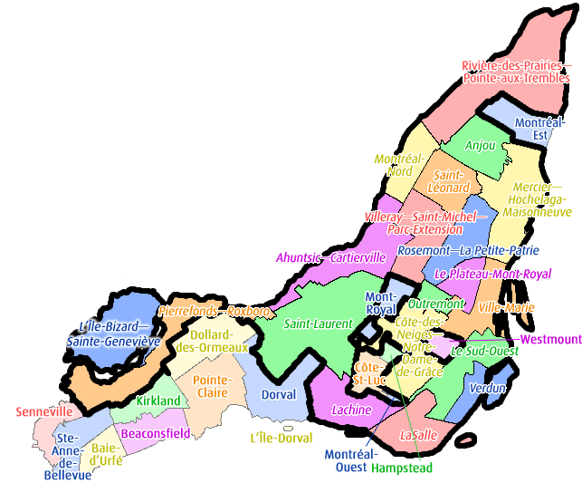
Data sets
1. Property listings in Montreal from real estate website
The targets: Prices
The features: Location, Size, Property type, etc.
2. Bounding polygons from Montreal Open Data
The labels: Montreal boroughs
Additional demographics from Statistics Canada
Income, Population age, Household size, etc.
Notes:
The label we are trying to predict are the prices.
Doesn’t make sense to have Stat Canada data.

Slide 4
Machine learning methods
1. Regression of the prices
Linear and logistic regressions
k-Nearest Neighbours
2. Classification of the boroughs
Supervised:
Logistic regressions
k-Nearest Neighbours
SVM
Neural Networks
Un-supervised:
k-Means

Slide 5
Preliminary Results
Account for variance in Price

Slide 6
Future directions
Incorporate data from Statistics Canada based on the defined Montreal boroughs

