Slide 1

Prediction of real estate property prices in Montreal
Nissan Pow Emil Janulewicz L. Dave Liu
Notes:
For our project, we predicted the real estate property prices in Montreal.

Slide 2
Prediction Question
Predict the selling price of properties
Motivations: Suggest appropriate
Selling prices for the sellers
Buying prices for the buyers
Notes:
Why is it important to predict the price of properties using regression analysis?
This relates generally to real estate appraisals and sales price predictions. The traditional human appraiser system has the disadvantage that the human appraisers are biased toward certain invested interest, and he or she might be costly. Whereas this is a quick and automated system that provides an independent 3rd party source that might be less biased.
For the buyers, this system is also useful to determine good or bad deals on the market in terms of investment.

Slide 3

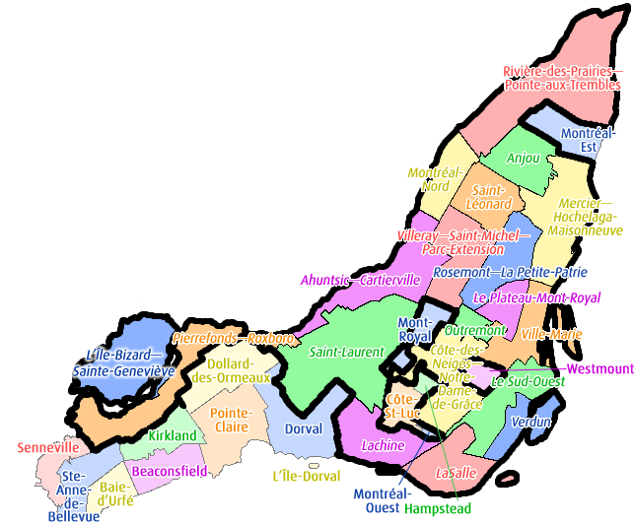
Data sets
1. Property listings in Montreal from a real estate website
The targets: Prices
The features: Area, # Rooms, etc.
2. Bounding polygons from Montreal Open Data to incorporate additional demographics
The features: Income, Crime rate, etc.
Notes:
Part of the dataset was from a real estate listing website, Centris.ca. The targets we are trying to predict are the prices of the properties. Some of the features were from the listings themselves, examples such as its living area and the number of rooms.
We used the bounding polygons from Montreal Open Data to incorporate additional demographic data based on the boroughs in Montreal. Examples of the additional geographical features are income and crime rate.

Slide 4
Machine learning methods
Regression of the prices
Linear regression
k-Nearest Neighbours
Support Vector Regression
(SVR)
Notes:
The baseline machine learning methods for the regression of the prices are
Linear regression
kNN
And support vector regression.

Slide 5
Preliminary Results (SVR)
Currently at 0.13 error
Goal: Predict within 0.05 error. (Caplin et al. 08)
Notes:
Plotting the predicted price versus the actual price. The SVR model tends to over predict the cheap properties and under predict the expensive properties. This prediction is also useful for the buyers, as predicted data points that falls largely overly the unity line are under-valued properties according to our model. Whereas the points that are largely under the unity line might be overly priced according to our model.
Currently, we can have a prediction error of 0.13 with SVR. Our goal is to have a prediction error of 0.05. Since similar performance has been achieve by Yann LeCun’s group on a similar dataset by incorporating more geographical features that I mentioned.

Slide 6
Preliminary Results (Cont’d)
The living area and the number of rooms (bathrooms) account for the most of the variance in price.
Notes:
For now, the features that account for most of the price variance for the linear model is the living area and the number of rooms (especially the number of bathrooms).

Slide 7
Future directions
Incorporate demographic data based on the defined Montreal boroughs
Implement additional features such as higher order terms and their interactions (Boston housing price dataset)
Implement neural network for regression (Quinlan 93)
Notes:
This is a work in progress
We will need to add the geographical location features into the dataset as mentioned
Some previous works have looked at the expansion of features into higher order terms, and we plan to do so as well
In terms of the machine learning methods, we plan to implement neural network for regression, which might further improve regression performance

