Slide 1
Meon
Glory awaits you.

Slide 2
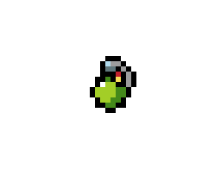
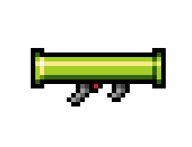
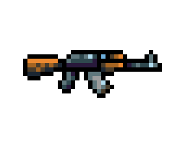



Meon - Description
Multiplayer game
Objective - kill your enemies
Several weapons at your disposal
health, armor and damage.

Slide 3
Meon - Features
1 vs 1;
Fast-paced and action-packed;
More than 10 different weapons at your disposal-
+ your fists;
2D side view;
Pixelated art;
Controller support.

Slide 4
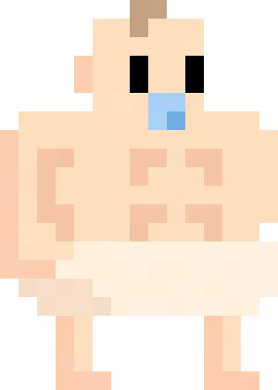
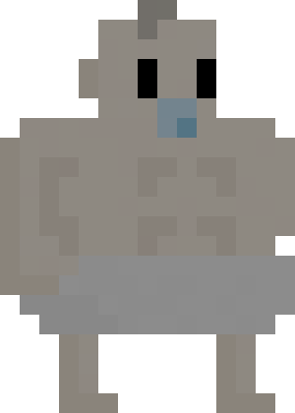

Meon – Playable Characters
In the beggining you’ll be able to play as a baby . As the game evolves we will be adding more characters.

Slide 5
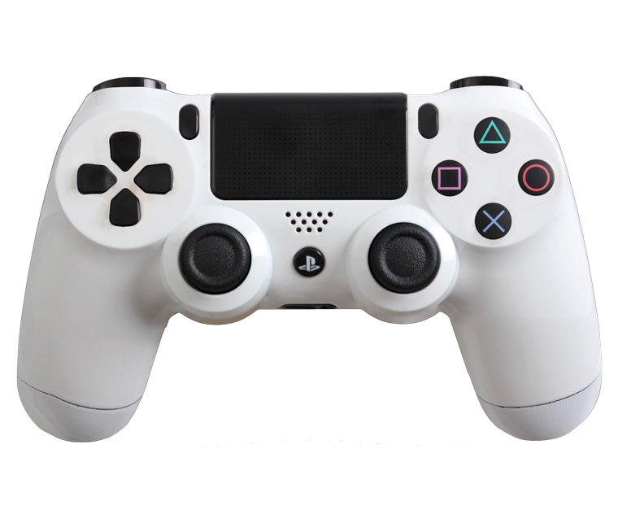
Meon - Controls
Use weapons;
Pick-up weapons;
Punch;
Jump;
Move.

Slide 6


Meon - Platforms
Windows
Linux

