Slide 1
Meon
Glory awaits you.

Slide 2
Meon - Description
Meon is a simple multiplayer game. You and another player start in opposite sides of the game and your objective is to kill each other.
You have weapons at your disposal that range from melee weapons such as knifes and baseball bats, to long-ranged ones like grenades and bazookas. Depending on their rarity, which is defined by the amount of damage they induce, they’ll spawn accordingly.
You’ll also have items that will help like increased health, armor and damage.
The game is very fast-paced so here is a protip: don’t blink.

Slide 3
Meon - Features
You versus a friend;
Fast-paced and action-packed;
More than 10 different weapons at your disposal-
+ your fists;
2D side view;
Pixelated art;
Controller support.

Slide 4

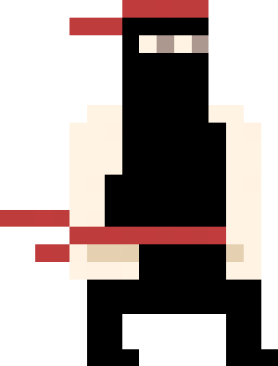
Meon – Playable Characters
In the beggining you’ll be able to play as a baby and a ninja. As the game evolves we will be adding more characters.

Slide 5
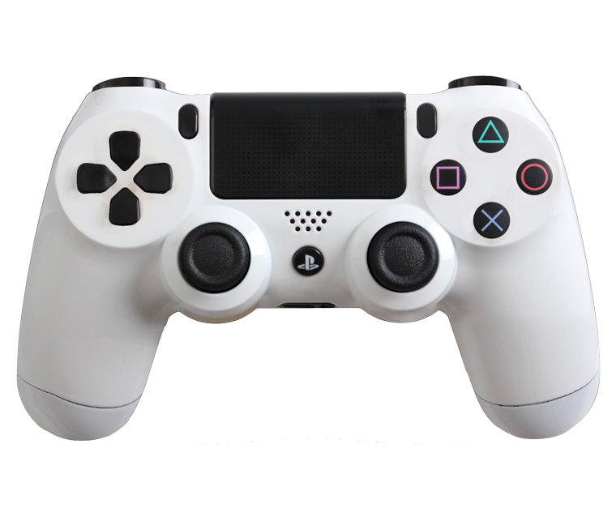
Meon - Controls
Use weapons;
Pick-up weapons;
Punch;
Jump;
Move.

Slide 6
Meon - Platforms
The supported platforms on an initial state will only be Windows but we’d like to make the game avaiable on macOS, Linux, Android and iOS in the future.

