Slide 1
Incorporating CI/CD
Continuous Integration & Continuous Deployment
A Value Proposition

Slide 2
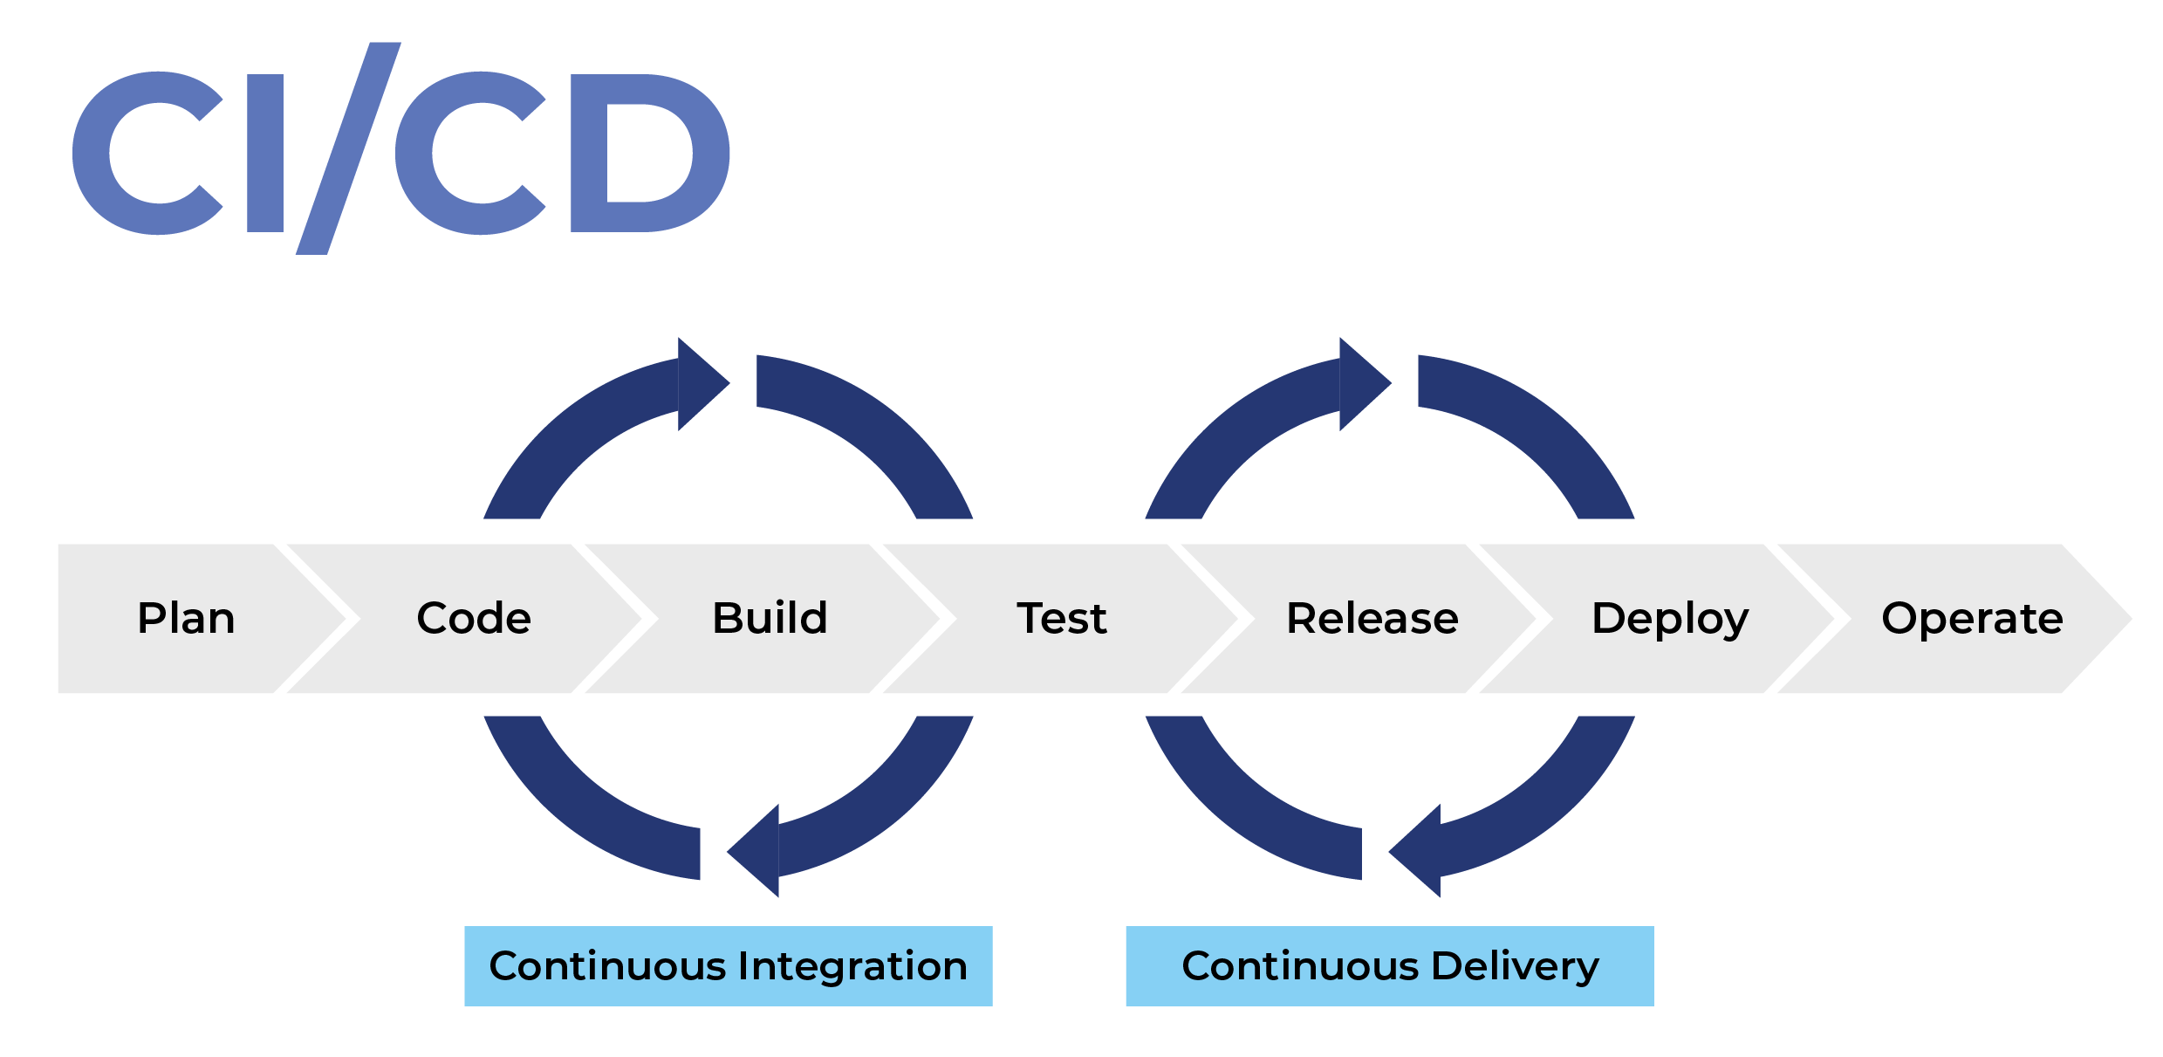
What is CI/CD?
A set of automated practices to release our code in small increments
Building/Testing/Analyzing code is performed on every commit.
Verified code is deployed to a Blue server for additional verification before switching to Green
All processes are fully automated and monitored. Warnings are raised at every stage of the process

Slide 3
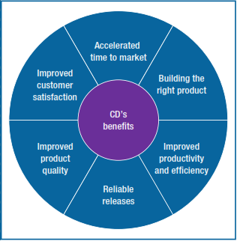
Why Should WE USE CI/CD?
By automating the build/deploy pipeline we free our developers time to actually develop our app.
Automating our build/deploy pipeline encourages a standardized process, which will reduce errors
By building and testing on each commit, we can catch issues early, reducing ‘merge hell’.
Analyzing merge conflicts is very expensive and time consuming, decrease them is good for our bottom line.

Slide 4
WHERE is the Value?
Scaling our App is very difficult. Without clear and automated development operations, chances of downtime increase as we scale.
The CI/CD system is integrated into our app repo. This means all developers are included in the pipeline by default. This simplifies management.
Increase uptime and fewer bugs == better user experience == more revenue!

Slide 5
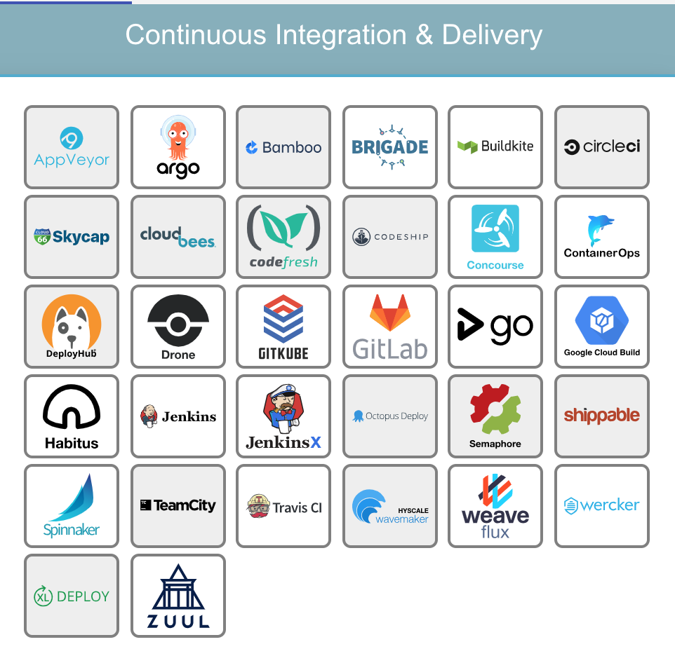
Conclusion
CI/CD is an established industry practice.
There are many open-source low-cost and mature tools we can use to build our pipeline.
Our engineering team is fully on board.
We will improve our app reliability and increase revenues while saving on costs

