Slide 1

Designing Microbial Communities Using Interpretable Gaussian Processes
Understanding and Designing Systems with Data

Slide 2
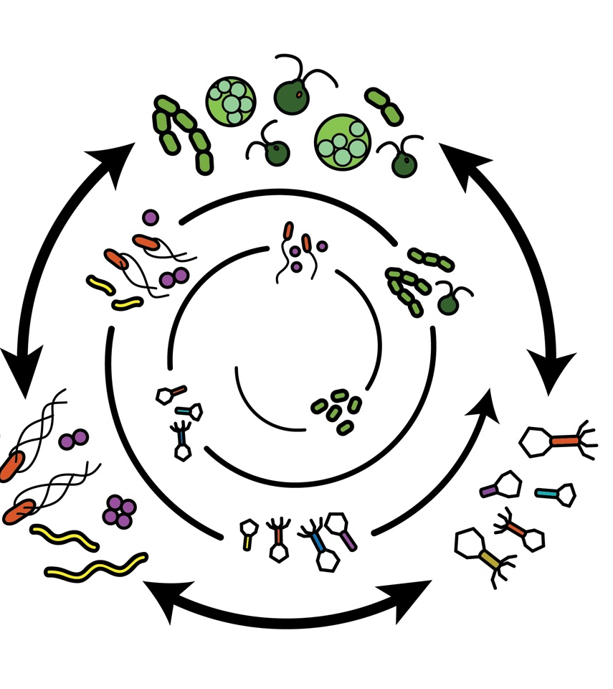
Objective: Generate a library of synthetic stable microbial communities
What are Microbial Communities?
What Can They Be Used For?
Why Not Monocultures?
Why Stable Communities?
Are Microbial Communities Not Stable?
Notes:
What are Microbial Communities?
Definition and basic characteristics of microbial communities.
What Can They Be Used For?
Applications in biotechnology, medicine, and environmental science.
Why Not Monocultures?
Limitations of monocultures in terms of functional complexity and stability.
Why Stable Communities?
Importance of stability in microbial communities for reliable and effective applications.
Are Microbial Communities Not Stable?
Challenges in naturally occurring microbial communities and the need for engineered stability.

Slide 3
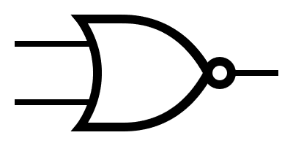
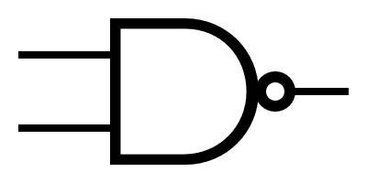
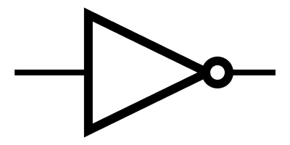

What are synthetic genetic circuits and what can they be used for?

Slide 4
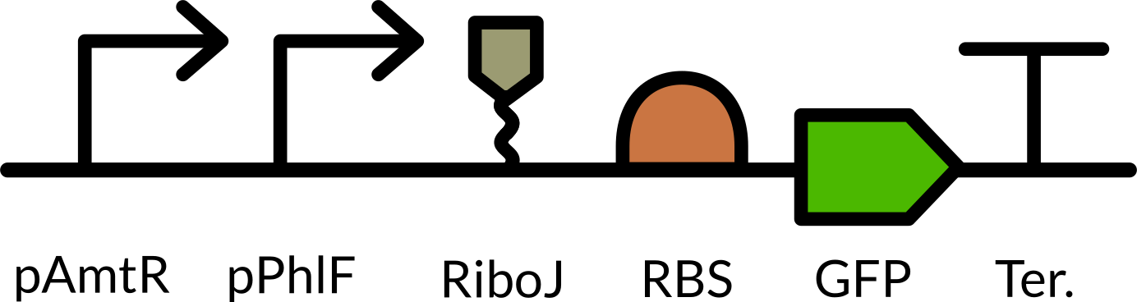
What are synthetic genetic circuits and what can they be used for?

Slide 5



What are synthetic genetic circuits and what can they be used for?

Slide 6

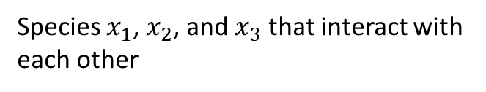


What are synthetic microbial communities?
$$x_{1}$$
$$x_{2}$$
Intentionally designed and assembled microbial communities with a specific composition and purpose in mind
$$x_{3}$$
Species $x_{1}$, $x_{2}$, and $x_{3}$ that interact with each other

Slide 7
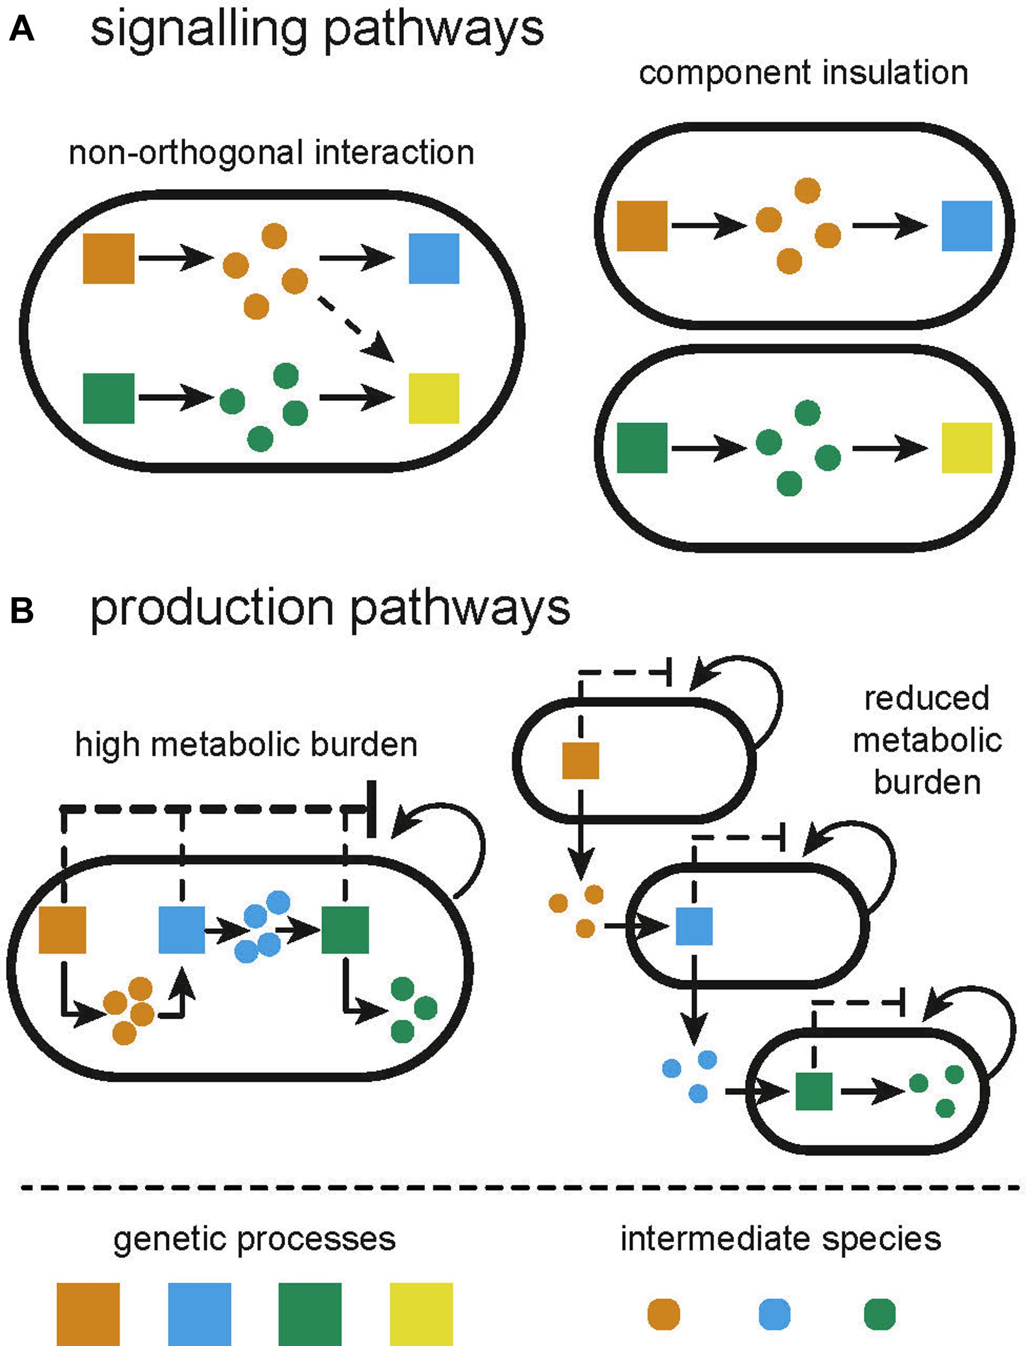
Why not monocultures? Why stable communities?
B. D. Karkaria, N. J. Treloar, C. P. Barnes, and A. J. H. Fedorec, “From Microbial Communities to Distributed Computing Systems,” Front. Bioeng. Biotechnol., vol. 8, 2020, doi: 10.3389/fbioe.2020.00834.
Notes:
- Division of Labor
- Chemical Synthesis of complex
- Less error prone (talk about hazards)

Slide 8
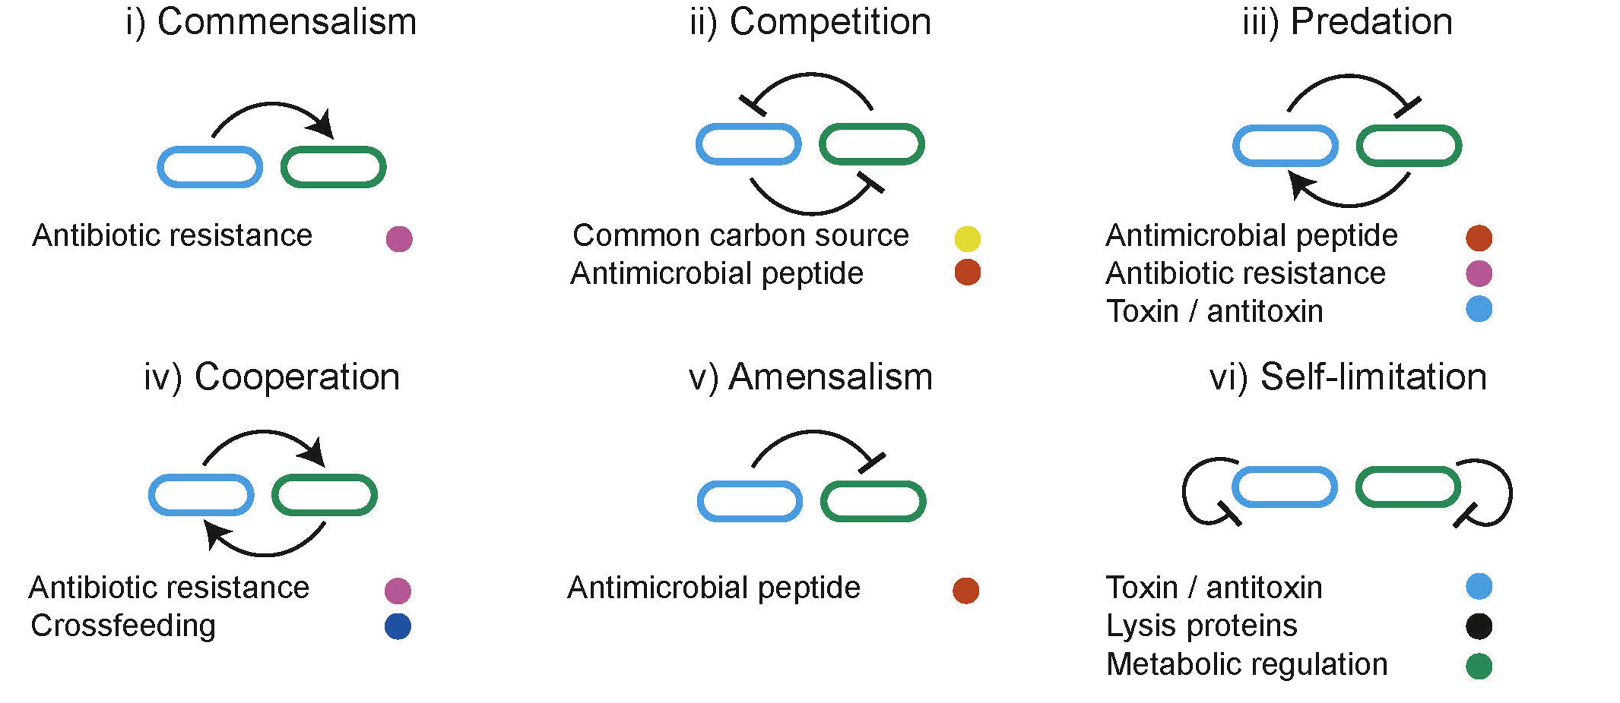
Ecological interactions used to dynamically manipulate resource allocation within co-cultures
B. D. Karkaria, N. J. Treloar, C. P. Barnes, and A. J. H. Fedorec, “From Microbial Communities to Distributed Computing Systems,” Front. Bioeng. Biotechnol., vol. 8, 2020, doi: 10.3389/fbioe.2020.00834.

Slide 9
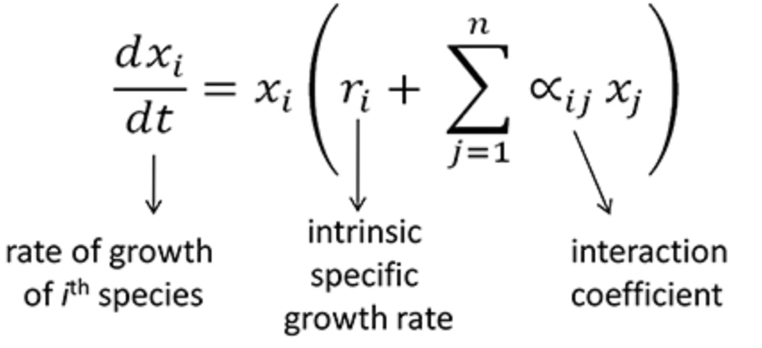
The model
$$x_{1}$$
$$x_{2}$$
$$x_{3}$$
Generalized Lotka-Volterra model

Slide 10

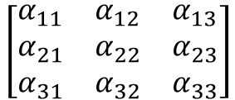

The model
$$x_{1}$$
$$x_{2}$$
$$x_{3}$$
$$\left[\begin{matrix}α_{11} & α_{12} & α_{13} \\ α_{21} & α_{22} & α_{23} \\ α_{31} & α_{32} & α_{33}\end{matrix}\right]$$
We are interested in $p\left(x_{3}\right| x_{1},x_{2}, θ)$

Slide 11
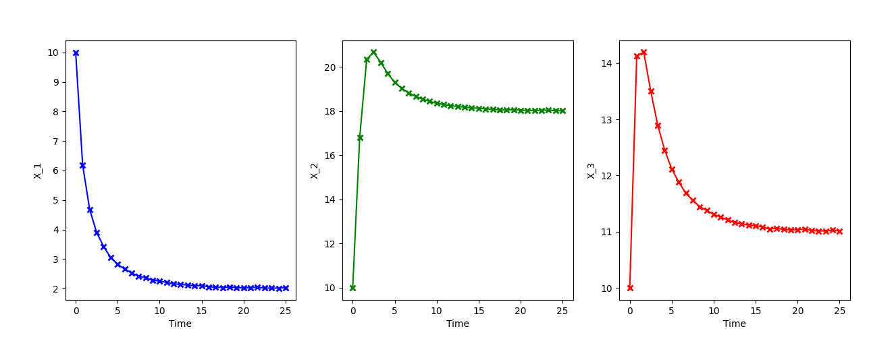
The simulation of Generalized Lotka-Volterra model
Notes:
However, time-series data of the steady state display little about its underlying dynamics, which is a bad scenario for system identification. To excite the system and get “richer” or more informative timeseries data, we apply external perturbations to drive the system and measure its response.

Slide 12





Extended Generalized Lotka-Volterra model (gMLV)
Includes external perturbations
$$x_{1}$$
$$x_{2}$$
$$x_{3}$$

Slide 13
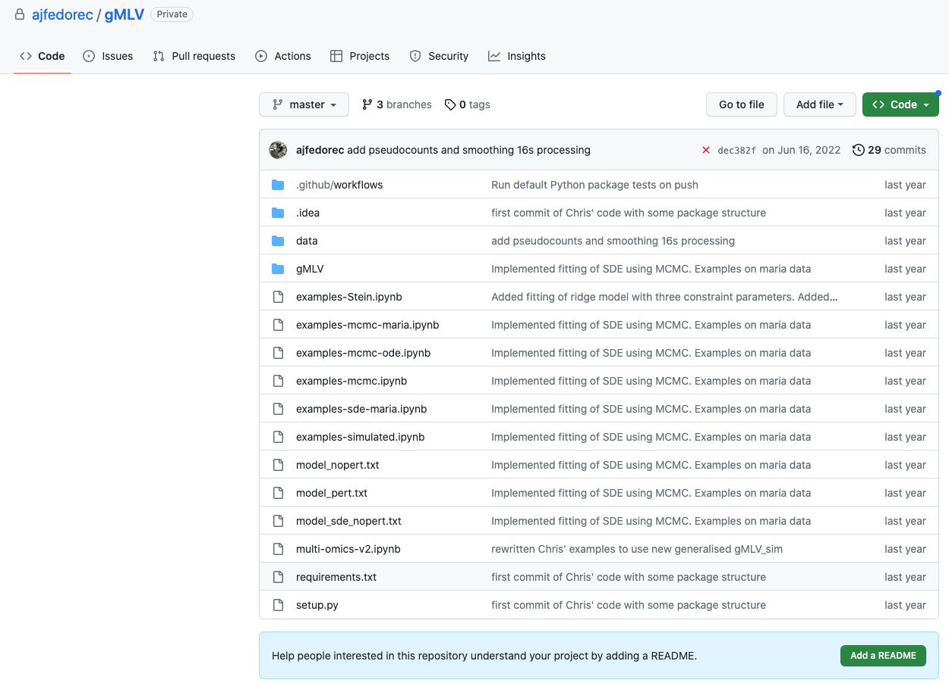
Extended Generalized Lotka-Volterra model (gMLV)
Software package: gMLV
Simulation and inference methods for microbial communities

Slide 14
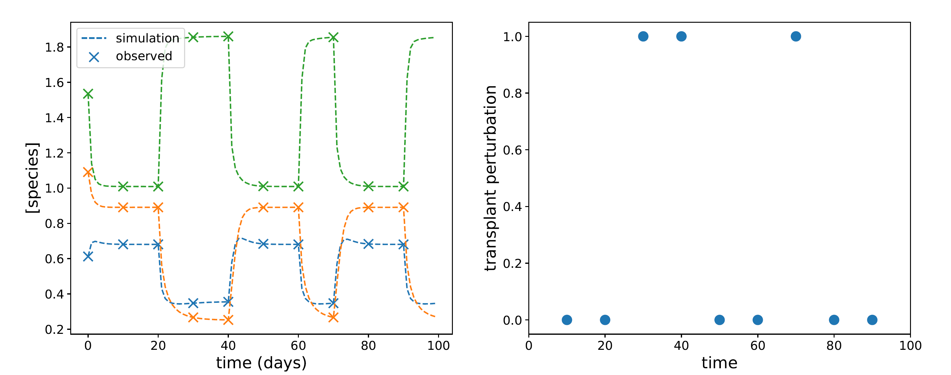
Simulation results of the Extended Generalized Lotka-Volterra model

Slide 15
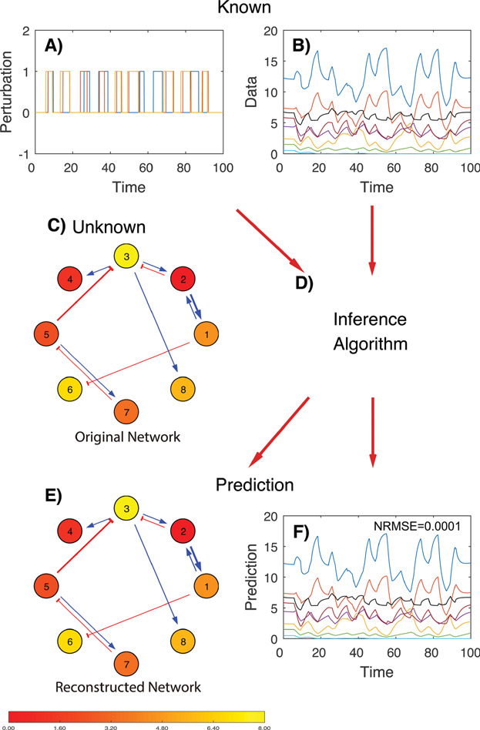
Design
Design stable synthetic bacterial communities
H.-T. Cao, T. E. Gibson, A. Bashan, and Y.-Y. Liu, “Inferring human microbial dynamics from temporal metagenomics data: Pitfalls and lessons,” BioEssays, vol. 39, no. 2, p. 1600188, 2017, doi: 10.1002/bies.201600188.

