Slide 1
Designing Stable Microbial Communities Using Gaussian Processes
Understanding and Designing Systems with Data

Slide 2
Introduction
Brief overview of the presentation
Importance of understanding and designing systems that generate data
The challenge with traditional machine learning models
Notes:
In this presentation, we will discuss the importance of understanding and designing systems that generate data. We will also touch upon the limitations of traditional machine learning models and how we aim to overcome them.

Slide 3
Machine Learning and Its Limitations
Explanation of how machine learning works
Emphasize on its predictive capabilities
Discuss its limitations: lack of interpretability, inability to understand underlying interactions or structures, and not suitable for designing systems with specific outcomes
Talk about to design microbial communities, we need a good model that can predict the types of interactions that are within the community that produce the data
Notes:
Machine learning is a powerful tool for predicting data. However, its models, while complex and accurate, do not provide us with an understanding of the underlying interactions or structures that generate the data. Furthermore, they are not suitable for designing systems with specific outcomes.

Slide 4
Gaussian Processes: An Overview
Definition and explanation of Gaussian processes
How Gaussian processes differ from traditional machine learning models
The balance Gaussian processes strike between capturing complex behaviours and being directly interpretable
Talk about that the first step is to create a model that:
1) predicts or fits to the data well and,
2) is interpretable, so we can understand what the underlying network is
Notes:
Gaussian processes provide a robust method for modelling non-linear functions in a Bayesian nonparametric framework. Unlike traditional machine learning models, they strike a balance between capturing complex behaviours and being directly interpretable

Slide 5
Gaussian Processes for System Understanding
How Gaussian processes can be used to understand a system that generates data
Explanation of how Gaussian processes model non-linear functions in a Bayesian nonparametric framework
Discuss examples of how Gaussian processes have been used to learn ordinary differential equation (ODE) models
Notes:
We can use Gaussian processes to understand a system that generates data. By learning ordinary differential equation models, we can gain insights into the system's behaviour and interactions

Slide 6
Show image that describes the difference between machine learning and GP!
Machine learning is great at predicting data. It does so from learning from data and generating a very complex, albeit non-interpretable, model to be able to predict regressions or classifications with great accuracy. However, these models only use case is to predict new values, but it is not good to understand the underlying interactions or structures that generated the data itself. Furthermore, if we want to use the models to designs systems with specific outcomes, classical machine learning isn't useful. In this project, we will try two things: generate gaussian processes models to accurately model microbial communities interactions and predict their stability, but at the same time also use these models to be able to design even more stable communities. We will do so by decomposing the kernels into simple kernels that are easier to interpret.

Slide 7
Gaussian Processes for System Design
Explanation of how Gaussian processes can be used to design more stable microbial communities
Discuss the concept of vector valued Gaussian processes to capture multidimensional design constraints
Explain how finding the covariance structure of the Gaussian processes that best fits the design objectives can infer how to construct the microbial community to achieve the desired behaviour
Notes:
Gaussian processes can also be used to design more stable microbial communities. By fitting vector valued Gaussian processes, we can capture multidimensional design constraints and infer how to construct the microbial community to achieve the desired behaviour.

Slide 8
AI4 grant: Project Objectives
Objective 1: Developing the Gaussian processes framework for interpretable dynamical system design
Objective 2: Generate a library of stable microbial communities
Notes:
Our project has two main objectives. First, we aim to develop the Gaussian processes framework for interpretable dynamical system design. Second, we plan to generate a library of stable microbial communities

Slide 9
AI4 grant: Project Objectives
Objective 1: Developing the Gaussian processes framework for interpretable dynamical system design
Adapt the "automated statistician" approach, which finds the best combination of GP covariance functions for non-linear regression.
The approach will be adapted to microbial system design by incorporating monotonic flows, developing kernels to capture the correlation between different species, and extending the search procedure to cover communities of up to five species.
Notes:
Our project has two main objectives. First, we aim to develop the Gaussian processes framework for interpretable dynamical system design. Second, we plan to generate a library of stable microbial communities

Slide 10
AI4 grant: Project Methodology
We will use GPs, a robust method for modelling non-linear functions in a Bayesian nonparametric framework.
Vector valued GPs will be fitted to capture multidimensional design constraints, representing microbial communities that are stable, oscillate, or respond to input environmental signals.
The covariance structure of the GPs that best fits the design objectives will be used to infer how to construct the microbial community for the desired behaviour.
Notes:
We will take inspiration from the 'automated statistician' approach, which finds the best combination of Gaussian processes covariance functions for non-linear regression. We will adapt this approach to microbial system design and generate a library of stable microbial communities

Slide 11
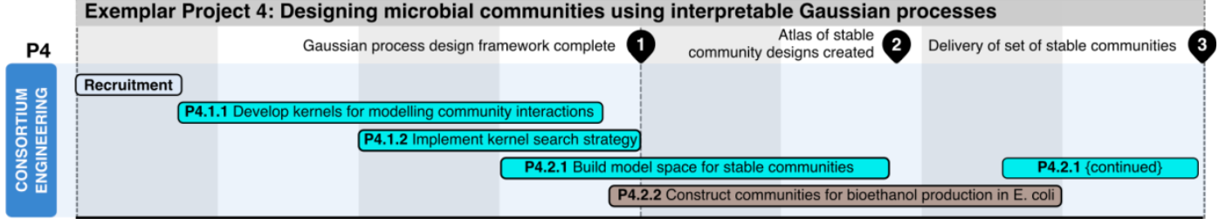
AI4 grant: Project Objectives and Deliverables
Objective 1: Develop the GP framework for interpretable dynamical system design.
Objective 2: Generate a library of stable microbial communities for bioethanol production.
PDRA time: 01.04.22 – 31.01.2024 (22 months)

Slide 12
Expected Outcomes
The project will construct a new library of stable communities to demonstrate the potential of the design approach.
The work will produce an expanded model space of stable communities, serving as an atlas for future biotechnology applications.
The project will provide insights into the design rules of stable communities, such as competition versus cooperation
Notes:
We expect to construct a new library of stable communities and gain insights into the design rules of stable communities. This work will serve as an atlas for future biotechnology applications.

Slide 13
Next Steps
1) Develop a synthetic data generation script
3) Utilize synthetic data to train Gaussian Process (GP) model selection
3) Use kernels to understand the underlying system or the relationship between species
Notes:
Our next steps involves the creation of synthetic data. Synthetic data will help us generate ample data to train our Gaussian Process models and give us a deeper understanding of the intrinsic relationships between different species in our study. This understanding can be used as a benchmark when we begin deploying GPs to interpret the systems.
Key Benefits of the Approach:
Accelerate the GP model training process
Facilitate a better understanding of underlying systems
Enable comprehensive comparison and matching of GPs with the "true" system
This approach will not only streamline and expedite the GP model training process but will also facilitate a more profound understanding of the underlying systems that generate the data. Moreover, it will provide us with the ability to compare and match our Gaussian Process understanding with the actual or "true" system in a comprehensive manner.
-----------------------------------
Produce a script to generate synthetic data. This will not only help us produce a lot of data to which train our gaussian processes models, but also know what is the “true” or “real” underlying relationship between species that generate the data. So when we start to use GPs to understand the underlying systems we can match and compare.
Produce a script to automatically generate the best GP regression that loops for these different variables: different kernels, different latent processes, etc

Slide 14
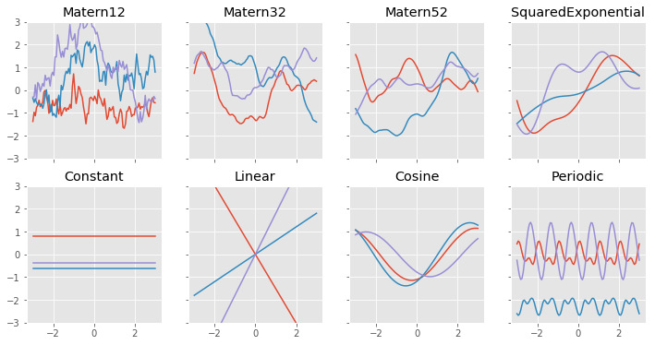
Gaussian Processes Script
Create an automated script to generate the best GP fit using kernel space exploration and dimensions
Loop through different variables: kernels, latent processes, and mean functions
First, through base kernels, then through combinations (by addition and/or multiplication) of kernels [1-3]
Possibly also loop through different likelihoods
Notes:
We will automate the process of GP regression model generation. This script will enable us to iterate through various parameters, such as different kernels and latent processes, to generate the optimal GP regression for our needs.

Slide 15
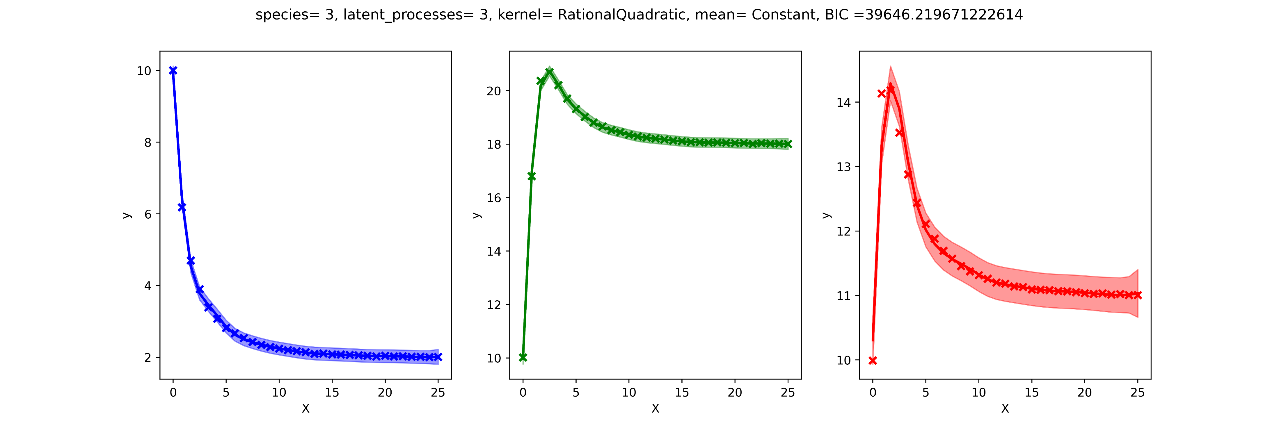
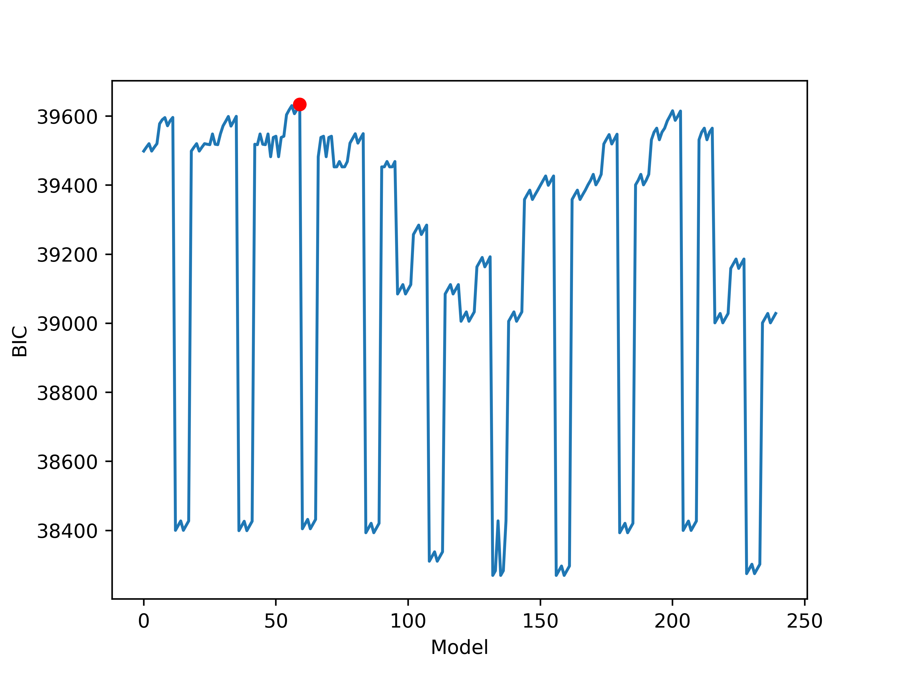
Initial Results

Slide 16
Kernel List
gpf.kernels.SquaredExponential, gpf.kernels.Matern32, gpf.kernels.RationalQuadratic, gpf.kernels.Exponential,
gpf.kernels.Linear,
gpf.kernels.Cosine,
gpf.kernels.Periodic,
gpf.kernels.Polynomial,
gpf.kernels.Matern12,
gpf.kernels.Matern52,
gpf.kernels.White

Slide 17
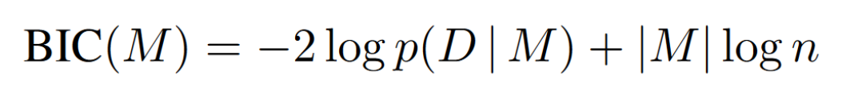
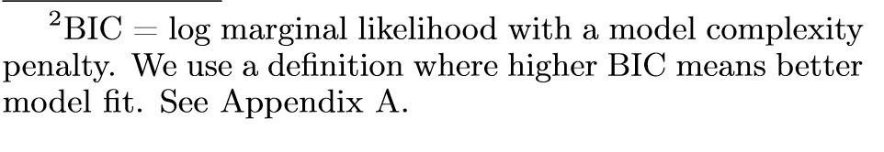
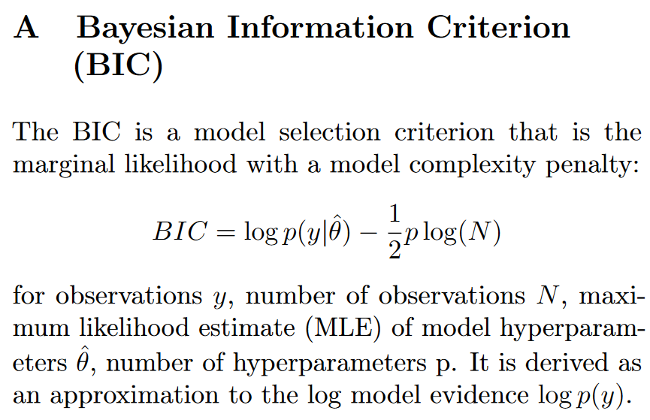
Scoring Models (alternative to BIC?) – LML, CLML, or other
BIC loss
Conditional LML: namely, we show how marginal likelihood can be negatively correlated with generalization, with implications for neural architecture search, and can lead to both underfitting and overfitting in hyperparameter learning. We provide a partial remedy through a conditional marginal likelihood, which we show is more aligned with generalization, and practically valuable for large-scale hyperparameter learning, such as in deep kernel learning. [1]
[1] Lotfi, S.; Izmailov, P.; Benton, G.; Goldblum, M.; Wilson, A. G. Bayesian Model Selection, the Marginal Likelihood, and Generalization. In Proceedings of the 39th International Conference on Machine Learning; PMLR, 2022; pp 14223–14247.

Slide 18
Simulated General Lokta-Volterra using gLMV

Slide 19
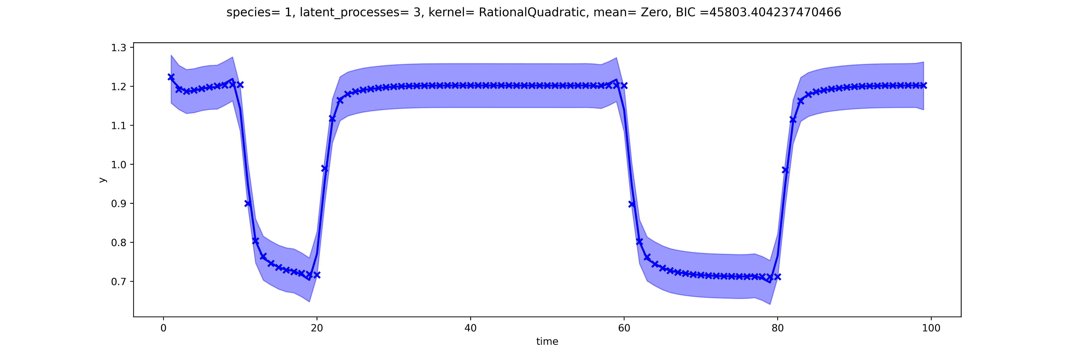
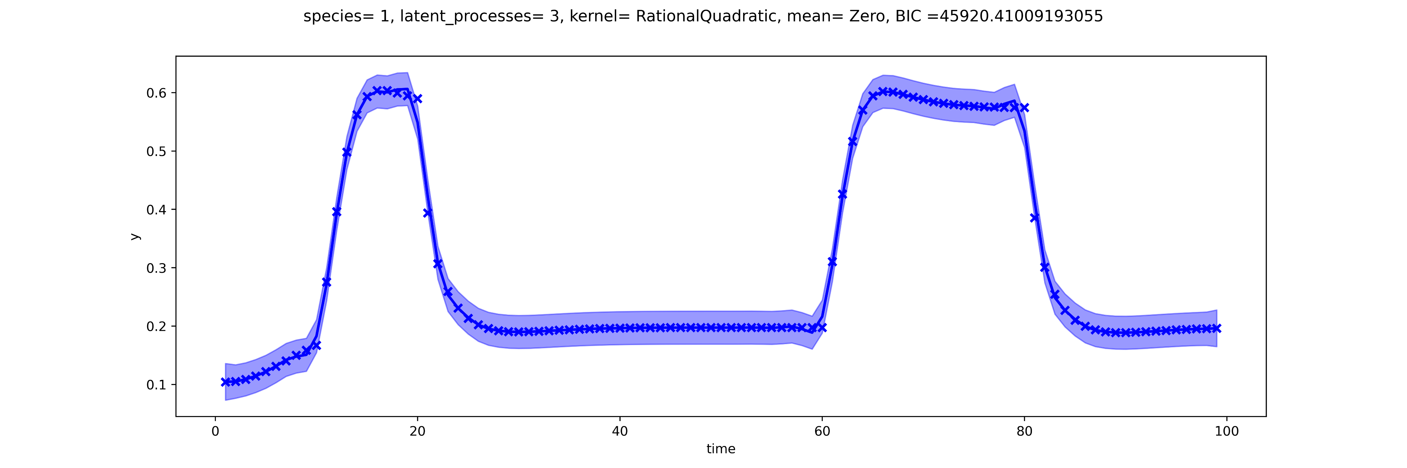
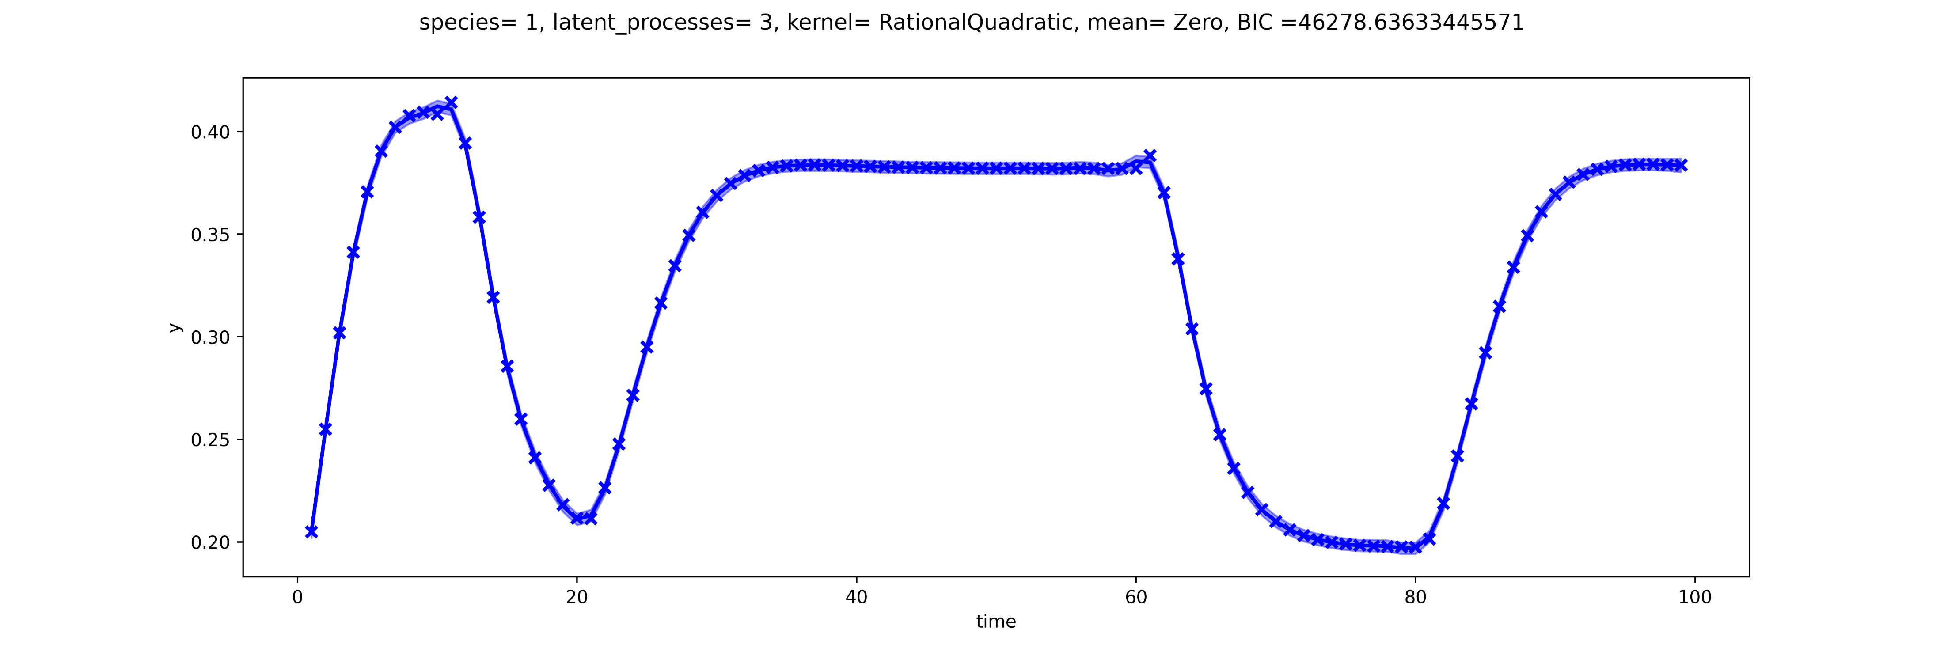
GP fitting using gMLV simulations
Notes:
This fits where done as independent fits (meaning, there is a GP regression fit for each curve) instead of doing the 3 simultaneously as done previously.
USES ALL POINTS instead of sampled (or observed)

Slide 20
Other Questions
Likelihoods
Testing different optimization packages/algorithms
Scipy* vs. lmfit
*Currently using scipy’s minimize optimization using L-BFGS-B method
gpf.likelihoods.Gaussian
gpf.likelihoods.StudentT?

Slide 21
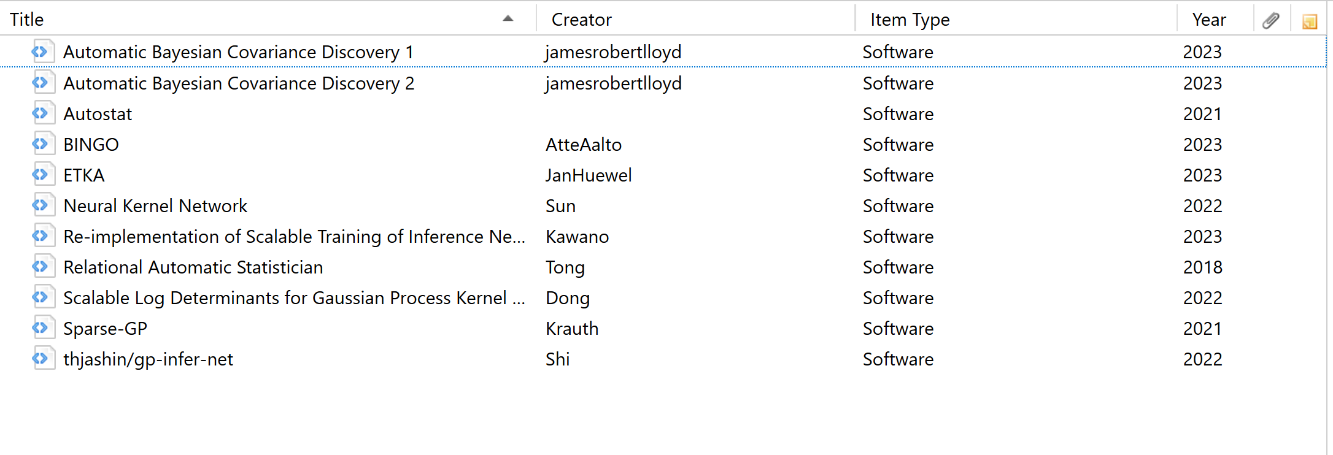
Search for working/recently-updated forks of the many GitHub repositories related to the Automated Statistician.

Slide 22
System learning/identification?

