Slide 1
Cisco Packet Tracer
By: Ivan galabov & aleix Bossa

Slide 2
Table of Contents
Introduction
Devices & Connections
Basic Networking Concepts
Network Services
Routing & VLAN
Simulation
Wrap Up

Slide 3
Purpose of this Workshop
Understand core networking fundamentals
Learn how devices communicate in a network
Gain hands-on practice using Cisco Packet Tracer
Connect concepts from Computer Architecture and Networking (CAN) with practical examples
Build and test small networks in a safe simulation environment

Slide 4
Connection to CAN
CAN covers how computers communicate internally (architecture) and externally (networks)
Shows how hardware components interact with network devices
Reinforces key CAN concepts like addressing, routing, protocols, OSI layers
Helps understand device roles: routers, switches, servers
Link CAN theory with real world examples

Slide 5

What is Cisco Packet Tracer ?
Network simulation and visualization tool from CISCO
Allows to build networks using virtual devices (switches, servers, routers)
Provides real time visualization of packet flow
Interactive environment to configure and test networking concepts
Requires no physical hardware

Slide 6
Why Cisco Packet Tracer?
Makes abstract networking concepts visual and intuitive
Allows to see protocols like ARP, DNS or DHCP in action
Useful for experimenting with:
  IP addressing
  LAN setups
  Networking services
Safe environment

Slide 7
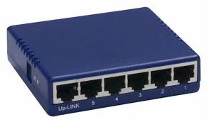
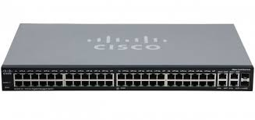
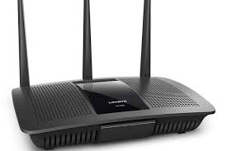
Network hardware
Hubs
  Broadcast data to ALL connected devices
  No understanding of MAC or IP addresses
  Low efficiency, no traffic management
Switches
  Connect devices within the same LAN
  Forward data using MAC addresses
  Traffic goes only to correct destination device
  Faster and more secure than hubs
Routers
  Connect different networks together
  Forward packets using IP addresses
  Determine where each packet needs to go (routing)

Slide 8
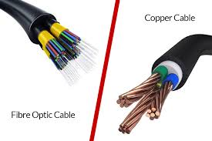
Transmission media
Copper cables
  Most common in LANs
Fiber optic cables
  High speed, long distance connections to routers or switches
Wireless connections

Slide 9
Common Physical Topologies
Star
  All devices connect to a central switch
  Easy to manage and expand
  Failure of one cable does not affect others
Bus
  All devices share one main cable
  Simple but outdated
  If cable breaks it brings network down
Mesh
  Devices are interconnected with multiple paths
  High redundancy level (reliable)
  Large or critical networks (internet)
Ring
  Devices connected in a circular path
  Data flows only in one direction
  Legacy systems

Slide 10
LAN vs WAN
LAN
  Covers small area (building, room, campus)
  Connects devices like PCs, printers
  High speed, low cost, managed privately
WAN
  Large geographical area (cities, countries)
  Connects multiple LANs together
  Slower, high costs, managed by ISP (Internet Service Provider)

Slide 11
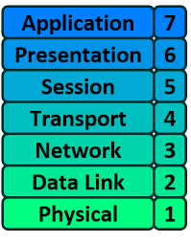
OSI model
Explains how data travels through a network

Slide 12
Address Resolution Protocol (ARP)
Translates IP addresses to MAC addresses
Enables communication within a LAN

Slide 13
Routing Information Protocol (RIP)
Dynamic routing protocol used to share routing information between routers
Allows routers to automatically learn the best paths
Uses hop count to identify the best path
  1 hop = 1 router away
  Max 15 hops

