Slide 1
Mnist
foojiayin

Slide 2
My Model
Layer 1
Layer 2
Layer 3 (fc1)
Layer 4 (fc2)
flatten
dropout
Conv2d
ReLU
Max pool 2d
Conv2d
ReLU
Max pool 2d
Fully connected
ReLU
Fully Connected
SoftMax
Loss function: Cross entropy loss (log loss)

Slide 3
Hyperparameter
Epoch & batch size
Batch size : 50
Epoch: 10 (tensorflow), 20 (pytorch)
Learning rate: 0.01 (pytorch), 1e-4(tensorflow)
No of tensor
Layer 1: 32
Layer 2: 64
Layer 3: 1024
Layer 4: 10

Slide 4
Hyperparameter
Initial weight & bias (tensorflow)
Initial weight: normal distribution of mean 0, std 0.1
Initial bias: 0.1
Conv2d kernel size: 5x5
Maxpooling
Kernel size: 2x2
Stride: 2x2

Slide 5
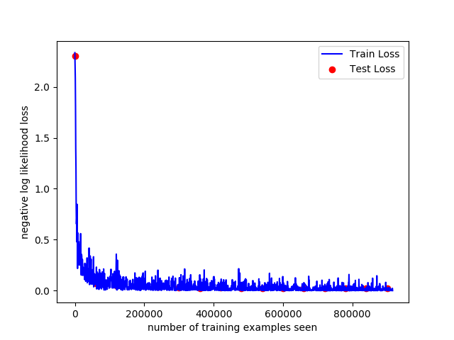
Loss Curve
Accuracy: 99%

Slide 6
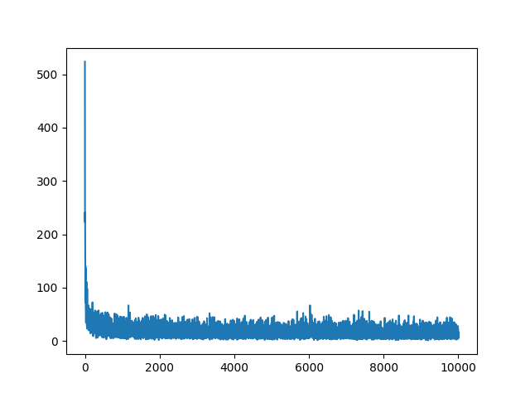
Model with out CNN
Accuracy: 91%

Slide 7
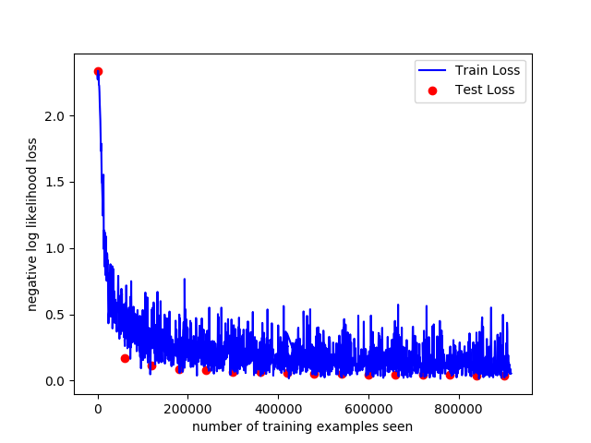
With less tensor
Accuracy: 98%

Slide 8
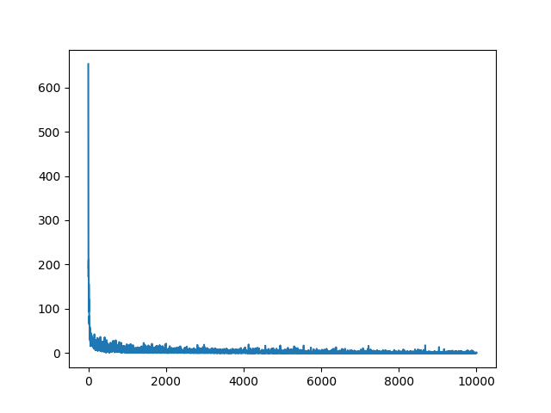
No dropout
Accuracy: 99%

