Slide 1
Final Exercise
TA Time

Slide 2
A - Markov Matrix

Slide 3
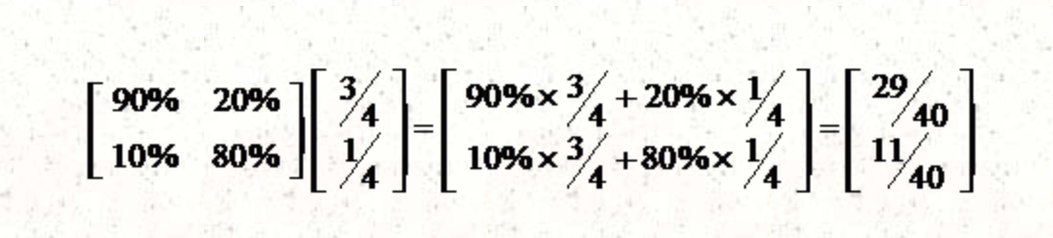

Slide 4
Thought
Keep multiplying transition matrix until:
The first city’s value is equal or below p
The first city’s value is equal or larger than the original value after the operation

Slide 5
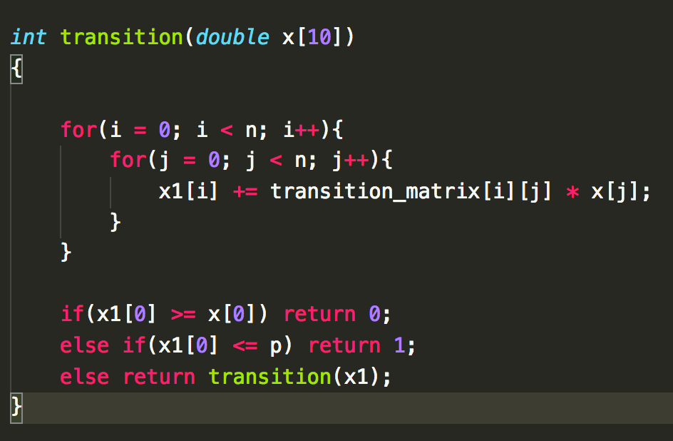

Slide 6
B - Great Depression Again

Slide 7
Sample Input :
10 3 4
TOYOTA 10 100
GM 20 90
FORD 30 80
Volkswagen 40 70
Daimler 50 60
Honda 60 50
Nissan 70 40
PEUGEOT 80 30
FIAT 90 20
BMW 100 10
Sample Output :
BMW
FIAT
PEUGEOT
X + Y <= N
Maximum Value

Slide 8
Instinctively,
Sort by A-B
Produce A
: Middle Point
BMW 200 100
BENZ 100 100
Toyota 100 200
A > B ， Producing only A
Produce B

Slide 9
However, this time we have limited resource. Which means (X + Y) may smaller than N.
(Produce only X type-A and Y type-B)
Sort
X’s
We sort the company that best produce type-A car by the value of A
So far we split the whole list at middle, and get a total value of (X’s+Y’s).
The maximum total value is the best combination.
Sort
Y’s
Same with type-B by value B

Slide 10
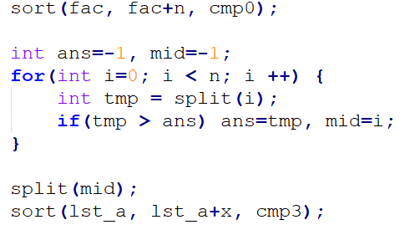
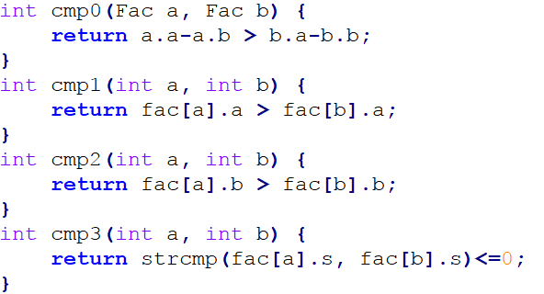
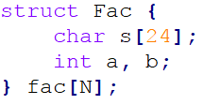
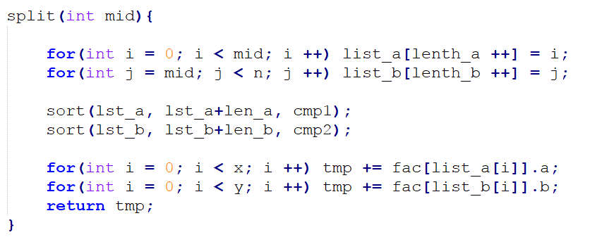
DO NOT DISAPPOINT HIM!!

Slide 11
C - Stable Sort

Slide 12
Definition
When you meet the same value, you will not change their original location
Method
You can use qsort and remember the enter of the order

Slide 13
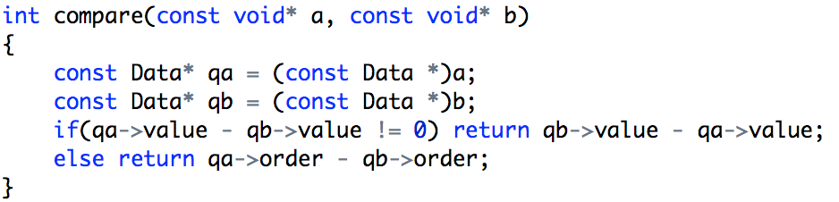

Slide 14
D - Determinant

Slide 15
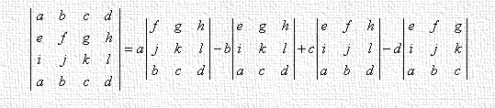


Termination

Slide 16
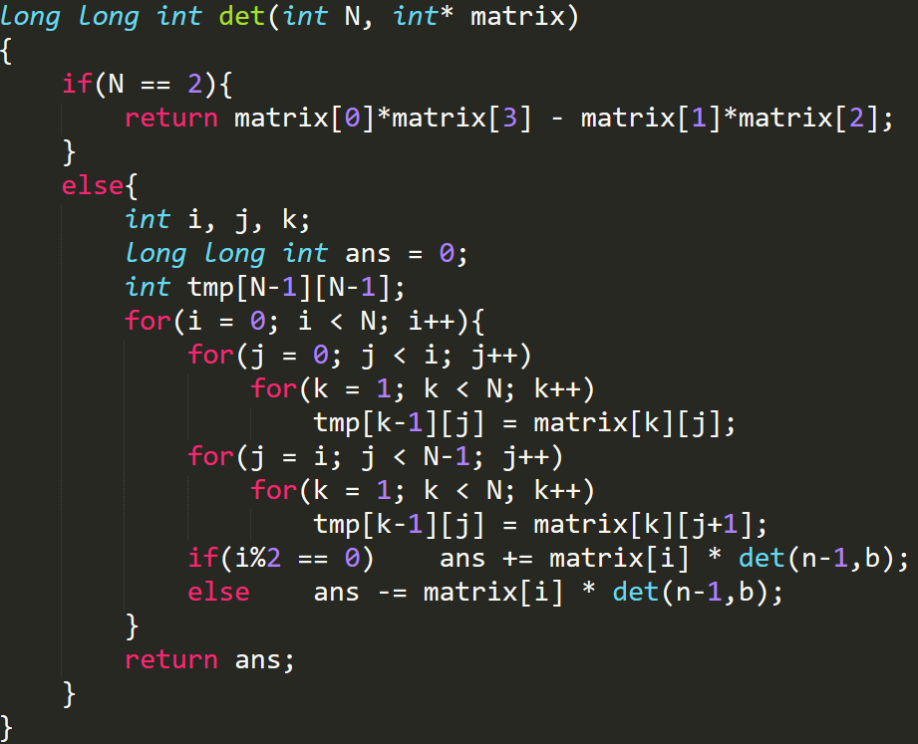

Slide 17
E - Reverse Linked List

Slide 18
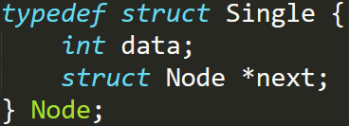

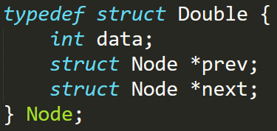

Slide 19

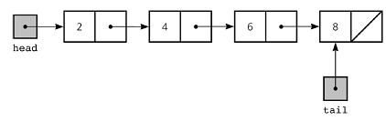


Slide 20
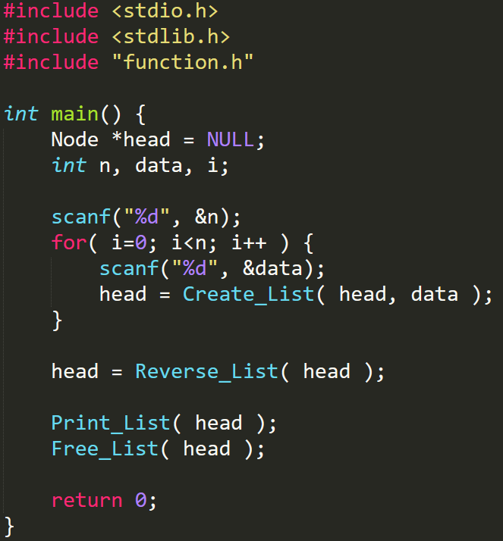

Slide 21
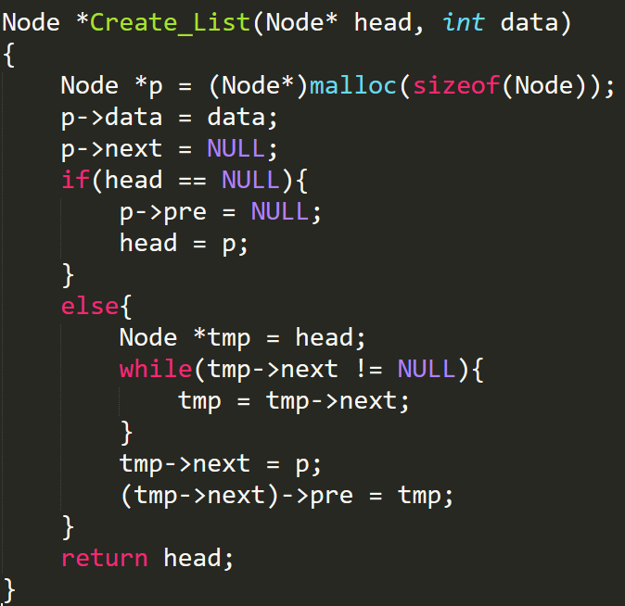
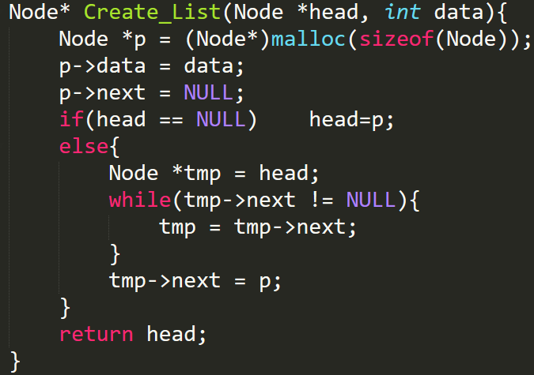
Create List

Slide 23
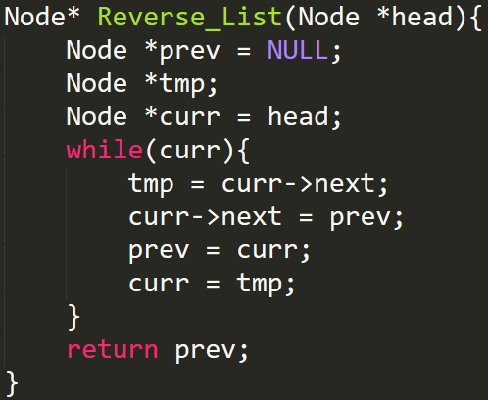
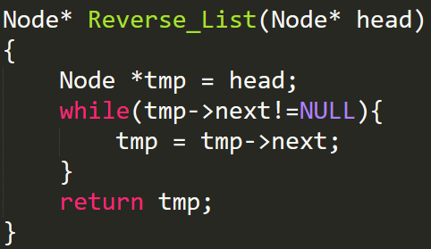
Reverse List

Slide 25
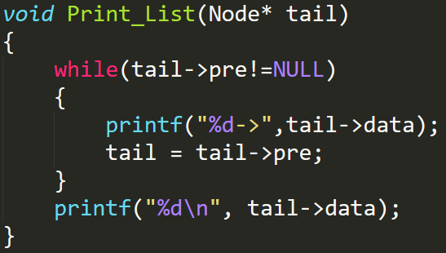
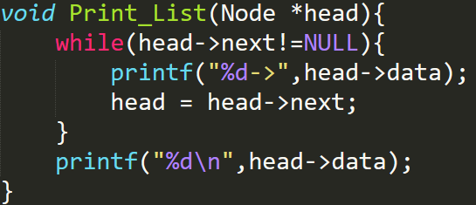
Print List

Slide 27
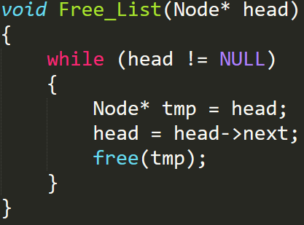
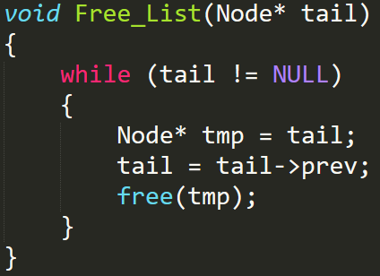
Free List

Slide 28
F - Bipartite Graph

Slide 29
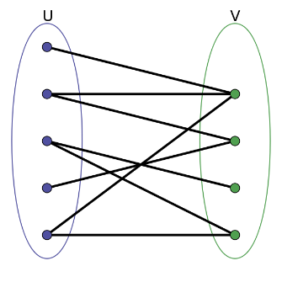
Definition
All vertices can be divide into two disjoint and independent sets U and V
such that every edge connects a vertex in U to one V

Slide 30
Method - Coloring
Any two adjacent vertices need to have different color
1
1
2
2
4
3
3
4

Slide 31
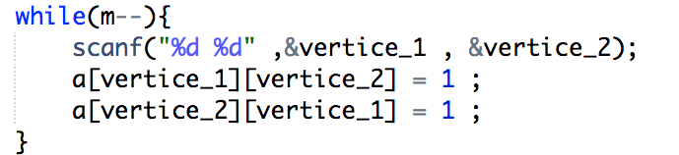
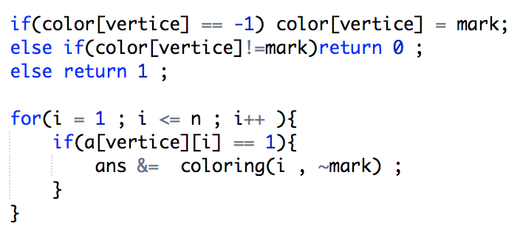

Slide 32
G - XOR

Slide 33
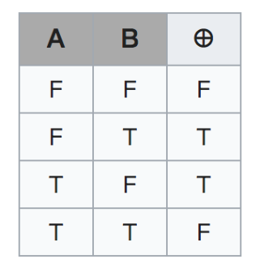
XOR
Exclusive or
Example
0101 xor 0011 = 0110 (Decimal 6)
0010 xor 1010 = 1000 (Decimal 8)
True table

Slide 34
SUM = ( a1 ^ k ) + ( a2 ^ k ) + ... + ( an ^ k )
SUM is minimum
Sample Input : 1 2 3 4 5 6
001^k + 010^k + 011^k + 100^k + 101^k + 110^k = SUM
Sample Output : 21
Another example: 0 1 1 1 1
0^1 + 1^1 + 1^1+ 1^1+ 1^1
Sample Output : 1

Slide 35
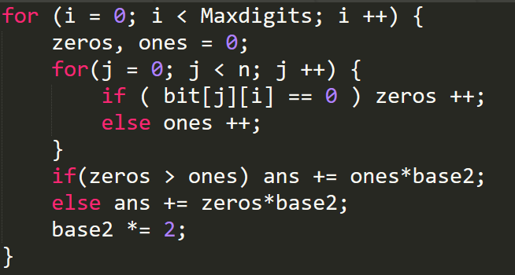

Slide 36

Thanks~

