Slide 1
Midterm Exercise
TA Time

Slide 2
Before
Lab
Lab 2 第三題
偏難，因為有特殊的測資 (Sorry!)
以後 Lab難度
Lab 2 第二題
Homework
不計分，難度會比 Lab 更難，會含有一些特殊測資
TLE, WA
注意測資的範圍
代表著一定有更好的方法
TA Time: 今日 8:30 ~ Delta 614

Slide 3


Slide 4
The number of occurrences
Statement
Find the maximum number of occurrences
Sample Input
12
4
12112212
12121212
111222
12112
Sample Output
4

Slide 5
The number of occurrences
Hint
可以用 strlen(A) strlen(B) 取得A與B的長度
跑過每個 B 的 index, 並從每個index出發, 看是否成功找到 A
計數總共找到幾組A
找出最大值

Slide 6
Progression
Statement
Judge whether input is Arithmetic Progression or a Geometric Progression
Print out the first number and the 5th number
Sample Input
2 -4 8
Sample Output
-1 -16

Slide 7


Slide 8
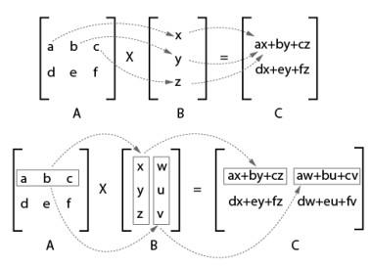
Matrix Multiplication
Statement
Compute C = A × B, where A, B and C are matrices of size n × m, m × p, and n × p, respectivily.
Sample Input
1 1 1
814
819
Sample Output
666666

Slide 9
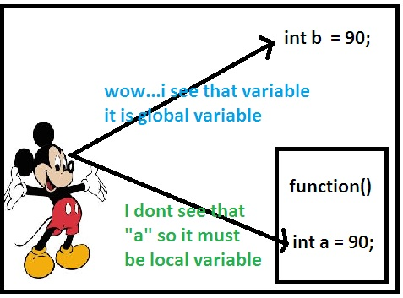
Matrix Multiplication
Hint
3 level for loop
Aware of variable range
For data set #4, 1 ≤ n, m, p ≤ 100 and |aij|, |bij| ≤ 10000.
Declare 2D-Array as global variable(討論區164256)
100*10000*10000 = 10¹⁰ > 10⁹
(-2,147,483,648 to 2,147,483,647 for int range)
It will not be your testcase forever at Lab in the future

Slide 10
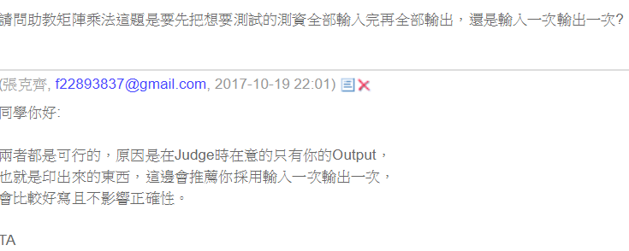

Slide 11
Simple integer sorting
Statement
List items in increasing order
Sample Input
5
4 5 3 1 2
Sample Output
1 2 3 4 5

Slide 12
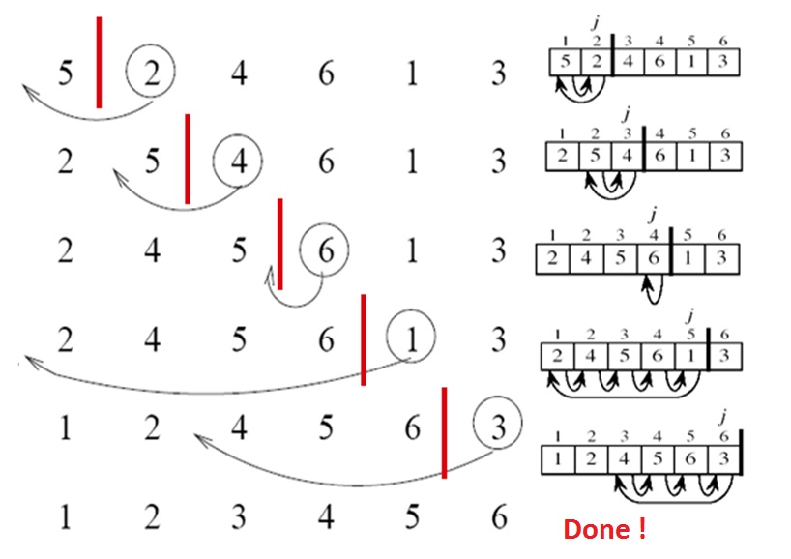
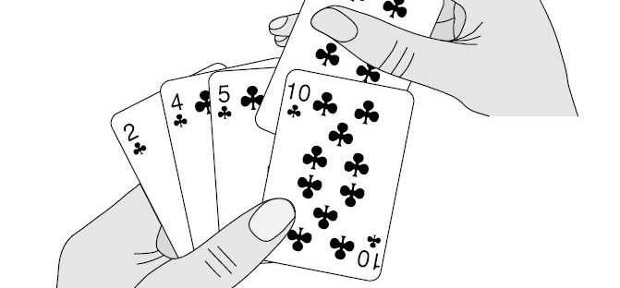
Simple integer sorting
Insertion Sort
goo.gl/nNwKCH

Slide 13
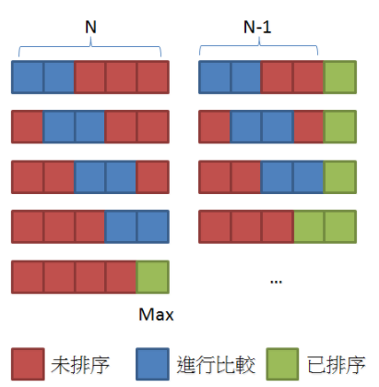

Simple integer sorting
Bubble Sort
Flag
goo.gl/WJZ7iL

Slide 14
Pa – Arranging a Sequence
Description
Maintain a sequence that when you input a number , the number will go to the first position of the sequence and you need to print out the sequence when the input end
Concept
When taking the assigned number to the first place, others after it will forward one place.
The last input will be the first output number

Slide 15





1
2
3
4
5
6
4
4
3
3
4
5
5
3
4
2
2
5
3
4
1
6

Slide 16
Pa – Arranging a Sequence
Implementation
Maintain an array, store the number which we want to pick it to the first
From the last to the first , maintain an array if the number doesn’t appear print it
From the first to the last , if the number didn’t change the position , print it out

Slide 17
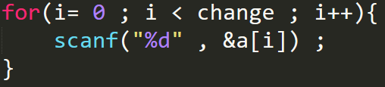
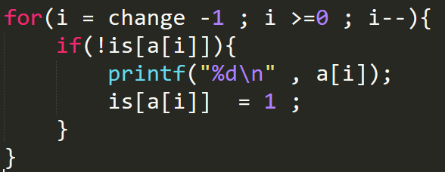
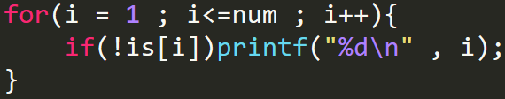

Slide 18
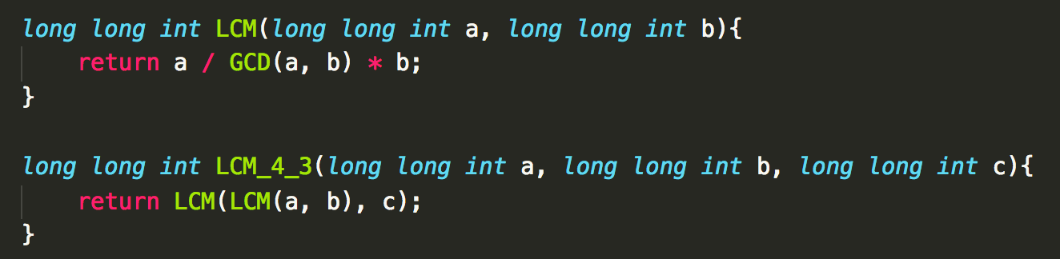
pB – Birthday Party
long long int
LCM(GCD between x, y, z and ponies)

Slide 19
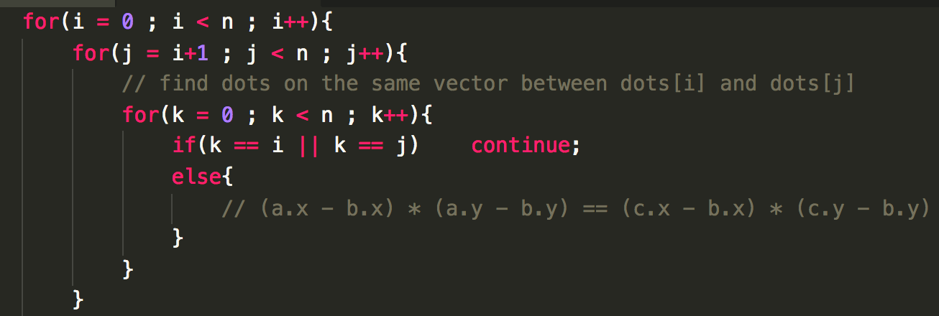

pC - Collinear
3 finite loops to compare any 2 points with the rest points

Slide 20
PD – Distrait
Description
Judge that if you can bingo or not , if you can , print which step we will bingo , if not , print Not yet \(^o^)/
Concept
Every time you can search whether you can bingo or not
Remember the row and column of the input number and only test this row and column

Slide 21
23 | 20 | 14 | 12 | 17
1 | 3 | 5 | 9 | 19
2 | 16 | 18 | 25 | 21
4 | 6 | 7 | 8 | 22
10 | 11 | 13 | 15 | 24

Slide 22
PD – Distrait
Implementation
Recall the index of the input data
Judge that if the number we give will make the bingo condition satisfied

Slide 23
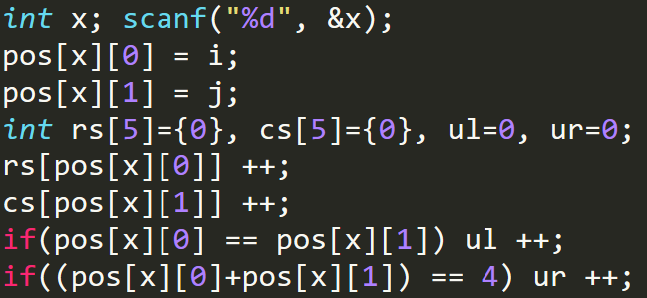

Slide 24
pE – Exquisite Substrings
String S - “PlayerUnknowns BattleGrounds”
A Substring of a string S is a string S’ that occurs in S.
For example, “BattleGrounds” is a substring (S’).
The list of all substrings of the string “Dude” would be
“Dude”, “Dud”, “ude”, “Du”, “ud”, “de”, “D”, “u”, “d”, “e”.

Slide 25
pE – Exquisite Substrings
A palindrome is a word, phrase, number, or other sequence of characters which reads the same backward as forward, such as AAAA or DudeduD.
In problem 11621 :
HT discovered that for some special string s, he could find
two distinct indices l and r such that if he reverses the
substring s[l, r]

Slide 26
pE – Exquisite Substrings
Input :
abcd
abab
aaaaa
Output:
0
2
10

Slide 27
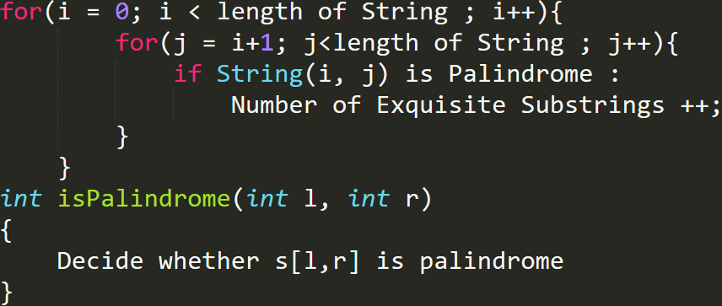
pE – Exquisite Substrings
Solution

Slide 28
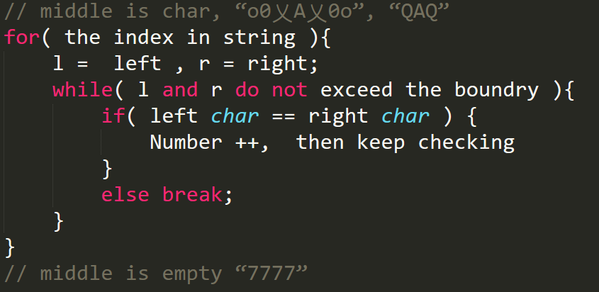
pE – Exquisite Substrings
Solution

Slide 29

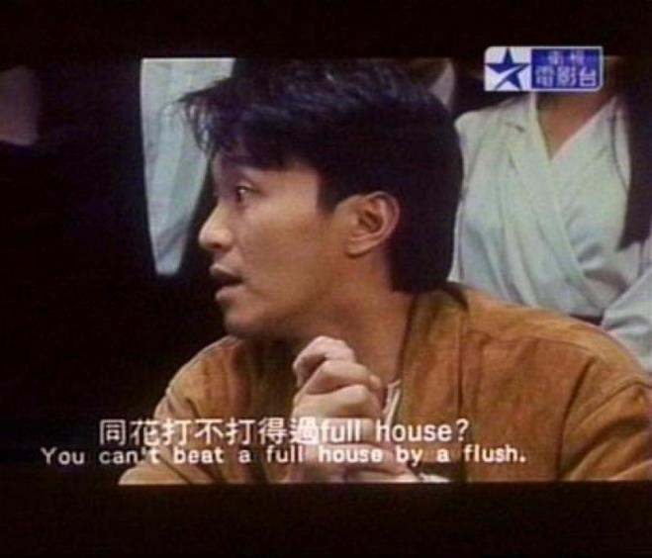
pF – Full House
For those who do not know what full house is :
https://zh.wikipedia.org/wiki/赌侠

Slide 30
pF – Full House
Output :
NO
NO
YES
YES
YES
Input :
5
2 3 4 5 6
2 2 2 2 A
3 3 3 4 4
2 A 2 A 2
3 3 2 2 2
Note that cards include A, 2, …, 10, J , Q , K

Slide 31
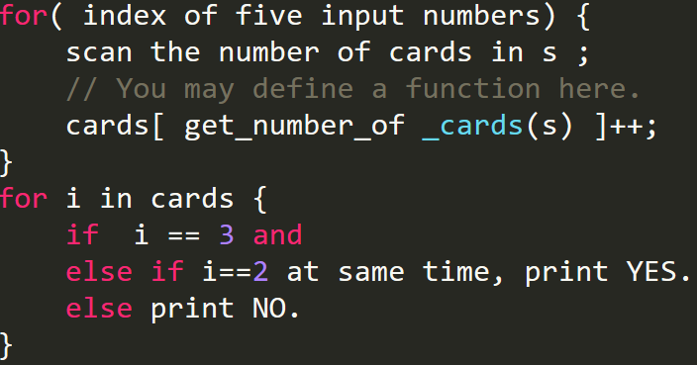
pF – Full House
Solution 1

Slide 32
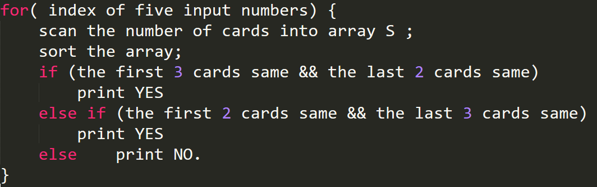
pF – Full House
Solution 2

