Slide 1

如何从课本中获取题目答案
How to Retrieve Answers from Textbooks
定位证据 / Retrieve evidence
抽取答案 / Extract answer
核验支持 / Verify support
CHENBAO · MATHEMATICAL MODEL / 数学建模
01 / 13
Notes:
中文讲稿 / Chinese notes
本报告只回答一个问题：给定课本与题目，怎样找到可核验的答案。用 q 表示题目，τ 表示题型，C_u 表示限定单元内的教材文本，e* 是最佳证据，a* 是答案。整个任务依次经过证据定位、答案抽取和证据核验。后面的公式分别刻画这三步。
English notes
This talk addresses one problem: given a textbook and a question, how do we find a verifiable answer? Let q be the question, τ its task type, C_u the textbook corpus in scope, e* the best evidence, and a* the answer. The process has three stages: evidence retrieval, answer extraction, and support verification.

Slide 2
成功不是“搜到一句话”
Success is more than finding a similar sentence
成功概率分解
Chain-rule decomposition
R
×
K
×
A
×
H
召回 / Recall
排序 / Rank
抽取 / Extract
支持 / Support
任一环节失效，端到端答题即失败 / One failed stage breaks end-to-end success
02 / 13
Notes:
中文讲稿 / Chinese notes
这条式子是概率链式法则，不是经验近似。R 表示正确证据进入候选集；K 表示它在已召回条件下排到可用位置；A 表示从它抽出正确答案；H 表示证据确实支持答案。用条件概率相乘，是为了把“搜不到”与“搜到了但抽错”分开诊断。它也解释了为什么优化单句相似度不足以保证答题成功。
English notes
This is the probability chain rule, not an empirical approximation. R means the correct evidence enters the candidate set; K means it is ranked usefully given retrieval; A means the answer is extracted correctly; H means the evidence supports that answer. The conditional product separates retrieval failure from extraction failure. Improving sentence similarity alone cannot guarantee success.

Slide 3
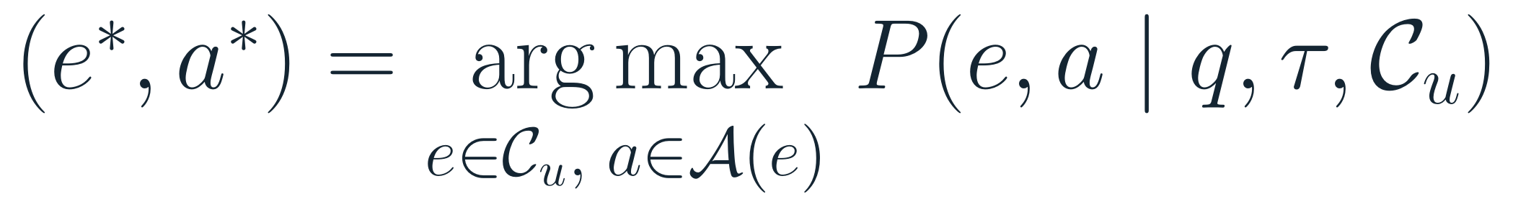
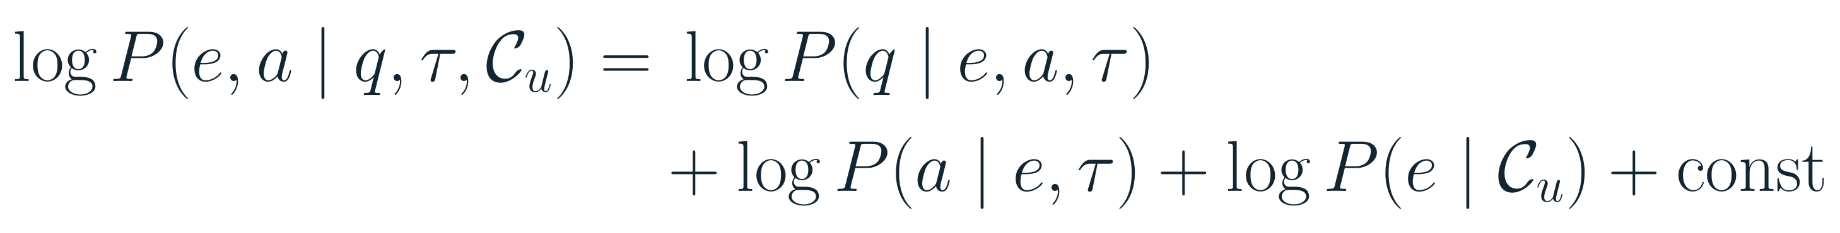
答案与证据联合推断
Joint inference over answer and evidence
目标解
Target solution
贝叶斯分解
Bayesian factorization
题证似然 × 答案可抽取性 × 教材范围先验 / Evidence likelihood × extractability × corpus prior
目标形式；非已校准概率 / Target form; not calibrated probabilities
03 / 13
Notes:
中文讲稿 / Chinese notes
这是把题目、答案和出处作为联合未知量的最大后验估计。第一项似然评价教材证据与题干是否相容；第二项评价候选答案是否能由证据中抽出；第三项是教材范围先验。取对数后，联合乘积变成加和，便于解释成不同证据来源的贡献。注意：这是目标形式化。当前应用采用启发式分数排序，未训练或校准成这些概率。
English notes
This is a maximum-a-posteriori objective with the answer and source evidence treated as joint unknowns. The likelihood measures compatibility with the question; the answer term measures extractability; the corpus prior represents the selected textbook scope. Taking logs converts products into additive contributions. This is a target formulation: the current app uses heuristic scores and does not estimate calibrated probabilities.

Slide 4
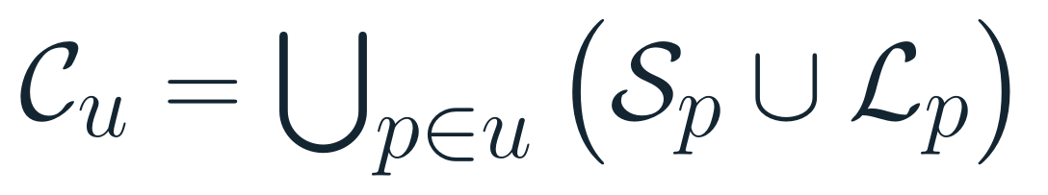
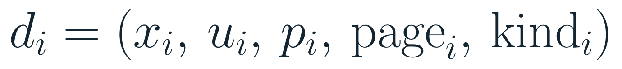
课本不是平面字符串
A textbook is structured evidence
层级切分
Hierarchical units
课本 / Book
→
单元 / Unit
→
段落 / Paragraph
→
句子 / Sentence
+ 列表 / List
文本 + 单元 + 页码 + 父段 + 结构类型 / Text + unit + page + parent + structure type
04 / 13
Notes:
中文讲稿 / Chinese notes
教材索引保留句子与列表等不同证据单元，并关联原始文档、单元、页码和文本位置。d_i 不是只有文字 x_i 的字符串，而是带有 u_i、page_i、parent_i、kind_i 的结构化对象。父段上下文有助于避免只截取孤立句；列表单元则服务于分类题和多项填空。这里强调建模粒度，不是在说每个原书段落都已被完美识别。
English notes
The textbook index retains different evidence units, including sentences and lists, together with source, unit, page, and text position. A document d_i is not only text x_i; it also carries unit, page, parent-context, and structure type. Paragraph context helps prevent isolated snippets, while list units support classification and multi-item questions. This describes the representation, not a claim that every paragraph boundary is perfect.

Slide 5
题干是原文的变换
A question is a transformed view of source text
出题生成过程
Question-generation model
挖空
改写
翻译提示
分类 / 列表
Mask
Paraphrase
Translation cue
Class / list
检索要逆转变换，不只找整句复现 / Invert the transformation; do not require exact-sentence overlap
05 / 13
Notes:
中文讲稿 / Chinese notes
令 x 为原文段落，a 为答案，τ 为题型。挖空、改写、翻译提示、分类列表会对原文做不同变换，ε 表示题面带来的干扰或省略。该式是出题过程的抽象生成模型，不意味着我们知道具体出题算子。它解释了无完全相同原句时仍可能从教材结构中找到答案。题型应影响候选检索与抽取方式。
English notes
Let x be the source passage, a the answer, and τ the question type. Blanking, paraphrasing, translation clues, and list/classification tasks transform the source in different ways; ε captures omitted or noisy wording. This is an abstract generative model, not a claim that the exact exam transformation is known. It explains why answers may be recoverable even without an identical sentence.

Slide 6
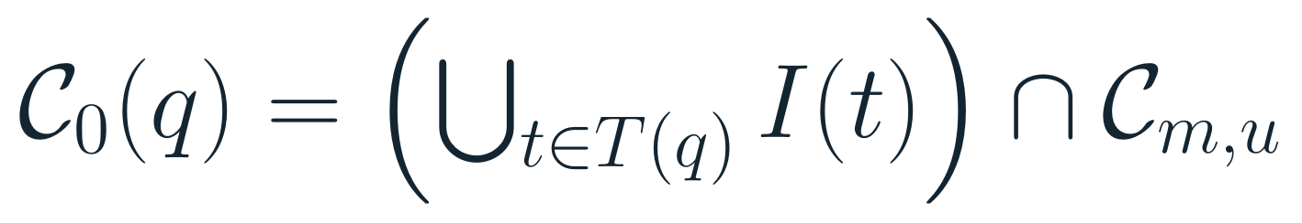
限定范围，再召回候选
Constrain the corpus, then retrieve candidates
来源 / 单元约束
Source / unit scope
倒排索引召回
Inverted-index retrieval
稀疏补召回：字符三元组
Sparse fallback: character trigrams
06 / 13
Notes:
中文讲稿 / Chinese notes
先用模式 m 与单元 u 缩小资料范围；Unit All 对应所有可用单元。倒排索引 I(t) 把词项直接映射到含词文本单元，查询词 postings 的并集构成初始候选，再和选定范围相交。当词面命中稀少时，当前实现扫描范围内的字符三元组 Dice 近邻作为补充，最多保留 240 个、相似度阈值大于 0.08。这样把高速精确召回与有限模糊回退组合起来。
English notes
First restrict the corpus by mode m and unit u; Unit All means all available units. The inverted index I(t) maps a term to text units containing it. The union of query postings is intersected with the selected scope. If lexical matches are sparse, the implementation supplements them with character-trigram Dice neighbors within scope, up to 240 candidates above 0.08 similarity. This combines fast lexical recall with bounded fuzzy fallback.

Slide 7
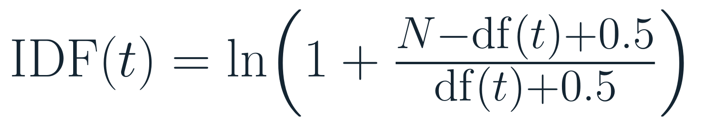
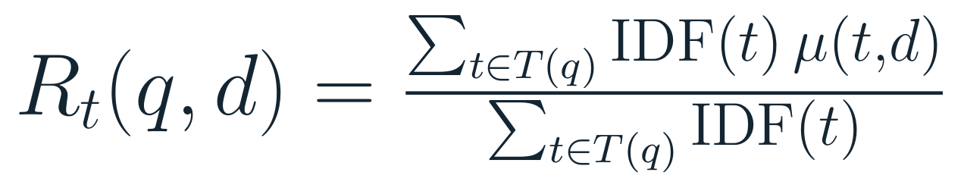
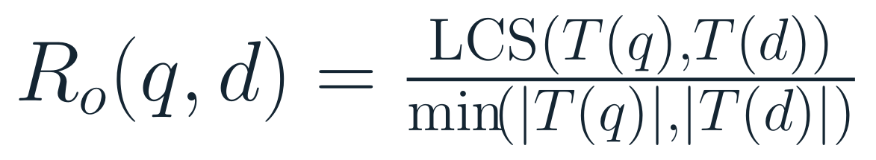
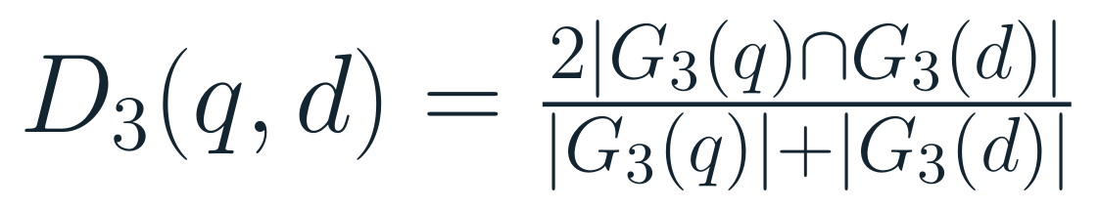
候选证据的相似度特征
Similarity features for candidate evidence
稀有词加权覆盖
IDF-weighted lexical coverage
词序 / Token order
字符三元组 / Character trigrams
覆盖回答“有哪些词” · 词序回答“顺序像不像” / Coverage asks what matches · order asks how it aligns
07 / 13
Notes:
中文讲稿 / Chinese notes
IDF 让全库少见的词比常见词更有区分度。R_t 是带 IDF 的覆盖率，μ 对精确词形取 1，对可接受近似词形取折扣值；R_o 用最长公共子序列衡量顺序保留程度；D_3 衡量字符三元组集合的 Dice 相似度。S_0 组合覆盖、顺序、字形和来源先验。普通检索使用 50/25/20 的词、序权重，填空检索使用 45/20/20；这些是手工启发式分值，不是可解释为概率的估计。
English notes
IDF gives globally rare terms more discriminative weight. R_t is IDF-weighted coverage; μ is 1 for exact terms and discounted for accepted near forms. R_o uses the longest common subsequence to measure order preservation, and D_3 is Dice similarity over character trigrams. S_0 combines coverage, order, spelling, and source prior. Ordinary and fill-in queries use different hand-set weights; these scores are heuristic ranks, not probabilities.

Slide 8
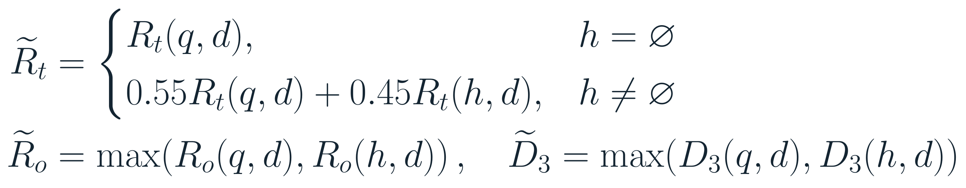
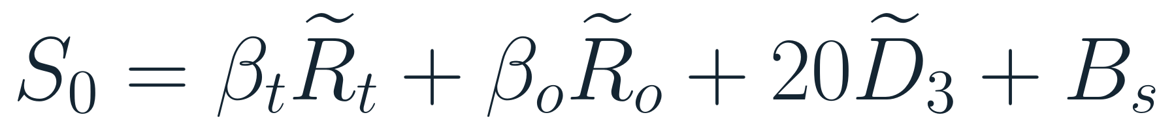

多路证据联合排序
Fuse evidence signals into a ranked score
附加原文提示 h
Optional source-text clue h
启发式融合分数
Heuristic composite score
一般题 / Ordinary: (50, 25) 填空 / Fill-in: (45, 20)
08 / 13
Notes:
中文讲稿 / Chinese notes
有附加原文提示 h 时，词项覆盖把题干与提示分别加权为 0.55 和 0.45；词序与字符相似度取题干或提示中更高的一项。若没有 h，则词项覆盖只使用题干。之后把覆盖、顺序、三元组 Dice 与来源先验相加。一般查询系数为 50、25、20；填空题系数为 45、20、20。填空分数还减去缺失长锚点惩罚，并设下限为词面覆盖分。所有权重是启发式超参数，便于排序，但不能解释成概率。
English notes
With an optional source-text clue h, lexical coverage blends the question and clue at 0.55 and 0.45; order and character similarity use the stronger signal. Without h, only the question is scored. Coverage, order, trigram Dice, and source prior are then combined. Ordinary queries use weights 50, 25, 20; fill-in queries use 45, 20, 20. Fill scores subtract a missing-anchor penalty but are floored by lexical coverage. These are heuristic ranking parameters, not probabilities.

Slide 9

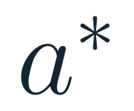

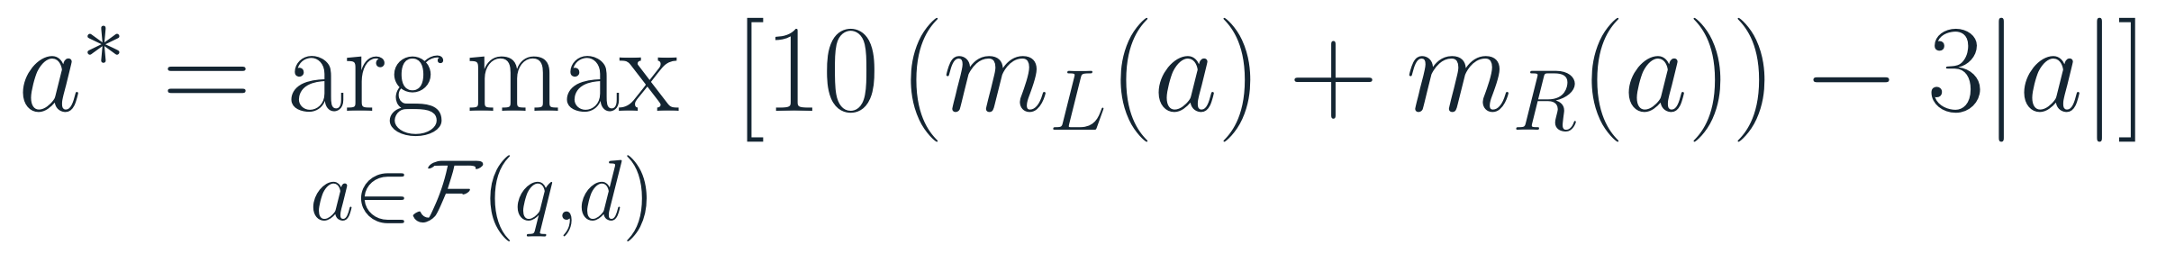
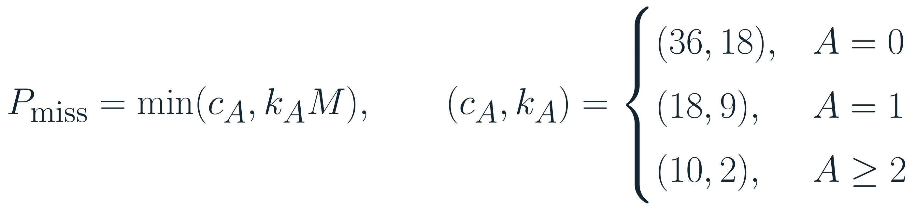
填空答案是受约束的跨度
A blank answer is a constrained text span
左右锚点对齐
Align left and right anchors
左锚点 / Left anchors
→
候选跨度 / Answer span
→
右锚点 / Right anchors
长锚点缺失惩罚
Penalty for missing long anchors
09 / 13
Notes:
中文讲稿 / Chinese notes
填空不是对整句打分后直接复制，而是先在候选证据中找左右锚点之间的可行跨度集合 F。匹配更多左右锚点会提高目标函数；跨度越长则扣分。当前代码每侧最多匹配 4 个锚点词，答案跨度限制为 1–8 词，锚点间隔上限通常为 12 词。对题干中长度至少 5 的锚点再计算缺失惩罚：匹配锚点越少，惩罚越重；这是为了避免上下文只共享泛词。边界空格有单独处理。
English notes
The system does not simply copy a whole high-scoring sentence. It finds feasible spans F between left and right anchors. More matched anchors raise the objective, while longer spans are penalized. The current code uses up to four anchor words per side, limits answers to 1–8 words, and usually caps the anchor gap at 12 words. Missing long anchors incur stronger penalties when few anchors match, reducing false positives from generic context words. Leading and trailing blanks have separate handling.

Slide 10
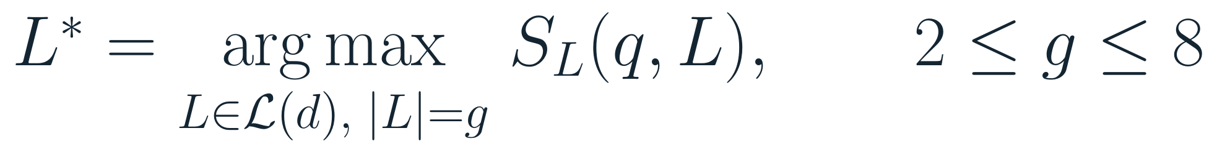
列表答案按结构抽取
Extract list answers as structured sets
题目空格数约束列表长度
Question cardinality constrains list length
c：提示词 / cue hits
s：主题重合 / shared topic terms
b：标题桥接 / heading bridge
ℓ：字面线索 / literal cue Bₛ：来源先验 / source prior
10 / 13
Notes:
中文讲稿 / Chinese notes
列表题不要求教材复现与题干完全相同的句子。将答案建模为列表 L，并以空格数量 g 约束 |L|=g。主题提示词与列表引导语或邻近主题建立联系；列表评分组合提示词重合 c、主题词重合 s、标题桥接 b、顺序和来源信息。当前代码分数封顶 88。该结构化路径寻找文本中的显式分类列表，不等同于任意开放域常识推理。
English notes
List questions do not require the textbook to repeat the query as an identical full sentence. Model the answer as a list L and constrain its size to the number of blanks g. Topic cues connect to the list introduction or nearby topic; the score combines cue overlap c, shared topic terms s, heading bridge b, order, and source. The implementation caps this score at 88. This structured path locates explicit classifications in text; it is not unrestricted commonsense reasoning.

Slide 11
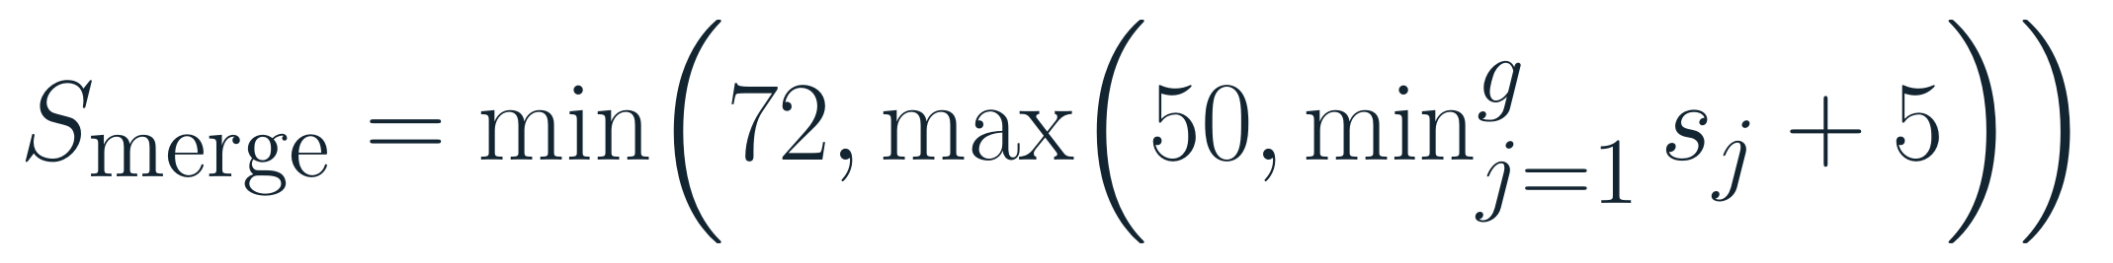
多空答案逐项取证再合成
Retrieve evidence per blank, then compose
第 j 空的局部最优
Local optimum for blank j
合成分数由最弱证据控制
The weakest evidence controls the merged score
(a₁,e₁) + (a₂,e₂) + ⋯ + (a_g,e_g)
每一空都要有独立出处 / Every blank needs its own traceable source
11 / 13
Notes:
中文讲稿 / Chinese notes
多空题按局部线索逐空检索，每个答案都必须带有可追溯片段。合成门槛要求答案证据分至少 65、片段分至少 15，答案不超过 5 个词；若任意一空没有支持片段，就不合成整题答案。合成分数取各支持片段中的最小分，再加 5 并截断到 50–72。取最小值是保守的瓶颈策略：多空答案的可靠度不能高于其中最弱的一空。
English notes
Multi-blank questions are searched gap by gap using local clues, and every answer must retain its own source passage. Composition requires answer-evidence score ≥65, passage score ≥15, and no more than five words; if any blank lacks support, the full answer is not composed. The merged score uses the weakest supporting score plus five, clipped to 50–72. The minimum is a conservative bottleneck rule: the reliability of a multi-part answer cannot exceed its weakest part.

Slide 12
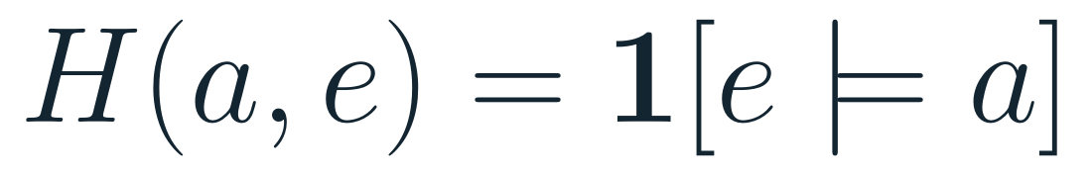
答案必须回到证据
Every answer must remain traceable to evidence
可核验证据包
Verifiable evidence tuple
语义支持判据
Semantic support criterion
命中句 / Focus sentence + 自然段 / Paragraph + 单元·页码 / Unit·page
相似度 ≠ 蕴含 / Similarity ≠ entailment
12 / 13
Notes:
中文讲稿 / Chinese notes
证据包 e_i 包含命中焦点句、它所在自然段、来源、单元和页码。H(a,e)=1 表示证据在语义上支持答案。这里的蕴含是验收标准，不应误说成当前应用已内置自然语言推理模型；目前系统用跨度、列表结构、锚点和来源规则近似检查。对照题库给出的标准答案可自动算答案准确率；证据支持仍应抽样人工核验。
English notes
An evidence tuple contains the focus sentence, its paragraph, source, unit, and page. H(a,e)=1 means that the evidence semantically supports the answer. Entailment is an acceptance criterion, not a claim that the app includes a natural-language inference model; the implementation approximates it with span, list, anchor, and source rules. Answer accuracy can be checked against an answer key, while evidence support should be audited by humans.

Slide 13

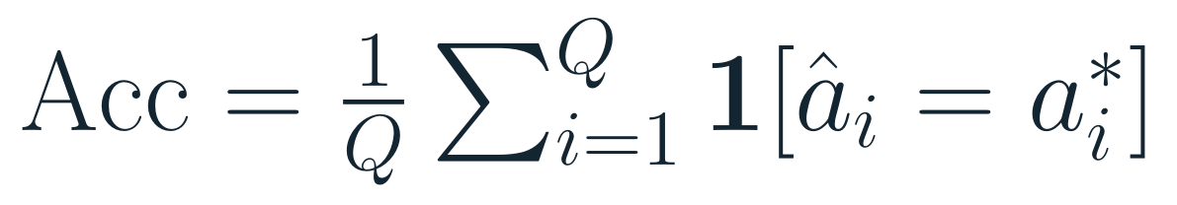
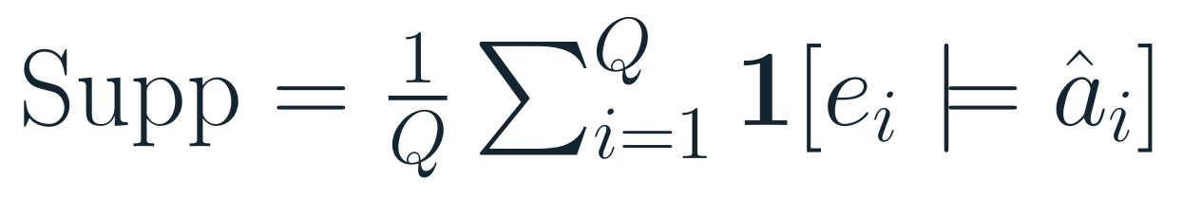
分层验收，而非只看相似度
Evaluate the pipeline, not just similarity
候选召回 / Candidate recall
答案正确 / Answer accuracy
证据支持 / Evidence support
按题型分层 / By task type
填空 · 改写 · 列表 · 多空
Blanks · Paraphrase · Lists · Multi-gap
未有独立标注集前，不报告准确率 / No accuracy claim without a held-out labeled set
13 / 13
Notes:
中文讲稿 / Chinese notes
用 Recall@10 检查正确教材出处是否进入前十；Acc 检查答案字符串或经定义的等价答案是否正确；Supp 检查所给教材证据是否支持答案。这三项分别诊断召回、抽取和支持问题，不应混为一个相似度分数。评估按填空、改写、列表、多空分层，才能找到哪一类题仍弱。目前没有本轮独立留出标注集的实测数据，所以本页只定义指标，不宣称准确率、召回率或提升幅度。
English notes
Recall@10 checks whether the correct textbook source appears in the top ten; Acc checks exact or pre-defined equivalent answers; Supp checks whether the cited textbook evidence supports the answer. These diagnose retrieval, extraction, and support separately. Evaluation should be stratified by blanks, paraphrase, lists, and multi-gap questions. No independent held-out labeled set was measured here, so the slide defines metrics without claiming performance or improvement.

