Slide 1

FOOD OASIS: HYPERHEX SPRINT 2
PROJECT MANAGER: DANIEL GREEN
SCRUM MASTER: PAULYN MONASTERIO
PROGRAMMER I: MINHAJ SHUJAUDDIN
PROGRAMMER II: STEPHEN GILBERT
QUALITY ASSURANCE: MIKE FANOR

Slide 2


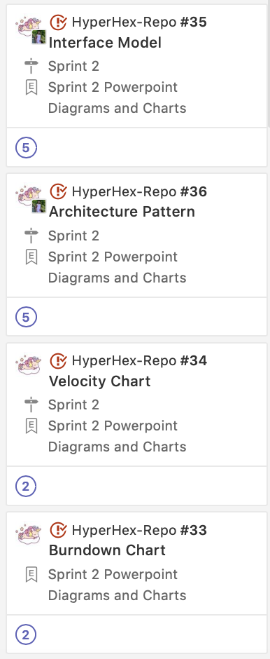
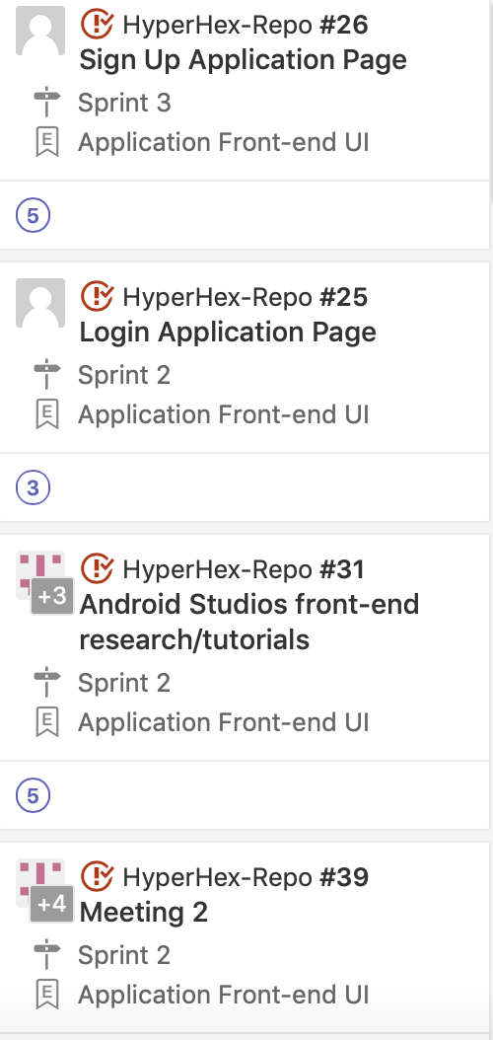
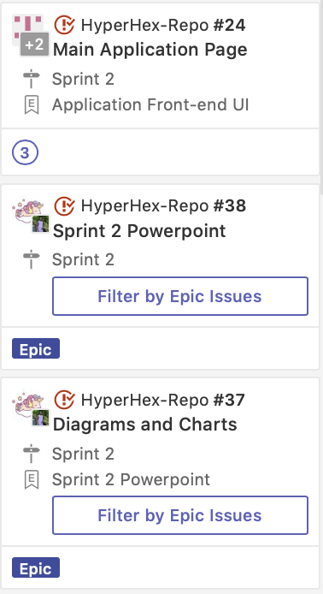
COMPLETED STORIES
We completed everything assigned in this sprint
Android Studios Research/Tutorials
Meeting 2
UI Pages
Sign Up
Login
Main Page
Diagrams & Charts
Burndown
Velocity
Architecture Pattern
Interface Model

Slide 3
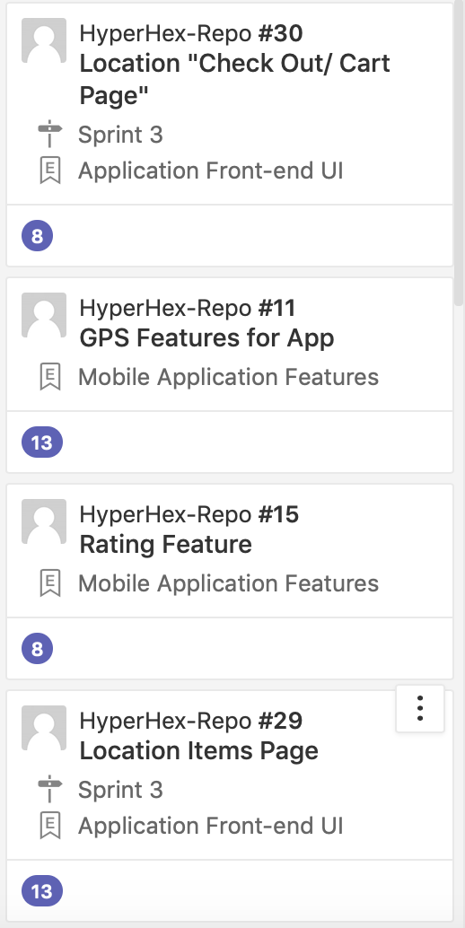
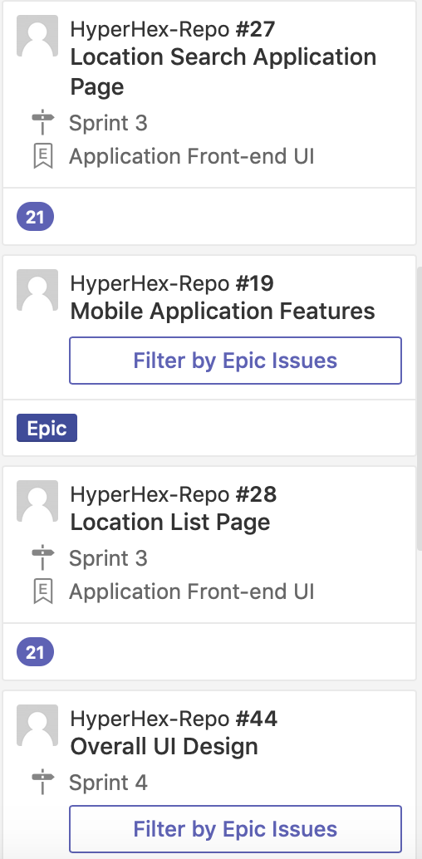
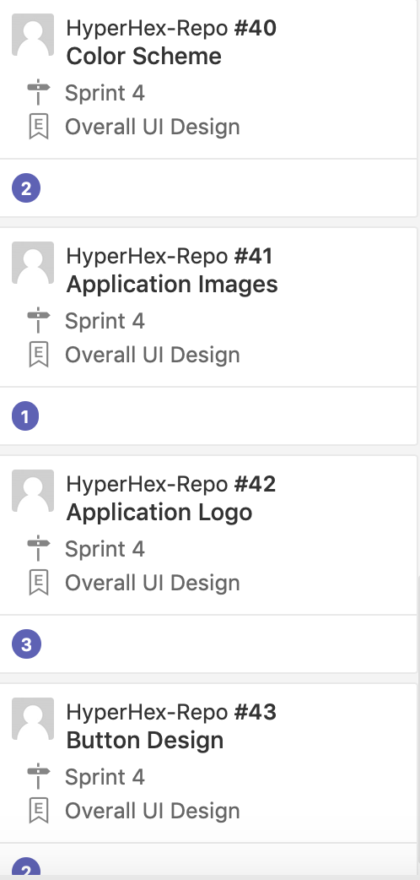
BACKLOG STORIES
We have a lot on our backlog
UI Pages
Location Page
Location Item Page
Map Page
Location Details
Application Features
GPS
Rating
Overall UI Design
Color Scheme
Button Design
Logos
Images

Slide 4
WHY A MVC ARCHITECTURE PATTERN?
TIME: It has a faster development process because it supports rapid and parallel development. This means with MVC, one programmer can work on the view while another can work on the controller or model. This is 3 times faster than other development patterns.
EASY TO MODIFY: The modification does not affect the entire model because the model does not depend on the views part vice versa. However they both depend on the controller.
Notes:
The chose this MVC pattern because it has a fast development speed and supports parallel development. This means that one programmer can work on the model while another works on the view. It is also easy to modify because the model does not depend on the view vice versa. However they both depend on the controller.

Slide 5
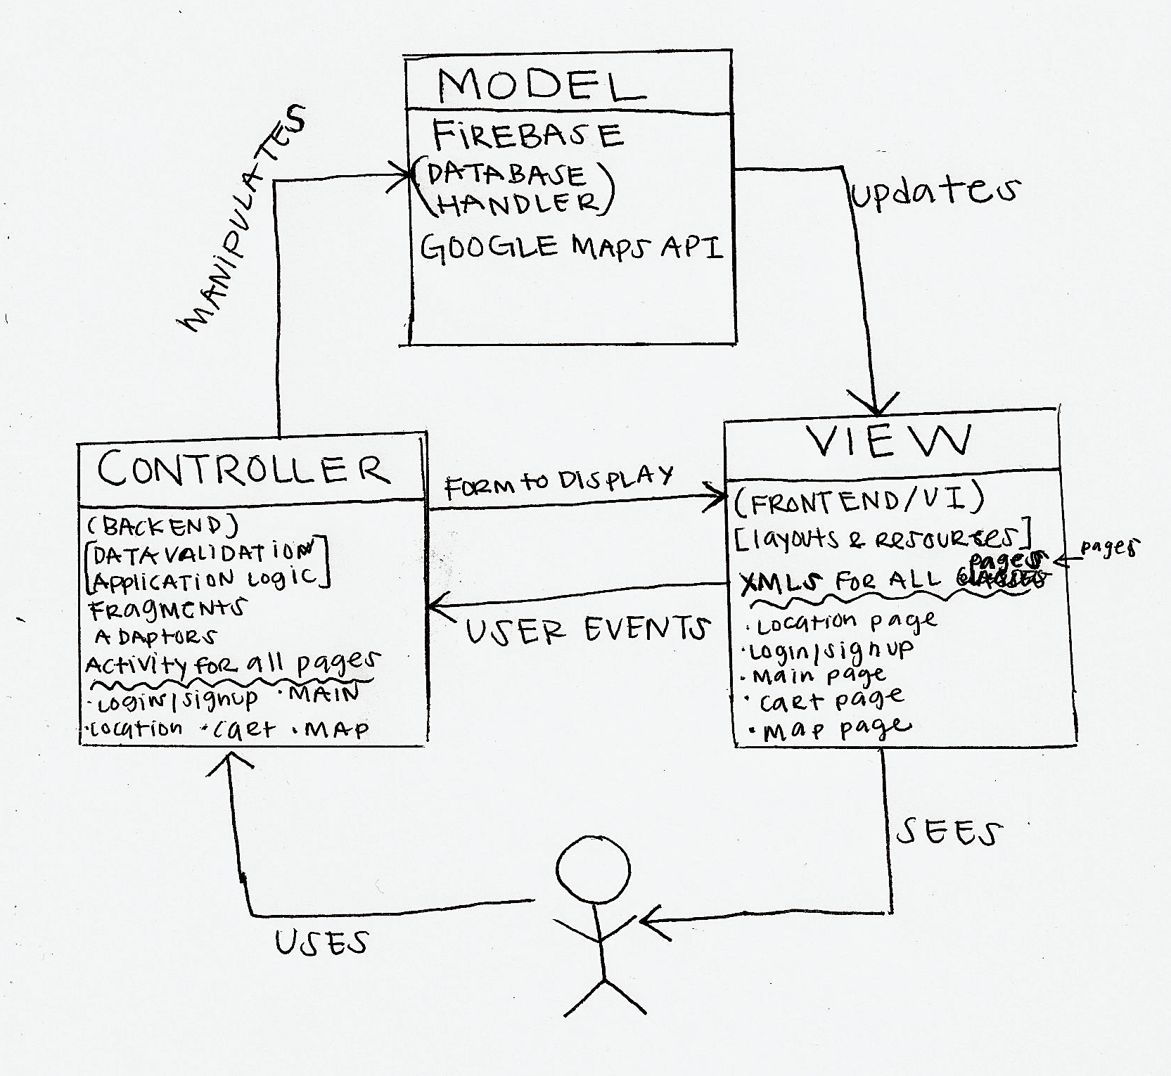
MVC PATTERN
Our 3 teams is basically broken down into a MVC architecture pattern that is separate but are dependent and interact with each other.
Sahara- Database (Model)
Gobi- Backend (Controller)
Hyperhex- Frontend (View)
Notes:
Model View Controller
Our 3 teams are broken down into the 3 separate components of the architecture pattern which are dependent and interact with each other
Team Sahara is in charge of the Database the Model
Team Gobi in charge of the Backend the Controller
Team Hyperhex in charge of the User Interface the View

Slide 6
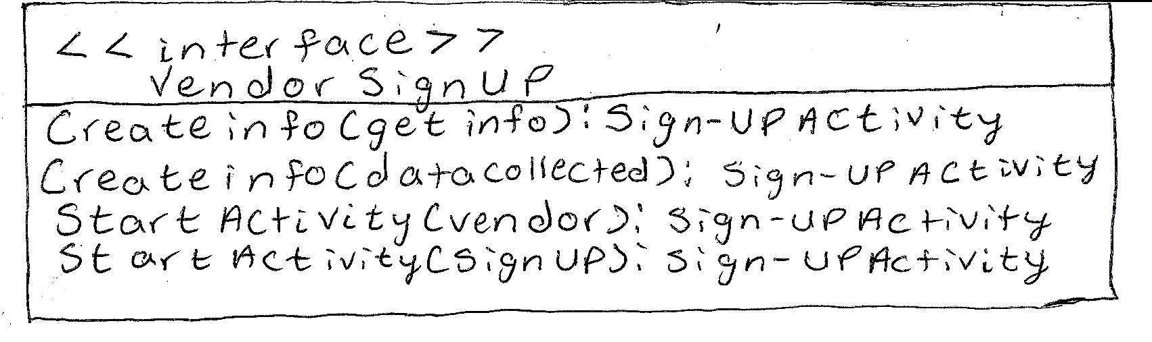
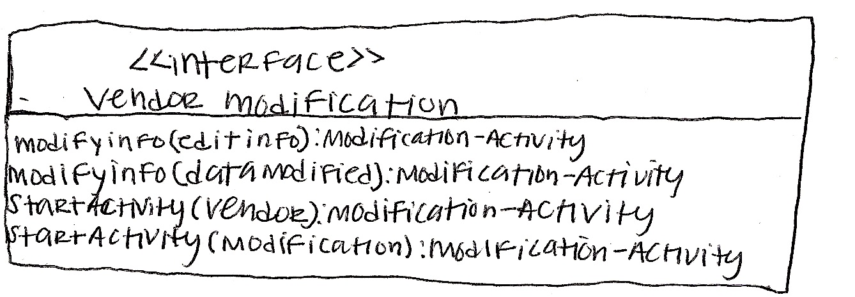
INTERFACE MODEL
Notes:
Ok here is our interface models. They all return to the sign up activity. The first one is the vendor sign up page with has a createinfo class that takes get info or data collected to later store within the database. Then we have the start activities if login is success it will proceed to go to the vendor page if not it will reload on the sign up page.

Slide 7
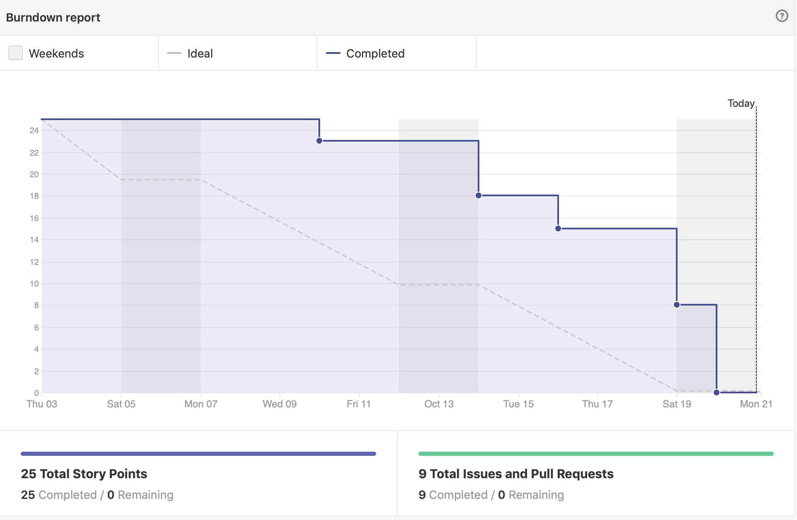
BURNDOWN CHART
Midterms
School work is done on the weekends
Sprint Story Issues were put into in-progress section too early
Too many issues added to Sprint 2

Slide 8
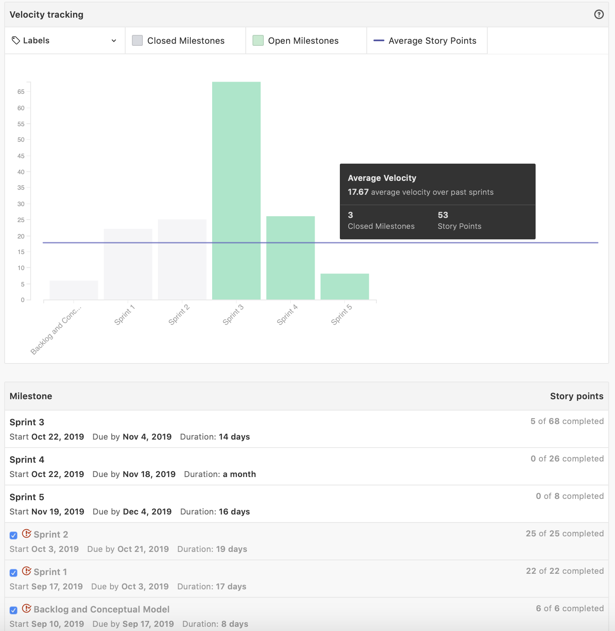
VELOCITY CHART
PREVIOUS SPRINTS ARE EASIER AND MORE DIFFICULT STORIES ARE IN UPCOMING SPRINTS
WE SHOULD OF ADDED MORE WORKLOAD IN PREVIOUS SPRINTS TO COMPENSATE SPRINT 3 AND FUTURE WORKLOAD.

Slide 9




RISKS
Meeting up with team members with midterms happening
Getting everyone on the same page with Android Studios
Coordinating the GitHub to work across the 3 repositories for one application
Having the completed Android Studio XML pages working with the database & backend

Slide 10

ANY QUESTIONS?

