Slide 1






In house presentation
By
Usashi Chatterjee
Cardiff University, School of Computer Science and Informatics
chatterjeeu@cardiff.ac.uk
Ref: https://doi.org/10.1007/978-3-319-48472-3_37
Notes:
My First Template

Slide 2



Collaborators…
Devika P. Madalli
Fausto Giunchiglia
Vincenzo Maltese

Slide 3

Context: online Recipe search

Slide 4

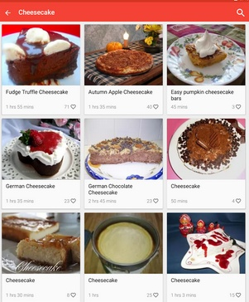
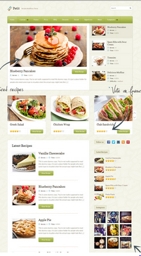
Diversity in Recipe Websites
… informal, heterogenous,terminology,different schema…

Slide 5
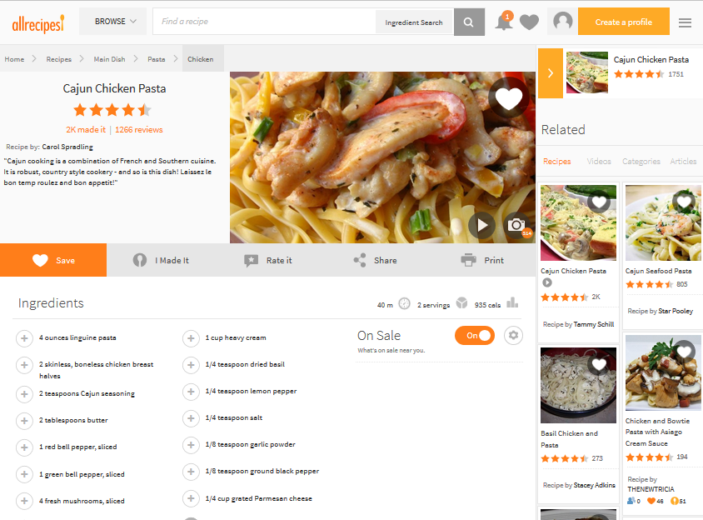
Different Style: Different recipe websites cover different content following their own style and standard.
Different Language: Some websites offer recipes not only in English but in Italian, German or Hindi language.
Variant Terminology: myrecipes.com uses the term preparation, chow.com uses the term instruction, and kraftrecipes.com uses make it
Home Page Layout
User Friendly
Three Click Rule
Secure
AV Tutorials

Slide 6
The problem

Slide 7
1
Informal and heterogeneous websites makes automate search difficult.
2
Different schema poses a challenge to support user queries.

Slide 8


Slide 9
1
Propose a formalized entity-relationship(ER) model.
2
Modelling methodology is based on competency questions.

Slide 10
Literature Review of Entity Modelling
Article | Aim | Competency Questions | Artifact(s) developed | Aspects Covered
DeMiguel et al. (2008) | Recipe search based on ingredient similarity | NO | Ontology & Search system | Ingredient, Meal,Dietary types
Sam et al. (2014) | Recipe search | YES | Recipe Model | Recipes and related properties
Batista et al. (2006) | To support the cooking process | YES | Ontology | Recipes, Food, Utensils, Units & Measures, Actions
Snae et al. (2008) | Menu planning based on diet restrictions | YES | Ontology | Food, Dishes, Dietary restrictions, Nutrients, Utensils, Cooking methods
.... | .... | .... | ... | ...

Slide 11
Methodology
Step 1:Identification
of the query patterns
Step 3:Formalizing the ER model
Step 2:Building the ER model
Step 4:Evaluation of the model
Notes:
My First Template

Slide 12

Step 1: Identification of the query patterns
1
2
Event Specific
Other Scenarios: Nutritional Constrain, Specific Region,..etc

Slide 13
Query Analysis
Competency Question
Give me a recipe to prepare roasted turkey for Thanksgiving celebration
2. Competency Question Analysis
Give me all Recipe for Dish X AND Event Y WHERE X.name= “roasted turkey”
AND Y.name = “Thanksgiving” AND recipeIngredient = Z AND Z.type = “turkey”
AND cookingMethod = “roasting”
3. Identification: Etypes and Properties
Etypes: RECIPE, DISH, EVENT
Property: Dish.name, Event.name, recipeIngredient.type, Recipe.cookingMethod

Slide 14
General Query Pattern
3
Give me all recipes R which belong to cuisine C
to prepare dish D appropriate for event E

Slide 15
Step 2: Building the recipe model
The model is categorized as:
1
Common entity types those that can be (re-)used across domains.
Core entity types are those returned by the queries.
Auxiliary entity types are those that in the general pattern
determine how to filter results.
2
3

Slide 16
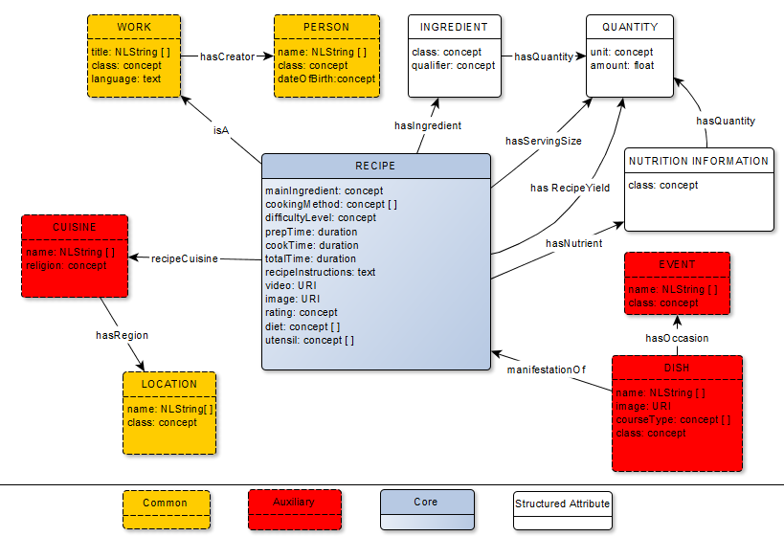
Recipe Model
Notes:
My First Template

Slide 17
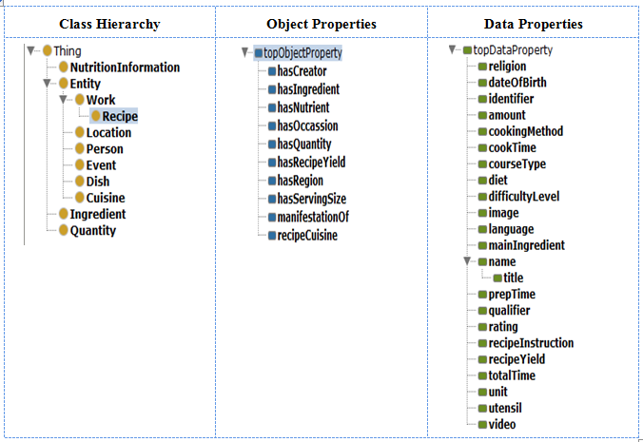
Step 3: Formalization
Used RDF as formal language
Protégé standard free open source ontology editor as modeling tool

Slide 18

Step 4: Evaluation of the model
  Syntactic correctness and consistency
1
2
  Completeness and conciseness
3
Empirical adequacy of the developed model

Slide 19
Comparison table of the terminology
eatingwell.com | Our Recipe model
Ingredients | INGREDIENT type qualifier unit amount
Preparation | recipeInstructions
Nutrition | NUTRITION INFORMATION type unit amount
Makes | SERVING SIZE unit amount
Active Time | prepTime
Total Time | totalTime
Health & Diet Considerations | Diet
 | hasCreator
Type of Dish | DISH courseType
Preparation/Technique | cookingMethod
----- | ------

Slide 20

Comparative Study:
Schema.org ,BBC Food Ontology vs. Recipe Model
Findings:
Incompleteness of properties
Properties such as Recipe Creator and Recipe Rating is absent.
Lack of Types
Schema.org and BBC Food Ontology does not associate recipes to specific event.
Lack of Hierarchy
Properties in Schema.org as plain text poses serious limitations to queries.
Lack of Structure
Schema.org defines ingredient as text prevents it to answer queries related to quantities and qualifiers for ingredients.
Notes:
My First Template

Slide 21

Highlights of the Proposed Model
Addressed the diversity problem in websites
Definition of a formal ER model captures the fundamental queries to be offered
The model is grounded in Information Science theories on creative works.
Clear distinction between Recipe and Dish
Overcomes the limitations of existing models
Schema.org and BBC food ontology

Slide 22
Thanks you for your attention!!
Reference:
Chatterjee U., Giunchiglia F., Madalli D.P., Maltese V. (2016) Modeling Recipes for Online Search. In: Debruyne C. et al. (eds) On the Move to Meaningful Internet Systems: OTM 2016 Conferences. OTM 2016. Lecture Notes in Computer Science, vol 10033. Springer, Cham.
https://doi.org/10.1007/978-3-319-48472-3_37

