Slide 1
A Novel
Tasting Experience
Tarini Naravane, Ekta Naravane Parpia

Slide 2
Introduction
Tarini Naravane - Phd @ UC Davis in Food Science and BAE, Previously a chef and computer scientist
Ekta Parpia - Baker & Confectioner specialising in personalised orders
Notes:
The pandemic has impacted some positive aspects of how we eat.
More home cooking
Less waste

Slide 3
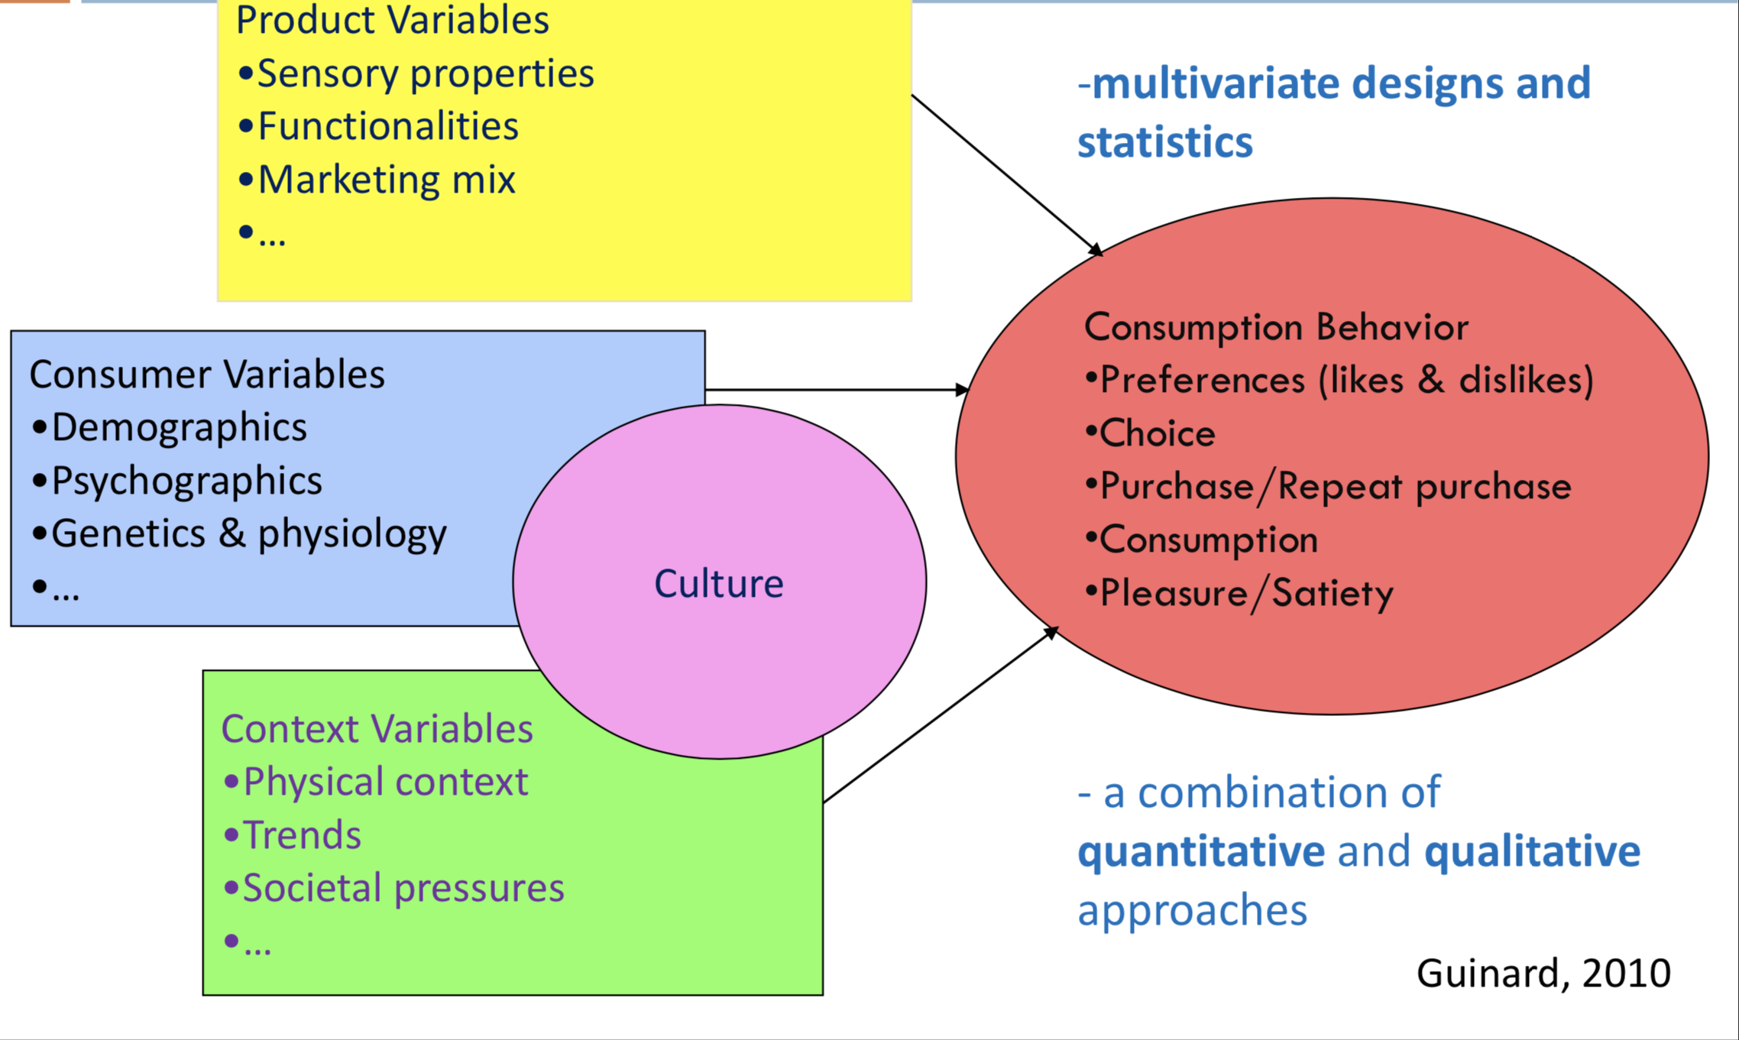
Factors influencing sensory perception
Has the pandemic introduced additional factors?
Does cooking impact perception ?
Does the ability to personalise food impact perception ?
Notes:
Memory and association is also a part of perception
Pandemic has made people more health conscious - no gyms open, hard to exercise. How to eat healthy

Slide 4
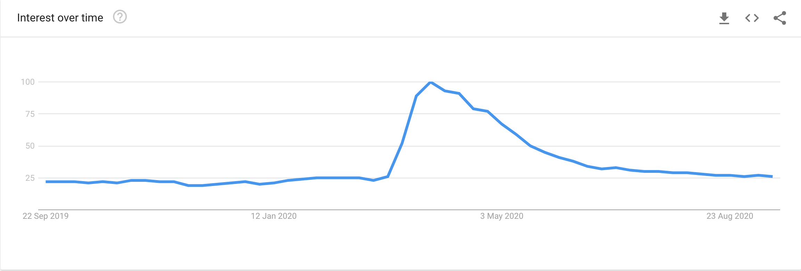
Why Banana Bread ?
Banana Bread among the top 3 recipes
Banana bread spikes on Google Trends
Quoted as :
“Unofficial baked good of the pandemic” - wellandgood
“Low risk- high reward” Delish.com

Slide 5
The recipe
We picked this recipe for the ease , and these versatile features
Mix of Almond, Rice flour - alternative grains in baking cakes
Oil - options include corn/canola/avocado/olive oil
Non-refined sugar - options are brown sugar, coconut sugar
Additions/Omissions - options are nuts, seeds, raisins, chocolate
Notes:
Mention that the website links has an option to use cup or metric measures.

Slide 6
Tasting Experience
Blind fold tasting of baked & purchased samples by variables.
Texture - fluffiness, chewability, time to masticate
Flavour - diversity, complexity
Filling, Satiety
We also ask you to comment on your experience of cooking the sample in a separate form.

Slide 7
Schedule/Format
21 September - Recipe and video emailed to participants
By 25 September - Questions from participants on the recipe/ingredients or the purchased sample
25 Sept - Tasting questionnaire provided to participants
26-27 Sept - Baking and Tasting
28 Sept - Participants to return the tasting experience forms
7 October - Analyse and present the results

Slide 8
Questions?
Contact : tnaravane@ucdavis.edu,ekta.parpia@gmail.com
Thank you.
We look forward to your responses !

