Slide 1
Development of a MIxS “Food” Environmental Package
Amanda M. Windsor, Ph.D.
ORISE Postdoctoral Fellow
Center for Food Safety and Applied Nutrition
Office of Regulatory Science
Tel +240-402-0057
Amanda.Windsor@fda.hhs.gov

Slide 2
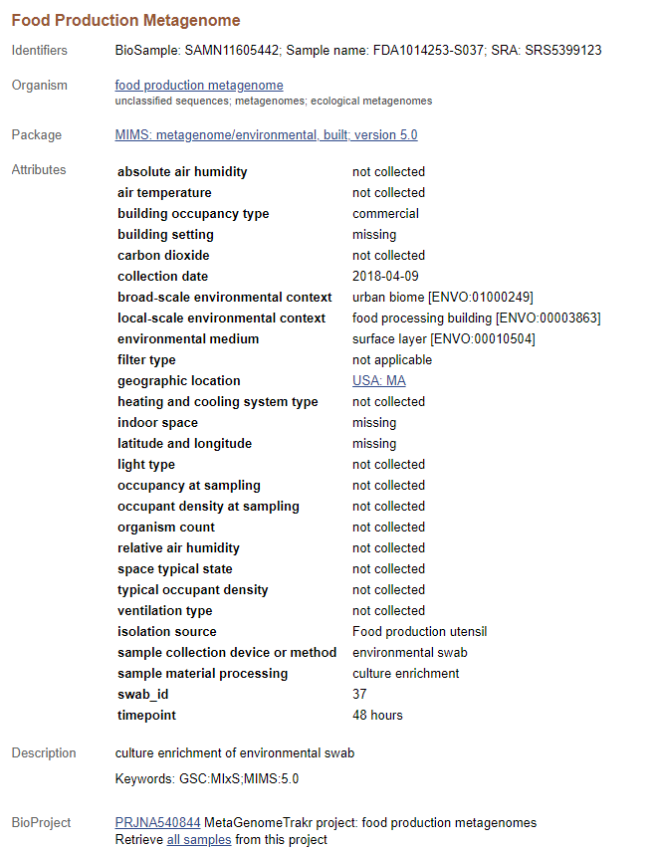
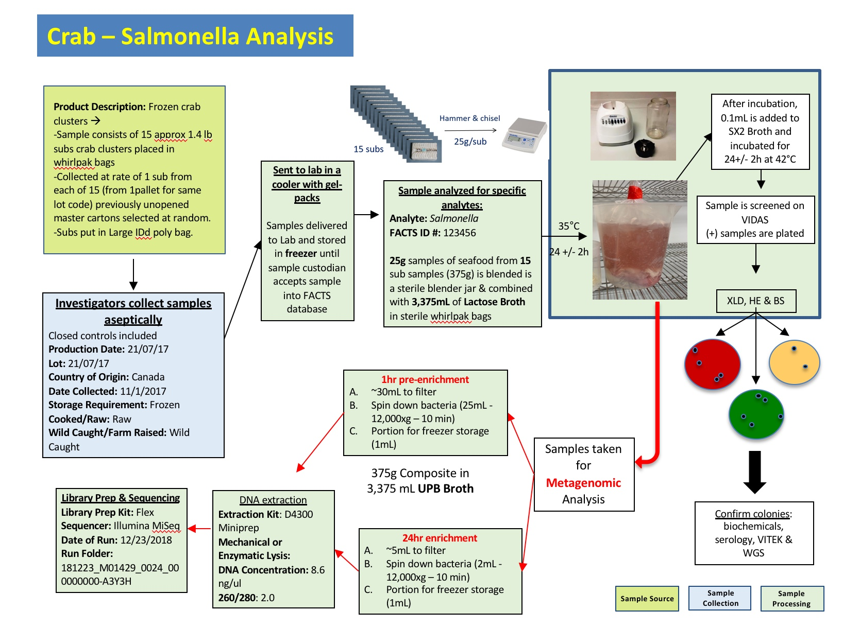
Background
Metagenomic sequencing data from project on environmental swabs and imported, frozen seafood.
Wanted to be MIxS compliant
Environmental swabs Built Environment
Seafood Miscellaneous Package
Decided to pursue “Food” Package
Notes:
When submitting biosamples to NCBI, it be came clear that existing metadata standards were not ideal for food and food-related samples.

Slide 3




Farm to Fork Production Chain
Goals of metagenomic sequencing: Pathogen detection, limit of detection, total hazard characterization, culture method improvements, regulatory decision-making (in the future)
Commodity 1
Commodity 2
Farm
Manufacturing/Processing Facility
Retail
Notes:
we are interested in understanding the pathogen burden at each stage of the farm to fork continuum because there are opportunities for pathogen introduction into the food supply across all stages in the supply chain.

Slide 4
Getting Started
Working group
40+ members
National & international regulatory, industry, academic input
Define scope
Use cases
What metadata do we collect?
Literature search
What metadata do others collect?
Published standards*
Existing standards
What can we re-use?
Ontologies
FoodOn
GenEpiO
ENVO
OBI
NCIT
* Major inspiration came from Dundore-Arias et al. 2020

Slide 5
Food Package Scope
Broadly
Metagenomic sequences associated with food and/or food production
Divide and conquer
Food for Human Consumption
raw materials, pre- & post-processing, consumer-ready, etc.
Food Production Environment
environmental swabs in facilities
Farm environment
Irrigation sources, growing conditions, soil, food crops, etc.
Livestock and animal feed
farm animal & pet food
Notes:
The scope of what includes food and its production, processing and distribution, at first glance, can seem intractable. One of the first steps to developing a food metadata standard was to define the boundaries of the sample types that would be covered, followed by the identification of metadata essential for each.

Slide 6

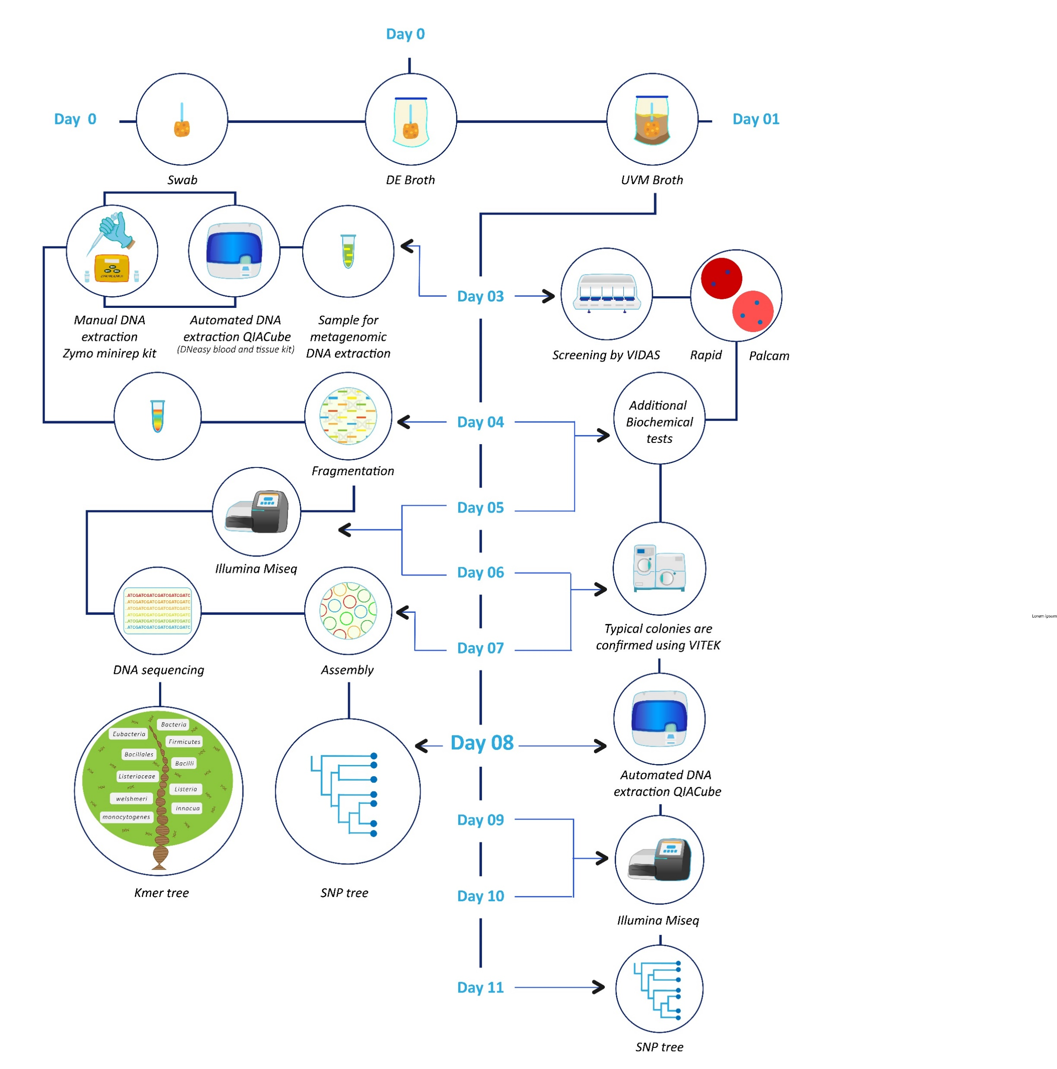
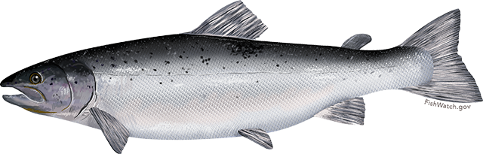

Environmental sponge from square sink at a cold-smoked salmon slicing room
Use Case
LOCATION WHERE SAMPLE WAS TAKEN
Country: USA → Country (NCIT:C25464)
US State: NY → US State (NCIT:C30010)
Establishment Type: Manufacturer → Manufacturer (NCIT:C25392)
Food Facility Type: RTE Fishery Products → Food Processing Building (ENVO:00003863)
SEQUENCING
Captured in SRA submission
FOOD PROCESSED DURING SAMPLING
Food Product: Salmon → Food product type (FOODON:00001002)
Common Name: Scottish salmon → Common Name (NCIT:C164471)
Local name: Bay Salmon → Biologic Entity Classification Common Name (NCIT:C164690)
Food origin: Scotland → Country (NCIT:C25464)
Geographical indication: Scotland → Country (NCIT:C25464)
Cultivation: Wild Caught → wild or gathered (FOODON:03530153)
Preservation: cold smoked → Food transformation process (FOODON:00002451)
WET LAB
Created Date: 07172020 → created date (GENEPIO:0001882)
Culture Medium: UVM → growth medium (OBI:0000079)
DNA Extraction Method: ZYMO Miniprep Kit → sequencing dna extraction method (GENEPIO:0002093)
SAMPLE COLLECTION DEVICE & AREA
Sample collection tool: Sponge → Sponge Stick (IP)
Zone: Zone 2 → Environmental Monitoring Zone (IP)
Surface: square sink → indoor surface (MIXS:0000764)
Surface Material: stainless steel → surf_material (MIXS:0000758)
Surface moisture: Yes → surface moisture (MIXS:0000128)
Room: Slicing Room → Sampling room ID (MIXS:0000244)
Temperature of air: 65°F → Temperature of air (ENVO:0920001)
Food processed: cold smoked salmon → prepared food product (FOODON:00001180)
Frequency of cleaning: 2x a day → freq_clean (MIXS:0000226)
Biocide: alkaline cleaner → Biocide (ENM:8000175)
Physical control technology: Gamma radiation → irradiation (OBI:0302889)
TRANSPORTATION
Transportation: Car → transportation (ENVO:02000125)
Sample Storage Location: Cooler #5 → sample storage location (MIXS:0000755)
Sample Storage Temperature: 4°C → sample storage temperature (MIXS:0000110)
Sample Storage Duration: 24 hours → sample storage duration (MIXS:0000116)

Slide 7
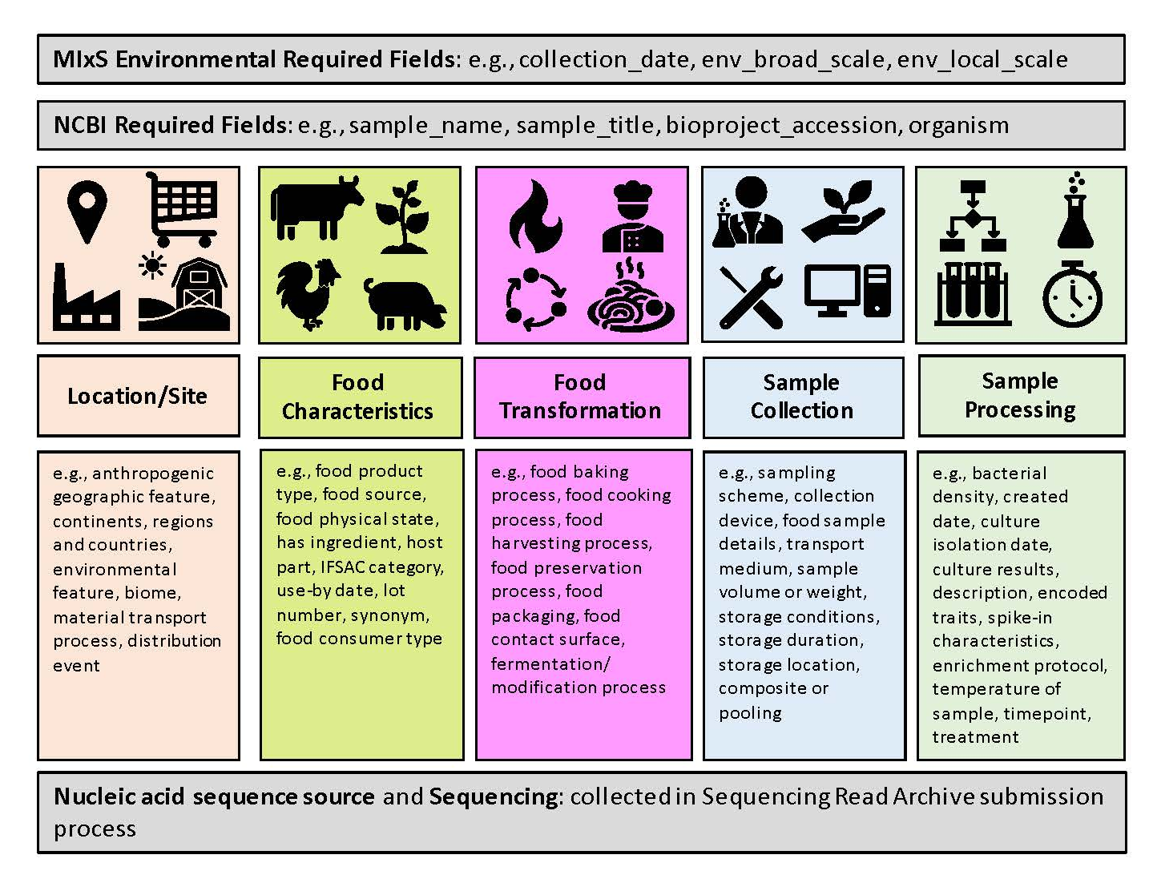
Metadata Categories
Notes:
we organized contextual information from exemplar use cases from our four major food sample types into several categories (Fig. 1). There are two categories of required metadata: 1) that which is required by MIxS, for all environmental Minimum Information about a Metagenome Sequence (MIMS) submissions, and 2) that which is required by NCBI and captured in the biosample and bioproject submission process. The remaining metadata variables were binned into five categories: location, food characteristics, food transformation, sample collection, and sample processing.

Slide 8

Refining Terms
Identify and reduce redundancy
Determine granularity
What level in ontological hierarchy to use
Evaluate against more use cases
Curate shared terms
Consistent definitions
MIxS format

Slide 9
Progress & Prospects
First Draft
4 “sub-packages”
Human foods
Food Animals & Animal Feed
Food Production
Farm Production
Curated, shared terms
Justifications for mandatory terms
Guidance Documents
Define scope of sub-packages
Use case examples
FAQ
Further development of livestock terms
Whitepaper describing the standard

Slide 10
Special Thanks
Sub-package development
Animal Feed – Chris Grim & Jennifer Jones
Farm Environment – Susan Leonard & Taylor Richter
Food Processing Facility – Brandon Kocurek
Human Foods – Amanda Windsor
Evaluation & Refinement
Amanda Windsor, Brandon Kocurek, Maria Balkey, Padmini Ramachandran
Genomic Standards Consortium
Lynn Schriml
CFSAN Team
Chris Grim, Brandon Kocurek, Susan Leonard, Taylor Richter, Jennifer Jones, Maria Balkey, Ruth Timme, Gopal Gopinath, Padmini Ramachandran, Andrea Ottesen, Karen Jarvis
Hsiao Public Health Bioinformatics Lab
Damion Dooley, Emma Griffiths

