Slide 1


ORION WP3 – data interoperability
Fernanda Dórea
Swedish National Veterinary Institute (SVA)
Estibaliz LA Garrido
Nazareno Scaccia
Matthias Filter
German Federal Institute for Risk Assessment (BfR)

Slide 2






One-Health picture of a Food-borne outbreak
prevalence
cases
outbreaks
Health Surveillance Ontology – ORION project – 2020-09-30 – www.datadrivensurveillance.org/ontology

Slide 3
Place of exposure
disease
Food vehicle
host
Contribut-ory factors
Outbreak
legislation
Surv. Activity
place
Country acquisition
Sampling design
cases
Reporting practices
Sample
material
gender
Context
date
Levels of information
result
assay

Slide 4





Surveillance objective
System description: AH
System description: FS
System description: PH
Surveillance Protocol
Sampling design
Reporting protocol
Sample collection protocol
prevalence
Diagnostic protocol
cases
outbreaks
Data about the samples / individual results
Results of aggregated analyses

Slide 5
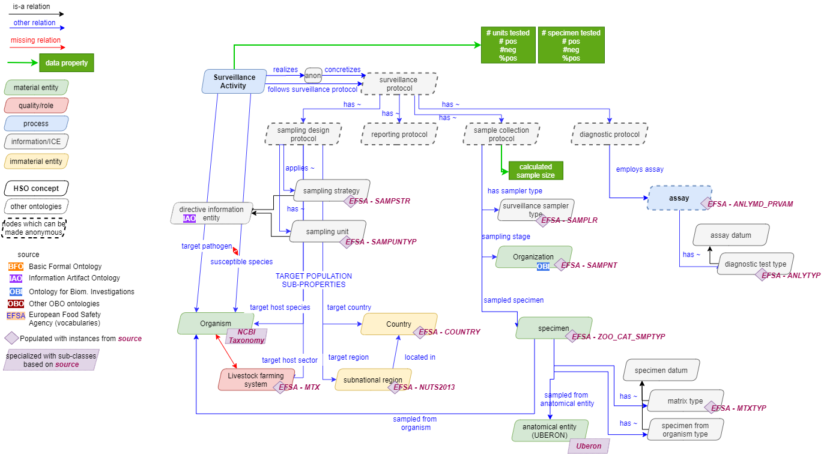
Attach context to data
Attach context to results

Slide 6







Interoperable
LINKED DATA
F
Lab data
Lab A
Lab data
Lab A
Lab data
Lab A
A
Lab data
Lab B
Lab data
Lab D
Lab data
Lab C
Epi data
ANIMALS
I
Population registry
Epi data
R
Weather data
Epi data
FOOD

Slide 7


Findable
Attach context to data
F
A
Farm
Slaughter-house
Processing plant
Retailer
Consumer
Health care
”LINKABLE” data
Concepts needed to ”map” surveillance activites
I
Identify activities, their purpose, their context
Make it clear across sectors
R
Identify similarities and be able to identify differences
Understand and document when things change

Slide 8
Attach context to data

Slide 9
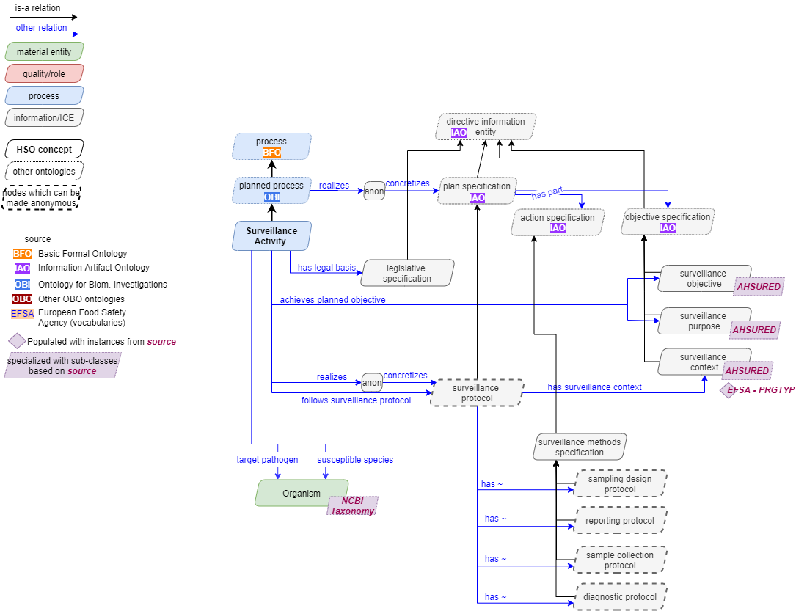

Slide 10




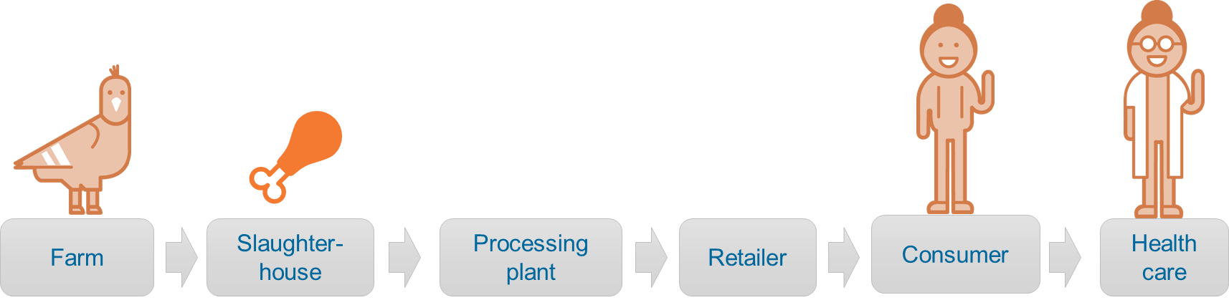
Next on TO-DO:
Define datasets and use HSO to make both data and datasets linkable
FAIR

Slide 11

In practice - tools
Automated workflows to data annotation
Graphical search of OH surveillance data
RDF to Excel workflows to retrieve found data

Slide 12
fernanda.dorea@sva.se
datadrivensurveillance.org/ontology

Slide 13
Syntatic interoperability
Semantic interoperability
Terminologies, data standards, dictionaries
Meaning, context
Source
Farm A
Source
Fecal swab
Symptom
Diarrea
Symptom
Diarrhoea
Symptom
Diarréia
Species
Chickens
Species
Broilers
Minimum information tables
Target
Campylobacter
Target
Campylobacteriosis
Mappings, data models

