Slide 1





The Plant Trait Ontology Links Wheat Traits for Crop Improvement and Genomics
Laurel Cooper, PhD
Oregon State University,
Planteome Project, GrainGenes Database
NSF #1340112

Slide 2
Goals of the Planteome Project:
Develop and maintain a network of reference ontologies
Link plant traits, phenotypes, gene expression, genomes and genetic diversity data across a wide range of plant species on a centralized platform
Align reference ontologies with descriptors from species-specific vocabularies to link to breeding data
Create mappings (links) to other ontologies and databases
Notes:
Fix this

Slide 3
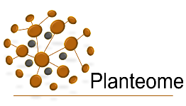

Planteome Database 4.0
Reference Ontologies for Plant Biology- PO, TO, PECO and PSO
Species-specific Crop Ontologies (CO):
cassava, lentil, maize, pigeon pea, potato, rice, sorghum, soybean, sweet potato, wheat, yam
Current status of annotation data:
Ontology-based annotations to data objects: ~19.8 M
Bioentities (data objects): ~3.1 M
genes and gene products
germplasm sources
QTLs
Covers more than 124 taxa, sourced from ~30 database sources
Ontologies integrated for use by over 40 major plant biology resources
Notes:
Updated numbers for Release Feb 2017

Slide 4
Reference Ontologies for Plants
 | Environment Ontology (ENVO)
 | Plant Experimental Conditions Ontology (PECO)
 | Plant Taxonomy | NCBI Taxonomy | Plant Stress Ontology (PSO) | Phenotypic Quality (PATO) | Biological Process (GO)
 | Anatomy | Plant Anatomical Entity Plant Ontology (PO) |  | Plant Trait Ontology (TO) | Plant Structure Development Stage (PO)
 | Cell | Plant Cell (PO) Cell (CL)
 | Cellular Component | Cellular Component (GO)
 | Molecule | Molecular Entity (ChEBI, PR) |  | Molecular Function (GO)
GRANULARITY
Key:
Yellow: Ongoing Planteome development; Blue: Collaborator ontologies with plant enrichment
Pink: New ontology to be developed

Slide 5
Plant Trait Ontology
plant growth and development trait
TO:0000357
plant quality trait
TO:0000597
biochemical trait
TO:0000277
plant trait
TO:0000387
stress trait
TO:0000277
biological process trait
TO:0000283
yield trait
TO:0000277
plant morphology trait
TO:0000017
sterility or fertility trait
TO:0000392
1578 terms with links (annotations) to 165,000 data objects in Planteome

Slide 6
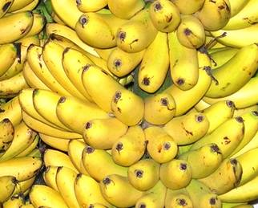
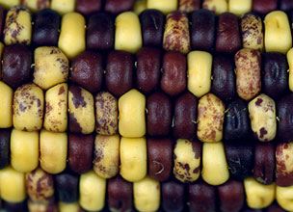
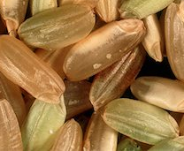
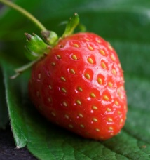
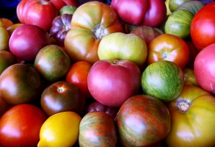
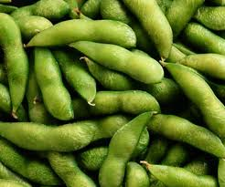
Planteome Trait ontology terms are linked to data from multiple species
Examples of fruit color traits (TO:0002617) across various species
Phenotypes
Expression
Gene
Function
Fruit Color
Kernel Color
Grain Color
Mutant
Homologs
Achene Color
Berry Color
Pod Color
QTL
Genotype
Germplasm
Domains
Interactors
Annotations are links between ontology terms and data objects

Slide 7
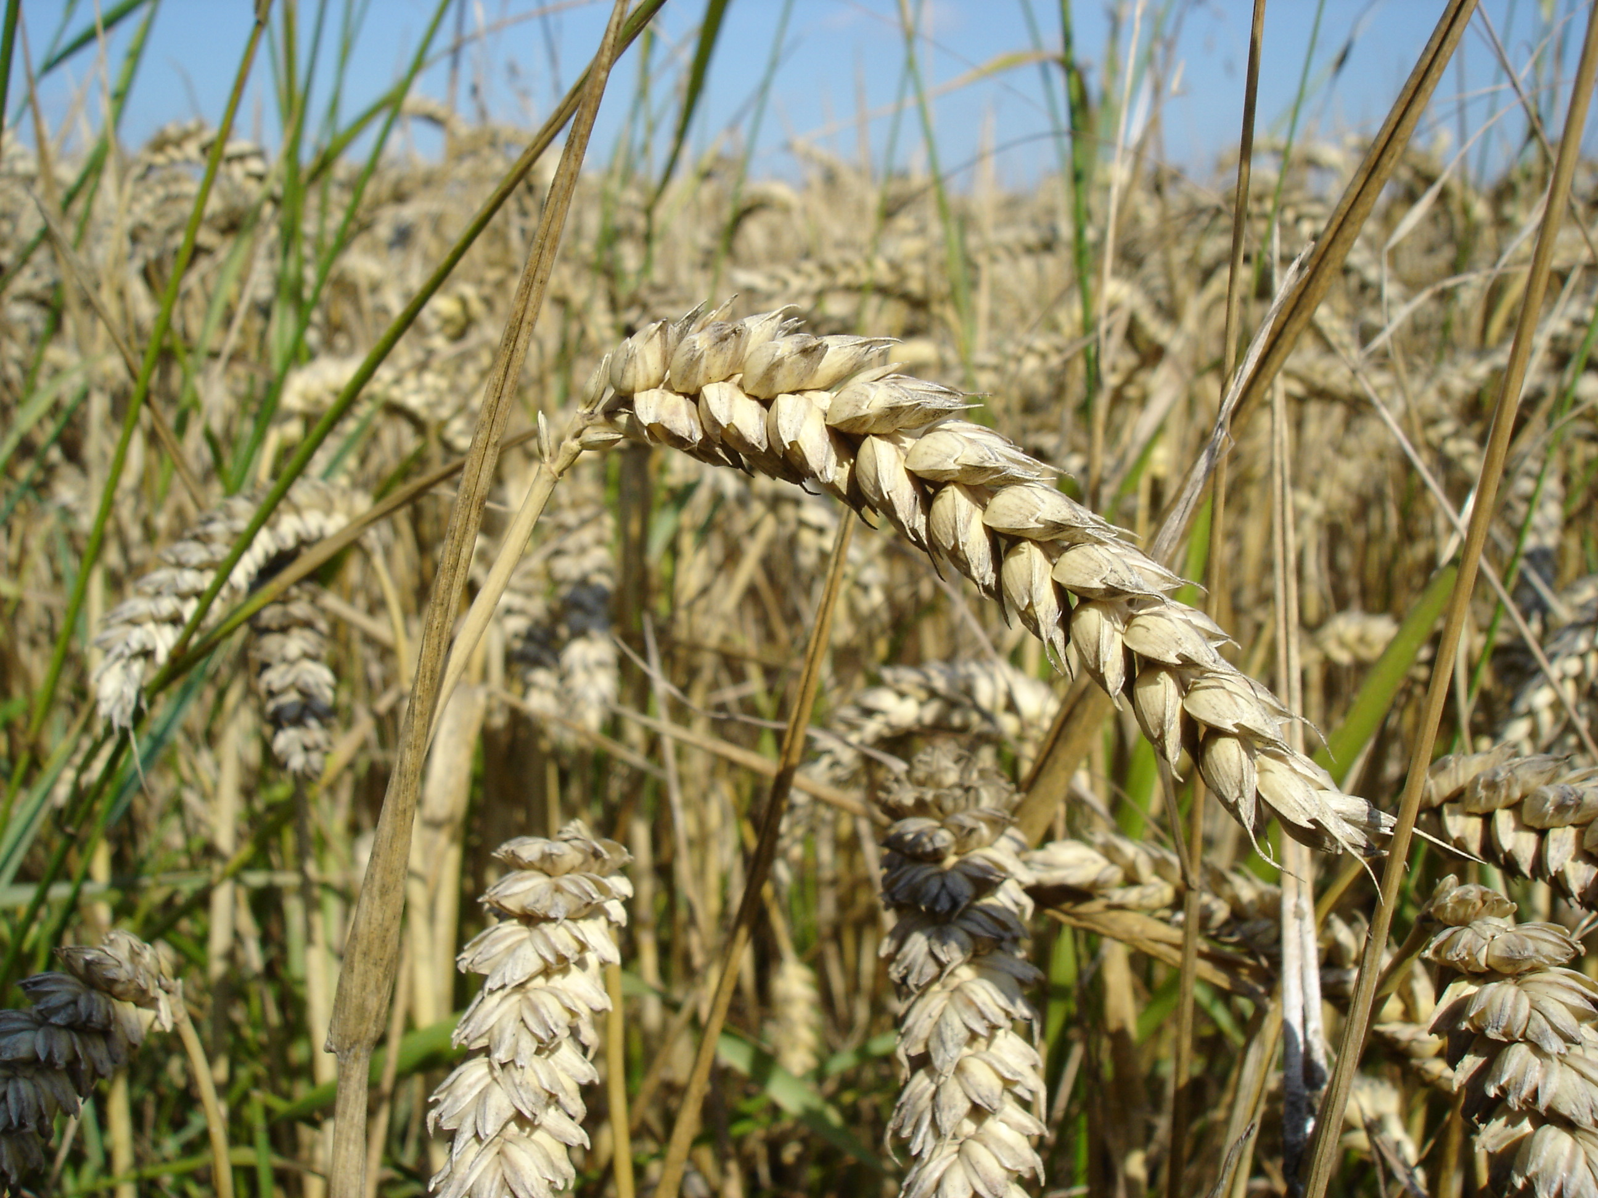
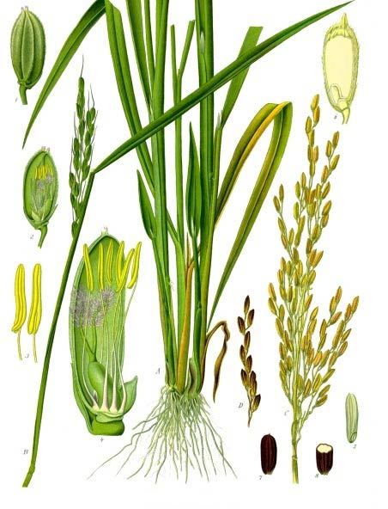
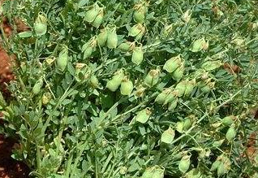
Species-Specific Ontologies and Data Annotations
Wheat- CIMMYT
Three examples from CGIAR Centers integrated into Planteome:
How can we make interspecific comparisons across these ontologies?
Image Source: Wikipedia
316 traits, for example:
awn length
grain weight
leaf rust severity
Rice- IRRI
Lentil- ICARDA
68 traits, for example:
pod weight
cooking time
root length
Image Source: Wikipedia
157 traits, for example:
caryopsis shape
amylose content
lodging incidence
Image source: Karthika Rajendra

Slide 8

Automated Mapping is based on Design Patterns For example: Entity-Quality pattern
CO_321:0000056
wheat spike length trait
TO:0000271
inflorescence length
?
Entity Quality
Entity Quality
PO:0009049
inflorescence
synonym: spike
PATO:0000122
length
PO:0009049
inflorescence
Synonym: spike
PATO:0000122
length
Reasoner infers that these terms are exact matches
Inference
TO:0000271
inflorescence length
equivalent
CO_321:0000056
Wheat spike length trait
Marie-Angélique Laporte
Crop Ontology, Alliance Bioversity International-CIAT
Notes:
“Compound mappings”¹ based the formal definition of a trait concept. 1 source ontology is mapped to 2 target ontologies
Trait = Entity (PO) + Attribute (PATO)
Benefit: formal definition are created and therefore mapping can be inferred by a reasoner

Slide 9
Integration of Species-Specific Ontologies
PATO:0000001
quality
Entities from Plant Ontology or Gene Ontology
TO:0000387
plant trait
PATO:0001241
physical object quality
PO:0025131
plant anatomical entity
TO:0000017
plant morphology trait
PATO:0000051
morphology
Trait qualities from PATO
TO:0000839
plant structure morphology trait
PATO:0000117
size
PO:0009011
plant structure
Relationships:
TO:0000398
whole plant morphology trait
PATO:0001708
1-D extent
is_a
TO:1000012
whole plant size
PATO:0000119
height
PO:0000003
whole plant
TO:0000207
plant height
inheres_in
CO_339:0000114
lentil plant height
CO_321:0000020
wheat plant height
CO_320:0000076
rice plant height
CO_334:0000432
cassava plant height

Slide 10
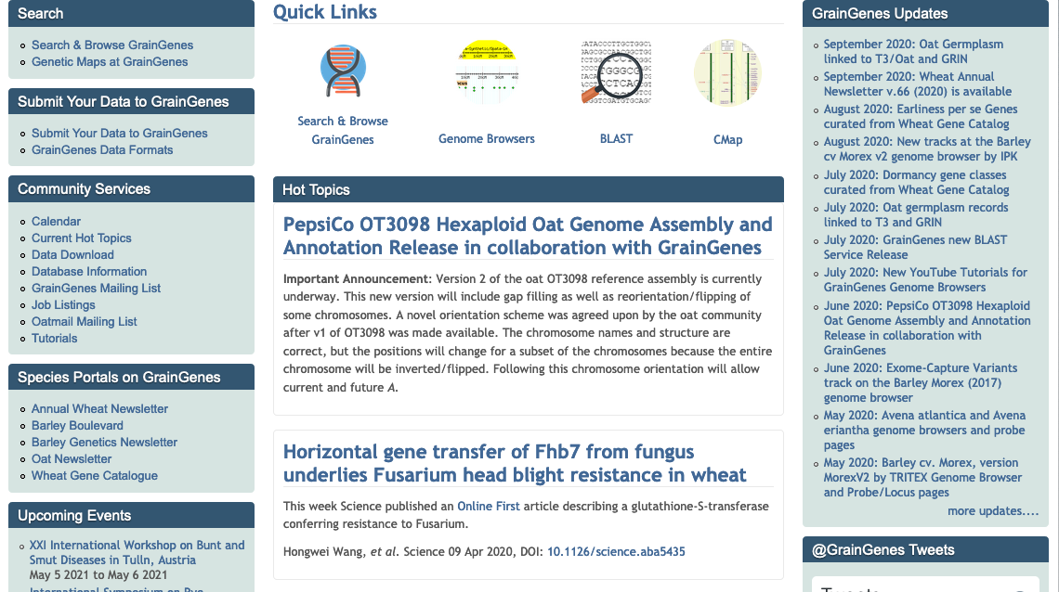
An integrated relational database and internet resource for the international small grains community
Provides curated genetic and genomic information about Triticeae species (mainly wheat, barley, rye and their wild relatives), and Avena species (mainly oat
Hosts a diversity of data types including genome browsers, comparative linkage maps, sequence polymorphisms, and QTLs.
Blake et al (2019) GrainGenes: centralized small grain resources and digital platform for geneticists and breeders. Database (Oxford). DOI: 10.1093/database/baz065

Slide 11
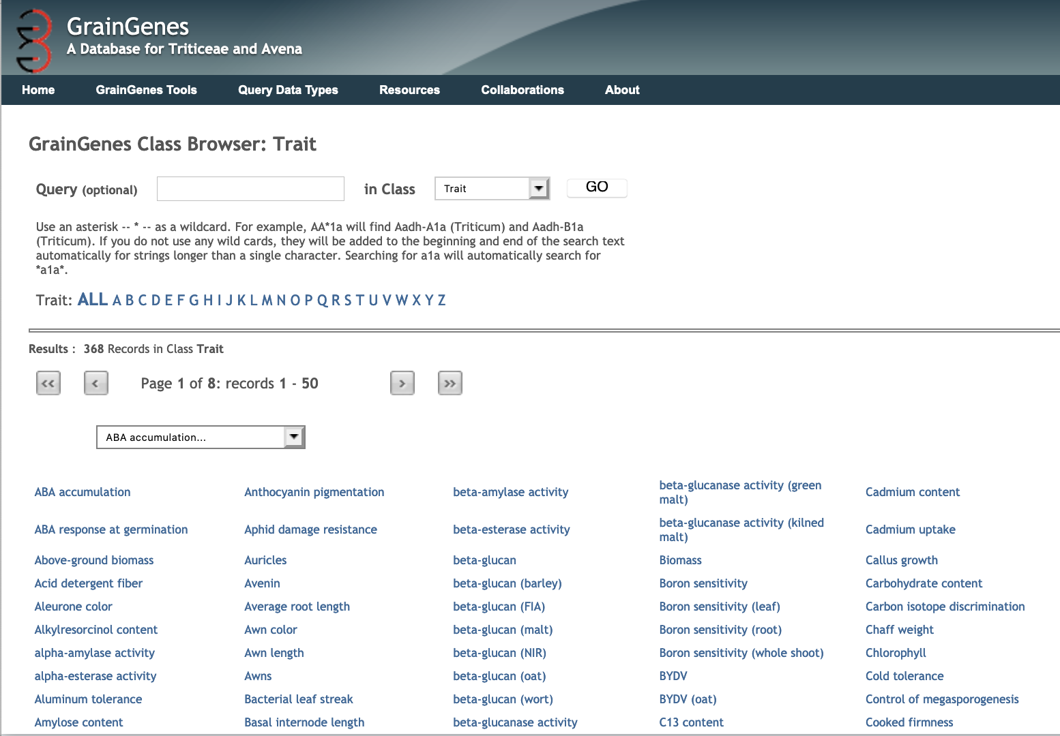
Trait data at GrainGenes for wheat, barley and other small grains
Annotation with TO, PO and CO terms make the data more interoperable
386 traits described
246 mapped to TO terms
72 also mapped to CO terms
Link back to the Planteome database
Notes:
368 traits described
To improve data standardization and interoperability, 246 traits in the GrainGenes database have been mapped to date to 155 unique TO terms, and 72 traits mapped to 42 unique wheat CO terms, all of which link back to the Planteome database.

Slide 12
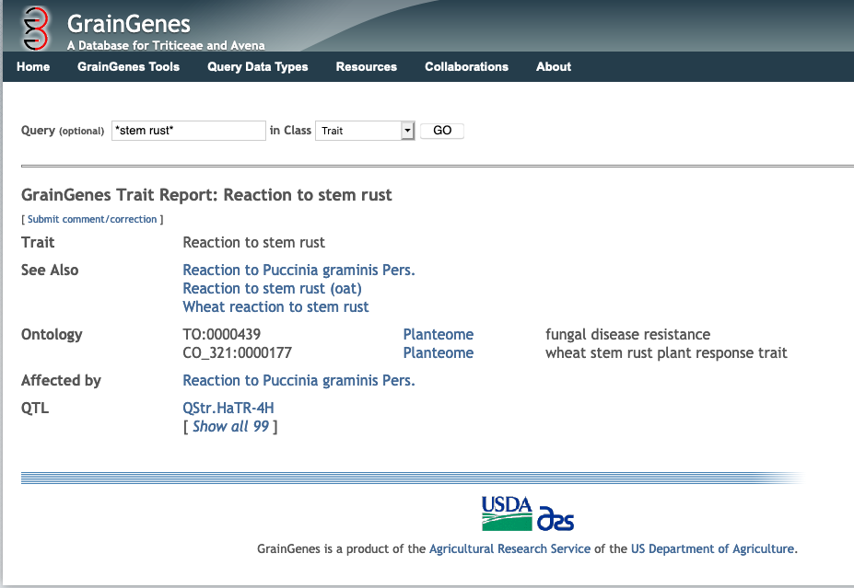
TO and CO Annotations: Reaction to stem rust trait

Slide 13
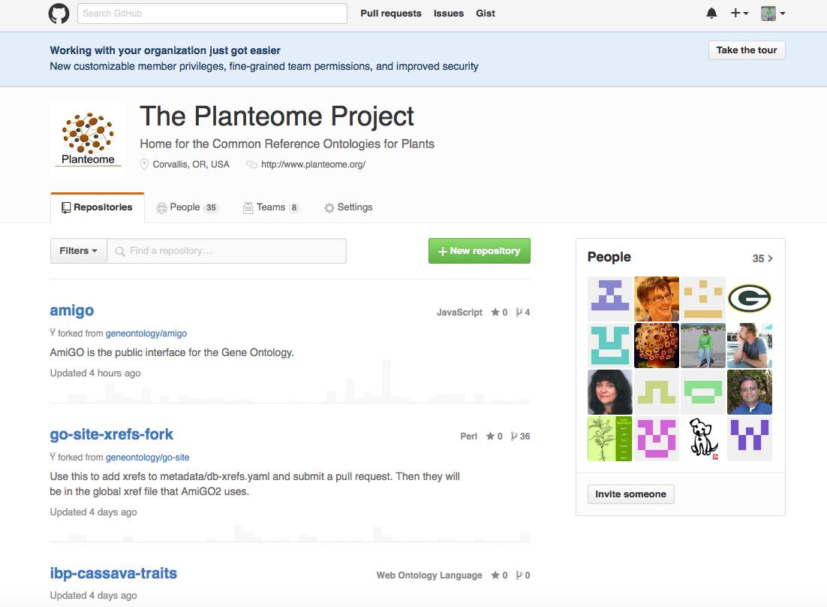

Practical tools for ontology development and collaboration- Planteome is available on GitHub
Ontologies are maintained at GitHub for sharing and tracking revisions
Community feedback- make comments, request terms, and suggest changes
https://github.com/Planteome

Slide 14
Getting Involved: How can you contribute and utilize these resources?
Explore annotations and ontologies for your own research work
Create a GitHub account to request terms, make comments, or share your own ontology
Annotate your data, and work with us to submit to our repository
Recent Publication:
The Planteome Database: Nucleic Acids Research,
Jan 2018

Slide 15

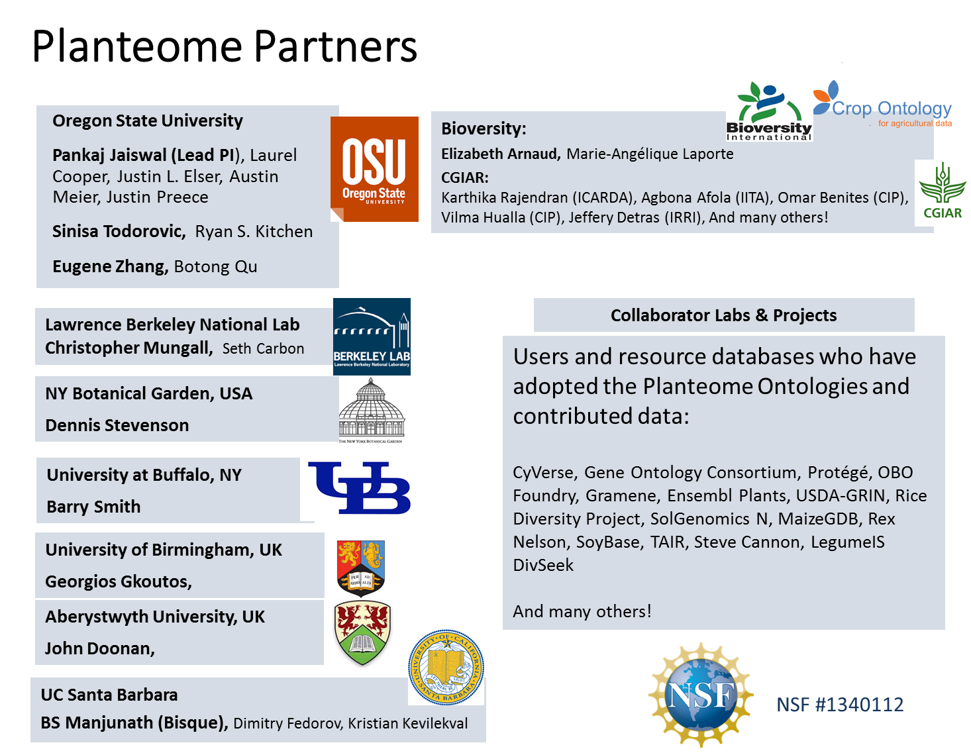
Elizabeth Arnaud, Bioversity:
Marie-Angélique Laporte, Leo Valette
CGIAR:
Rosemary Shrestha (CIMMYT), Karthika Rajendran (ICARDA), Agbona Afola (IITA), Omar Benites (CIP), Vilma Hualla (CIP), Jeffery Detras (IRRI)
And many others!
Victoria Carollo Blake, Taner Z. Sen
and the GrainGenes Team

Slide 16

Thank you!

Slide 17
Useful links:
Planteome homepage: http://planteome.org/
Development site: http://dev.planteome.org/
CyVerse Mirror site: http://draco.cyverse.org/amigo
Planteome on GitHub: https://github.com/Planteome
Plant Ontology Issue tracker: https://github.com/Planteome/plant-ontology/issues
Plant Trait Ontology Issue tracker: https://github.com/Planteome/plant-trait-ontology/issues
Plant Experimental Conditions Ontology Issue tracker: https://github.com/Planteome/plant-environment-ontology/issues
Planteome data files in Gaf 2.0 format: http://palea.cgrb.oregonstate.edu/viewsvn/associations/

