Slide 1

The Agronomy Ontology: A semantic layer to standardize agronomic data in farming systems research and development
Céline Aubert
AgrO curator
AgroFIMS project coordinator Consultant at IFPRI
Co authors: Marie-Angélique Laporte, Elizabeth Arnaud, Medha Devare
Notes:
Thank you for the introduction. I will present you the Agronomy Ontology. First let me explain you the project context

Slide 2

Context
What does variation in crop response to fertilizer look like for Sub-Saharan Africa?
I need data for my crop model – to recommend sustainable intensification possibilities for west Africa.
I want to predict land use change between 2030 and 2050 at national and sub-national level in South Asia.
Céline Aubert

Slide 3
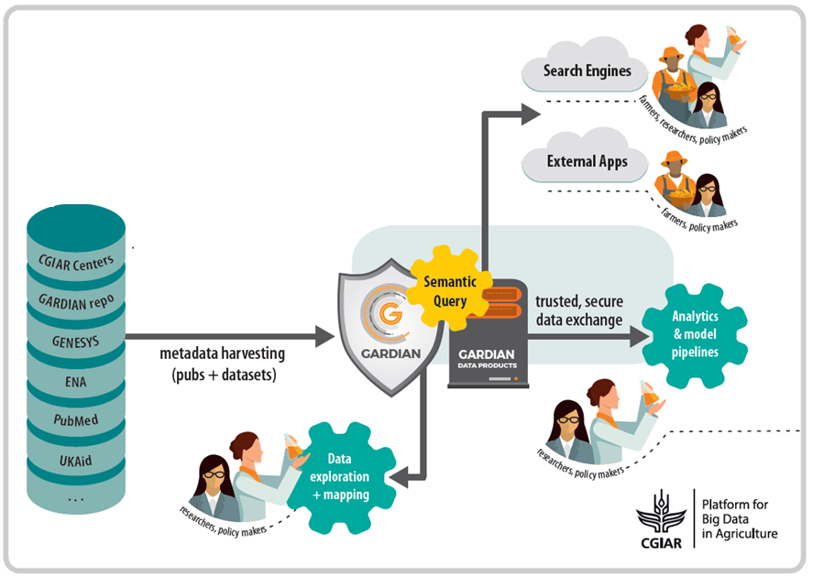
Context
Céline Aubert

Slide 4
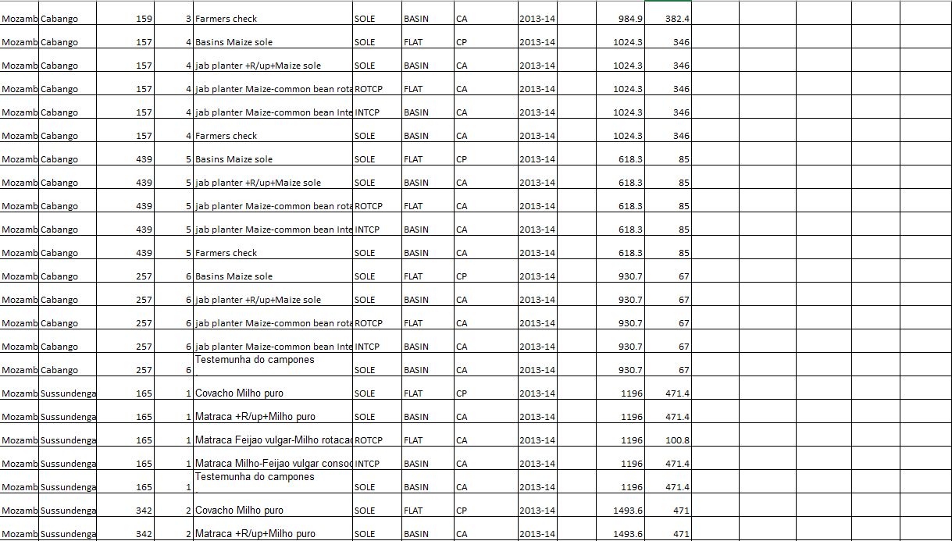
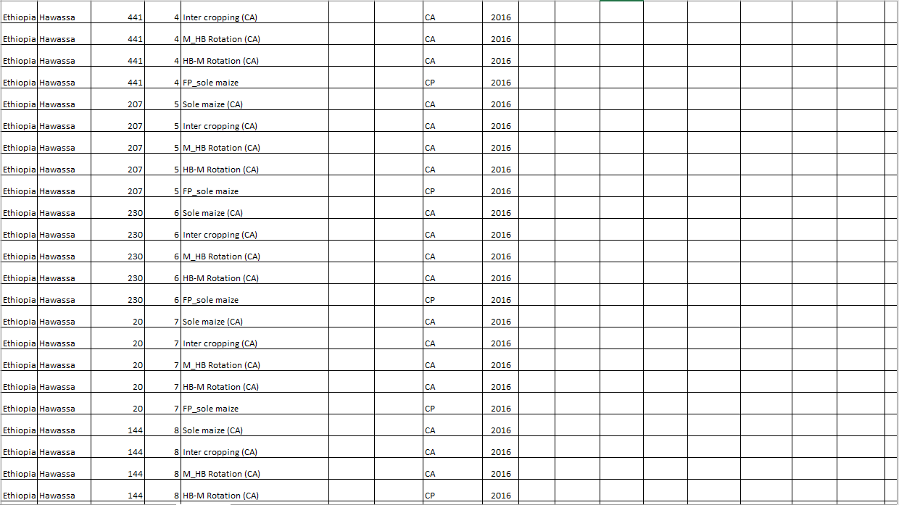
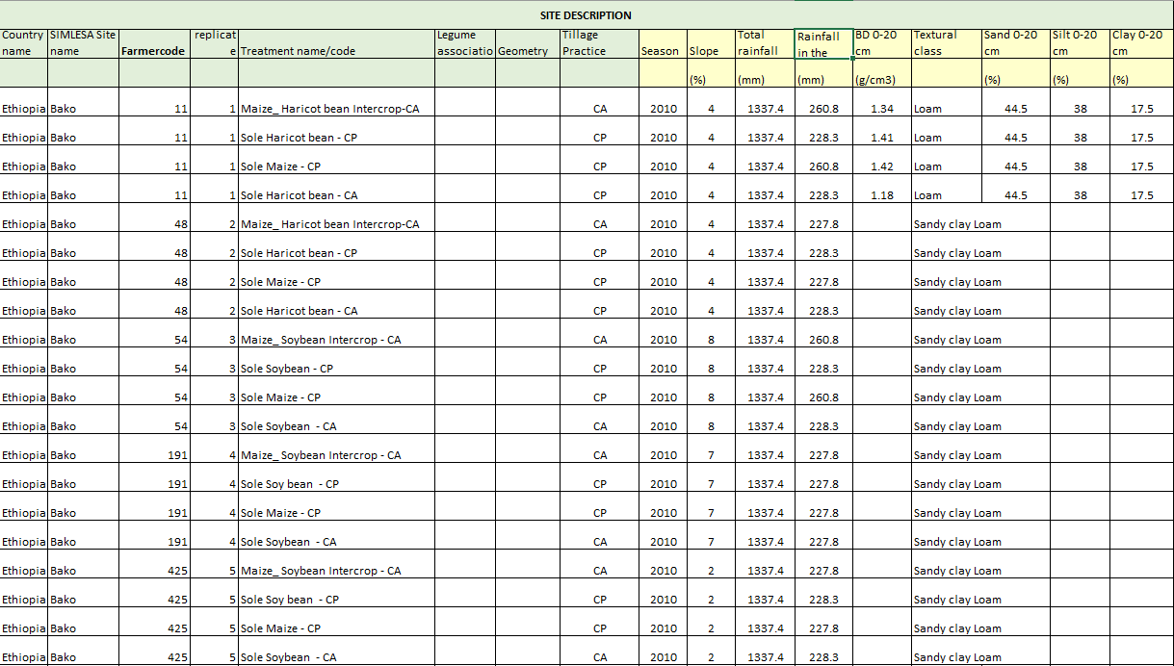
?
Medha Devare

Slide 5
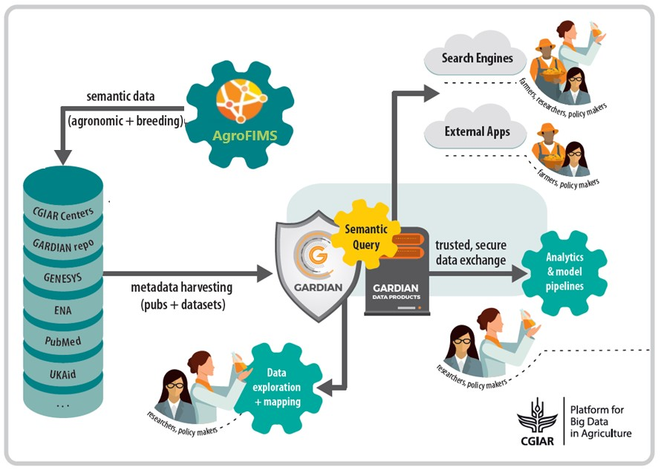
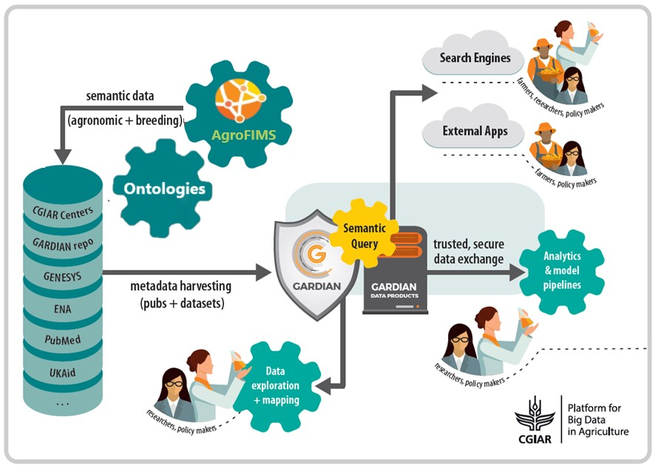
Context
Céline Aubert

Slide 6
Context
Céline Aubert

Slide 7




Ontologies reused in AgrO
Plant anatomy, morphology, growth
AgrO
Unit Ontology
Trait Ontology/ Crop Ontology
Units
Phenotypic traits in plants
PECO
Abiotic treatments, growing conditions and study types
Foundation of the ontology
Basic Formal Ontology
Qualities of entities
Chemical entities
ChEBI
PATO
Study design, protocols and instrumentation
Environments and related entities
Food products
FoodOn
Céline Aubert

Slide 8
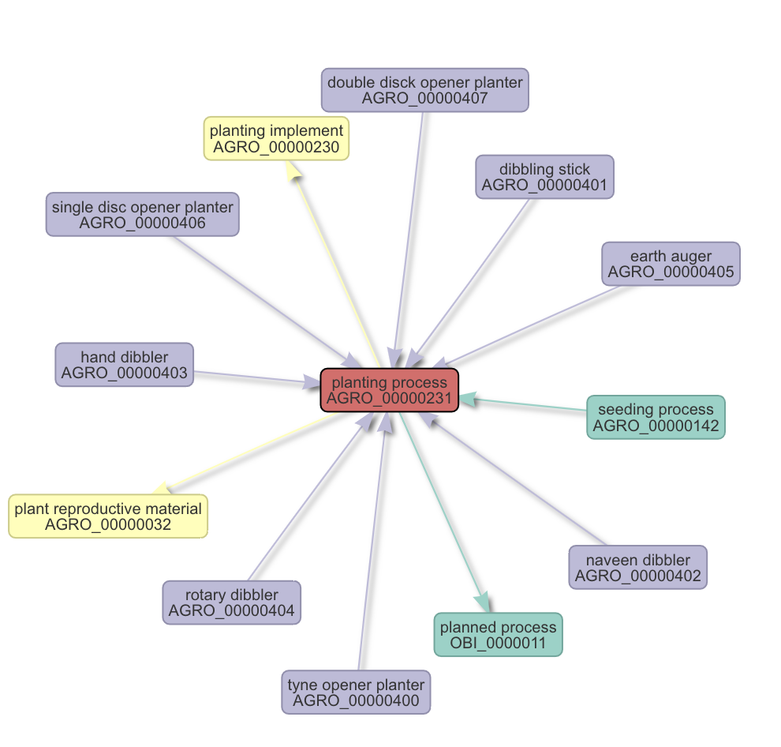
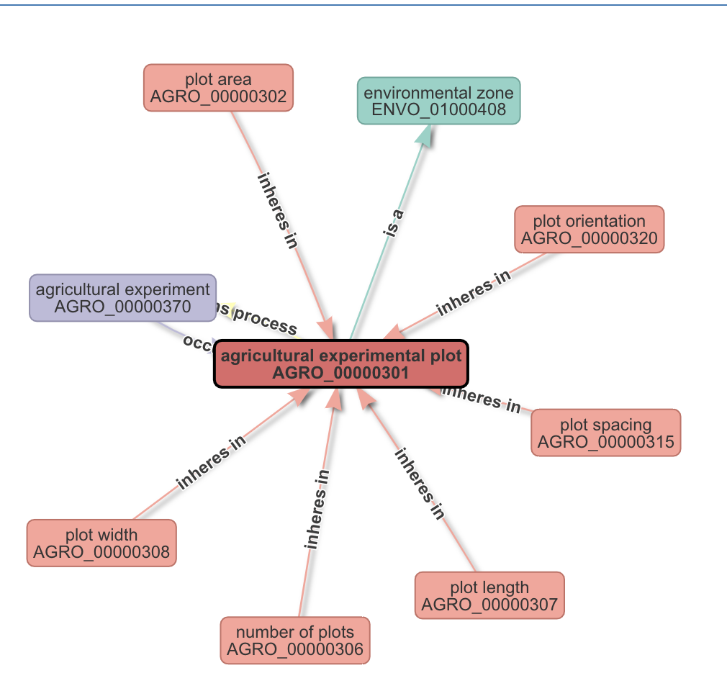
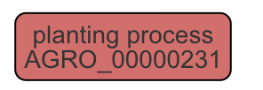
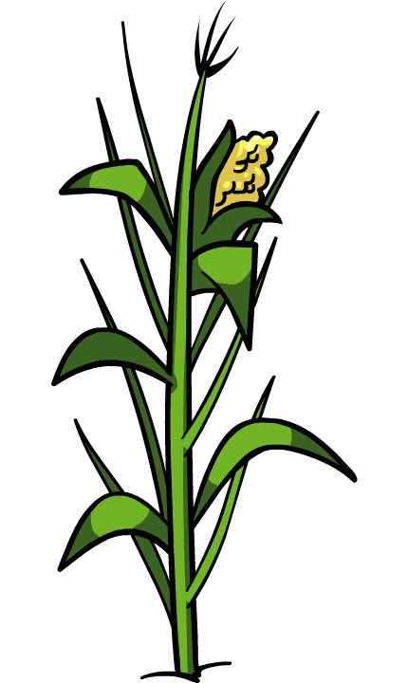
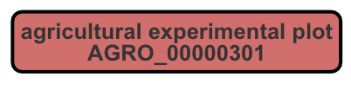
AgrO structure
Céline Aubert

Slide 9
AgrO structure
Agricultural experiment
realizes
occurs in
has part
Agronomic experimental design
Agricultural experimental plot
Treatment
Agricultural process
is a
Planned process
occurs in
part of
OBI
is a
is a
Completely randomized design
Agronomic fertilization process
Broadcast spreader
has participant
has participant
Sedimentary rock
Is a
Limestone
has role
Fertilizer
ENVO
ENVO
CheBI
has quality
Inorganic fertilizer amount
Amount
Kg/ha
is a
is unit of
PATO
UO
Céline Aubert

Slide 10
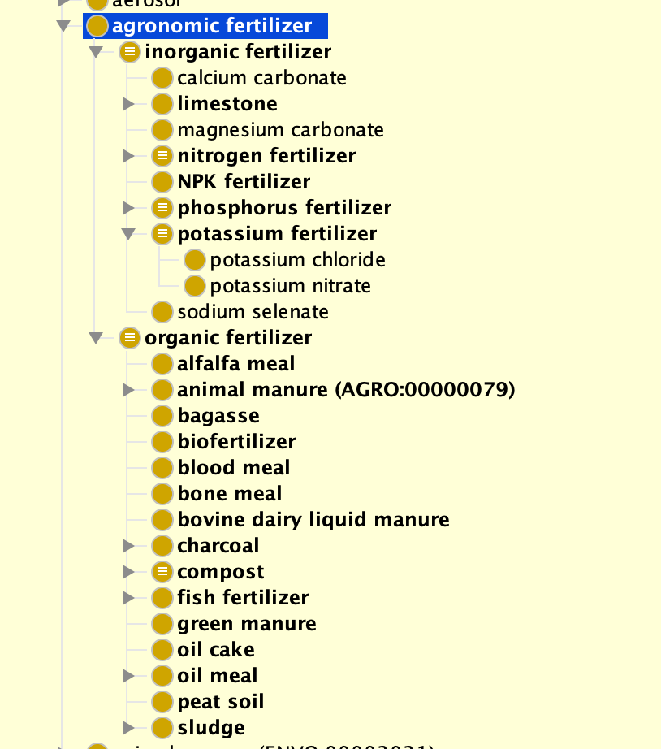
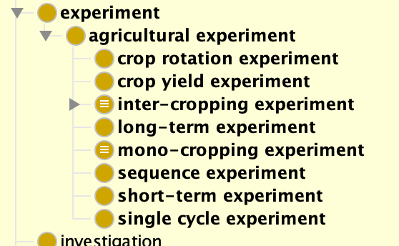
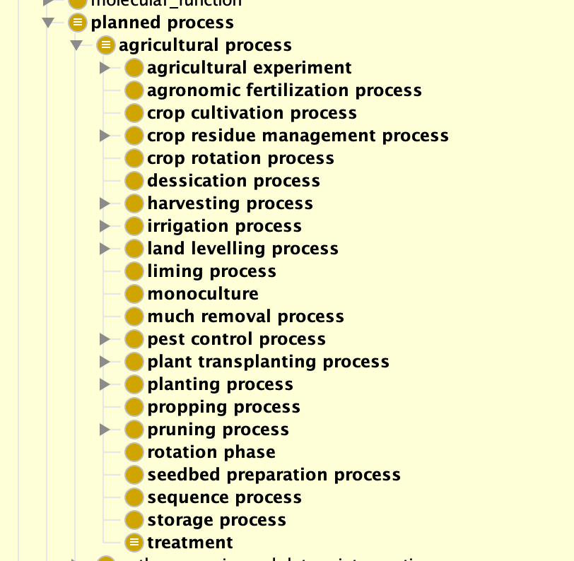
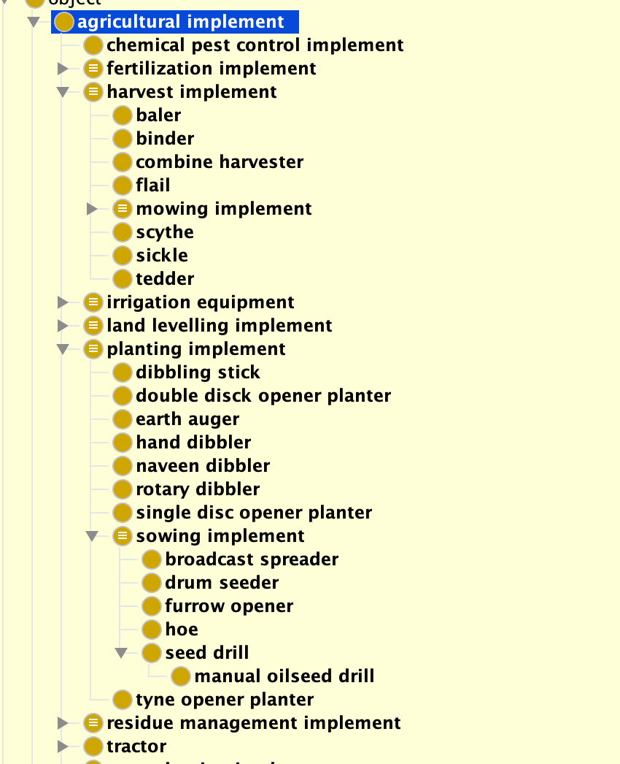
AgrO content
Céline Aubert

Slide 11



AgrO maintenance
Follows OBO
Foundry principles
Ontology publisher
Issues tracker
Ontology builder
https://github.com/AgriculturalSemantics/agro/issues
Céline Aubert

Slide 12
Acknowledgments
Contributors
Pier Luigi Buttigeg – ENVO - Alfred Wegener Institute
Chris Mungall – Berkley Lab
Richard Ostler - Rothamsted Research
Damion Dooley - FoodOn - University of British Columbia
Cheryl Porter - ICASA - University of Florida
Jeffrey White - ICASA - University of Florida
Léo Valette – Bioversity International (2015)
Core team
Marie-Angélique Laporte – AgrO developer -Alliance Bioveristy-CIAT
Céline Aubert – AgrO developer and curator - IFPRI
Elizabeth Arnaud – Project co-lead – Alliance Bioversity- CIAT
Medha Devare – Project lead - IFPRI
Céline Aubert

Slide 13
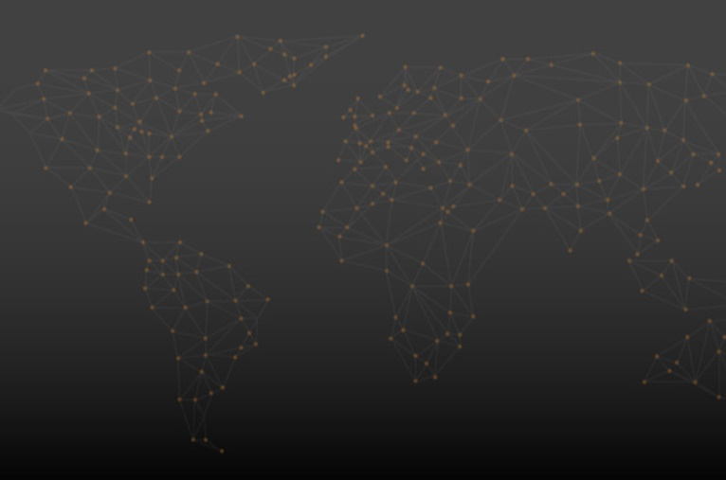

Thank you

