Slide 1

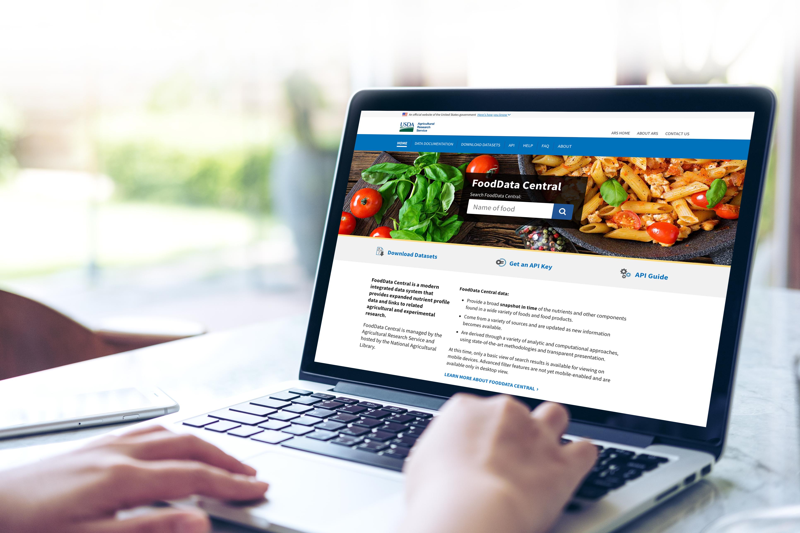
USDA ARS FoodData Central Ontology Integration
FoodData Central
United States Department of Agriculture
Kyle A. McKillop, Damion M. Dooley, Tarini Naravane, James M. Harnly, John Finley, Naomi K. Fukagawa

Slide 2
What is FoodData Central?
An integrated data system that provides expanded component profile data and links to related agricultural and experimental research.
Integrated Datasets
Standard Reference Legacy – Historical analytical component analysis
FNDDS – What We Eat in America survey foods
Branded Foods – Food label as provided by industry
Foundation Foods – New analytical component analysis
Experimental Foods – Launching October 2020

Slide 3
What is FoodData Central?
An integrated data system that provides expanded nutrient profile data and links to related agricultural and experimental research.
Integrated Datasets
Standard Reference Legacy – Historical analytical component analysis
FNDDS – What We Eat in America survey foods
Branded Foods – Food label as provided by industry
Foundation Foods – New analytical component analysis
Experimental Foods – Launching October 2020

Slide 4
Ontology Goals
1. Application usability
Harmonizing multiple controlled vocabulary systems.
Food classification and categorization
Nutrient classification and analytical methods of analysis
Metadata definitions on agriculture, environment, processing, etc.
Increasing search understanding and capabilities
“Foods high in essential amino acids and low in sodium per 100 gram servings”
Discovering and understanding food component differences.
Ripe versus Overripe
2. Research Capabilities
Gaining insight in our data through ontological pathways
Agriculture → Foods → Human health outcomes

Slide 5
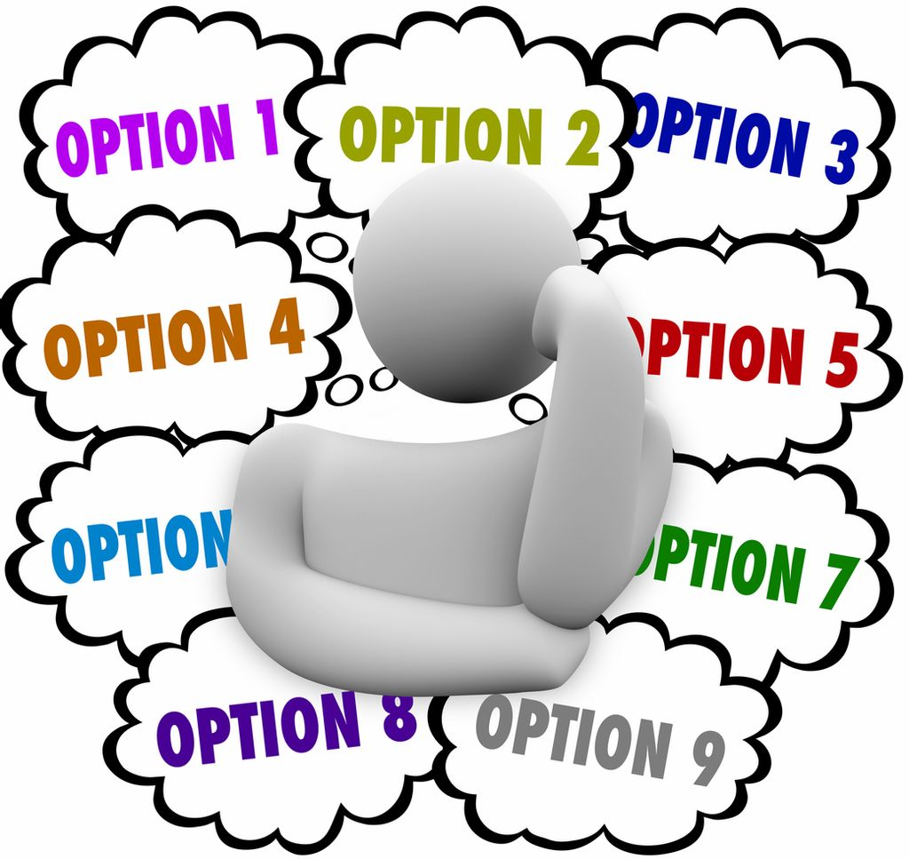
Challenge 1. Selecting an Ontology

Slide 6
FoodOn and the OBOFoundry Family
+ Interoperability
+ Attractive domain specific vocabularies
Agricultural (AGRO)
anatomical (PO, UBERON)
taxonomic (NCBITaxon)
chemical (CHEBI)
environmental (ENVO)
Missing terms & differing definitions
Raw
Food Processing
Fortification and additives
Degree of plan maturity

Slide 7

Challenge 2. Mapping Data

Slide 8
FoodData Central Ontology
FoodData Central Ontology Integration Layer
FoodOn
FoodData Central Data
Foundation Foods
Vegetable
Raw
???
Mature
Fortified
Honeycrisp

Slide 9

Challenge 3. Technology

Slide 10

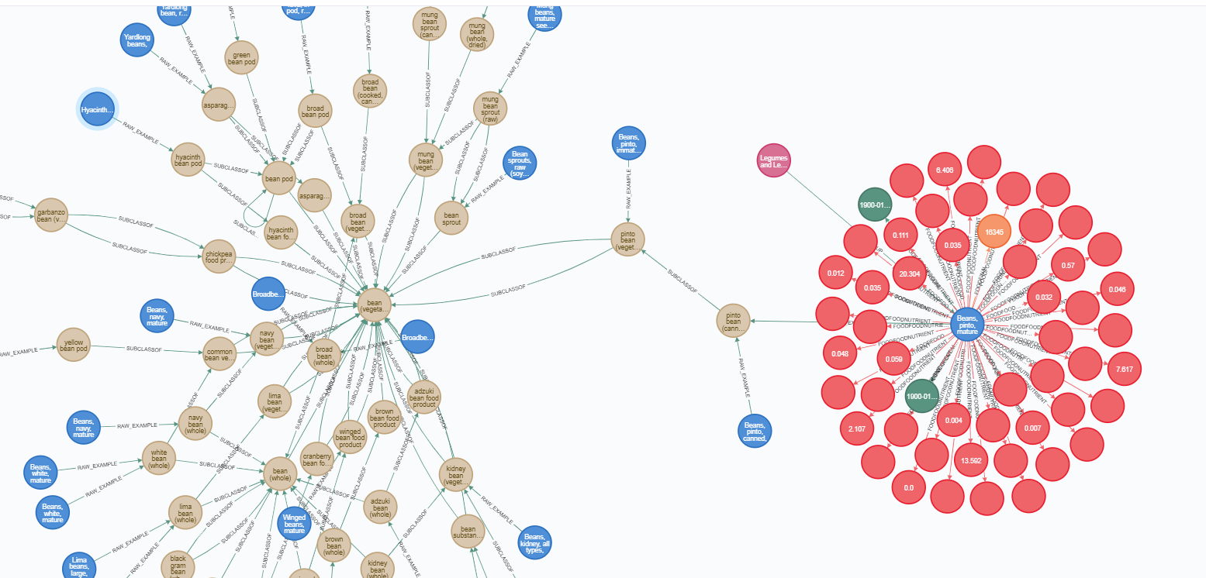
Graph Database Infrastructure Launches October 2020

Slide 11
Graph Database Infrastructure Launches October 2020
neo4j
Public site (fdc.nal.usda.gov)
Technology transfer
No ontology integration
Prototype→
Brown = FoodOn
Blue = Foundation Food
Red = Samples

Slide 12
Remaining Challenges and Roadmap
Ontology Expertise (2020)
Research
Mapping efforts
Technology infrastructure for data/term curation (2021)
Enhancing application with ontology (2021+)
Implement artificial intelligence to give us insights about our data (2022?)

