Slide 1
Cheferone
Brad Ritzema, Sanjeev Dasari, Hamin Hong, Jason Park, Won Seok Park

Slide 2
“Cheferone allows beginner chefs to view recipes and add those recipes to a planner.”
Vision Statement

Slide 3
WHAT
WHY
HOW

Slide 4
Demonstration
1. Browse & Search a recipe
2. Planned recipe
3. Aggravated ingredient

Slide 5
UI / UX

Slide 6
Information systems design
ROOM SQLite
Database table

Slide 7
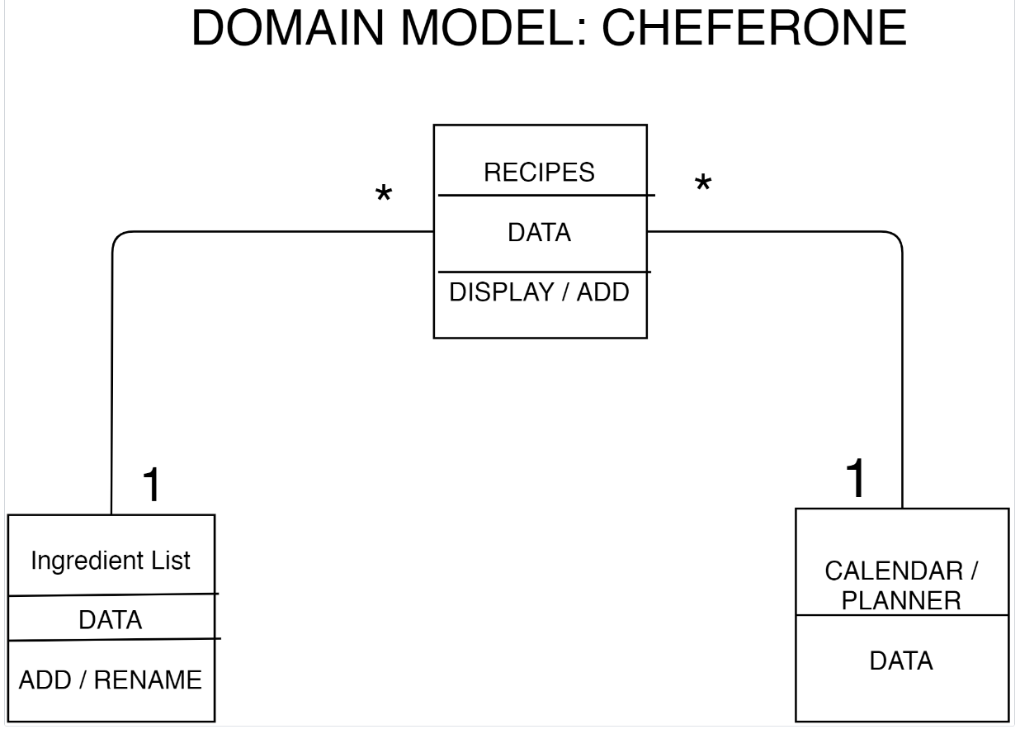

Slide 8
Status Report
Implementation of API
Aggregated list

Slide 9
Thank You

Slide 10
Questions

