Slide 1
Cheferone
Brad Ritzema, Sanjeev Dasari, Hmain Hong, Jason Park, Won Seok Park

Slide 2
Vision Statement
Cheferone allows beginner chefs to view recipes and add those recipes to a planner. On the planner you will be able see each of your individual recipes. Unlike competitors such as AllRecipes and Spoonacular, you will also be able to see your ingredients from each recipe in one centralized list! On this list, the quantities of ingredients will be combined! For example, a half a pound of beef from your spaghetti recipe and a half a pound of beef from your burger recipe will be simplified to one pound of beef. Because of these features, planning and shopping for your meals will be easier! No longer will you resort to your default shopping list because making a list with new recipes is such a hassle. Cheferone takes that hassle away in order create a better culinary experience.
To transform Cheferone from an idea to a usable app, the Foodies team will be utilizing Android Native for app development and the Spoonacular API so that any android user can access hundreds of thousands of recipes on this app.

Slide 3
Demonstration
1.
2.
3.

Slide 4
User Interface Design

Slide 5
UI

Slide 6
Information systems design

Slide 7
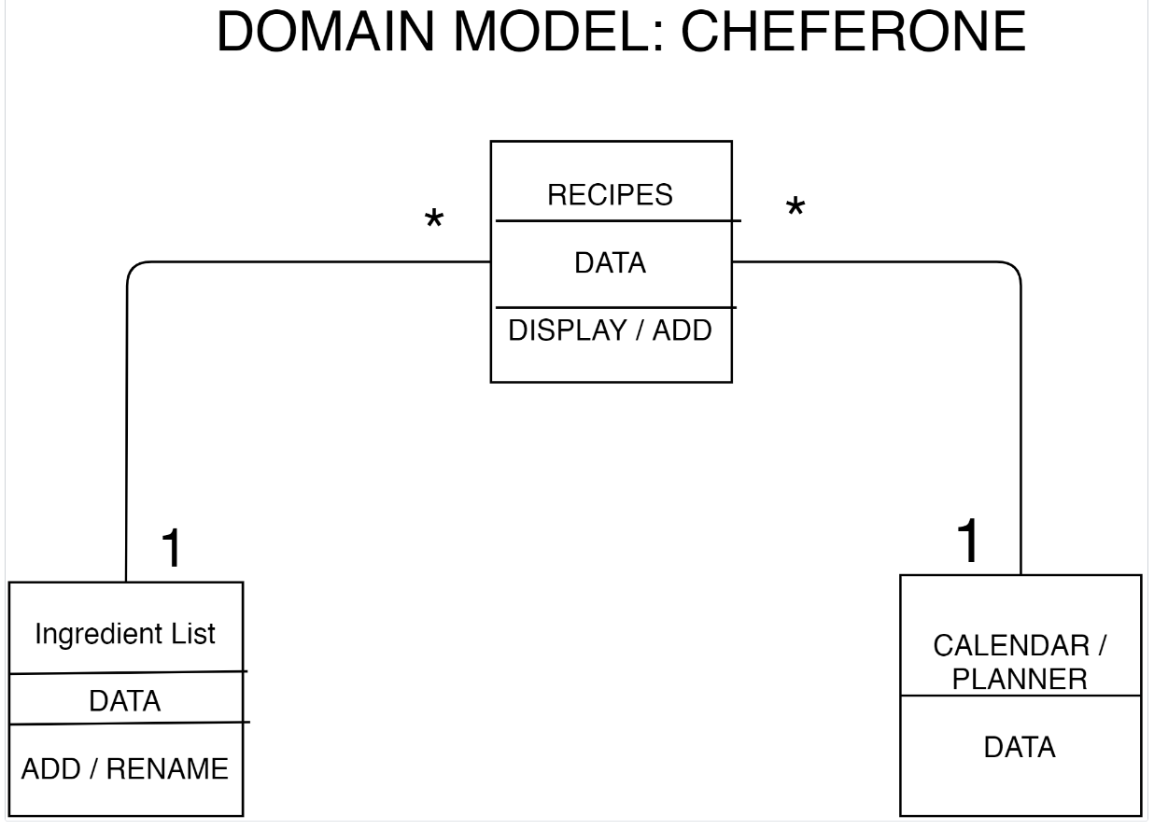

Slide 8
Thank You

Slide 9
Question

