Slide 1
RepCut: Superlinear Parallel RTL Simulation with Replication-Aided Partitioning
By Haoyuan Wang, Scott Beamer
Presenter: Boyang Zhang, Department of ECE, UW Madison
bzhang523@wisc.edu

Slide 2
About me
Education
BS in School of Electronic and Information, South China University of Technology, China, 2020.
MS in Department of ECE, Rutgers University, 2021.
Second-year PhD student (supervisor: Prof. Tsung-Wei Huang).
Current research
Incremental task graph partitioning.
A paper^{[1]} of task graph partitioning was accepted to DAC’24.
I am submitting a paper to ICCAD’24.
[1] Boyang Zhang, Dian-Lun Lin, Che Chang, Cheng-Hsiang Chiu, Bojue Wang, Wan Luan Lee, Chih-Chun Chang, Donghao Fang, and Tsung-Wei Huang, "G-PASTA: GPU Accelerated Partitioning Algorithm for Static Timing Analysis," ACM/IEEE Design Automation Conference (DAC), San Francisco, CA, 2024

Slide 3
Outline
Introduction to Register Transfer Level(RTL) simulation
What is RTL simulation?
Why partitioning?
Partitioning challenges?
Introduction to RepCut
Partitioning algorithm walkthrough
Scheduling the partitions
Experimental results
Current research
Limitations of RepCut partitioning
Our partitioning

Slide 4
Introduction to RTL simulation

Slide 5
What is RTL simulation?
A process to simulate the behaviors of a Register Transfer Level(RTL) design to verify its functionality.
Event-driven(more accurate) or full-cycle(less time-consuming).
Full-cycle simulator: Verilator^{[2]}, ESSENT^{[3]}(unoptimized).
[2] https://github.com/verilator/verilator
[3] https://github.com/ucsc-vama/essent
Notes:
So, what is RTL simulation?
It is a process to simulate the behaviors of a Register Transfer Level design to verify the design’s functionality and correctness
RTL simulator can be mainly classified as 2 types, event-driven RTL simulator and full-cycle RTL simulator.
An event-driven simulator takes each change of the input stimulus as an event and propagate this value changes through the circuit.
A full-cycle simulator is oblivious to the changes of input stimulus within one cycle and only stimulates the design once per cycle.
So in a word, an event-driven simulator gives more accurate simulation results but when it comes to very large circuit design, full cycle RTL simulator is much faster.
In this paper, we focus on full-cycle RTL simulator and there are 2 full-cycle RTL simulators that are evaluated in this paper, Verilator, and ESSENT.
More specifically, the partitioning method introduced by RepCut is operated in an unoptimized version of ESSENT to demonstrate its effectiveness verses the baseline partitioning
method in Verilator, which we will talk a bit more in experimental results.

Slide 6
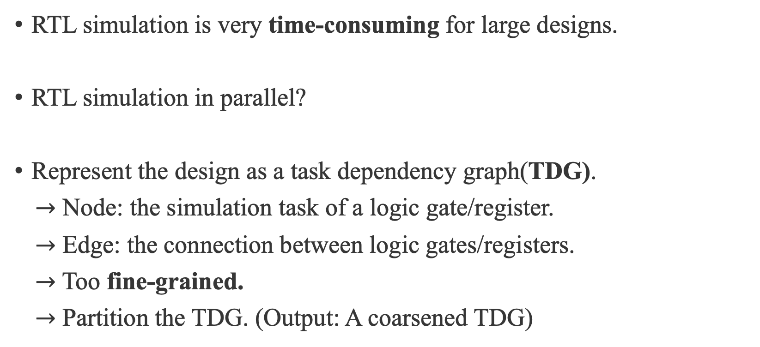
Why partitioning?
RTL simulation is very time-consuming for large designs.
RTL simulation in parallel?
Represent the design as a task dependency graph(TDG).
$→$ Node: the simulation task of a logic gate/register.
$→$ Edge: the connection between logic gates/registers.
$→$ Too fine-grained.
$→$ Partition the TDG. (Output: A coarsened TDG)
Notes:
So, this paper talks about partitioning in RTL simulation.
First, we need to answer a question, why do we need partitioning in RTL simulations.
Well, RTL simulation is very time-consuming when it comes to large designs even for a full-cycle simulator.
For a very large design that contains millions or billions of gates, RTL simulation can be bottleneck in the whole circuit design process.
So how to speedup this simulation process, well naturally we will think about maybe we can do it in parallel.
A typical first step to do RTL simulation in parallel is to represent the hardware design as a TDG, which is a task dependency graph.
TDG is essentially a dependency acyclic graph.
For TDGs in RTL simulation, each node represents a simulation task of a register or a logic gate that we want to test in the design.
Each edge represents the connections among these logic gates and registers.
With TDGs, we can distribute each simulation task to CPU/GPU threads to do them in parallel.
But, as I said, the circuits can contain billions of gates, and such fine-grained distribution of tasks is just too overwhelming to CPU or even GPU!
To solve this issue, we can coarsen the TDG by partitioning it.
Partitioning a TDG here is to cluster multiple gates or registers into one partition, or one task.
After this, we can distribute the partitions to either CPU/GPU threads to achieve RTL simulations in parallel.

Slide 7
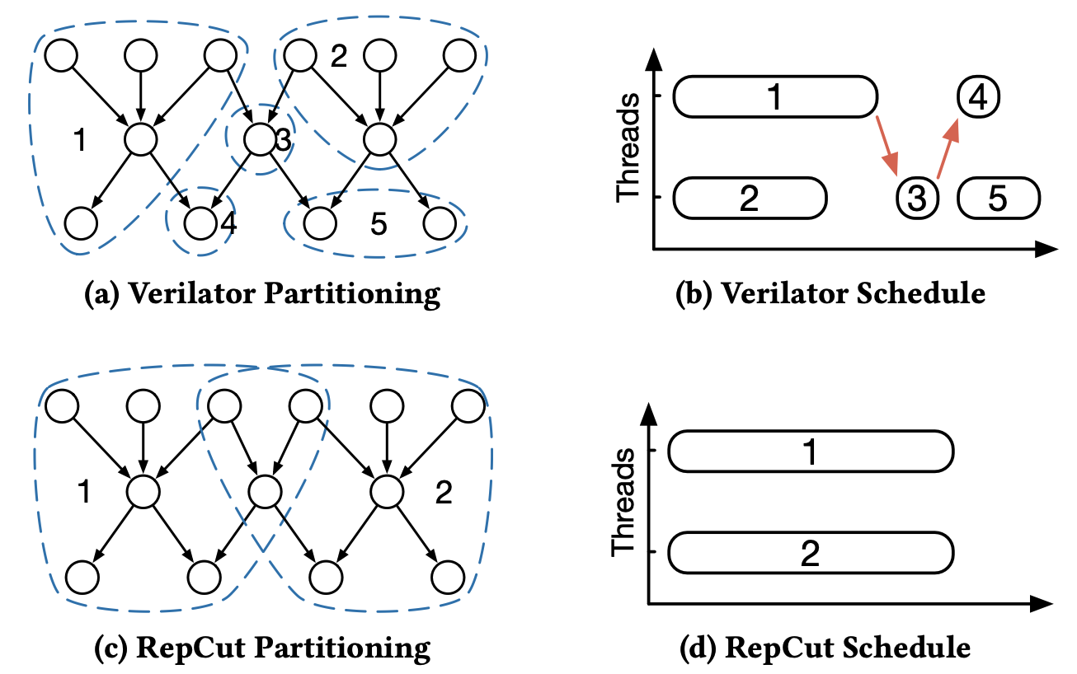






Partitioning challenges?
Goal: Balanced partitions and minimal synchronization effort.
$$sync$$
$$one simulation cycle$$
$$sync$$
$$sync$$
$$sync$$
$$one simulation cycle$$
Notes:
Now, what are the challenges for partitioning such a TDG in RTL simulations?
To understand the challenges for partitioning here, let me first bring up our goal here for the partitioning.
Ideally, we want our partitions to be balanced and by balanced I mean the number of tasks within a partition should be roughly the same.
And we want to have minimal synchronization effort within a simulation cycle. Ultimately, all the threads should only synchronize once at the end of the simulation cycle.
Now, let’s look into the 4 figures here to understand why we want such a goal for partitioning.
In this figures, figures A and C shows the same TDG but they are applied with different partitioning methods.
Figure A shows the partitioning method in the baseline Verilator and figure C shows the partitioning method introduced by RepCut.
Figure B and D shows the scheduling, or the distributions, as I mentioned in the last slides, of partitions to the threads for Verilator partitioning and RepCut partitioning accordingly.
The impact of these 2 different partitioning methods to the runtime of RTL simulations is quite obvious here in this example.
Figure B shows that if we apply Verilator partitioning in this example, threads will need to synchronize 3 times.
Meanwhile Figure D tells us if we apply RepCut partitioning, we are not only able to synchronize only once but also able to finish one simulation cycle faster.
Also, comparing figure B and D, we can clearly see that Verilator provides a very unbalanced partitioning results which cause the threads being idling, the so-called bubbles in simulation process.
While RepCut provides a perfectly balanced partitioning results with all the threads running the entire time within the simulation cycle.
So what’s the magic RepCut is doing here? In figure C, RepCut is replicating the overlapping tasks between partition 1 and partition 2 so that when they are being executed by the threads, they don’t have
to wait for each other but only need to synchronize once at the end of the simulation cycle.

Slide 8
Introduction to RepCut

Slide 9
Introduction to RepCut
An example of RepCut partitioning.
Schedule the partitions.
Experimental results.
Notes:
And in the remaining slides, I will reveal RepCut’s magic on how it performs its partitioning by walking through an example in the paper.
I would also talk about how RepCut schedule the partitions to the threads to do RTL simulations in parallel.
Finally, I would present the experimental results.

Slide 10
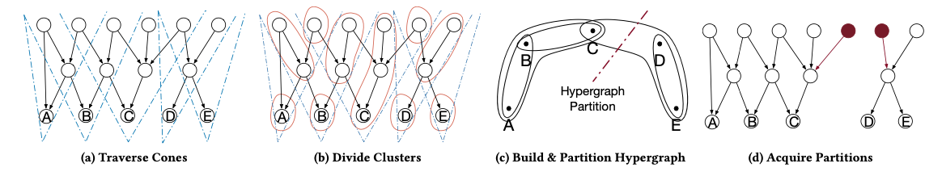



Introduction to RepCut – An example
Input: A fine-grained TDG.
Output: A coarsened TDG.
$→$ Build “cones”.
$→$ Cluster the graph.
$→$ Build hypergraph and partition.
$→$ Acquire partitions.
$$Partition 1$$
$$Partition 2$$
Notes:
Now, let’s dive into an example of how RepCut performs its partitioning method to a TDG.
Again, the input of a partitioning method for TDG, is a fine-grained TDG. As is shown in the left most figure A here, each task represents the simulation task of a register or logic gate and each edge represents their connections.
The output of a partitioning method for TDG, is a coarsened TDG. As is shown in the right most figure D here. Through RepCut, we have divided the TDG into 2 partitions.
All the tasks in the left are included in partition 1 and all the tasks in the right are included in partition 2.
RepCut’s partitioning method contains 4 steps, which are shown in the below figures from left to right.
We first build the so-called cones in the graph. Then we cluster the graph according to the cones we built.
Then we build a hypergraph according to the clusters and called a hypergraph partitioner to partition it.
Finally, we acquired our desired partitions from the hypergraph partitioning results.

Slide 11
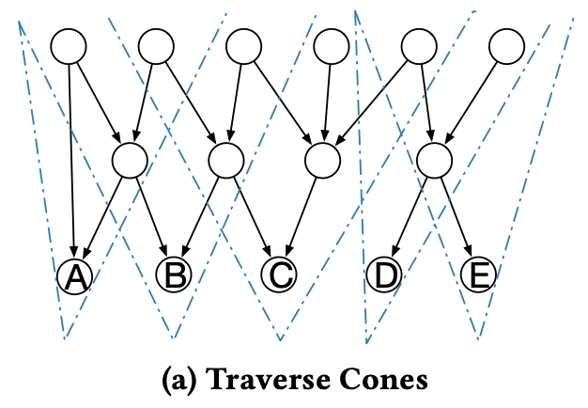
Introduction to RepCut – Build “Cones”
Start from sink nodes, traverse nodes within its ”cone”.

Slide 12
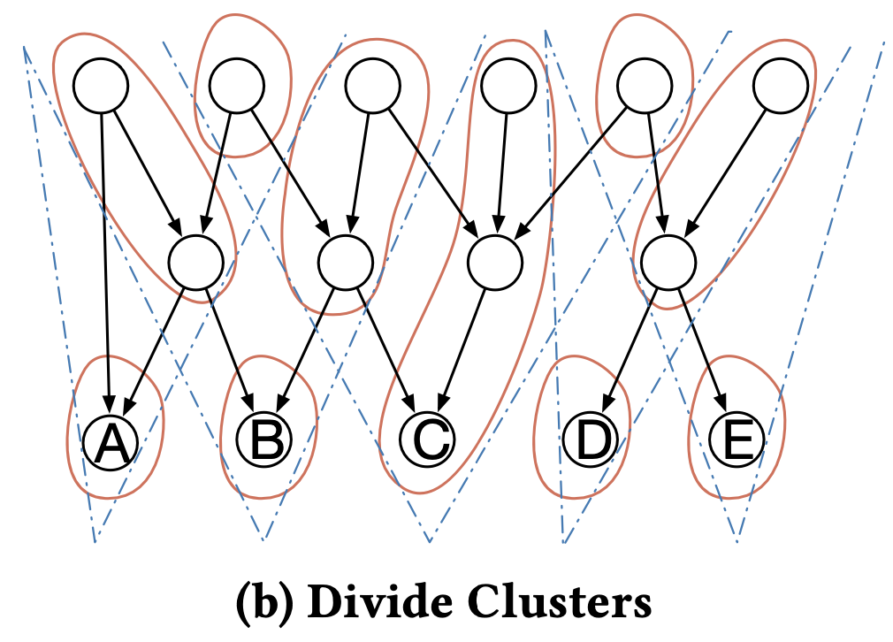










Partitioning Walkthrough
Cluster tasks according to ”cones”.
$$ABC$$
$$BC$$
$$CDE$$
$$E$$
$$AB$$
$$A$$
$$B$$
$$C$$
$$D$$
$$E$$

Slide 13
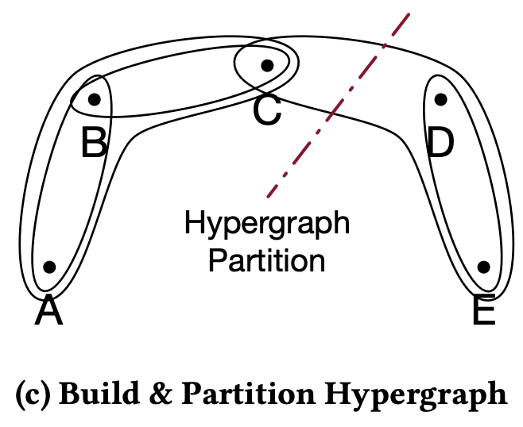
Partitioning Walkthrough
Build hypergraph according to clusters

