Slide 1
RepCut: Superlinear Parallel RTL Simulation with Replication-Aided Partitioning
By Haoyuan Wang, Scott Beamer
Presenter: Boyang Zhang
Department of Electrical and Computer Engineering
University of Wisconsin at Madison, Madison, UT
https://tsung-wei-huang.github.io/
Notes:
Hello, everybody. My name is Tsung-Wei Huang. Today, I am going to talk about Intelligent high-performance computing, classical and quantum.
I am going to show you how to overcome new challenges in heterogeneous computing so you can quickly accelerate your application performance.

Slide 2
About me
Education
BS in School of Electronic and Information, South China University of Technology, China, 2020.
MS in Department of ECE, Rutgers University, 2021.
Second-year PhD student (supervisor: Prof. Tsung-Wei Huang).
Current Research
Task graph partitioning (TGP) to enhance task parallel workloads (e.g., STA).
Published a GPU-accelerated TGP paper^{[1]} in DAC’24.
Submitting an incremental TGP paper to ICCAD’24.
[1] Boyang Zhang, Dian-Lun Lin, Che Chang, Cheng-Hsiang Chiu, Bojue Wang, Wan Luan Lee, Chih-Chun Chang, Donghao Fang, and Tsung-Wei Huang, "G-PASTA: GPU Accelerated Partitioning Algorithm for Static Timing Analysis," ACM/IEEE Design Automation Conference (DAC), San Francisco, CA, 2024

Slide 3
Outline
Introduce Register Transfer Level (RTL) simulation
What is RTL simulation?
Why partitioning?
Partitioning challenges?
Introduce RepCut
Walk through an example
Schedule the partitions
Experimental results
Introduce current research

Slide 4
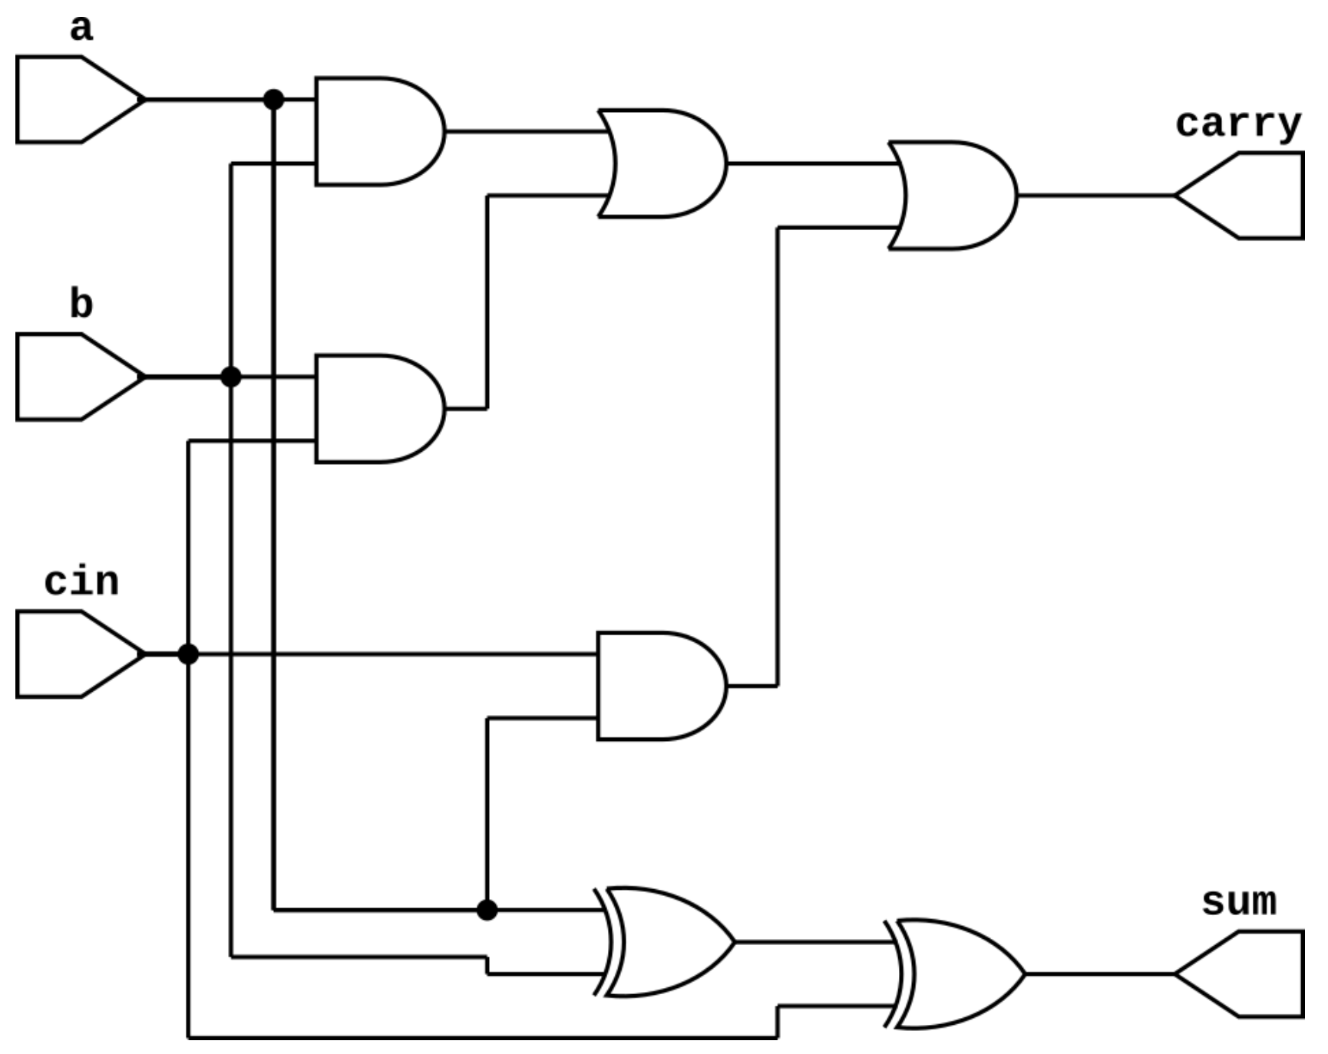
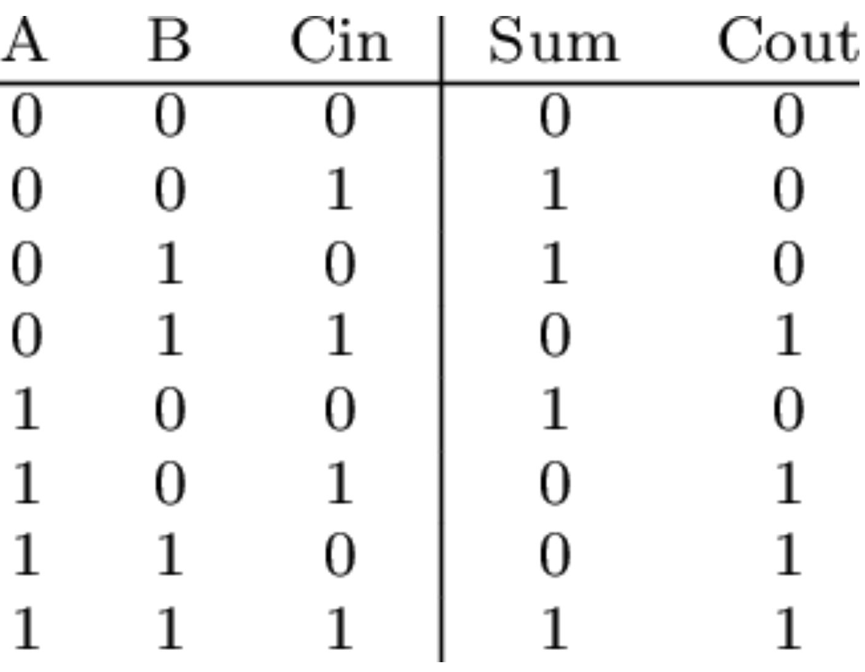


What is RTL simulation?
A process to simulate the behaviors of a Register Transfer Level (RTL) design to verify its functionality.
$full adder truth table$^{[3]}
$full adder$^{[2]}
[2] https://circuitfever.com/full-adder-verilog-code
[3] Turner, Andrew & Miller, Julian. (2014). NeuroEvolution: Evolving Heterogeneous Artificial Neural Networks. Evolutionary Intelligence. 7. 135-154. 10.1007/s12065-014-0115-5.

Slide 5

What is RTL simulation?
A process to simulate the behaviors of a Register Transfer Level (RTL) design to verify its functionality.
$$input stimulus$$
$full adder truth table$^{[3]}
$full adder$^{[2]}
[2] https://circuitfever.com/full-adder-verilog-code
[3] Turner, Andrew & Miller, Julian. (2014). NeuroEvolution: Evolving Heterogeneous Artificial Neural Networks. Evolutionary Intelligence. 7. 135-154. 10.1007/s12065-014-0115-5.

