Slide 1


Base Composition Heterogeneity
James Fleming - j.f.fleming@nhm.uio.no
@JamesfvFleming
NHM UiO

Slide 2


What is Base Composition and why do we care about its Homogeneity?
Put simply, the proportion of nucleotides or amino acids (Bases) in a sequence.
Generally, sequences that are closely related ought to have relatively similar proportions of those bases, even if they are in different places.
This assumption is one that a lot of phylogenetic models rely on, we call it the assumption of homogeneity
A/C/G/T
0.25/0.25/0.25/0.25
0/0.25/0/0.75
0.25/0.25/0.25/0.25
0.17/0.25/0.17/0.42
A/C/G/T
0.375/0.25/0.25/0.125
0.25/0.25/0.25/0.25
0.375/0.25/0.125/0.25
0.33/0.25/0.21/0.21
CATGAGTC
CAAGAGTC
CTTTTTTC
ACAGGTTC
CGTAACTG
Total
CAAATCTG
Total

Slide 3

The Assumption of Homogeneity?
When constructing a phylogenetic tree, a sequence ”evolves” according to a model.
These models consist of a substitution matrix and a set of frequencies.
Frequencies are often derived from the data – though sometimes they are sourced from large databases
Together, they determine the probability that, at any given point in time, a base will change from one state to another.
But if one sequence has a radically different composition, it likely has different probabilities for how it changes at any given point!

Slide 4
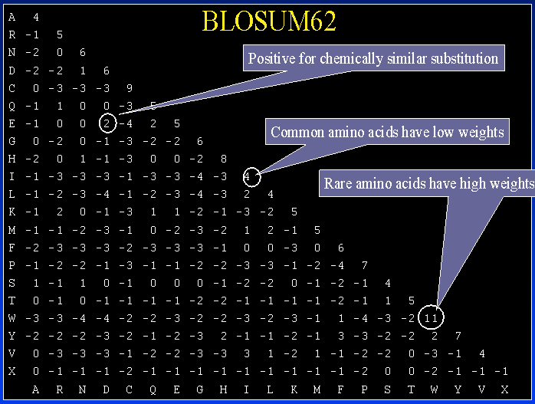
A Substitution Model: Blosum62

Slide 5
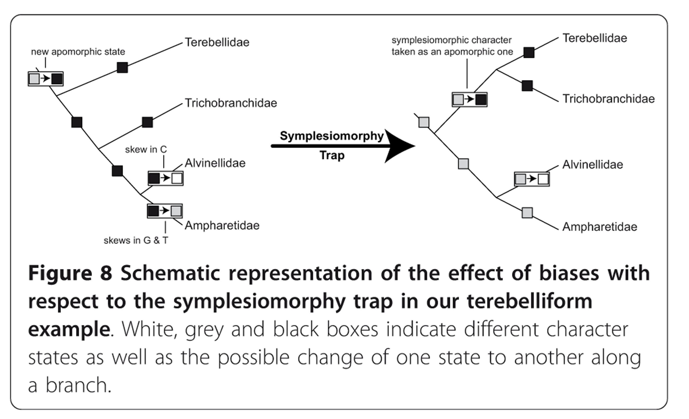
Symplesiomorphy Trap

Slide 6
Amino Acid and Nucleotide Data
Amino Acid, rather than Nucleotide data is often used over long timescales for phylogenetics.
As many codon combinations code for one amino acid, more resistant to change over time.
But this can present a greater issue with compositional heterogeneity – more characters, more possibility for model violating levels of variation across a dataset.

Slide 7
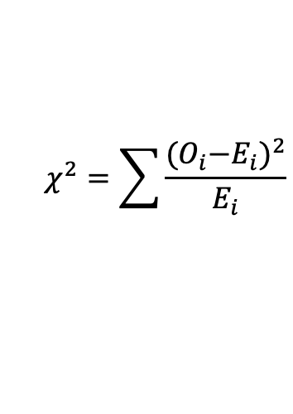
Chi-squared test for Compositional Heterogeneity
It’s just a classic Chi-Squared test that you remember from your undergraduate or high school statistics class!
O is OBSERVED Frequencies (Frequencies in the sequence). E is EXPECTED Frequencies (Average in the dataset)
High chance of Type 2 Error (False Positive)
More comparisons, more chance that just something, anything will give you a significant result.
IQ-Tree implements a much simpler version of this – it is fast, so can be useful to get an idea of your data, but don’t take it as anything more than a general proposal!
$$χ^{2}=\sum{\frac{{{(O}_{i}−E_{i})}^{2}}{E_{i}}}$$

Slide 8
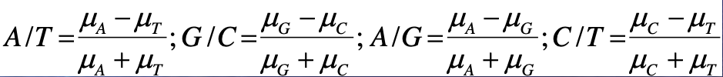
Skew Values
Perna & Kocher (1995); Zhong et al. (2011)
First of two equations today (Sorry)
Strands and Classes can be skewed
Strands: skewed in favour of AT or GC
Classes: skewed in favour of AG or CT
The Skew Value represents how much these groups make up a dataset.

Slide 9
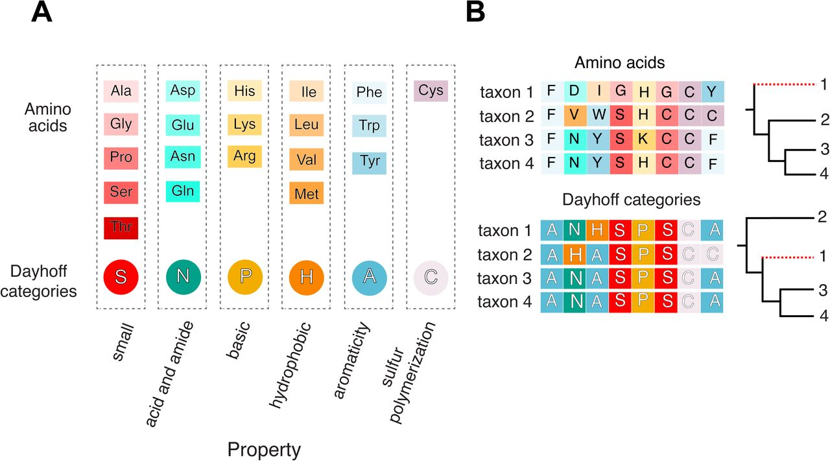
Recoding
Recoding is a way to deal with this.
By compressing each amino acid to, most commonly, six groups based on their shared properties, you can reduce compositional variation.
Not always six! DNA can be recoded to Purines/Pyramidines, and Amino Acids can be recoded in a lot of ways

Slide 10
Get better models?
Site Specific Models!
By assigning separate substitution profiles to collections of similar sites, you can overcome problems from lumping everything together in one set of compositional frequencies
But computationally much more intensive!
A/C/G/T
0.25/0.25/0.25/0.25
0/0.25/0/0.75
0.25/0.25/0.25/0.25
0.17/0.25/0.17/0.42
CATGAGTC
CTTTTTTC
CGTAACTG
Total
Profile 1: Sites 2, 4, 6
Profile 2: Sites 1, 3, 7 Profile 3: Sites 5, 8

Slide 11
Posterior Predictive Testing
Posterior Predictive tests are a broad group of diagnostic tests that use a Bayesian Posterior (In this case the treelist chain made from a Bayesian analysis)
They simulate replicates of the dataset based on this posterior, and then test the replicates to see how similar they are to the original dataset.
This can help diagnose problematic sequences or genes
But needs to be done after an initial analysis, so again, very intensive computationally!

Slide 12
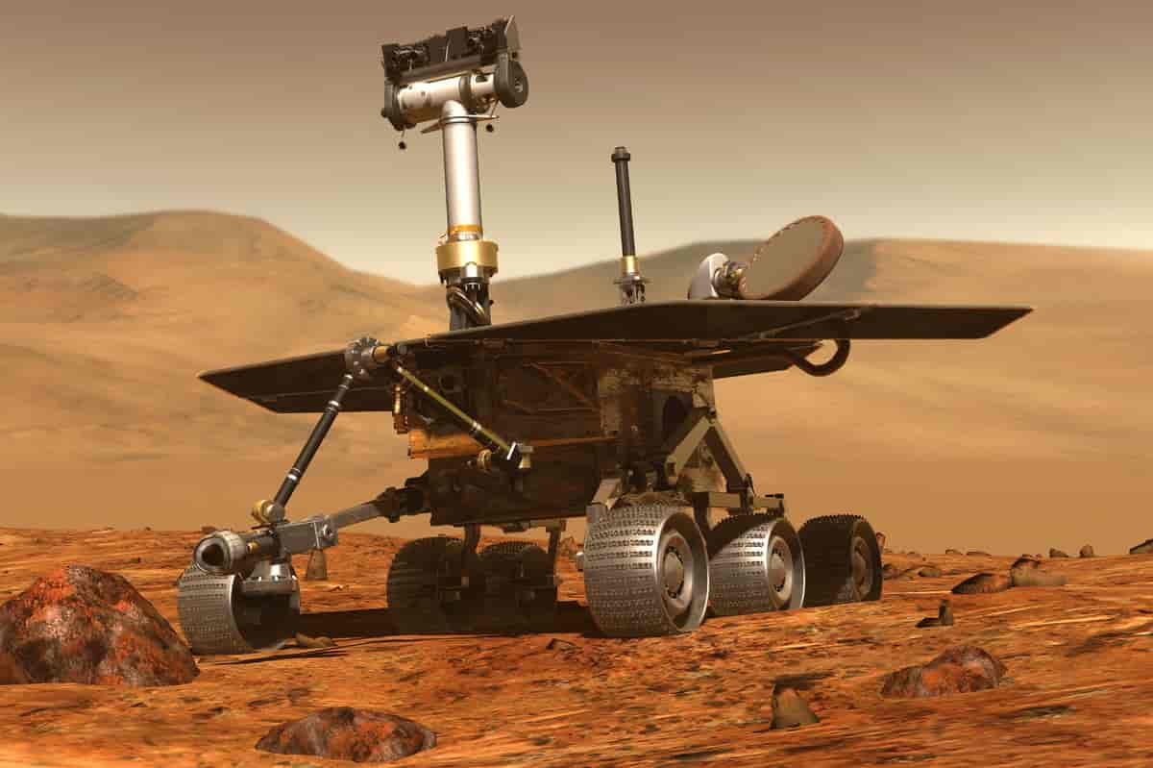
Bayesian Posteriors? Treelists?
If you use a Bayesian phylogenetic software like Phylobayes or MrBayes, you’ll quickly become very familiar with the term “Treelist File”
Bayesian phylogenetic approaches are interested in exploring the tree space using multiple chains that ultimately converge on a topology.
Think of it as two (or three, four, etc.) little robots plonked down on mars, happier to go uphill than downhill, but still comfortable going down sometimes. Every few metres, they make a little note of how high up they are, the likelihood.
Eventually, after much rambling they meet at the highest point.
In the process, they have made a little map of the area from which we know the topology of from their travels.
This landscape is our posterior, and each little note is a tree with a likelihood. So that means we can simulate datasets using those trees our rovers have come across to better understand the landscape they trundled through.

Slide 13

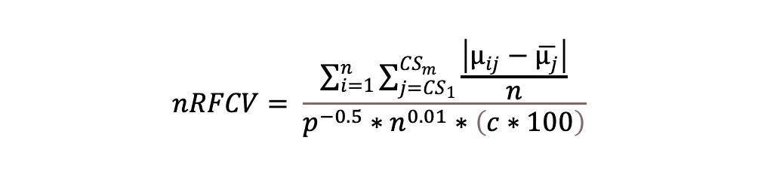
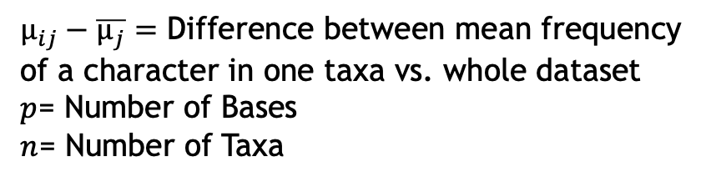
RCV->RCFV->nRCFV: measuring Compositional Heterogeneity
nRCFV is a brand-new metric to detect compositional heterogeneity!
You’ll all be testing my software for the first time today so hopefully that goes well!
nRCFV = Normalised Relative Composition Frequency Variability
Third iteration of this measurement (Originally Relative Compositional Variability, then Relative Compositional Frequency Variability)
Can be calculated for a character or a taxon as well as a whole dataset
$$nRFCV= \frac{\sum_{i=1}^{n}{\sum_{j={CS}_{1}}^{{CS}_{m}}{\frac{\left|µ_{ij}−\overline{µ_{j}}\right|}{n}}}}{p^{−0.5}∗n^{0.01}∗\left(c∗100\right)}$$
$µ_{ij}−\overline{µ_{j}}=$ Difference between mean frequency
of a character in one taxa vs. whole dataset
$p$= Number of Bases
$n$= Number of Taxa

Slide 14
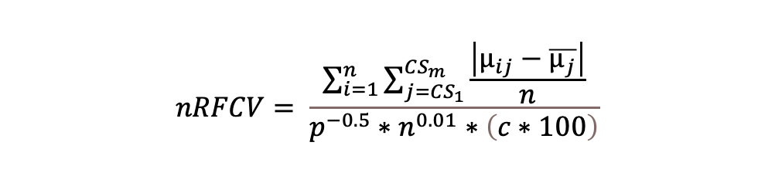
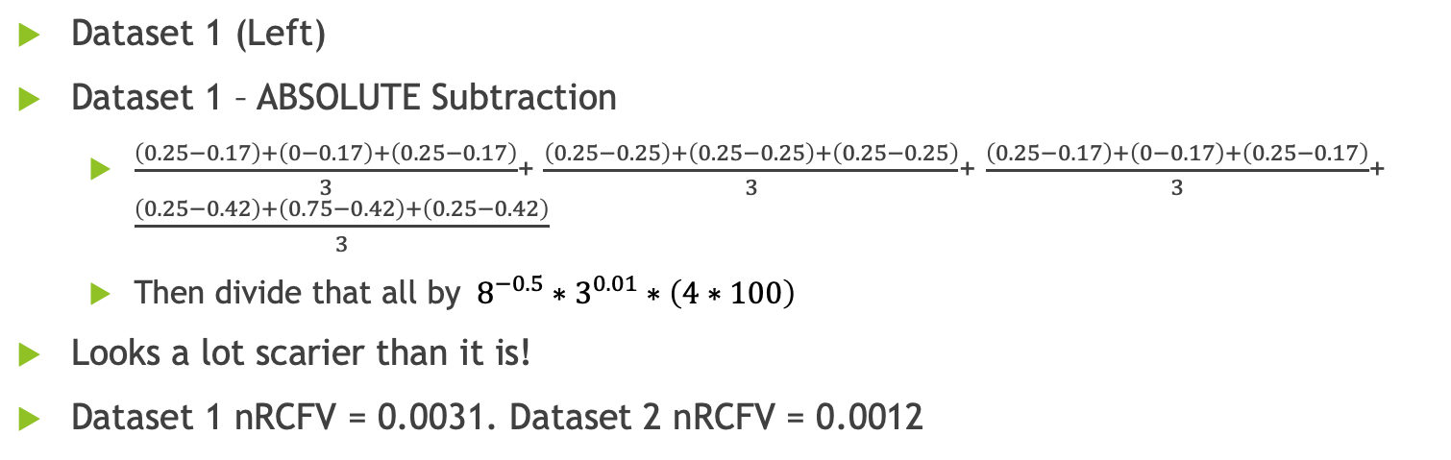
Move back to our Example from the start
A/C/G/T
0.25/0.25/0.25/0.25
0/0.25/0/0.75
0.25/0.25/0.25/0.25
0.17/0.25/0.17/0.42
A/C/G/T
0.375/0.25/0.25/0.125
0.25/0.25/0.25/0.25
0.375/0.25/0.125/0.25
0.33/0.25/0.21/0.21
CATGAGTC
CAAGAGTC
CTTTTTTC
ACAGGTTC
CGTAACTG
Total
CAAATCTG
Total
$$nRFCV= \frac{\sum_{i=1}^{n}{\sum_{j={CS}_{1}}^{{CS}_{m}}{\frac{\left|µ_{ij}−\overline{µ_{j}}\right|}{n}}}}{p^{−0.5}∗n^{0.01}∗\left(c∗100\right)}$$
Dataset 1 (Left)
Dataset 1 – ABSOLUTE Subtraction
$\frac{\left(0.25−0.17\right)+\left(0−0.17\right)+\left(0.25−0.17\right)}{3}$+ $\frac{\left(0.25−0.25\right)+\left(0.25−0.25\right)+\left(0.25−0.25\right)}{3}$+ $\frac{\left(0.25−0.17\right)+\left(0−0.17\right)+\left(0.25−0.17\right)}{3}$+ $\frac{\left(0.25−0.42\right)+\left(0.75−0.42\right)+\left(0.25−0.42\right)}{3}$
Then divide that all by $8^{−0.5}∗3^{0.01}∗\left(4∗100\right)$
Looks a lot scarier than it is!
Dataset 1 nRCFV = 0.0031. Dataset 2 nRCFV = 0.0012

Slide 15
Conclusions
Compositional Heterogeneity is a thorny problem!
One still hotly debated, with new methods emerging to try and resolve it
A problem that is biological in origin (caused by lots of change), but due to imperfect interactions with our models of evolution
Ways to address it:
Removing problem sequences or genes: nRCFV, Posterior Predictive Testing
Recoding your data, or using a sensitive model
These two options can work together – using removal and amelioration for the best results!

