Slide 1

Intro to the Command Line and the Plant Sci Cluster
Anne Thomas
Ecology group meeting 21/7/2020

Slide 2
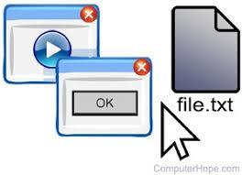
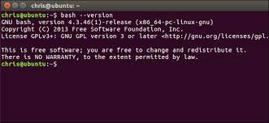
Why the command line?
GUI: graphical user interface
Convenient but limited
Software more likely to be proprietary
Command line
Learning curve but powerful
Lots of very useful open-source software designed for command line
Big data: efficient manipulation of files, automation of tasks
Access to more powerful computers

Slide 3
Linux/Unix and BASH
“In the beginning, there was UNIX”*
Original powerful operating system
MacOS and Linux derived from UNIX
Linux is open-source
Windows/DOS is its own thing
BASH (“Bourne Again Shell”)
Shell = interpreter for command language
Bash = shell + essentially a programming language
It has a personality…
But it’s useful and widespread
*https://www.quora.com/What-is-the-difference-between-Linux-Unix-Mac-and-Windows

Slide 4
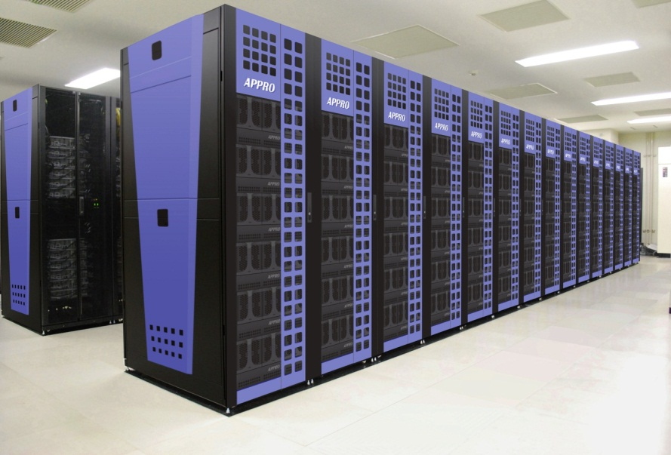
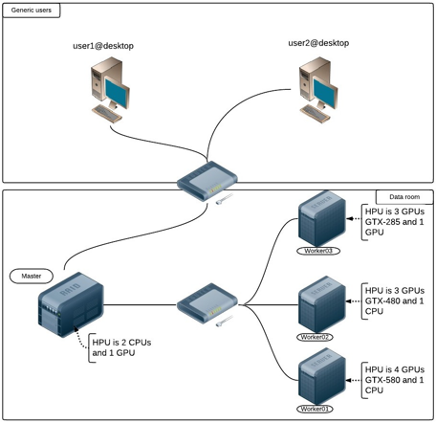
The Plant Sciences cluster
Access to ~16 powerful integrated computers
Run demanding programs independently of your computer
Login via ssh (Secure SHell)
Type this at the command line:
ssh crsid@hydrogen.plantsci.cam.ac.uk
Create or enter password
You’ve entered the login node: hydrogen
Interactive node: ssh node13
Job submission node: ssh node7
Rest of nodes = worker nodes (jobs are assigned there; you don’t access)

Slide 5
SSH options
Mac or Linux terminal
File transfer: scp command (or third-party GUI software)
Windows
Third-party software: PuTTY shell
Windows Linux subsystem shell
File transfer: WinSCP, Filezilla, or other GUI software

Slide 6
Command line: Getting oriented
Directory structure
Root: /
Absolute file path: /dir/from/the/root
Relative file path: dir/from/current/directory
Home shortcut: ~ (= /home/user)
Current directory shortcut: .
Parent directory shortcut: ..
Print working directory: pwd
List files: ls

Slide 7
Command line: Getting oriented
Change directories: cd /abs/path/of/dir
cd ~/dir
cd ..
Make new directory: mkdir newdir
mkdir /abs/path/newdir
Useful tips
tab to auto-complete filenames
up/down arrow keys to flip through previous commands

Slide 8
File and text manipulatoin
Print text: echo "Hello world"
Print to a file: echo "Hello world" >> testfile.txt
Print contents of a file: cat testfile.txt
Preview of a large file: head testfile.txt
Scroll through file: less testfile.txt
up and down arrows to scroll and q to quit
Do fancy things with text:
sed (stream editor)* sed s/Hello/hi/ testfile.txt > testfile2.txt
Pipe: | echo day | sed s/day/night/
Other programs: awk, grep (pattern matching, regular expressions)
*https://www.grymoire.com/Unix/Sed.html

Slide 9
File and text manipulation
Open interactive text editor: vim testfile.txt
Vim has its own system of commands (= learning curve)
i (=insert) to start edit mode; esc to leave edit mode; :wq to save and quit
Compare two files vimdiff file1.txt file2.txt
Other text editors: nano, emacs, and more
Delete a file: rm testfile.txt
Careful, it’s permanent!!
Delete a directory: rm –r /some/dir
Will delete everything inside, subdirectories included (careful!!)
Copy a file: cp testfile.txt newfile.txt
Move a file: mv testfile.txt /new/location
Rename a file: mv testfile.txt newname.txt

Slide 10
Working with strings and variables
Save string as named variable: testvar=foobar
No spaces around =
If string has spaces, use quotes
Access variable with $: echo $testvar
Paste variable to other string: echo "$testvar"_plus
echo "$testvar" plus
Do stuff with the variable string inside ${}:
Get string length: echo ${#testvar} (prints ‘6’)
Get substring: echo ${testvar:0:3} (prints ‘foo’)
Start at pos 0, extract next 3 characters
Use negative position to start from end

Slide 11
If statements
if [ $testvar = yes ]
then
echo "true"
else
echo "false"
fi
One line: if [ $testvar = yes ]; then echo "true“; fi
Only newlines or semicolons between lines are relevant; tabs are just visual
you DO need spaces around everything in the [] test expression
numbers: use -eq for equals, -gt for greater than, -lt for less than
https://ryanstutorials.net/bash-scripting-tutorial/bash-if-statements.php

Slide 12
For loops
for i in {1..5}
do
echo "Printed $i times"
done
Can use variables with commands in $() for i in $(seq $start $end)
Useful: iterate through files
cd testdir
for file in *.txt
do
echo $file
done
* is a wild card matching any text (in this case any filename ending in .txt in the testdir directory)

Slide 13
While loops
Iterate through lines of a file:
while read line
do
echo $line
done < testfile.txt

Slide 14
Bash scripts
Create a file with list of commands that execute as if in the terminal
Name file with .sh extension vim testscript.sh
First line: #! /bin/bash
Tells shell to interpret it using bash
Each following line = a command
E.g. echo "Hello world"
Comment out/ignore lines with # # annotate your script
Make script executable: chmod +x testscript.sh
Run by typing the script name ./testscript.sh
Or /abs/path/testscript.sh

Slide 15
Bash script with user input
Make a script that accepts user input like this:
./testscript.sh arg1 arg2
Access input in script with $1, $2 (etc) var1=$1
var2=$2
Use the variables in the script echo $var1 $var2
Use with if statement if [ $var1 = "go" ]; then echo $var2; fi
Use with for loop for i in $(seq $var1 $var2); do echo $1; done
Try it!

Slide 16
Using the cluster: accessing software
Lots of programs already installed in the /applications directory
Usually run by a single command with flags for options and arguments for filenames, etc
eg mafft -auto input_file.fasta
Use --help or -h with most softwares to see options (or look up documentation online)
Can also be scripts run by other programs
eg Rscript script.R or python script.py
Some program commands already loaded in the cluster’s environment
eg R (starts interactive session)

Slide 17
Using the cluster: accessing software
For other softwares the cluster needs to be told the path to the directory where the executable is stored
Add this to your environment via the PATH variable:
export PATH=$PATH:/path/to/program
To make this load automatically at login, add that line to your ~/.bashrc file
Some softwares can be installed in your own directories but your permissions are limited
Ask computing@plantsci.cam.ac.uk to install new programs cluster-wide

Slide 18
Using the cluster: submitting jobs
Run a script or a program on worker nodes through node7
Request multiple cores, extra RAM, etc (no time limit on dept. cluster)
Job management platform: Condor
Submit job through configuration file
Easier: use wrapper someone wrote to create this file and submit job:
/scripts/csmit -c #ofcores -m 4G "script-or-program arg1 arg2"
Script will print out script/program output but this can be cancelled and the job will continue running

Slide 19
Using the cluster: submitting jobs
Check status of your jobs: condor_q
Cancel a job: condor_rm <jobid> or condor_rm -a (all jobs)
Check status of all jobs on cluster: /scripts/cusr
See output of job: stdout file and err file in same directory where job was submitted (also condor and log files)
Check status of cluster nodes at http://h2-cluster.plantsci.cam.ac.uk/ganglia/

Slide 20
Other BASH topics
Arithmetic/expressions: https://ryanstutorials.net/bash-scripting-tutorial/bash-arithmetic.php
(a royal pain)

Slide 21
Questions?
Google and Stack Exchange are your friends
Also the department cluster tech support (for software problems) if they’re in business

