Slide 1
Stats club An Introduction to GDAL
Aland Chan

Slide 2

What is GDAL
Stands for “Geospatial Data Abstraction Library”
An open source library for processing geospatial datasets
Rasters
Vectors
Geographic networks
Supports a wide range of data formats
Used by most GIS programmes

Slide 3
Installing GDAL
For Windows users, the easiest way to get GDAL up and running is by installing OSGeo4W, which also provides options to install QGIS/GRASS/Python among other things
https://trac.osgeo.org/osgeo4w/
To download GDAL without OSGeo4W, see
https://sandbox.idre.ucla.edu/sandbox/tutorials/installing-gdal-for-windows
For Linux/Mac, see
https://github.com/domlysz/BlenderGIS/wiki/How-to-install-GDAL

Slide 4
Checking basic information
Basic information of a raster could be displayed through gdalinfo
Gives:
Driver name
Raster size and resolution
Corner coordinates
Coordinate reference system
Information of raster bands
gdalinfo E:/PhD_project/GDAL_presentation/Sentinel_epsg_2326.tif

Slide 5
Translation and reprojection
Rasters could be translated between different formats through gdal_translate
gdal_translate -ot Byte -of PNG -b 4 -b 3 -b 2 –scale E:\PhD_project\GDAL_presentation\Sentinel_epsg_2326.tif E:\PhD_project\GDAL_presentation\Output\Sentinel.png
Rasters could be reprojected to another coordinate reference system through gdal_warp
gdalwarp -of GTiff -t_srs EPSG:4326 -co TILED=YES -multi E:\PhD_project\GDAL_presentation\Sentinel_epsg_2326.tif E:\PhD_project\GDAL_presentation\Output\Sentinel_epsg_4326.tif

Slide 6
Compression and resampling
Rasters can be compressed to minimize file size or decompressed to maximize processing speed (COMPRESS=NONE)
gdalwarp -co COMPRESS=DEFLATE E:\PhD_project\GDAL_presentation\Output\Sentinel_epsg_4326.tif E:\PhD_project\GDAL_presentation\Output\Sentinel_epsg_4326_deflate.tif
Resolution can be changed by the -tr command in gdalwarp
gdalwarp -tr 30 30 -r bilinear E:\PhD_project\GDAL_presentation\Sentinel_epsg_2326.tif E:\PhD_project\GDAL_presentation\Output\Sentinel_epsg_2326_30m_res.tif

Slide 7
Cropping
Rasters can be cropped using xmin/xmax/ymin/ymax in gdalwarp
gdalwarp -te 114.3739 22.4063 114.3880 22.4311 E:\PhD_project\GDAL_presentation\Output\Sentinel_epsg_4326.tif E:\PhD_project\GDAL_presentation\Output\Sentinel_epsg_4326_cropped_gdalwarp.tif
Equivalent cropping can also be achieved by gdal_translate using the –srcwin or –projwin commands

Slide 8
Edit information
If you don’t want to do any transformations/reprojections, but just want to artificially edit the raster information without creating a new file, gdal_edit is your best friend
gdal_edit -a_srs EPSG:27700 E:\PhD_project\GDAL_presentation\Output\Sentinel_epsg_4326_cropped_gdalwarp.tif

Slide 9
Mosaicking rasters
Could be done using gdal_merge, but most sources recommend the faster/more reliable gdalbuildvrt followed by gdalwarp/gdal_translate
gdalbuildvrt E:\PhD_project\GDAL_presentation\Output\DTM_merged.vrt E:\PhD_project\GDAL_presentation\DTM_tiles\*.tif
gdalwarp -of GTiff E:\PhD_project\GDAL_presentation\Output\DTM_merged.vrt E:\PhD_project\GDAL_presentation\Output\DTM_merged.tif

Slide 10
Tidying extent and resolution
A creative trick to tidy up two files with different extents and resolution is to use gdal_translate to subset a raster
gdal_translate -b 1 E:\PhD_project\GDAL_presentation\Output\Sentinel_epsg_4326.tif E:\PhD_project\GDAL_presentation\Output\DTM_10m_res.tif
Then use gdalwarp to overwrite the new one band Sentinel 2 raster with DTM data
gdalwarp -dstnodata 0 -r bilinear -multi E:\PhD_project\GDAL_presentation\Output\DTM_merged.tif E:\PhD_project\GDAL_presentation\Output\DTM_10m_res.tif

Slide 11
Raster <> vector conversions
gdal_polygonize can be used to convert raster files with discreet levels into a shapefile layer
gdal_polygonize -f "ESRI Shapefile" E:\PhD_project\GDAL_presentation\Vegetation_classification_4326_cropped.tif E:\PhD_project\GDAL_presentation\Output\Vegetation_classes_shape.shp
gdal_rasterize is the reverse of gdal_polygonise
gdal_sieve helps removes small raster polygons and replaces the pixel values with that of nearby pixels
gdal_sieve -st 10 E:\PhD_project\GDAL_presentation\Vegetation_classification_4326_cropped.tif E:\PhD_project\GDAL_presentation\Output\Vegetation_classification_4326_sieved.tif

Slide 12
Working with topography
gdaldem can be used to generate hillshade, slope, topographic position index (TPI), terrain ruggedness index (TRI), and roughness maps from a DTM
gdaldem hillshade E:\PhD_project\GDAL_presentation\Output\DTM_10m_res.tif E:\PhD_project\GDAL_presentation\Output\Hillshade.tif
gdaldem slope E:\PhD_project\GDAL_presentation\Output\DTM_10m_res.tif E:\PhD_project\GDAL_presentation\Output\slope.tif
gdaldem TPI E:\PhD_project\GDAL_presentation\Output\DTM_10m_res.tif E:\PhD_project\GDAL_presentation\Output\TPI.tif
gdaldem TRI E:\PhD_project\GDAL_presentation\Output\DTM_10m_res.tif E:\PhD_project\GDAL_presentation\Output\TRI.tif

Slide 13
Generating contours
Contours can be generated by gdal_contour for topography visualization
gdal_contour -i 5 E:\PhD_project\GDAL_presentation\Output\DTM_merged.tif E:\PhD_project\GDAL_presentation\Output\Contours.shp

Slide 14
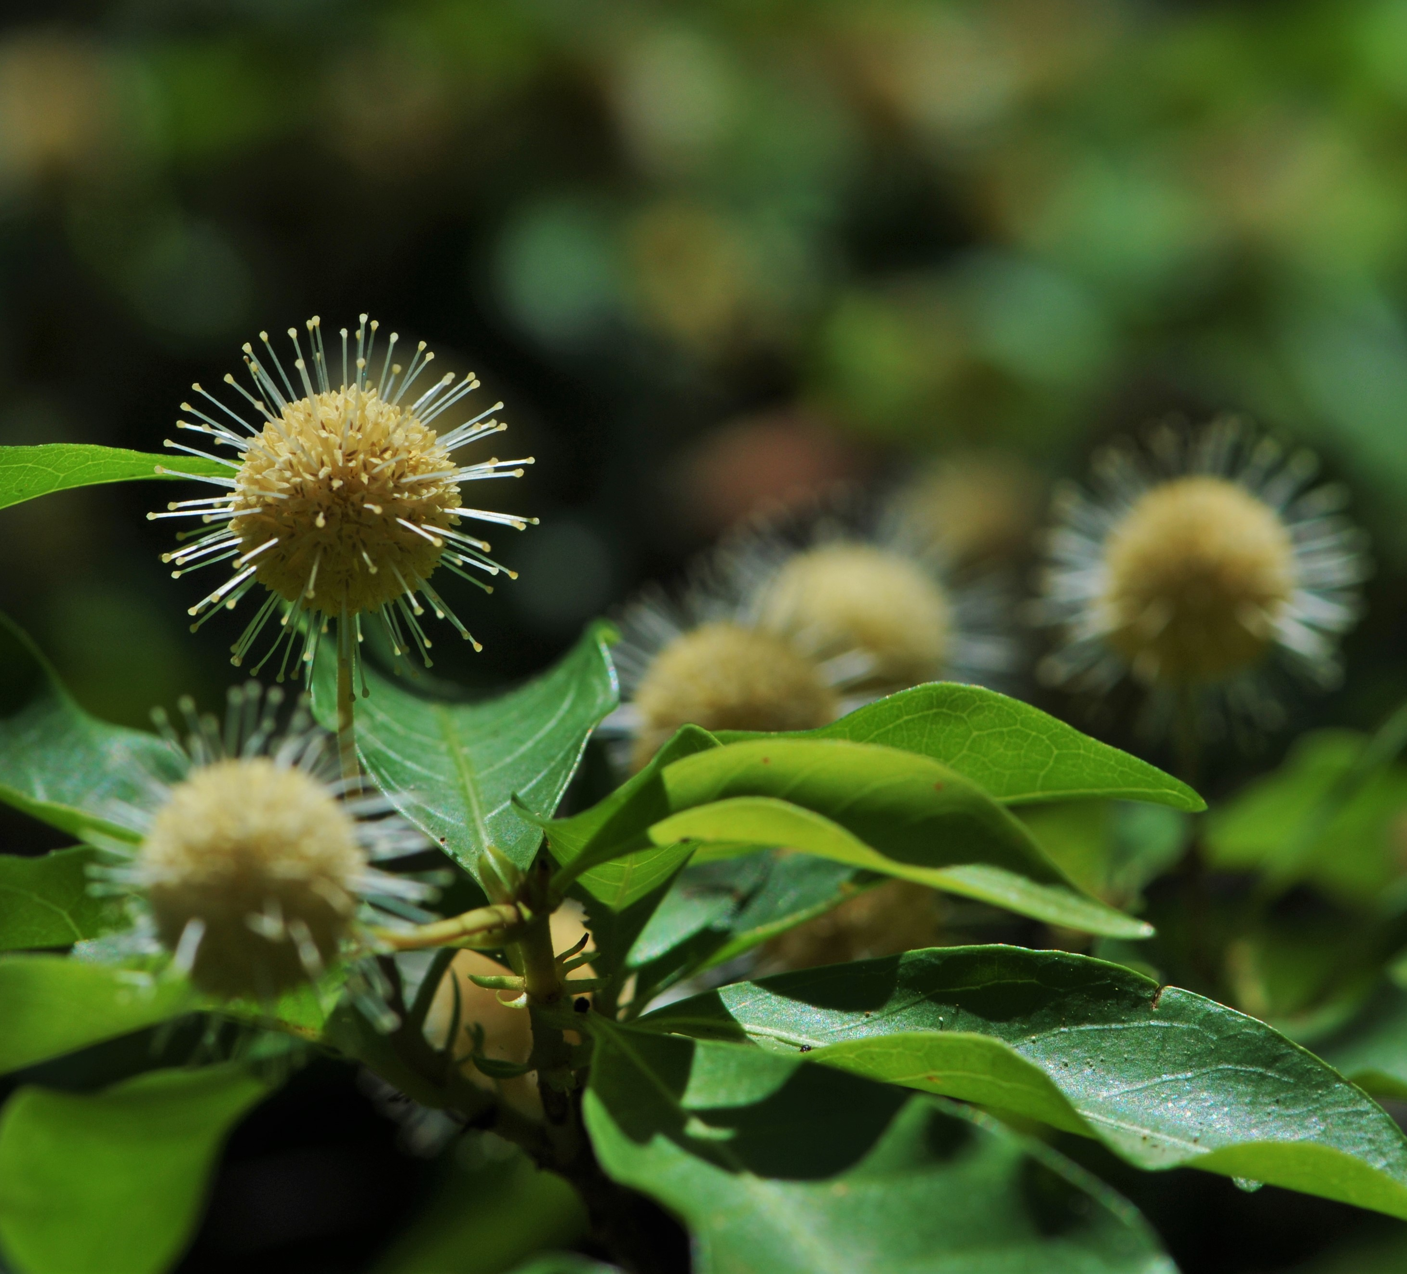
Questions? Anything to add?
Adina pilulifera
Chinese Buttonbush

