Slide 1
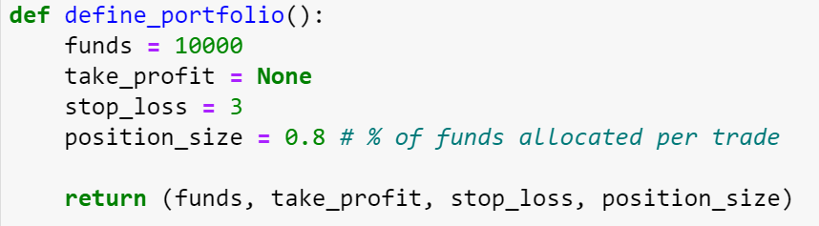
Portfolio

Slide 2
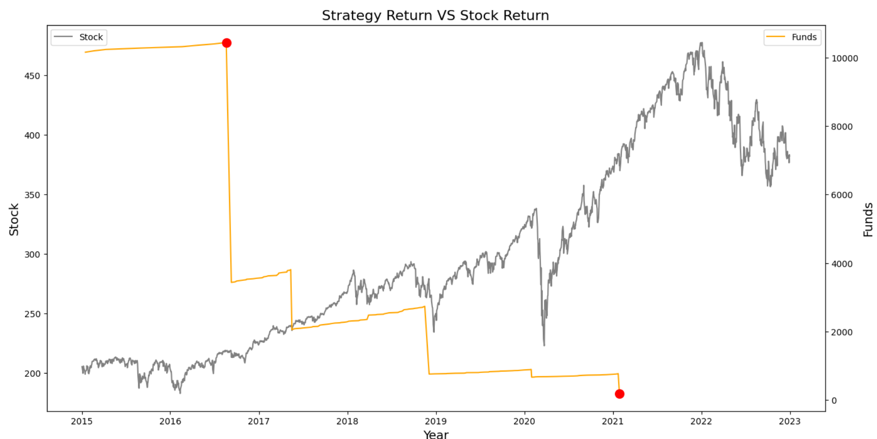
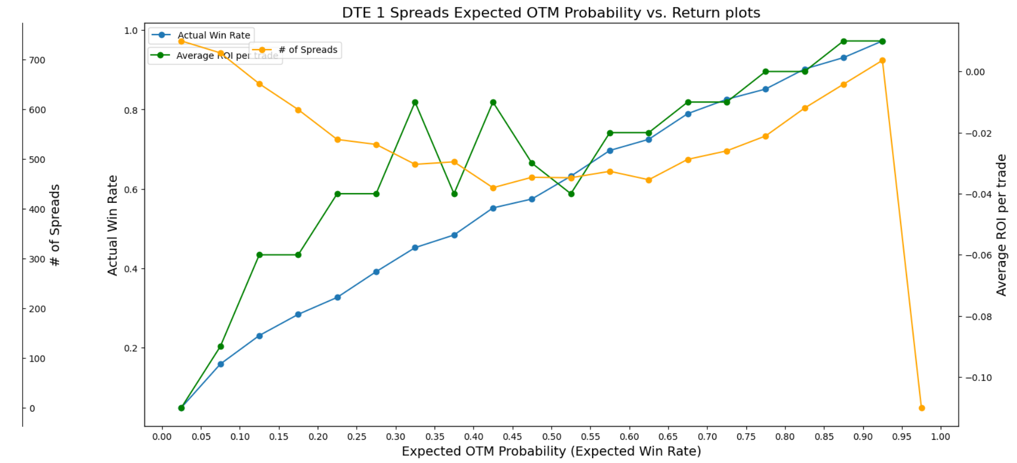
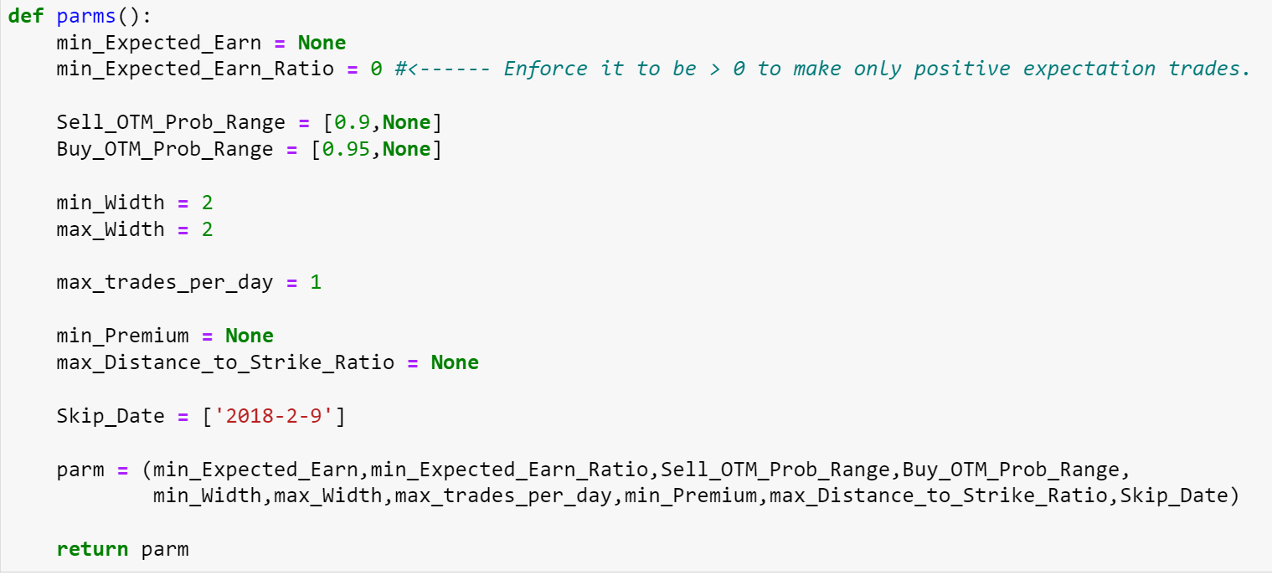
SPY DTE1 (trade on every work day except Friday) Credit Put Spread
Since on the last day we cannot open/close any contract, there is way of stopping loss.

Slide 3
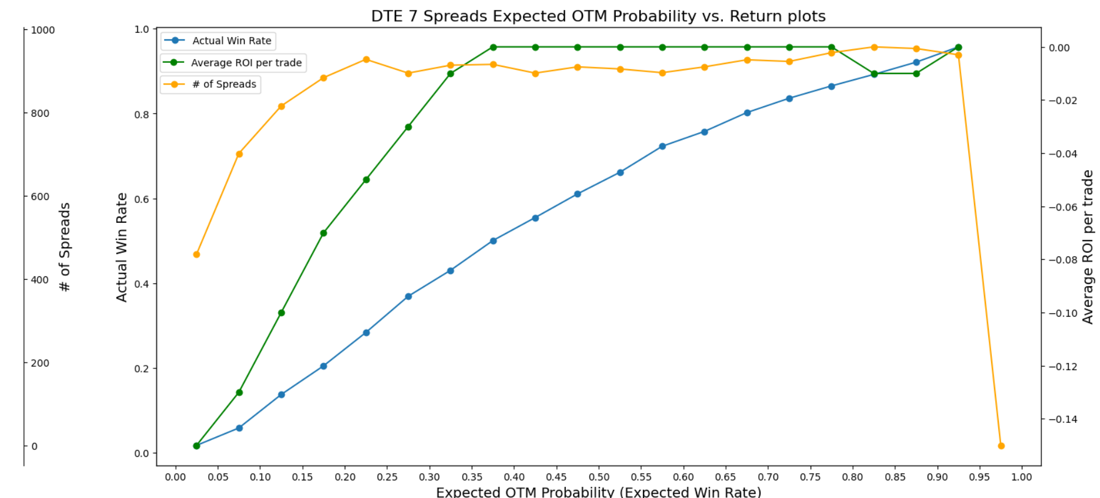
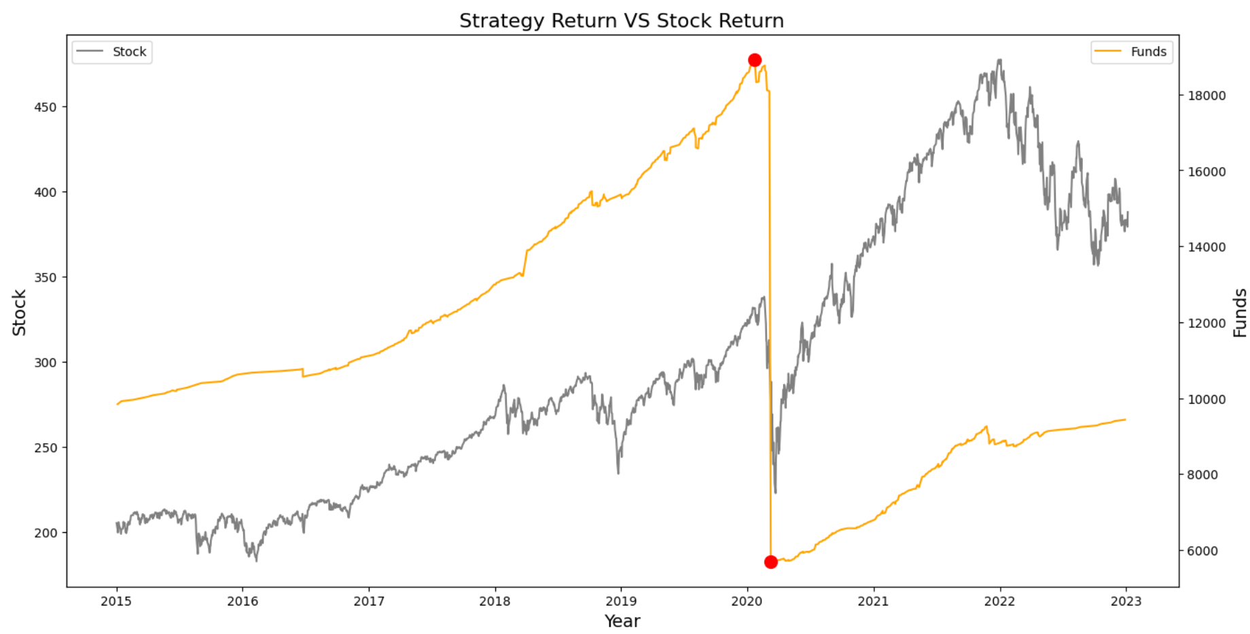
SPY DTE7 Credit Put Spread
Parameters:
Width: 2
Sell OTM: >= 0.9
Buy OTM: >= 0.95
刚好过期当天遇到股灾无法stop loss

Slide 4
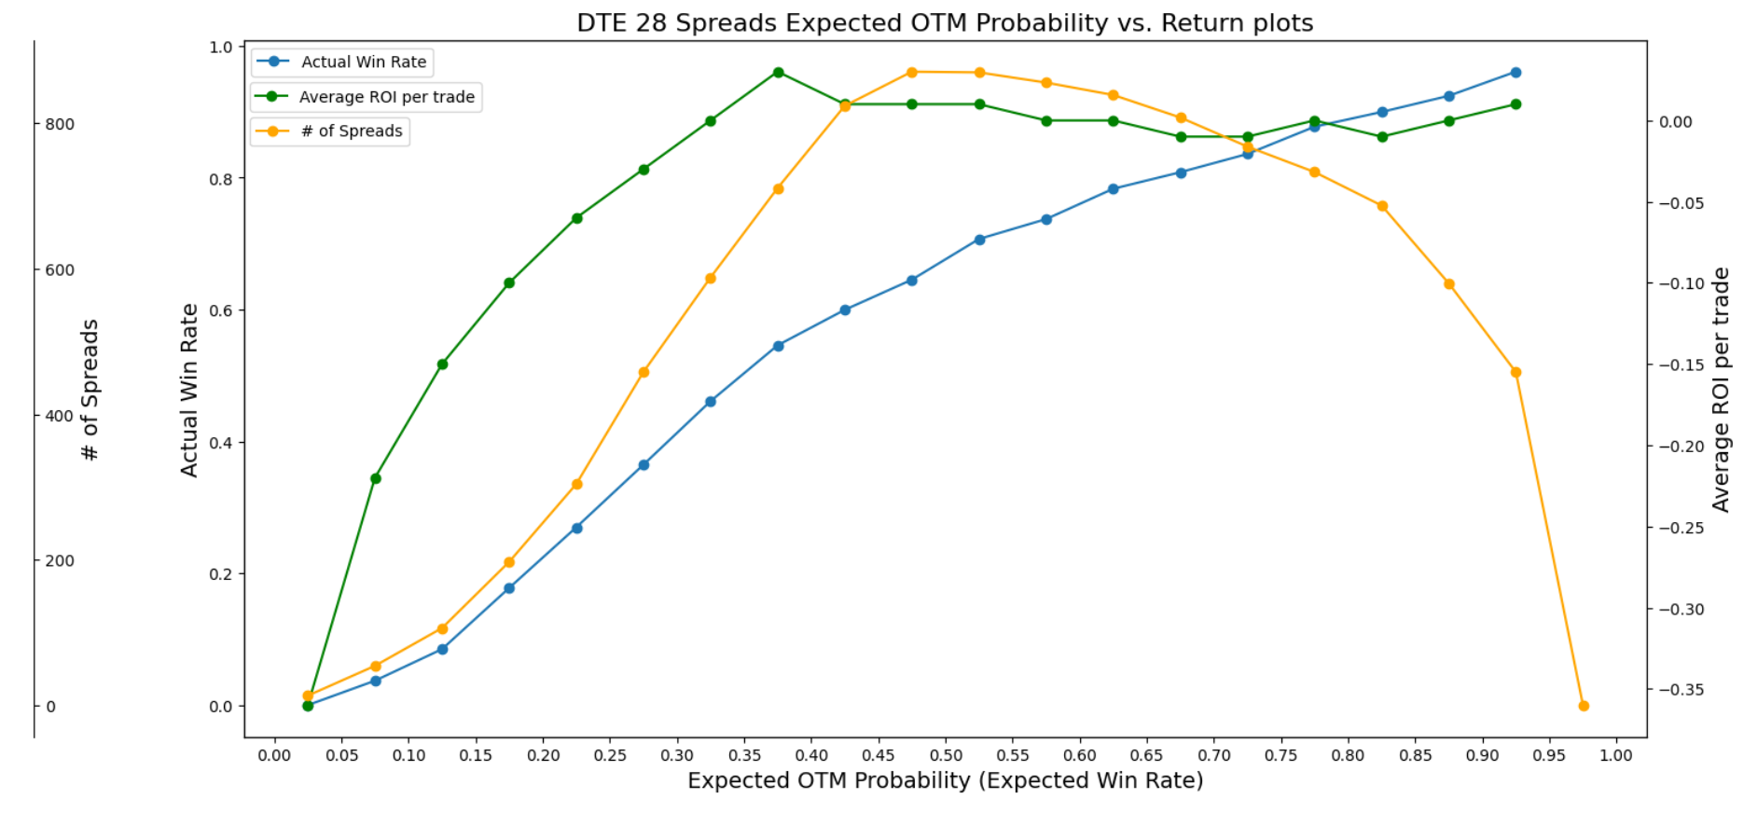
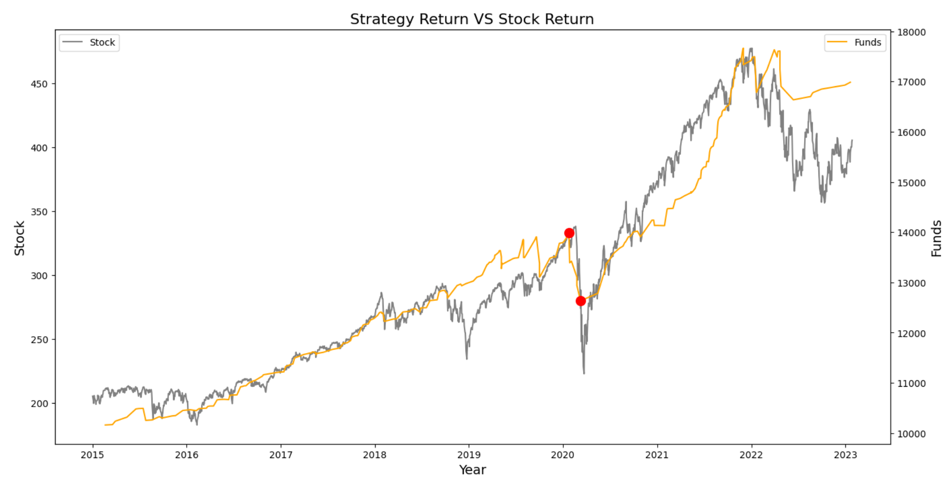
SPY DTE28 Credit Put Spread
Parameters:
Width: 2
Sell OTM: >= 0.75
Buy OTM: >= 0.8

Slide 5
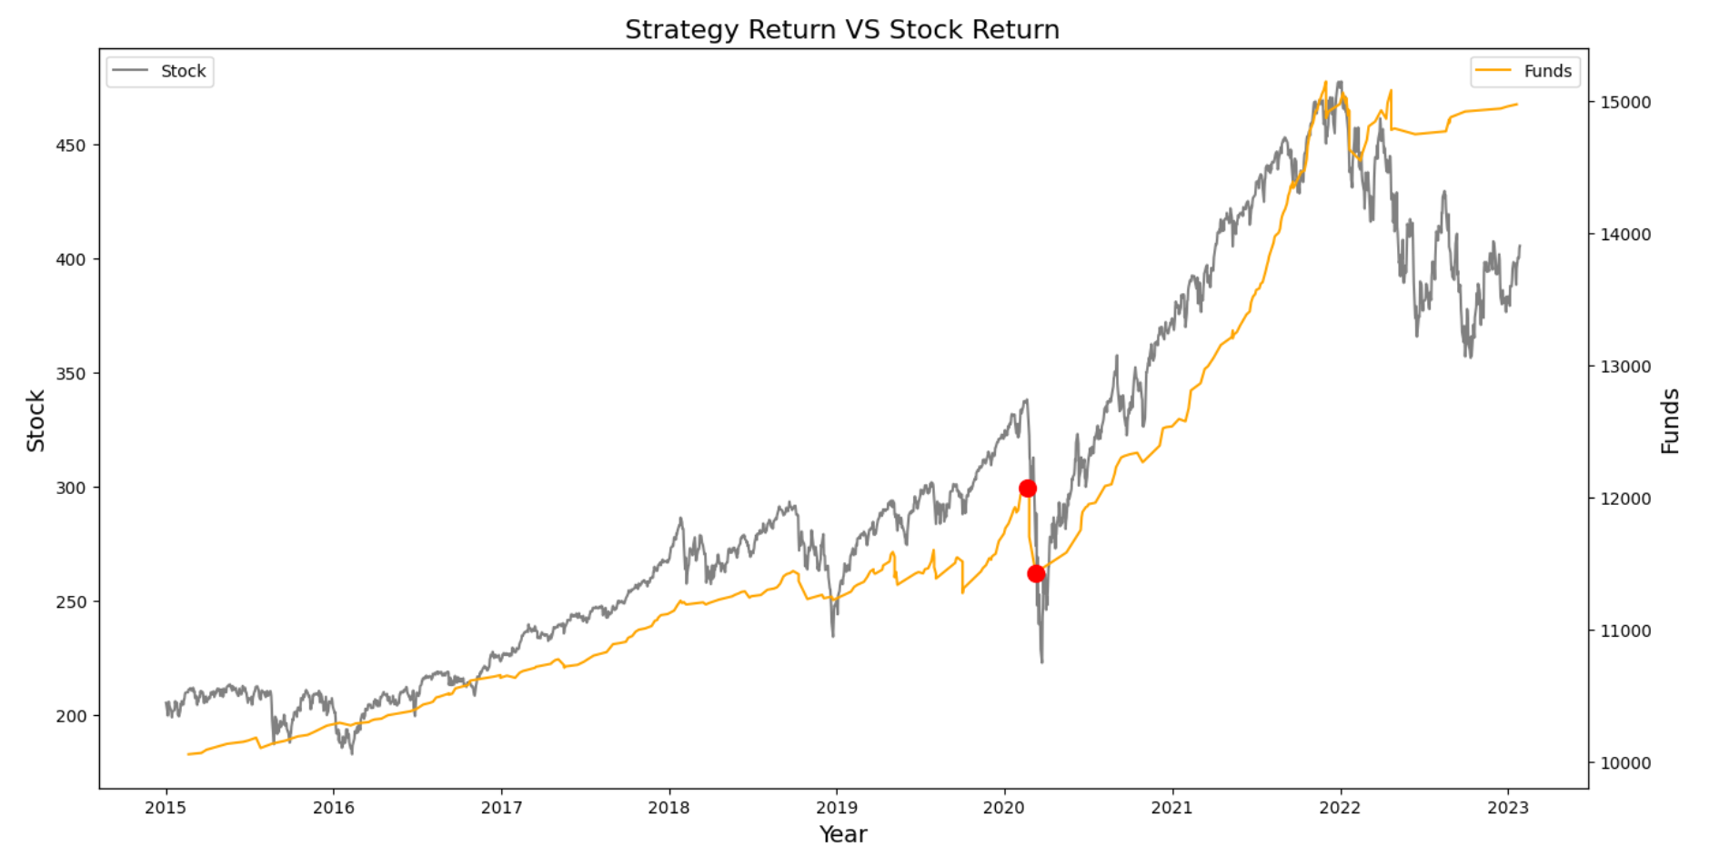
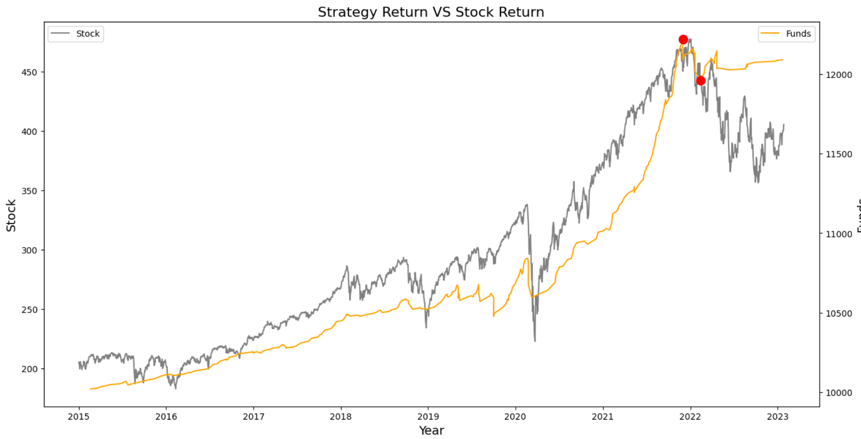
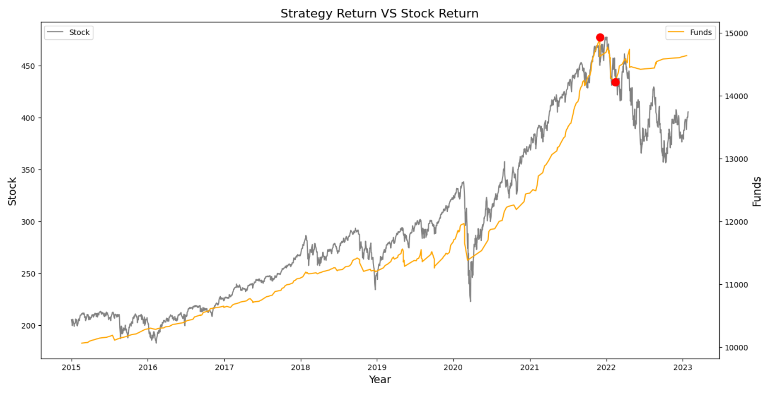
SPY DTE28 Credit Put Spread
每笔交易占仓位30% Sharpe: 0.99
每笔交易占仓位80%
每笔交易占仓位10% Sharpe: 0.73
每笔交易占仓位30%, 总仓位最高不超过70% Sharpe: 0.85

