Slide 1
OmniaMea: User Interface: Options dialog
The current UI is extremely difficult to document do to a lack of labeling of components such as the list.
This document proposed changes to the UI which are needed urgently in order to documentation to be able to proceed with this critical dialog.
The design proposed here tries to compromise between improved usability and “documentability” and relative ease of implementation. In some cases there are variants, one of which is simpler to implement, with the other preferred if time/resources permit.
Designs shown are not intended to be an exact pixel-by-pixel rendering, but rather as a guideline for implementation. Where details are critical they are noted.

Slide 2
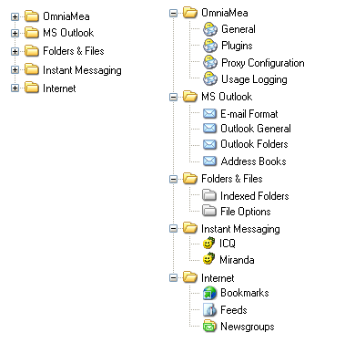
OmniaMea: User Interface: Options dialog:
Treeview Grouping of Options
Replace current unlabeled list of option groups with treeview with options grouped as shown
Collapsed Expanded
Actual icons to be
designated by project
graphics designer

Slide 3
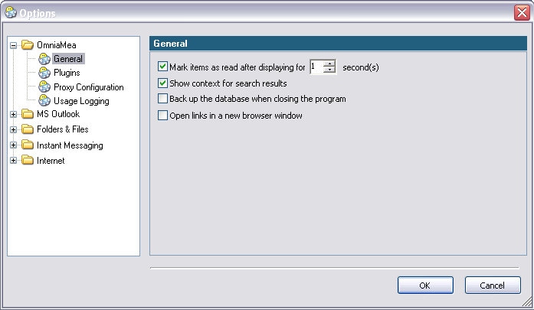
OmniaMea: User Interface: Options dialog
OmniaMea: General
Synchronize treeview selection and title of detail

Slide 4
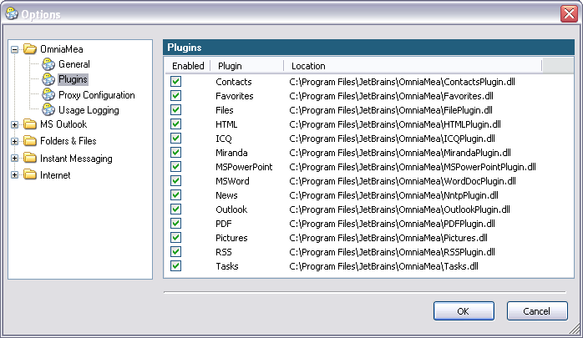
OmniaMea: User Interface: Options dialog
OmniaMea: Plugins
For now don’t change, but is it really useful information for average user, esp. beginner/intermediate?
Perhaps a short description, e.g. “Support for MS Word documents” would be preferable?

Slide 5
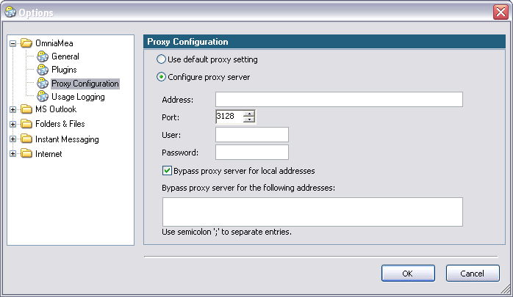
OmniaMea: User Interface: Options dialog
OmniaMea: Proxy Configuration
No substantial changes here.

Slide 6
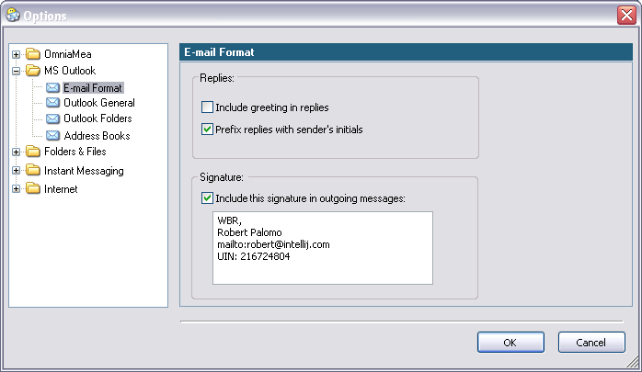
OmniaMea: User Interface: Options dialog
Outlook: E-mail Format
Please consider more conventional grouping as shown. Old-fashioned?
Maybe, but always clear.
Group technique &
appearance should be
consistent throughout
the dialog.

Slide 7
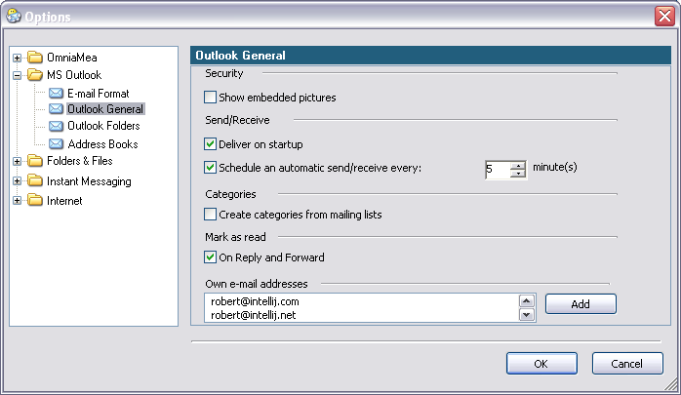
OmniaMea: User Interface: Options dialog
MS Outlook: Outlook General (Variant #1)
This variant just ports current layout into changed dialog layout. However, this layout
has problems (see below). See variant #2 (next) for possible improvements.
Space wasted and messy layout created by making group when there is only one option in the group.
More conventional group box would be clearer (see note here)

Slide 8
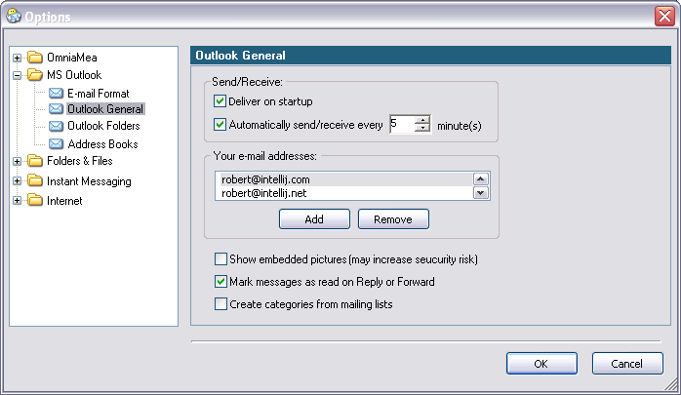
OmniaMea: User Interface: Options dialog
MS Outlook: Outlook General (Variant #2)
Group box used only when there are related things to group.
Unrelated options not grouped.
Wording is changed to convey same information.

Slide 9
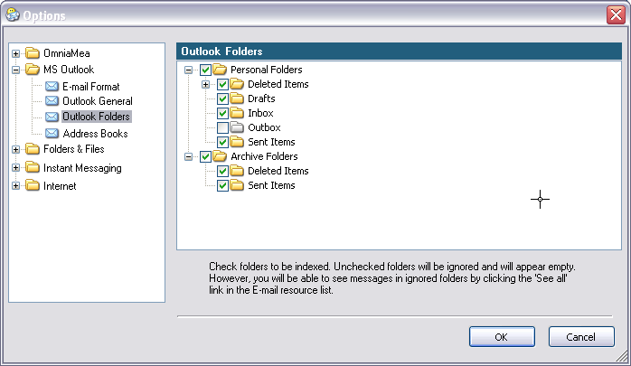

OmniaMea: User Interface: Options dialog
MS Outlook: Outlook Folders
Note slightly revised wording.
Text file embedded below (accessible in Edit mode):

Slide 10
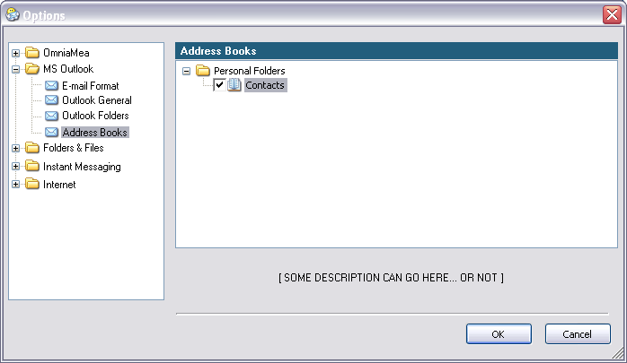
OmniaMea: User Interface: Options dialog
MS Outlook: Address Books
Same layout as Outlook Folders

Slide 11
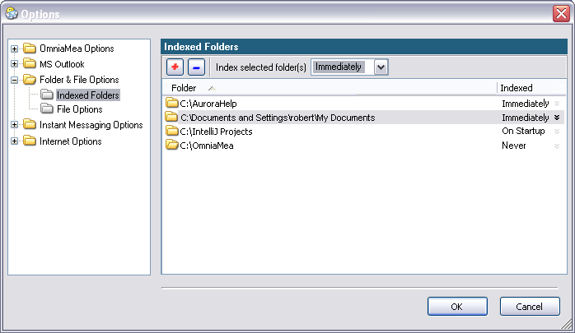
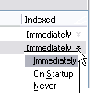
OmniaMea: User Interface: Options dialog
Folders & Files: Indexed Folders
Value shown changes to sync with selection if user scrolls folder list.
Use designer’s icons
Set one selected folder only.
See next slide for more…

Slide 12
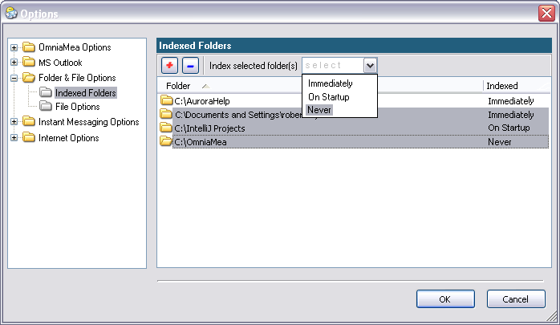
OmniaMea: User Interface: Options dialog
Folders & Files: Indexed Folders
Change displayed value to “select” when multiple folders are selected. On dropdown, list selection matches last folder selection.
Please note wording changes here and in dropdown list.
Not displayed when multiple folders are selected

Slide 13
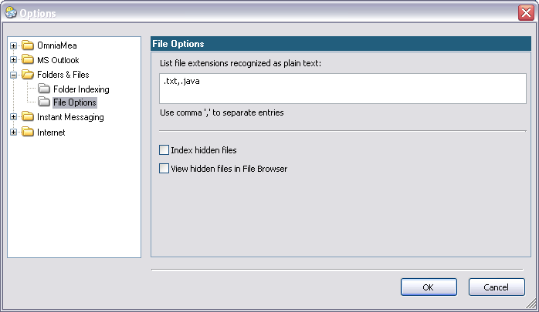
OmniaMea: User Interface: Options dialog
Folders & Files: File Options (Variant #1)
This will be easiest to implement. But see Variant #2 in case there will
be time/resources to implement it.

Slide 14
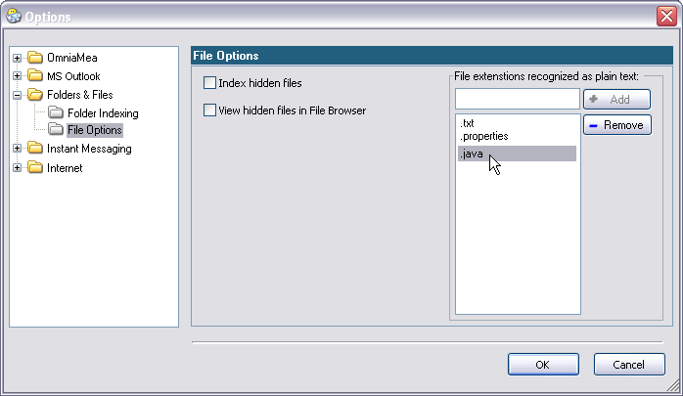
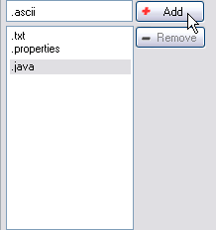
OmniaMea: User Interface: Options dialog
Folders & Files: File Options (Variant #2)
If user inputs “.” accept it, if not, add it when writing to the list
Button disabled until user types something.
(Use designer’s Add / Remove icons)

Slide 15
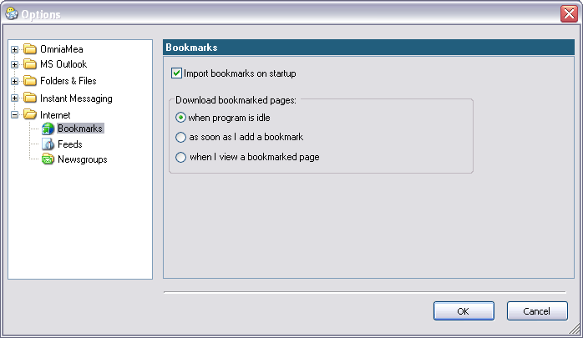
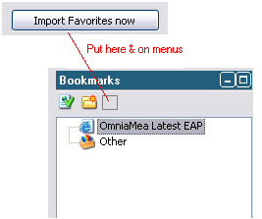
OmniaMea: User Interface: Options dialog
Internet: Bookmarks
This action seems not appropriate in a configuration dialog.

Slide 16
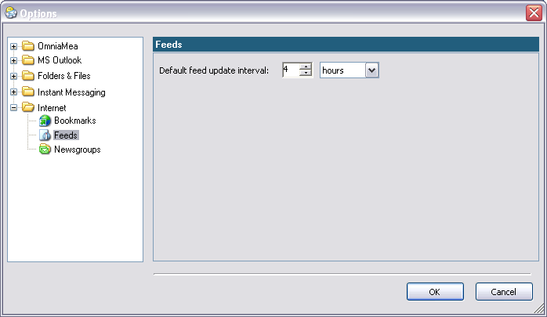
OmniaMea: User Interface: Options dialog
Internet: Feeds
No substantial changes here.

Slide 17
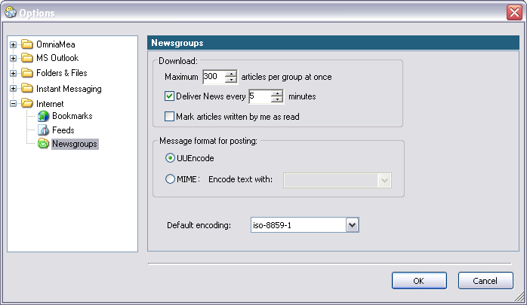
OmniaMea: User Interface: Options dialog
Internet: Newsgroups
Again, more conventional
grouping, used consistently

Slide 18
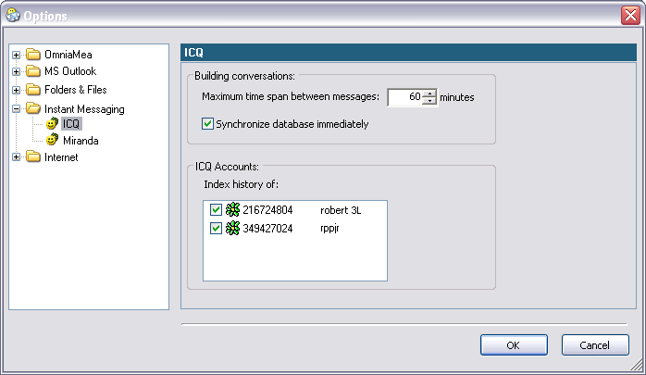
OmniaMea: User Interface: Options dialog
Instant Messaging: ICQ
Again, more conventional
grouping, used consistently

Slide 19
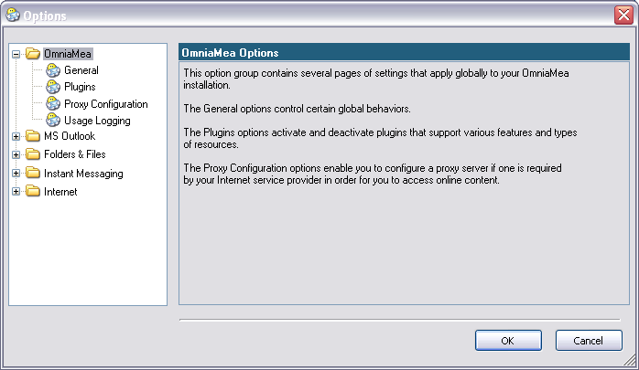

OmniaMea: User Interface: Options dialog
When a folder is selected:
When a folder is selected, display some relevant text in the options pane. See text file attached to this slide for the texts.
Embedded text file (open from edit mode):

