Slide 1
Artificial Meat Review Predictions
Tamar Brand-Perez, Tiffany Price, Ben Tubbs, and Jose Santos

Slide 2
Executive Summary
Overview
The fake meat industry has recently experienced a dramatic positive shift in consumer interest and exponential growth. Our team wants to predict how consumer reviews affect ratings, which will assist store owners in their decision making process of which brand to sell.
Objectives
By analyzing the Amazon consumer reviews between *** - ***, our machine learning tool will predict whether a non-rated review will be positive negative.
Notes:
Content: The presentation should tell a cohesive story about the project and include the following:
Selected topic
Reason the topic was selected
Description of the source of data
Questions the team hopes to answer with the data
Description of the data exploration phase of the project
Description of the analysis phase of the project
Technologies, languages, tools, and algorithms used throughout the project
Result of analysis
Recommendation for future analysis
Anything the team would have done differently

Slide 3
Team Members & Responsibilities
Tiffany Price:
Project Manager
Ben Tubbs:
Machine Learning Lead
Tamar Brand-Perez:
Database Lead
Jose Santos:
Dashboard Lead

Slide 4






Products Used
Technology
Tools
Language
Algorithms
Algorithm: Bag of Words Model
Machine Learning: Naive Bayes Classifier

Slide 5
Data Exploration & Analysis

Slide 6
Purpose & Sourcing
Our data set was pulled from the Amazon Grocery and Gourmet Food section (http://deepyeti.ucsd.edu/jianmo/amazon/index.html).
In this project we used a Natural Language Processing machine learning model to train a sentiment classifier on the dataset containing over 1 million reviews.
The goal of this classifier is to predict user sentiment (positive or negative) for artificial meat products.
We believe this analysis and our interactive dashboard will assist store owners in their decisions regarding which artificial meat products to sell in their stores.

Slide 7
Exploration

Slide 8
Analysis

Slide 9
Database

Slide 11
Machine Learning

Slide 12
Data Splitting, Training & Testing

Slide 14
Dashboard

Slide 15
Dashboard Design

Slide 16
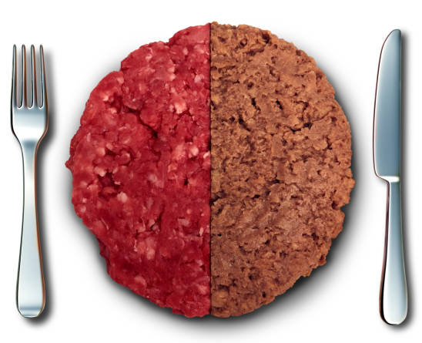
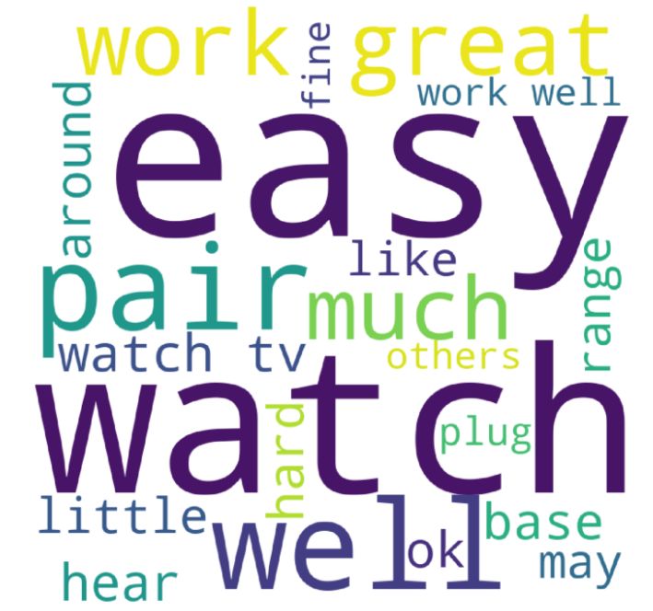
Fake Meat Brand Sentiment
Brand selector
Brand selector
Positive Review word frequency
Negative Review Word Frequency
Positive & Negative Reviews per month
Notes:
Brand choices:

Slide 17
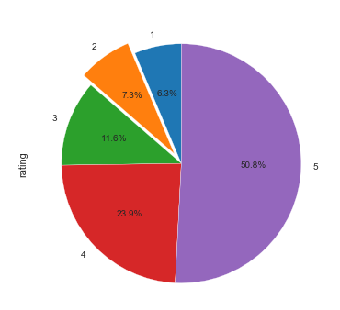
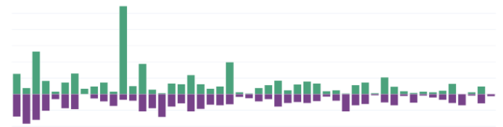
Fake Meat Brand Sentiment
Brand selector
Brand selector
Positive & Negative Reviews per month
Positive & Negative Reviews per month
Notes:
Brand choices:

Slide 18



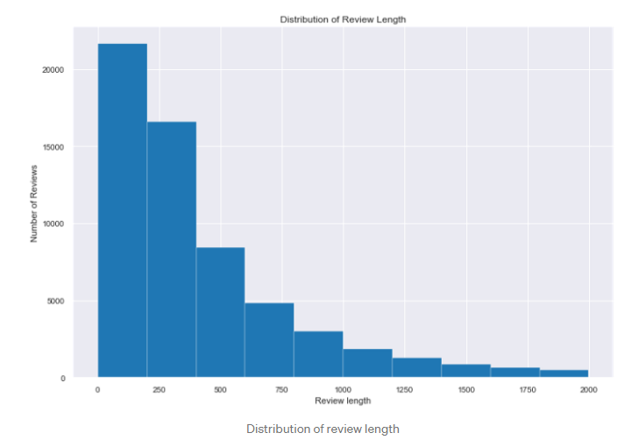
Fake Meat Brand Sentiment
Number of Reviews:
353
Brand selector
Positive Review word frequency
Negative Review Word Frequency
Positive & Negative Reviews per month
Breakdown of Positive / Negative Reviews
Positive Review Length
Negative Review Length
Overlay training set data?
Overlay training set data?
Notes:
Brand choices:

Slide 19
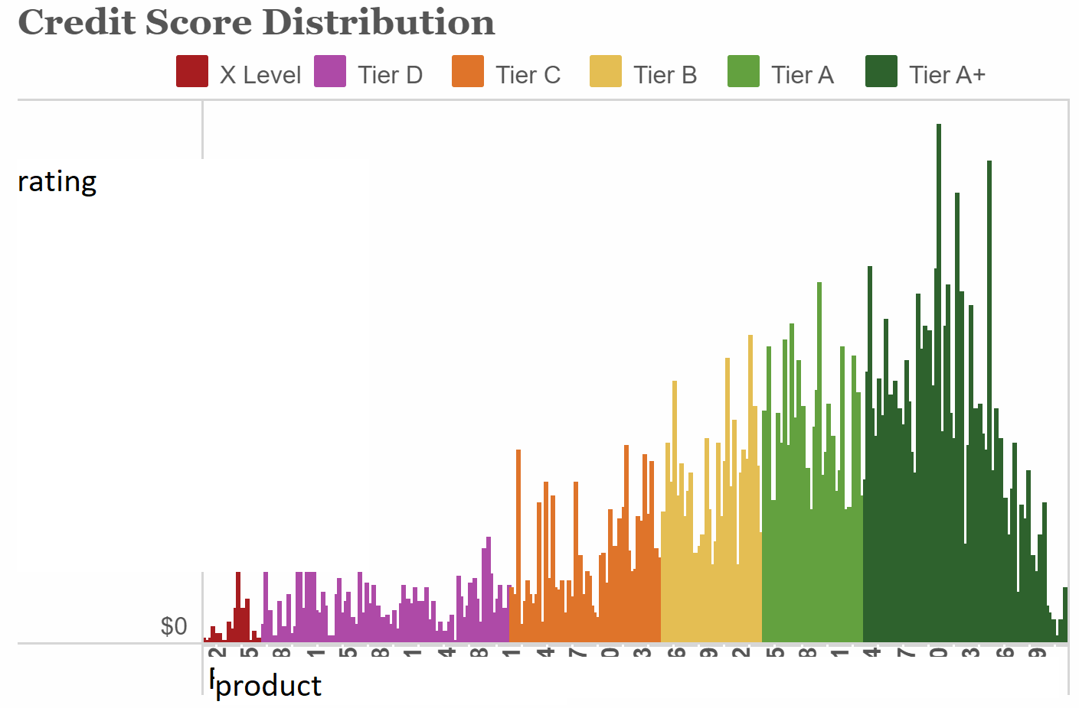
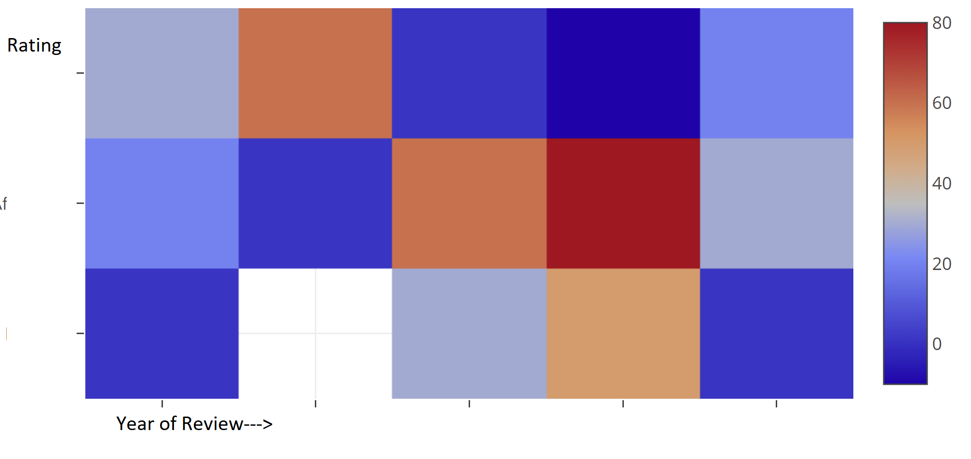
Notes:
Heat Map: Comparing rating v Year of Review? Other options could include:
Rating v price
Year of Review v price
All pulling from the amazon dataset
Bar Char
Showing ratings per product from amazon dataset
Bar Chart

Slide 20
Interactive Dashboard

Slide 21
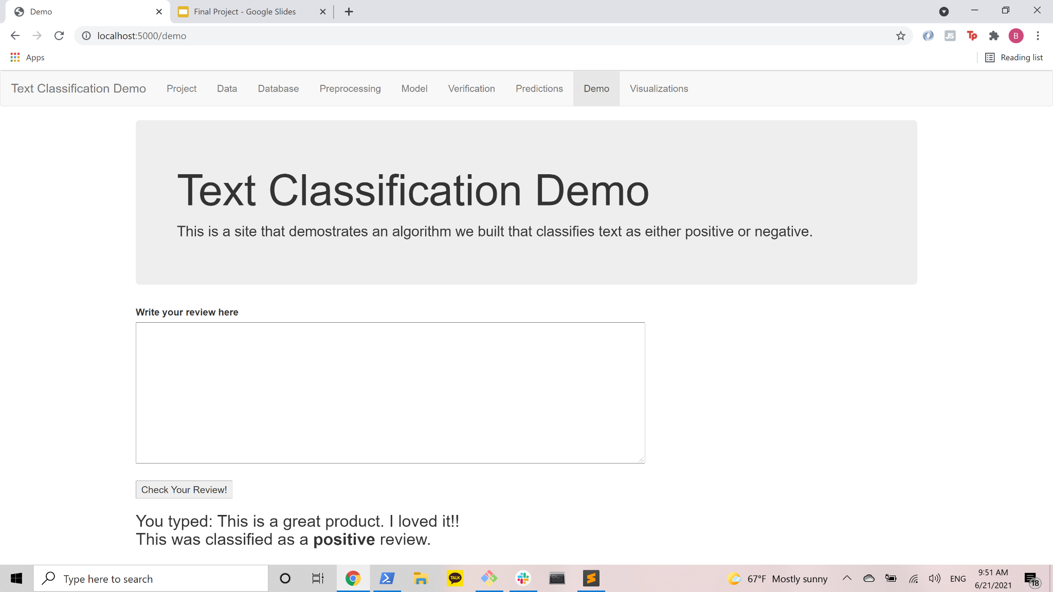

Slide 22
Conclusion

Slide 23
Results

Slide 24
Conclusion
Recommendation for future analysis
What our team would have done differently

Slide 25
Things to include from the module
Content: The presentation should tell a cohesive story about the project and include the following:
Selected topic
Reason the topic was selected
Description of the source of data
Questions the team hopes to answer with the data
Description of the data exploration phase of the project
Description of the analysis phase of the project
Technologies, languages, tools, and algorithms used throughout the project
Result of analysis
Recommendation for future analysis
Anything the team would have done differently

Slide 26
Live Presentation
Requirements for the live presentation follow:
All team members present in equal proportions.
The team demonstrates the dashboard's real-time interactivity.
The presentation falls within any time limits provided by the instructor.
The submission includes speaker notes, flashcards, or a video of the presentation rehearsal.

Slide 27
