Slide 1
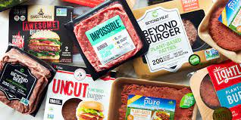
Where’s the Beef?
Tamar Brand-Perez, Tiffany Price, Ben Tubbs, and Jose Santos

Slide 2
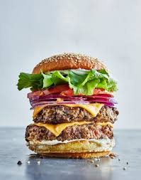
The Artificial Meat Industry
Security
Safety
Sustainability
$4.3 billion Industry
Notes:
Tiffany
Good evening everyone. Tonight we are going to answer the question of “Where’s the beef?”
Meat substitutes are emerging options for food security, food safety, and sustainability
Per Fortune Business Insights, the global population is projected to reach 9.8 billion in 2050; it is not feasible to sustain such an enormous population on animal meat alone.(https://www.fortunebusinessinsights.com/industry-reports/meat-substitutes-market-100239)
One of the most significant wake up calls is related to the pandemic. According to the NYT, farmers and ranchers who supply the nation with meat products were confronted with several crises at once: for example, during 2020, large processing plants shut down as workers fell ill as a result of COVID, and many producers were already strained by the trade war with China.
A larger concern is around global warming; the meat business has been under growing scrutiny in recent years for its climate change consequences, with scientists and environmentalists urging Americans to eat less meat. (https://www.nytimes.com/2020/04/17/climate/meat-industry-climate-impact.html)
The plant-based meat market was estimated to be valued at $4.3 billion in 2020. (https://www.marketsandmarkets.com/Market-Reports/plant-based-meat-market-44922705.html) And could be a $450 billion market by 2040. (https://www.bloomberg.com/news/articles/2021-04-16/beyond-meat-bynd-impossible-foods-battle-over-future-of-fake-meat-industry) OVERVIEW
The fake meat industry has recently experienced a dramatic shift in positive user sentiment. We wanted to explore this concept to ultimately provide stakeholders with the information and tools to assist them in determining which artificial meat brand to sell.
We feel passionately about the subject and hope that our efforts will aid in increasing the awareness and sales of artificial meat products.

Slide 3








Technology, Tools &
Language Used
Bag of Words Model
Machine Learning: Naive Bayes Classifier
Notes:
Tiffany
Technology used: Tableau & SQ Lite
Tools used: Git Hub, Flask, TablePlus
Language used: Python, sql, NLTK
Algorithms used: Bag of words model, Machine Learning: Naive Bayes Classifier
Now we will discuss Data Exploration & Analysis. Tamar will next spend the next few minutes sharing about our data gathering process and database.

Slide 4
Data

Slide 5
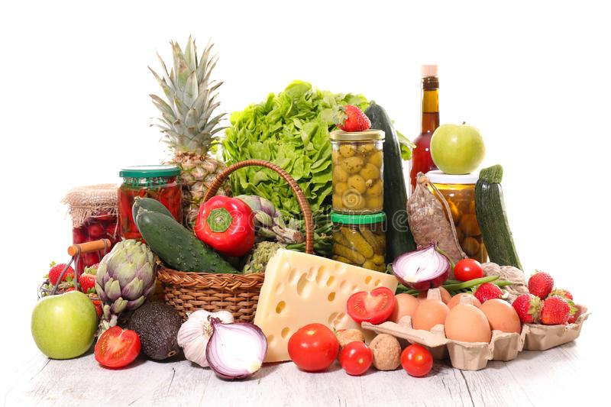
Data Source
Amazon product data
Metadata
Amazon scraped data
Reddit scraped data
Notes:
Our initial goal was to use amazon reviews to create a machine learning model that accurately predicts whether a review is positive or negative.
Our goal was to focus on fake meat products but in the reviews dataset there was no brand and product information so we added the metadata dataset hoping to combine the two and find reviews specifically about fake meat.
That did not work so we added the scraped data.
We scraped reviews from amazon as well as reviews from reddit.

Slide 6
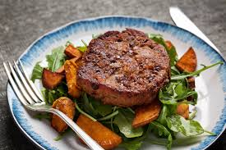
Alternatives to Meat
Notes:
Amazon and reddit scraped reviews were specifically of fake meat products.

Slide 7

Data content
Source | Amount | Star rating | Review Text | Reviewer | Date | Brand | Product | Price | asin | len
UCSD Amazon | > 1 million
UCSD metadata | 116
Scraped Amazon | 1073
Scraped Reddit | 19
Notes:
This table shows an overview of the data available in each of the datasets we used:
UCSD Amazon - general groceries reviews
UCSD metadata - fake meat product and brand information supposed to be of the same dataset as the UCSD Amazon.
Scraped Amazon - review of fake meat
Scraped Reddit - review of fake meat
We wanted a dataset that had all of the columns mentioned here and most importantly, the review text as well as the product and price information because we wanted to focus only on fake meat reviews. Since the dataset from UCSD had groceries reviews but no product and brand information, we tried to merge it with the metadata that was supposed to belong to it.
The general groceries dataset from ucsd had more than 5 million reviews. After cleaning the data we had more than 1 million reviews. The metadata had a similar number initially but after choosing only the fake meat reviews, the metadata set had only 116 reviews. Then when we merged the UCSD amazon with the metadata we were left with only 12 rows. We tried many different variations of merge, join, concatinate, with an inner, outer, left joins with no success. The only common column in these datasets was the asin which is the Amazon’s product number. When we looked further into the data we found that the asin in one of the datasets was made of letters and digits and the other one was digits only so this explained why the merging of these datasets did not work.
So we decided to shift to scraped data from Amazon website. We got the information we needed.
Scraped data was specifically about fake meat products. when scraping we had to input multiple url’s to get the data.
The reddit reviews did not have star ratings. We scraped the reddit reviews about fake meat to show that our machine learning model could predict if a review is positive or negative therefore expanding the number of reviews that store owners could use to help them in understanding how people feel about different fake meat products and ultimately, help them decide which brands and products they may want to sell in their stores.

Slide 8

Data Cleaning
Dropped columns
Added length column
Dropped duplicates
1 and 5 stars
Trimmed the 5 stars
Notes:
Data cleaning:
We dropped columns that were not relevant for our goal:( columns that were dropped were: verified, reviewer name, summary of the review text, unix review time,( vote, image and style - had little data in them))
We added the review length column because we were going to find out if there was a connection between the length of a review and its sentiment (We ended up not using that). This column showed the number of words in each review.
We dropped duplicate rows that is rows that all data was identical were dropped.
We narrowed the data to include only the 1 and 5 starred reviews so the difference between the positive and negative was more obvious.
We trimmed the 5 star reviews from more than 3 million reviews to 600,000 to match the number of reviews we had for 1 star to feed a balanced set into the machine learning model.

Slide 9
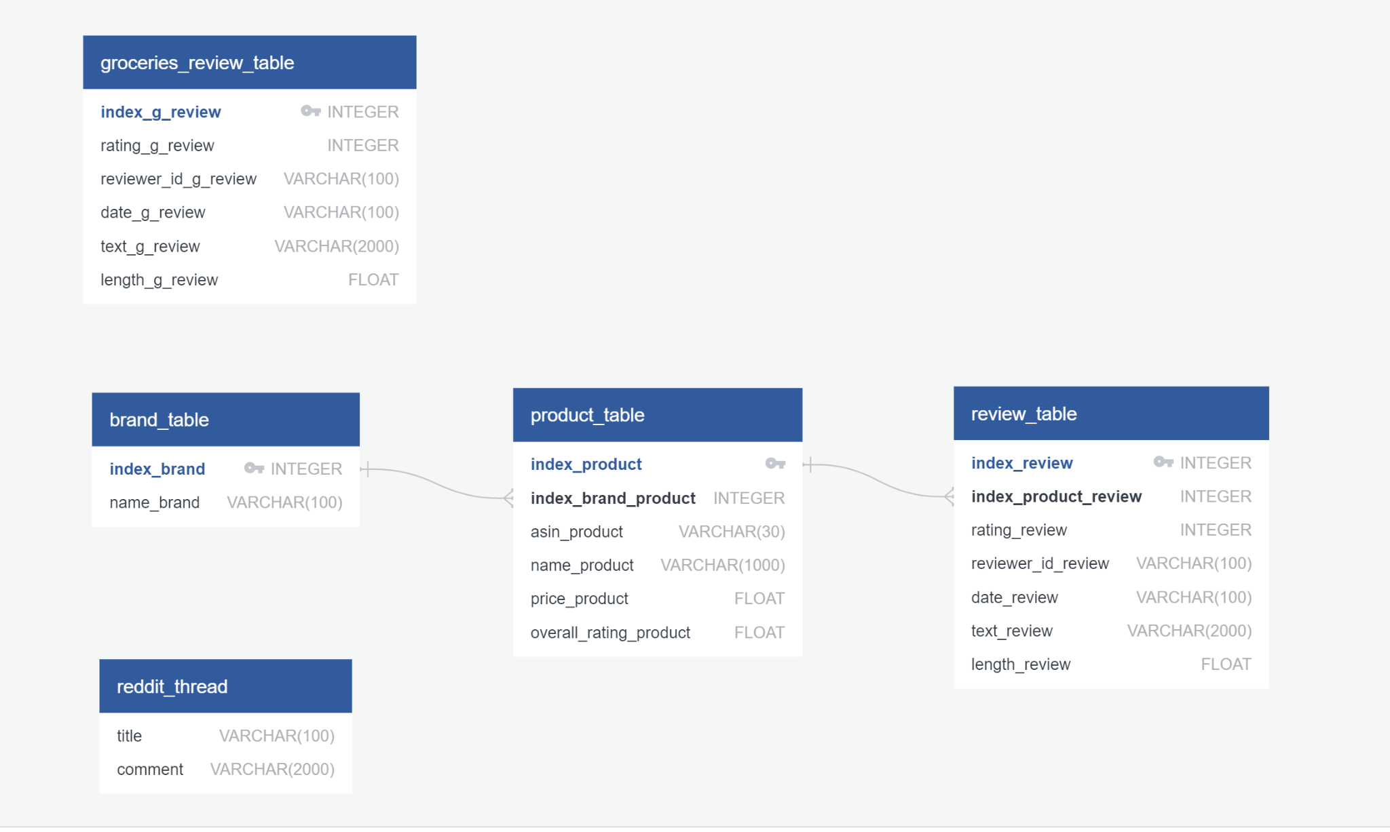
Database
Notes:
Database
We used Sqlite and sqlalchemy to create the database. This was a local database that is suitable for the development stage of a project.
We interacted with the database using python, and table plus.
This ERD is showing the tables in the database. The first one is the data from UCSD amazon general groceries. (I did not include the metadata because we did not use it.) The three in the middle are from the amazon scraped data. The first one is of the brands. The second is the products. Since each brand has several products, the connection is one to many. Since each product has multiple reviews the connection between the product and the review table was also one to many. Lastly we have the reddit table with Reddit reviews.

Slide 10
Questions
How do people feel about fake meat products
Positive or negative review?
Frequent words reviewers associate with a brand.
Price change over time?
Rating change over time?
Inform grocery store owners
Notes:
The questions our team hoped to answer with this data:
We wanted to collect information about fake meat and provide it to stakeholders so they can make informed decisions. We wanted to provide a better understanding of how people feel about fake meat products:
Did a fake meat product receive a positive or negative review?
What are some keywords that users use to describe specific products, which may provide insight into what characterizes a specific product in the eyes of reviewers.
Did the price of these fake meat product change over time?
Did the rating of these products change over time?
All of this information would be provided for example to groceries store owners to help them decide which products and brands they might choose to sell in their stores.

Slide 11
Machine Learning
Notes:
We are creating a sentiment analyzer that classifies reviews as positive or negative.
Our dataset is a collection of Amazon reviews that we used to train the model. Amazon reviews may contain any type of lexicon including words that are misspelled, abbreviated, capitalized, contain punctuation, etc. The first step is to normalize this lexicon so that items such as “I’m”, “Im”, “i’m” and “im” are not treated as different words.

Slide 12
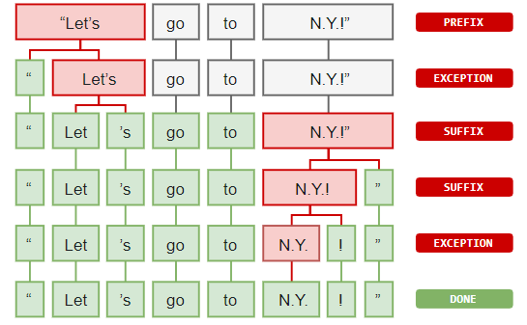
Preprocessing and Normalization
Tokenization
Casing
Removing Non Alphanumerics
Length
Stop Words
Lemmatization
Notes:
We need to split the sentence into a list of words for processing. We could do something simple like split the sentence at each word space. Tokenizers split words in an intelligent way, so that words with periods, such as “Mr.” are not treated as separate tokens.
Normalization
Casing - The first step was to switch every letter of every token to lowercase, so that tokens such as “The” and “the” would not be treated as separate entries
Removing Non Alphanumerics - Next all letters that were not alphanumeric were removed to prevent words such as “mr” and “mr.” from being treated as separate tokens
Length - All tokens that were less than length 2 were also removed
Stop Words - Stop words were removed
Lemmatization - All words were lemmatized for greater normalization

Slide 13
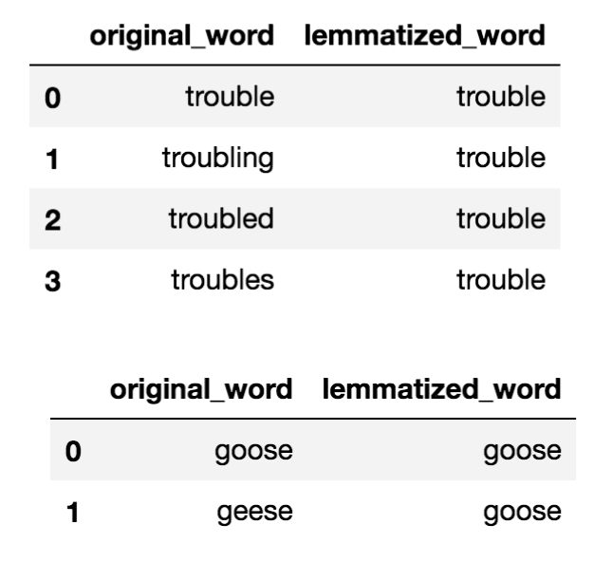
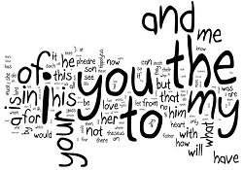
Cleaning
Notes:
Stop words are words that do not add a lot of meaning to the text such as “the”, “it”, “as” and “about”. Stop words were removed.
The same word may come in many forms, such as: “eat”, “ate”, “eaten”, etc. All of these words can be normalized to what are called lemmas so that they are not treated as separate tokens, but as the same token.

Slide 14
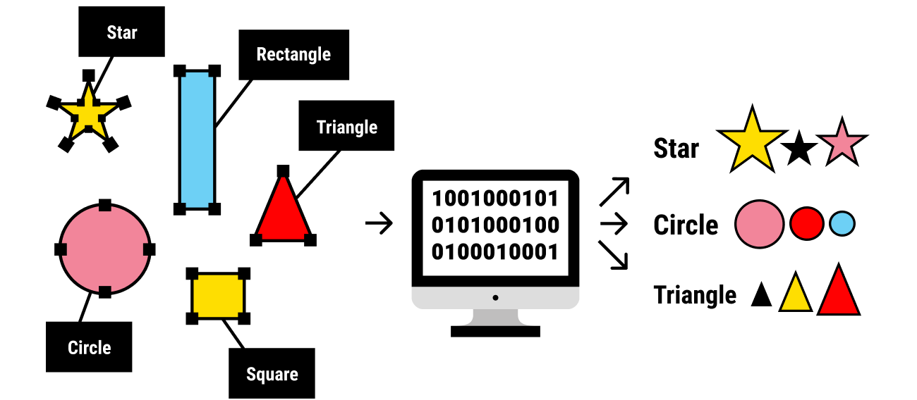
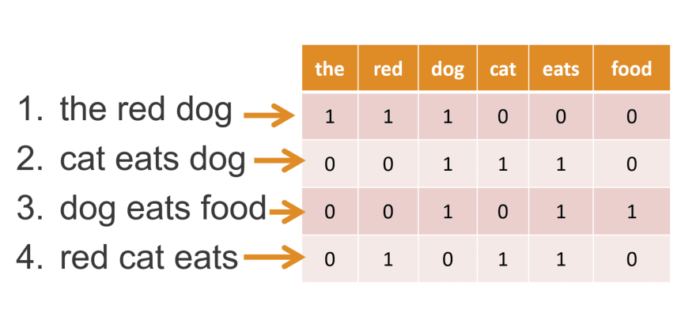
Feature Set
Notes:
Next, we need to create the labeled data. We used only the five star reviews as positive and the one star as negative. There were many more positive than negative reviews, so we used only 1000 of each to eliminate bias in the model. We used monograms which means each word is treated separately and word order is not taken into account. We then turned each review into a vector (a python dictionary) of the 3000 most common words in all of the reviews. This dictionary stores the presence or absence of each of the 3000 most common words in all of the reviews.

Slide 15
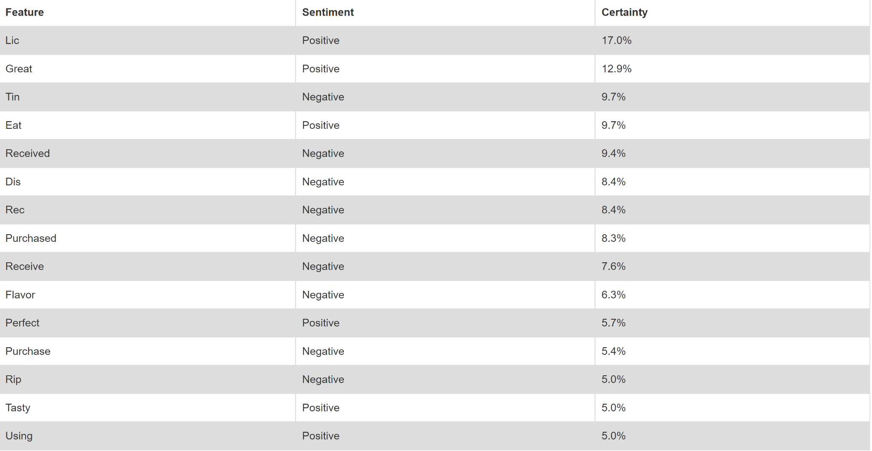
Most Informative Features
Notes:
Here are the top fifteen most informative features along with whether they are positive or negative and the percentage of how telling they are.

Slide 16
Visualizations
Notes:
Tiffany - introduction
To create visualizations in Tableau, we scraped amazon for reviews and ratings of 5 fake meat brands. Using over 1,000 reviews we were able to analyze various aspects of the data. Jose will explain in detail.

Slide 17
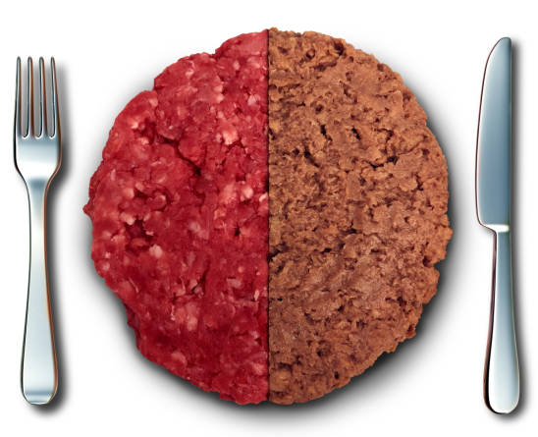
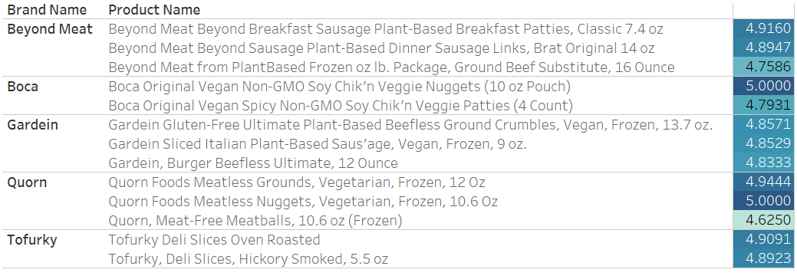




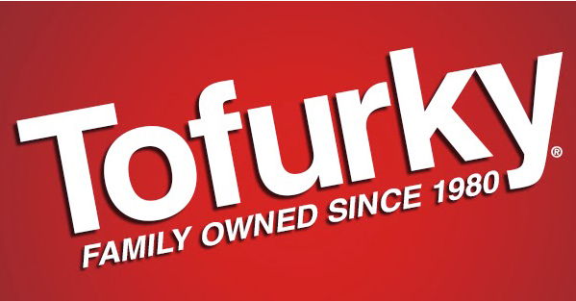
Fake Meat Products Reviewed
Notes:
We scrapped reviews for fake meat products from 5 popular brands: Beyond Meat, BOCA, gardein, Quorn and Tofurky.
On average we scrapped reviews from 2 products for each brand: 3 products for Beyond Meat, 2 products for BOCA, 3 products for gardein, 3 products for Quorn and 2 products from the Tofurky brand.

Slide 18
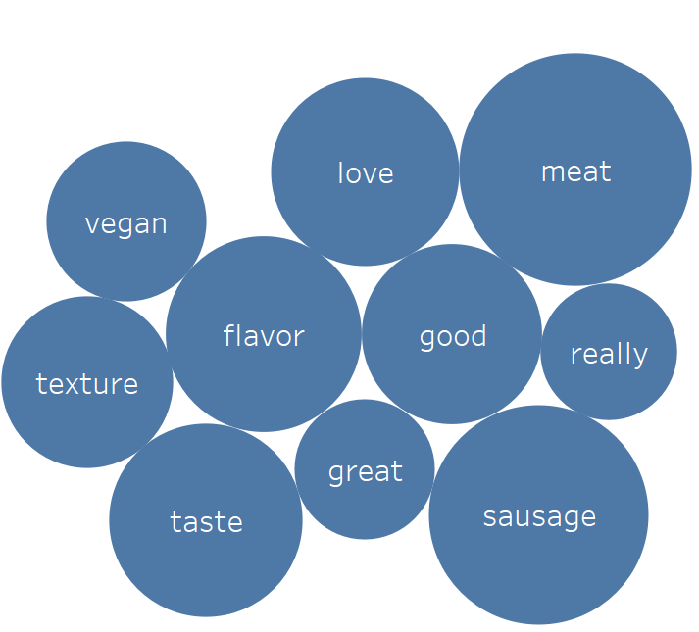
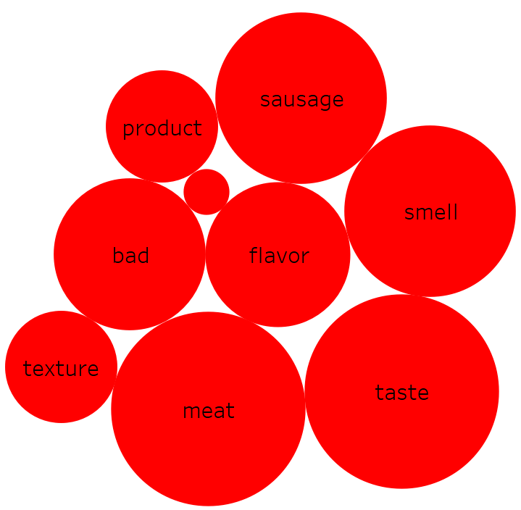
Fake Meat Brand Sentiment
Vegan, love, good, really, great
Product, bad, smell
Notes:
Two word clouds to show the 10 most frequent words used in positive (blue circles) and negative reviews (red circles) of Beyond Meat products.
Area of circle is proportional to the frequency that the word appeared in the reviews (normalized per sentiment).
Stars indicate words that are only used in one sentiment review (positive or negative).
This view allows a stakeholder to associate keywords that define a brand with positive and negative reviews. By doing so, the stake holder is afforded a comparison between positive and negative “traits” per brand (as shown here) or positive/negative traits for a brand comparison (alternative view).
Starred words indicate words with high frequency in a sentiment review and that do not show up in high frequency on the opposite sentiment review.

Slide 19
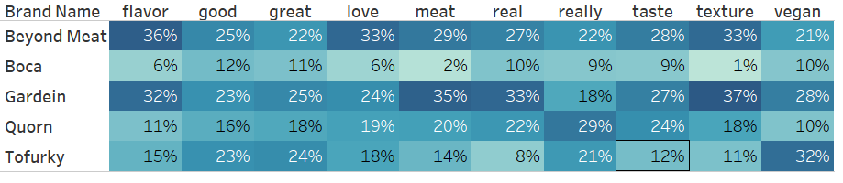
Keyword frequency by brand in positive reviews
Notes:
Info on how often a keyword (top 10 from all reviews) is used in a review of a product of a brand - brand to brand comparison. E.g. out of total number of times that “flavor” was used in positive reviews for all brands (100%), 36% of those instances were found in reviews of Beyond meat products.
This view allows the store owner to perceive how each reviewer associates a keyword in a POSITIVE review with a certain brand.
The bordered cells indicate the brand for which that particular word was used with the highest frequency.
Cells are colored from light blue (low frequency) to dark blue (high frequency) according to percent observed down a column.

Slide 20
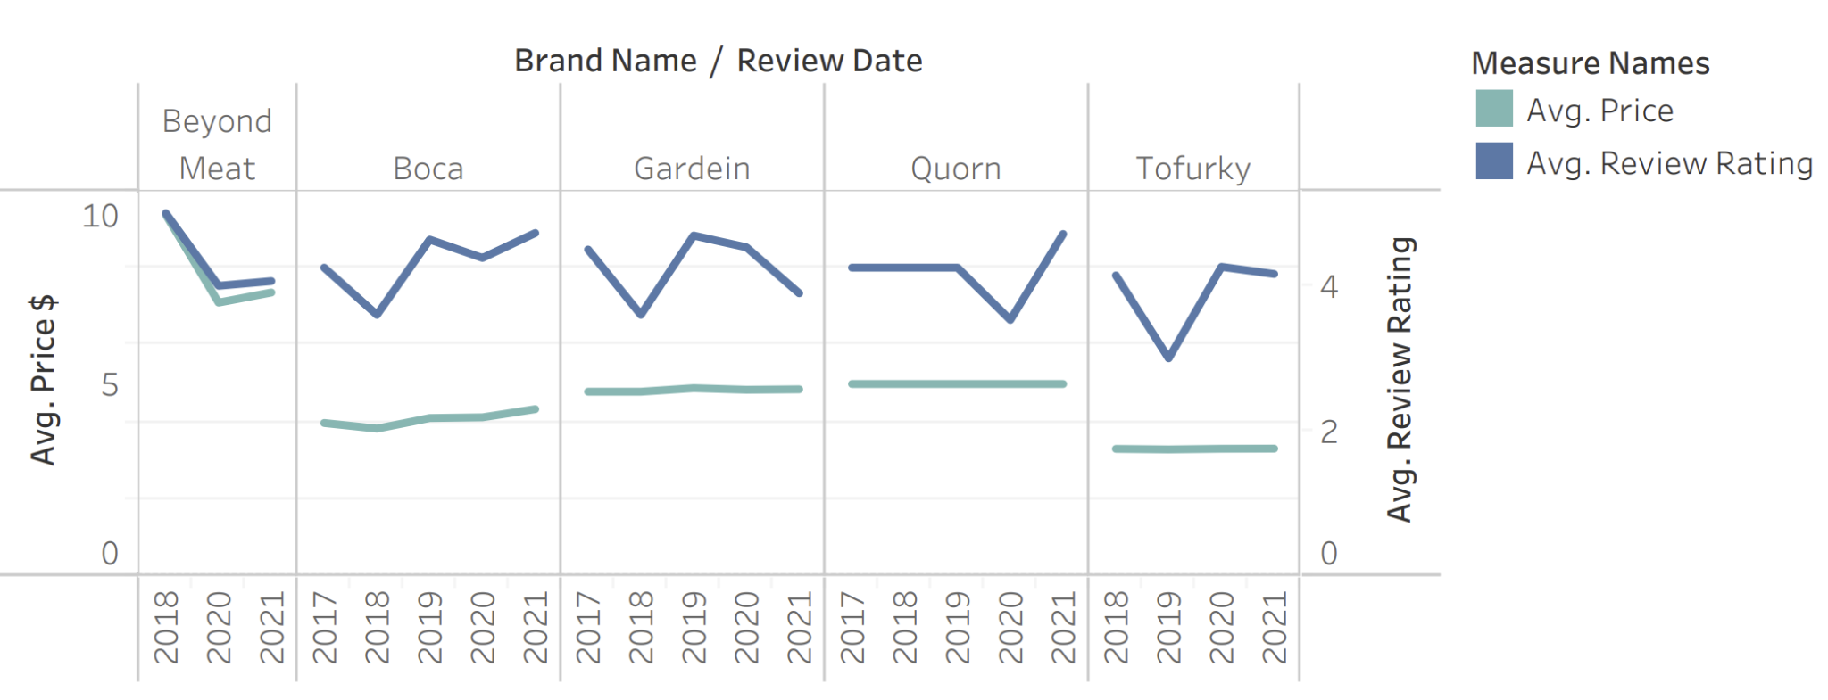
Review v. Price by Brand per Year
Notes:
A plot of the evolution of average price and average review rating for each brand.
This plot allows the stakeholder to perceive 1) evolution of consumer sentiment for each brand, and 2) how the evolution in sentiment correlates with evolution in price.
For example, for the “Beyond Meat” products reviewed, the average price appears to be well correlated with the average review rating since when the average price appears to change at the same rate and in the same direction as the average review rating. For the other brands there appears to be no correlation between price and consumer sentiment evolution.

Slide 21
Summary
Results
ML model accuracy is 82%
Stakeholders’ prediction of customer sentiment
Specific words and brand association
Limitations
Rushed time frame
Limited initial data set
Algorithm does not consider the order of words
Notes:
Tiffany
RESULTS
In conclusion, our hope is to facilitate increased sales of artificial meat products by way of empowering store owners in their decision making process of which products/brands to sell.
Our ML model predicts the sentiment of user entered reviews with approximately 82% accuracy. We have seen a range of 80-84% depending on which data is used to train the model.
Also, through use of our interactive website, stakeholders have the ability to understand customer sentiment upon testing reviews.
Finally, from the word clouds and the table analysis of the reviews, the stakeholder will be able to associate specific product description words with the respective brand. This allows for a deeper understanding of how customers choose to comment about a specific product and brand.
LIMITATIONS
· Our time frame was rushed; as were learning about the limitations of our data set, we were already using it
·
Since our initial data set was limited, we were not
necessarily focused on the best data set available. We operated with what we had and made the
most of it due to time and resource constraints, including but not limited to,
computer capacity and also eventually being blocked by Amazon during our web
scraping.
·
Finally, the algorithm does not consider the order
of words (ie food tastes great v great tasting food)

Slide 22
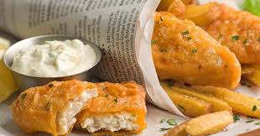
Future Analysis
Interactive visualizations
Larger data set
Location data
Ways to Improve Project
Search for a more accurate algorithm
Have algorithm consider word order
Host website on server
Notes:
Tiffany
FURTHER ANALYSIS
If we were to continue future analysis, we would:
· Include more interactive visualizations for the end user
·
Scrape in a larger data set, as available
·
Pull in location data of reviews to further enable
stakeholders’ insight into consumer sentiment by location. This would allow for
more market focused guidance.
WAYS TO IMPROVE PROJECT
· We would search for a more accurate algorithm
·
We would have our algorithm consider word order
·
Finally, we would host our website on a server
Thank you and now Ben will present our website and the informative interactive features.

Slide 23
Interactive Website Demo

Slide 24
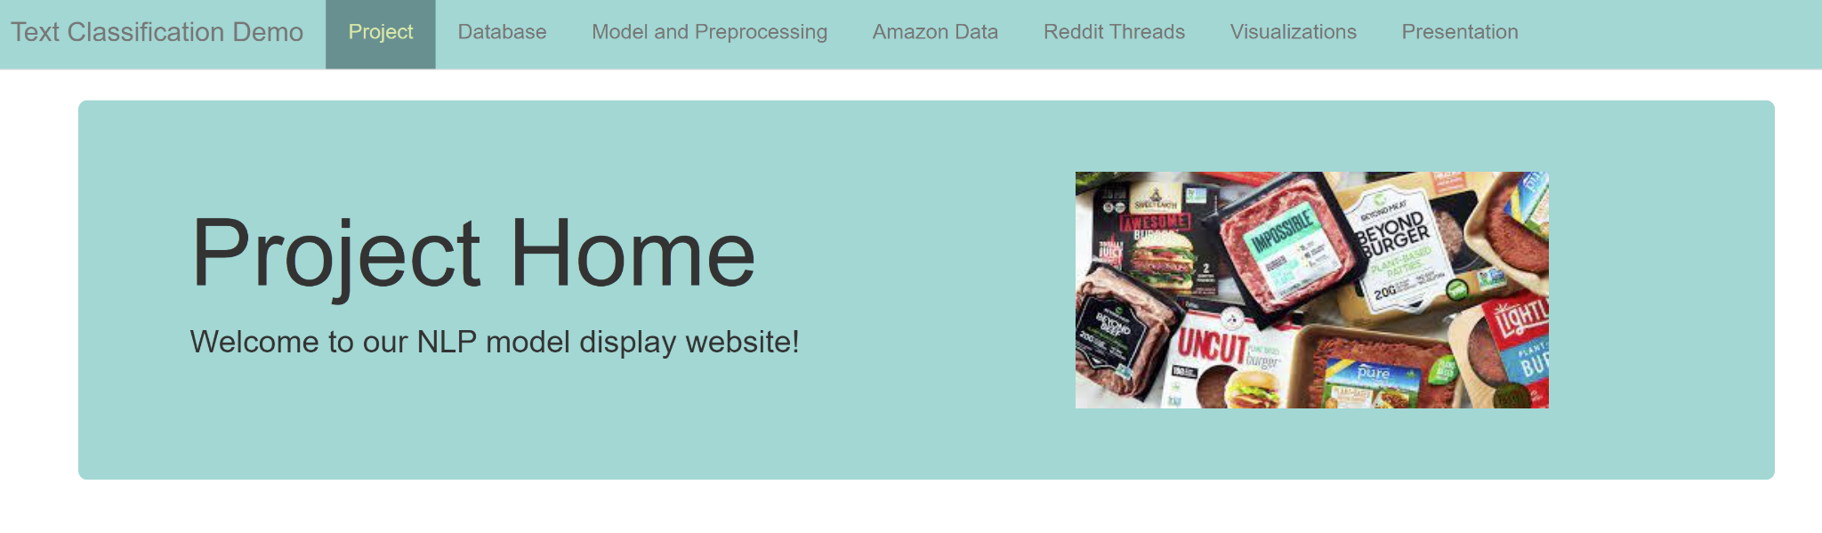
Interactive Dashboard
Notes:
Ben
Explanation of website/dashboard and interactivity features to predict if a review will be classified as a positive or negative review.

