Slide 1
Artificial Meat Review Predictions
Tamar Brand-Perez, Tiffany Price, Ben Tubbs, and Jose Santos

Slide 2
Executive Summary
Overview
The fake meat industry has recently experienced a dramatic positive shift in consumer interest and exponential growth. Our team wants to predict how consumer reviews affect ratings, which will assist store owners in their decision making process of which brand to sell.
Objectives
By analyzing the Amazon consumer reviews between 2017 - 2021, our machine learning tool will predict whether a non-rated review will be positive or negative.
Notes:
Tiffany
Overview
The fake meat industry has recently experienced a dramatic positive shift in consumer interest and exponential growth. Our team wants to predict how consumer reviews affect ratings, which will assist store owners in their decision making process of which brand to sell.
Objectives
By analyzing the Amazon consumer reviews between 2017 - 2021, our machine learning tool will predict whether a non-rated review will be positive or negative.

Slide 3
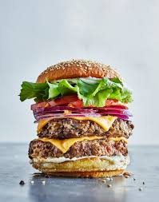
Team Members & Responsibilities
Tiffany Price:
Project Manager
Ben Tubbs:
Machine Learning Lead
Tamar Brand-Perez:
Database Lead
Jose Santos:
Dashboard Lead
Notes:
Tiffany
Tiffany: Project Manager
Ben: Machine Learning Lead
Tamar: Database Lead
Jose: Dashboard Lead

Slide 4







Products Used
Technology
Tools
Language
Algorithms
Algorithm: Bag of Words Model
Machine Learning: Naive Bayes Classifier
Notes:
Tiffany
Technology used: Tableau & SQ Lite
Tools used: Git Hub, Plotly, Flask, TablePlus
Language used: Python
Algorithms used: Bag of words model, Machine Learning: Naive Bayes Classifier

Slide 5
Data Exploration & Analysis

Slide 6
Purpose & Sourcing
Amazon Grocery and Gourmet Food data set: (http://deepyeti.ucsd.edu/jianmo/amazon/index.html).
NLP was used to train a sentiment classifier.
Goals:
Predict user sentiment for artificial meat products.
Assist store owners’ with their analysis.
Notes:
Tiffany
Our data set was pulled from Amazon Grocery and Gourmet Food data set: (http://deepyeti.ucsd.edu/jianmo/amazon/index.html).
Natural Language Processing machine learning model was used to train a sentiment classifier on the dataset containing over 1 million reviews.
The goal of this classifier is to predict user sentiment (positive or negative) for artificial meat products.
We believe this analysis and our interactive dashboard will assist store owners’ decisions regarding which artificial meat products to sell in their stores.

Slide 7
Database

Slide 8
Exploration
Notes:
Tamar

Slide 9
Data Source
Notes:
Tamar

Slide 10
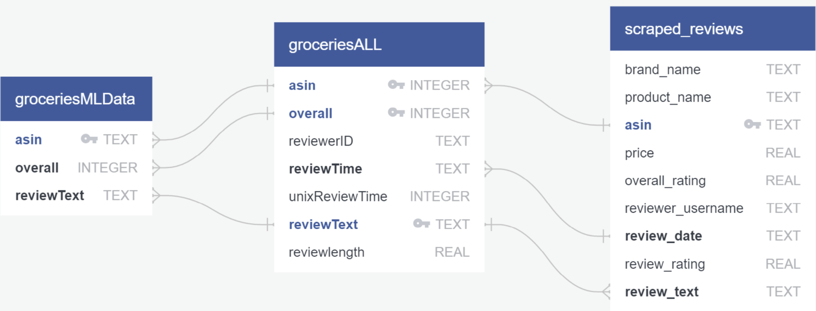
Database
Sqlite and sqlalchemy were used to create a database.
The database is accessed with python and also using table plus.
Notes:
Tamar

Slide 11
Machine Learning

Slide 12
Data Splitting, Training & Testing
Notes:
Ben

Slide 13
Analysis
Notes:
Ben

Slide 14
Dashboard
Notes:
Tiffany - introduction
To create visualizations in Tableau, we scraped amazon for reviews and ratings of 5 fake meat brands. Using over 1,000 reviews we were able to analyze various aspects of the data. Jose will explain in detail.

Slide 15
Visualization #1
Notes:
Jose

Slide 16
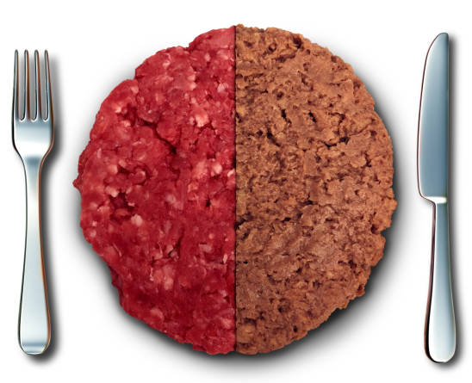
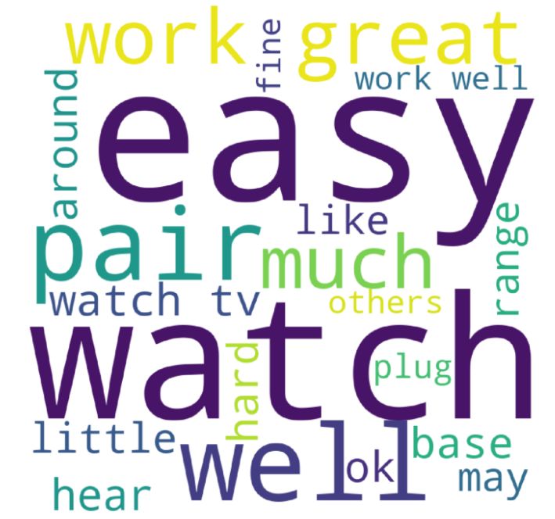
Fake Meat Brand Sentiment
Brand selector
Brand selector
Positive Review word frequency
Negative Review Word Frequency
Positive & Negative Reviews per month
Notes:
Brand choices:

Slide 17
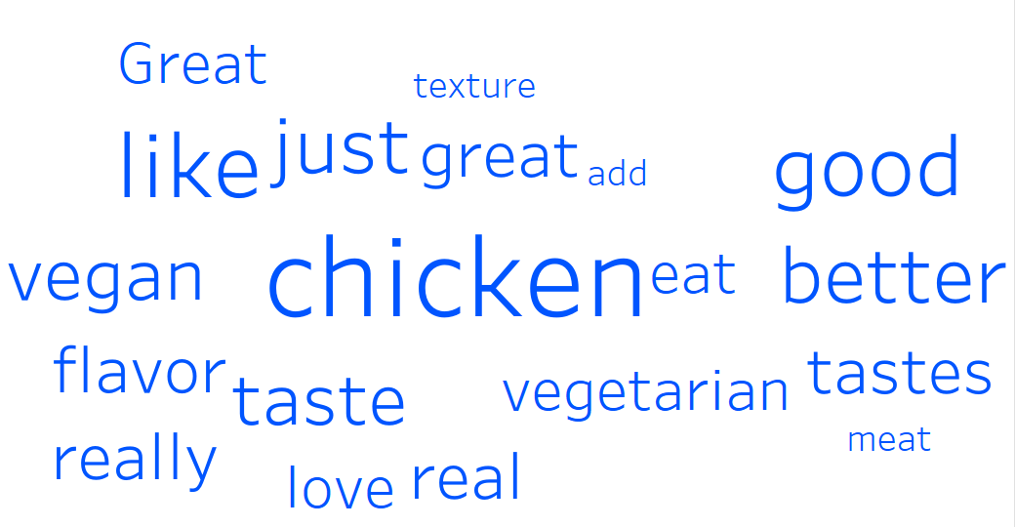
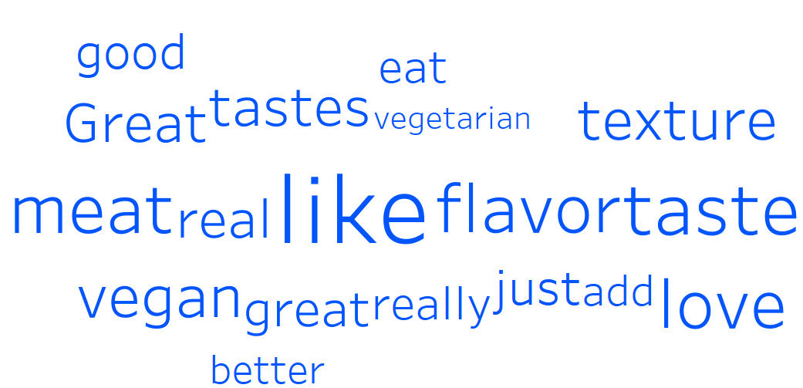
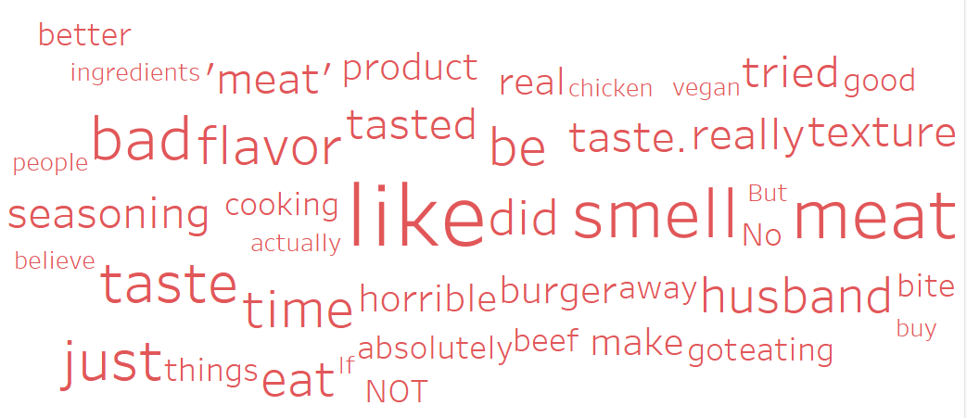
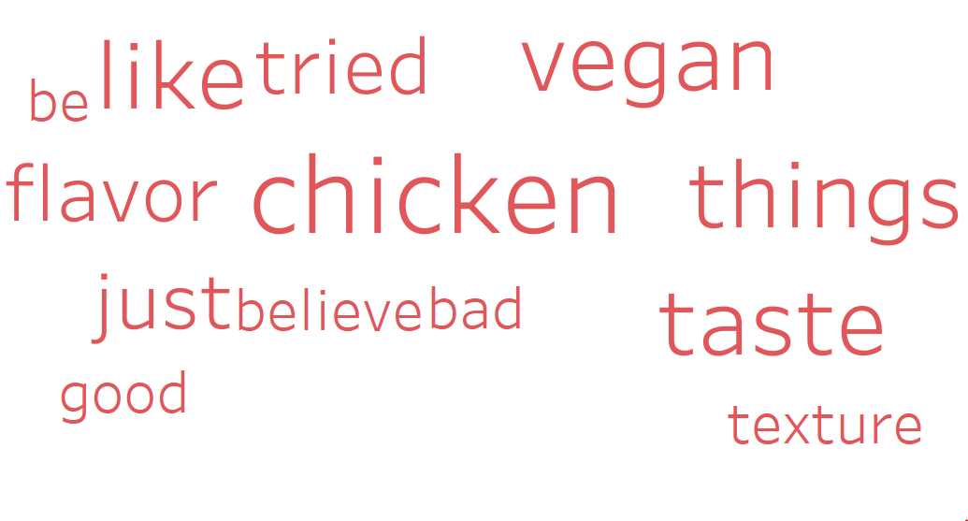
Fake Meat Brand Sentiment
Brand selector
Brand selector
Positive Review word frequency
Negative Review Word Frequency
Positive & Negative Reviews per month
Notes:
Brand choices:

Slide 18
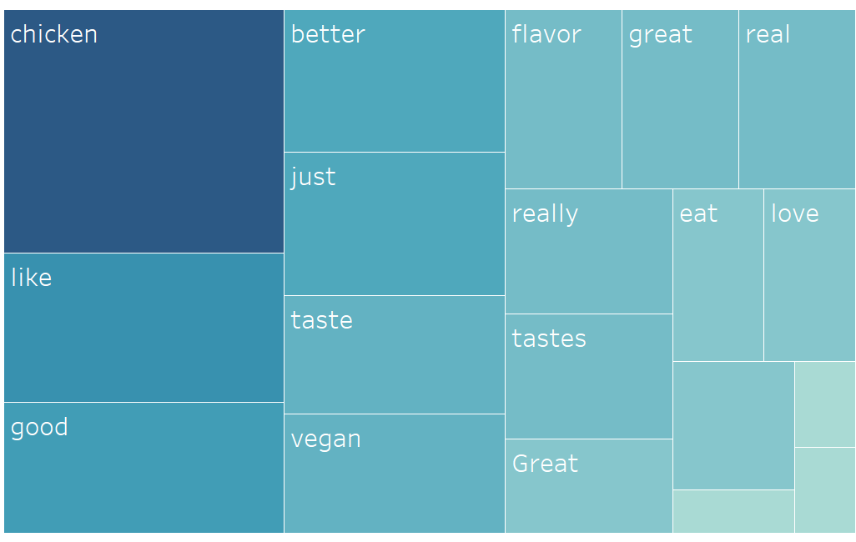
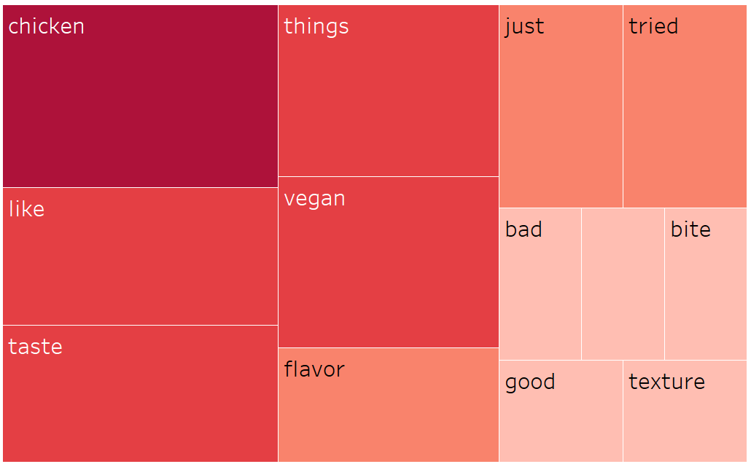
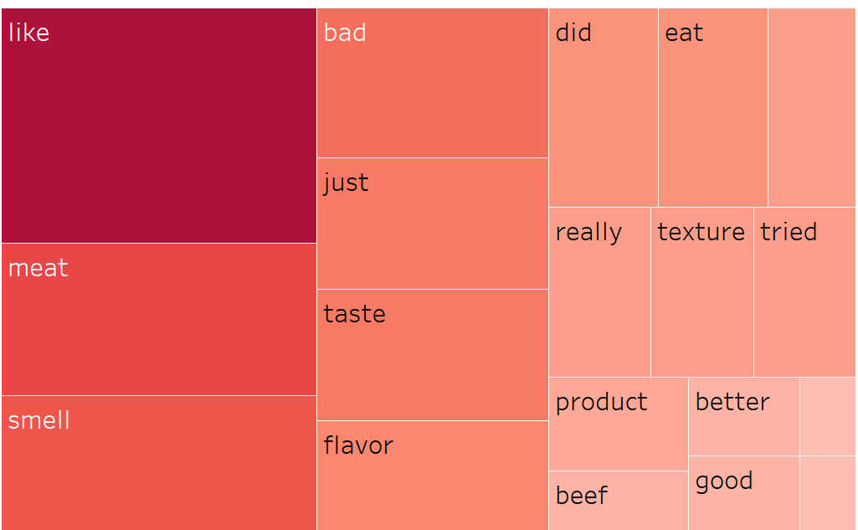
Fake Meat Brand Sentiment
Brand selector
Brand selector
Positive Review word frequency
Negative Review Word Frequency
Positive & Negative Reviews per month
Notes:
Brand choices:

Slide 19
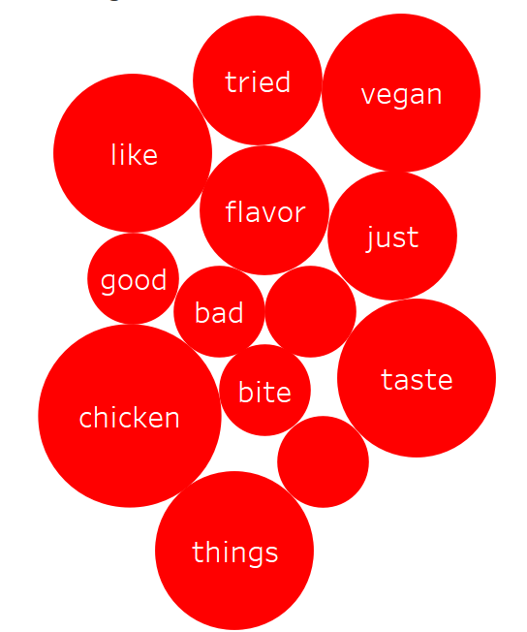
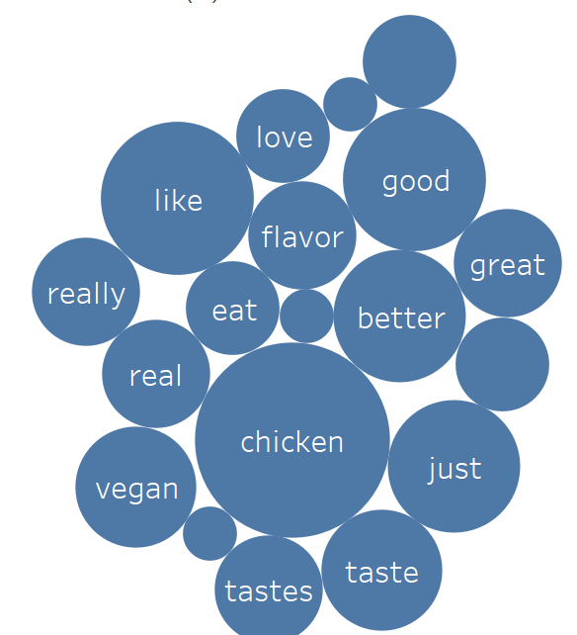
Fake Meat Brand Sentiment
Brand selector
Brand selector
Positive Review word frequency
Negative Review Word Frequency
Positive & Negative Reviews per month
Notes:
Brand choices:

Slide 20
Fake Meat Brand Sentiment
Brand selector
Positive Review word frequency
Negative Review Word Frequency
Notes:
Brand choices:

Slide 21
Fake Meat Brand Sentiment
Brand selector
Positive Review word frequency
Negative Review Word Frequency
Notes:
Brand choices:

Slide 22
Fake Meat Brand Sentiment
Brand selector
Positive Review word frequency
Negative Review Word Frequency
Notes:
Brand choices:

Slide 23
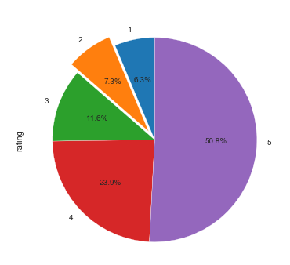
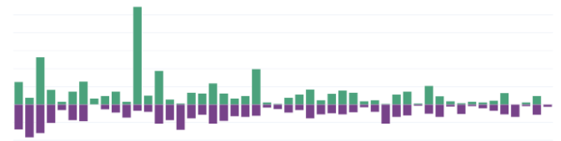
Fake Meat Brand Sentiment
Brand selector
Brand selector
Positive & Negative Reviews per month
Positive & Negative Reviews per month
Notes:
Brand choices:

Slide 24



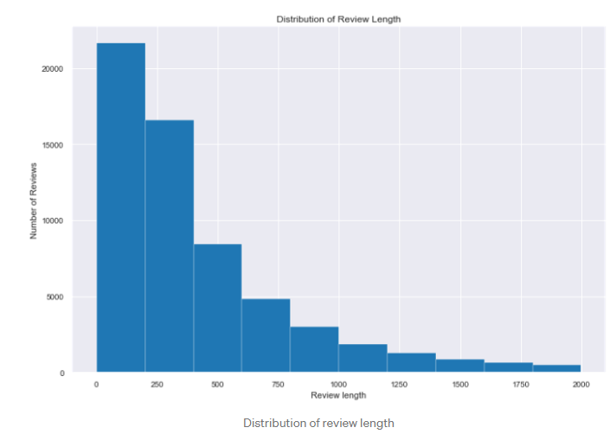
Fake Meat Brand Sentiment
Number of Reviews:
353
Brand selector
Positive Review word frequency
Negative Review Word Frequency
Positive & Negative Reviews per month
Breakdown of Positive / Negative Reviews
Positive Review Length
Negative Review Length
Overlay training set data?
Overlay training set data?
Notes:
Brand choices:

Slide 25
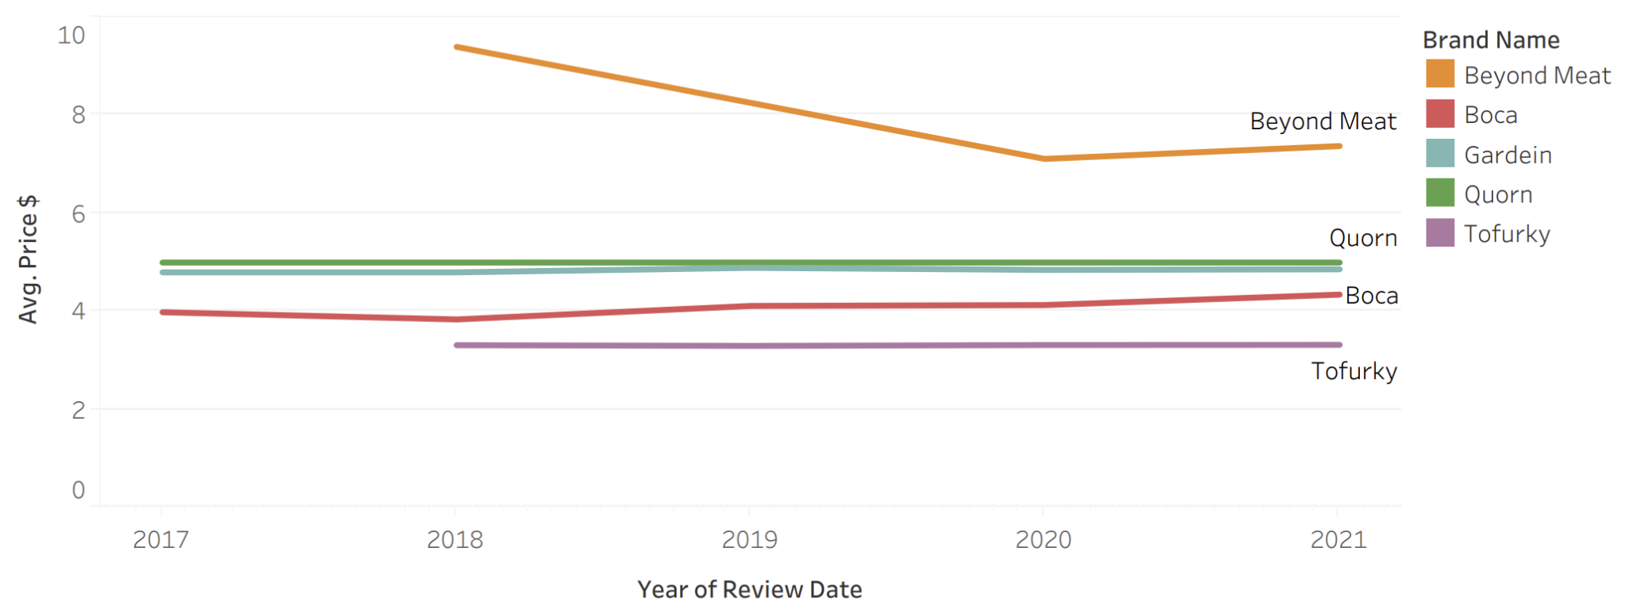
Price v. Year of Review
Notes:
Tiffany
This graph shows the relationship between the average price of the products each brand sells over the span of years scraped from the amazon website. This may be helpful to a business owner as it shows the trend in the average price of the brands over the years and if they have remained constant or fluctuate.

Slide 26
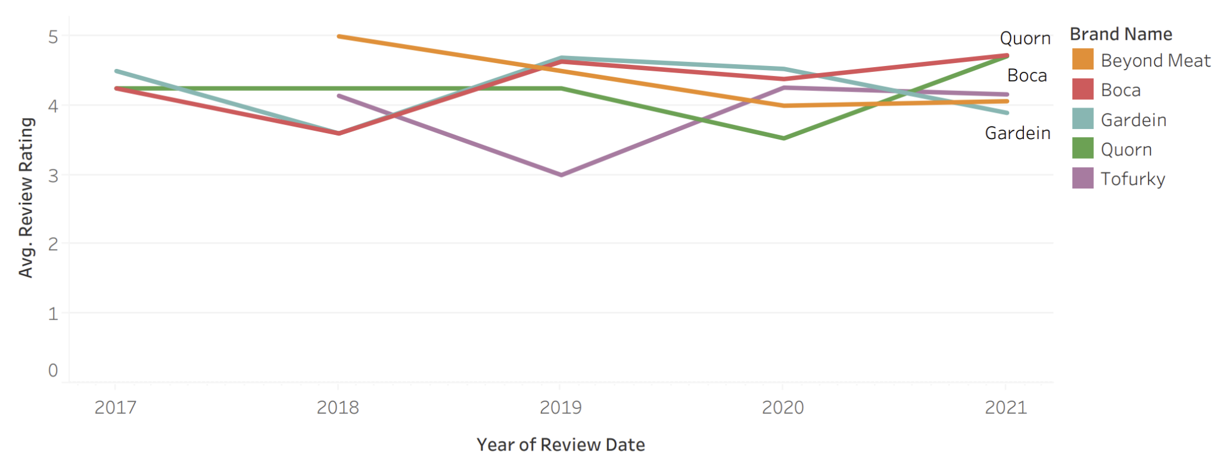
Rating v. Year of Review
Notes:
Tiffany
This graph shows the relationship between the average review rating of the products each brand sells over the span of years scraped from the amazon website. This may be helpful to a business owner as it shows the trend in the average ratings of the brands over the years and how they have fluctuated. What is interesting is Boca and Quorn seem to be on the rise with trending favorable reviews, while Gardein and Tofurky are declining. After a large decline, Beyond Meat is holding steady. Further info could be gathered to determine what has caused the change in consumer sentiment.

Slide 27
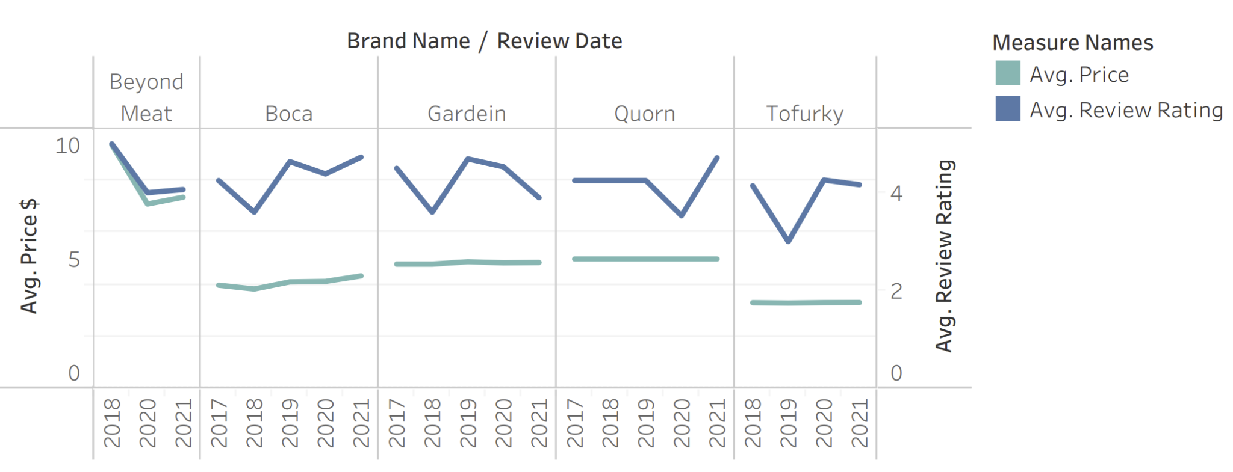
Review v. Price by Brand per Year
Notes:
Tiffany
This slide reflects both price and review by brand each year. We wanted to see if there was a correlation between fluctuation of price v consumer rating. As you can see, there was a strong correlation between the price drop and ratings of Beyond Meat. Boca’s also seem to be correlated. Interestingly, Gardein’s reviews are decreasing while the prices are slightly increasing.

Slide 28
Conclusion

Slide 29
Results
80.### % accuracy from ML model
Top 3 Positive Words
Top 3 Negative Words
Limitations
Notes:
Tamar?
80.### % accuracy from Machine Learning model
Top 3 Positive Words:
Top 3 Negative Words:
Limitations:

Slide 30
In Summary
Recommendation for Future Analysis
Algorithm does not consider the order
What Our Team Would Have Done Differently
Improve the algorithm to make it more than 80% accurate
Notes:
????
Recommendations for Future Analysis
Algorithm does not consider the order of the words
What our Team Would Have Done Differently
Improve the algorithm to make it more than 80% accurate

Slide 31
Demo
https://project-group-3.herokuapp.com/

Slide 32
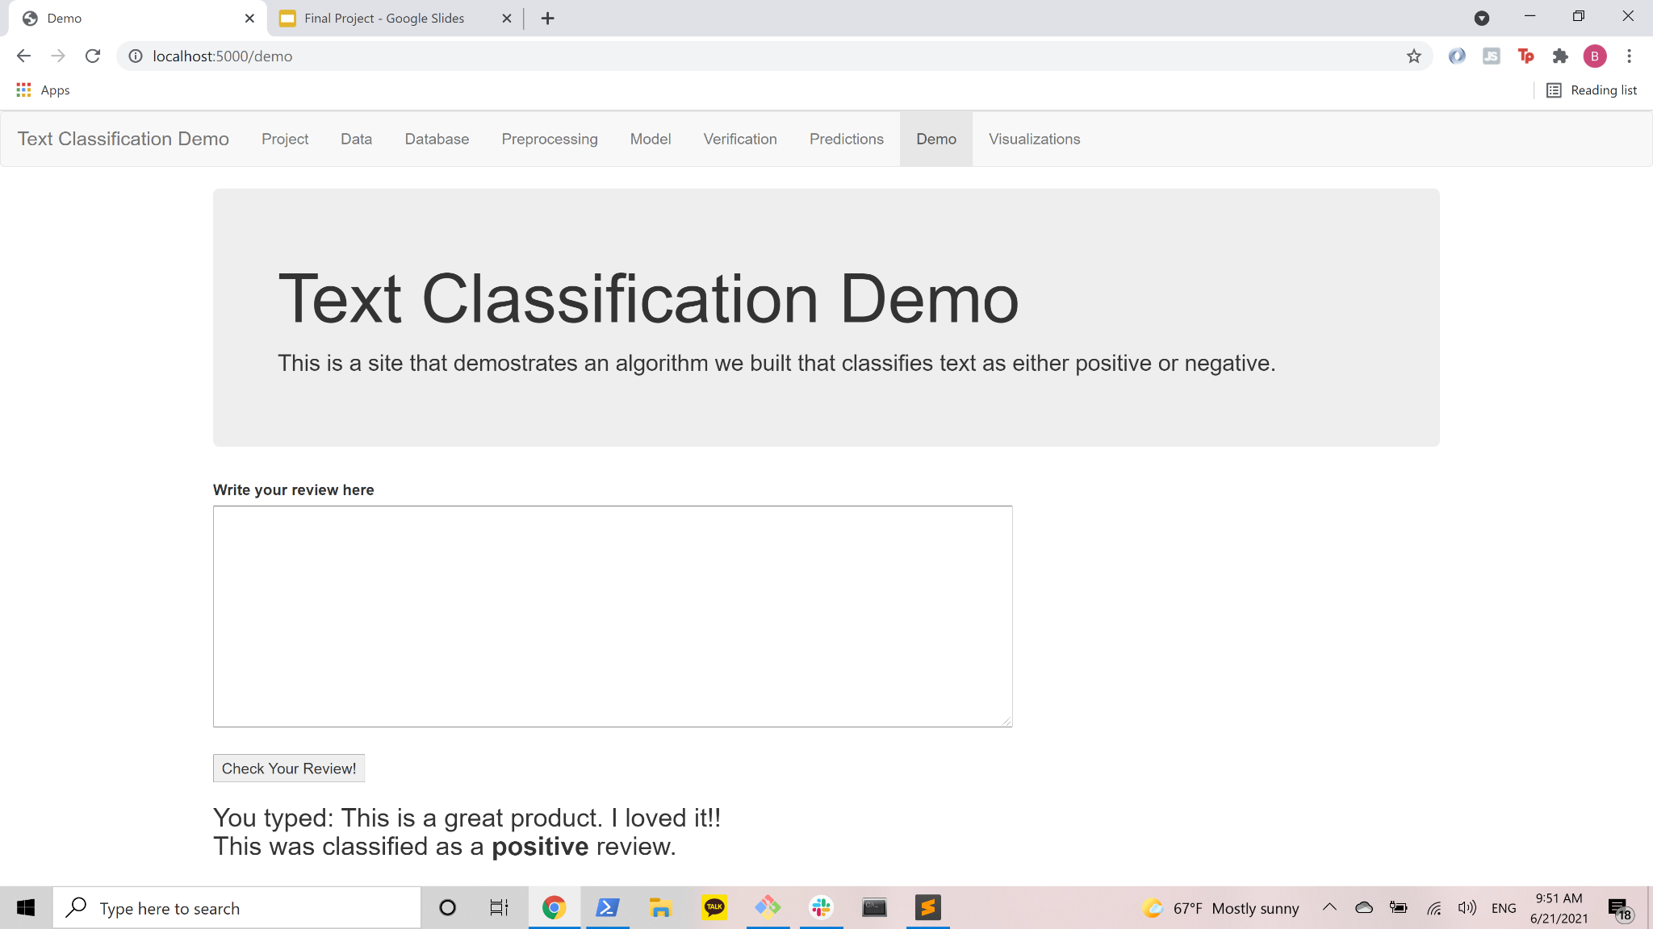
Notes:
Ben
Explanation of website/dashboard and interactivity features to predict if a review will be classified as a positive or negative review.

Slide 33
Things to include from the module
Content: The presentation should tell a cohesive story about the project and include the following:
Selected topic
Reason the topic was selected
Description of the source of data
Questions the team hopes to answer with the data
Description of the data exploration phase of the project
Description of the analysis phase of the project
Technologies, languages, tools, and algorithms used throughout the project
Result of analysis
Recommendation for future analysis
Anything the team would have done differently

Slide 34
Live Presentation
Requirements for the live presentation follow:
All team members present in equal proportions.
The team demonstrates the dashboard's real-time interactivity.
The presentation falls within any time limits provided by the instructor.
The submission includes speaker notes, flashcards, or a video of the presentation rehearsal.

