Slide 1
Secure data hiding in images using Steganography
CAPSTONE PROJECT
Presented By:
Student Name : Babariya Foram Pareshbhai
College Name & Department : Leelaben Dashrathbhai Ramdas Patel Institute Of Technology & Research

Slide 2
OUTLINE
Problem Statement
Technology used
Wow factor
End users
Result
Conclusion
Git-hub Link
Future scope

Slide 3
Problem Statement
Ensuring data security in digital communication is crucial since conventional techniques are vulnerable to interception. This project, "Secure Data Concealment in Images Using Steganography," embeds confidential information within image pixels, making it undetectable by unauthorized individuals. The encrypted data is retrievable only through a password-protected decryption process, ensuring secure transmission.

Slide 4
Technology used
OpenCV – Enables image processing and pixel manipulation.
Python – Utilized for the steganography algorithm.
OS Module – Manages file operations and image handling.

Slide 5
Wow factors
Advanced Security – Hidden messages remain undetectable within images. Password Protection – A passcode is required for decryption, adding another layer of security.
Lightweight & Fast – Simple Python and OpenCV functions ensure efficiency.
Minimal Image Distortion – The appearance of the image remains unchanged.
Practical Applications – Ideal for secure communication, digital watermarking, and private messaging.

Slide 6
End users
🔹 Investigative Journalists & Whistleblowers – Safeguard sensitive information from unauthorized access. 🔹 Government & Defense Sectors – Facilitate secure intelligence sharing. 🔹 Cybersecurity Experts – Strengthen data protection mechanisms. 🔹 Businesses & Corporations – Secure confidential business transactions. 🔹 General Users – Ensure private messages remain protected.

Slide 7
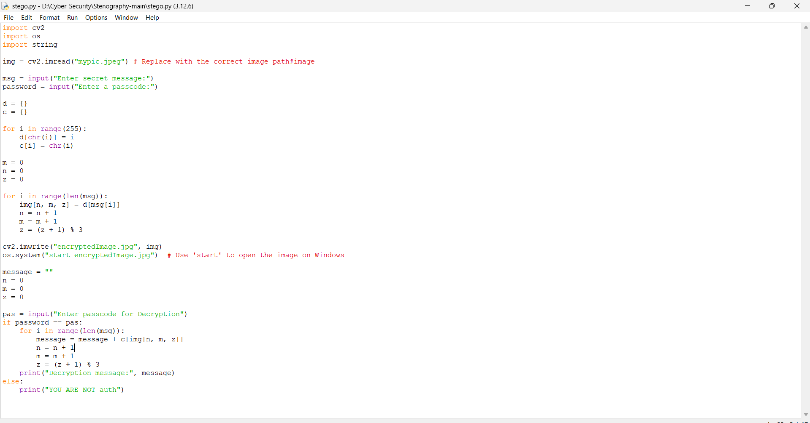
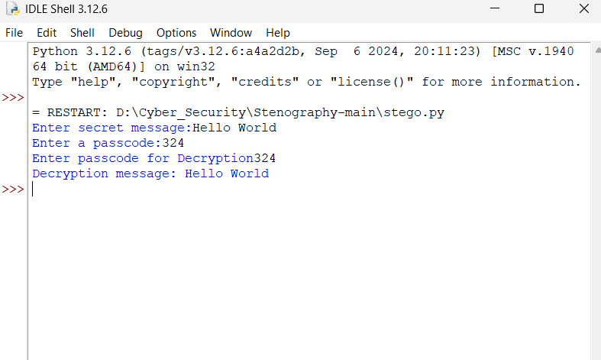

Results
ScreenShot-2:Output
ScreenShot-3:Output Image
ScreenShot-1: Code

Slide 8
Conclusion
By embedding confidential data within images, this project ensures secure communication using steganography. With pixel-level manipulation and a passcode-based decryption mechanism, it prevents unauthorized access while maintaining the image’s original appearance. Its efficiency and simplicity make it a viable solution for secure data transfer across various domains.

Slide 9
GitHub Link
https://github.com/Foram-20/Steganography

Slide 10
Future scope(optional)
🔹 Enhanced Encryption – Incorporating stronger cryptographic techniques. 🔹 Higher Storage Capacity – Optimizing algorithms to embed more data with minimal distortion. 🔹 AI-Driven Steganography – Leveraging machine learning to refine data concealment techniques. 🔹 Cross-Platform Usability – Expanding to mobile and web applications. 🔹 Real-Time Secure Messaging – Implementing steganography in live encrypted chat platforms.

Slide 11
THANK YOU

