Slide 1

Pharma Connect
Front end tool :
wordpress
Back end tool :
mysql
Team Member :
1. Delvadiya Foram D.

Slide 2

Home

Slide 3
Main Menu
Company
Products
Research & Development
Contact

Slide 4

Company

Slide 5
products
A. Allopathic Medicines
1. Antihypertensives
2. Antidiabetics
3. Antibiotics
4. Analgesics
B. Ayurvedic Medicines
5. Bhasmas
6. Churnas
C. Homeopathic Medicines
7. Bio-Combinations
8. Dilutions
9.Mother Tinctures

Slide 6
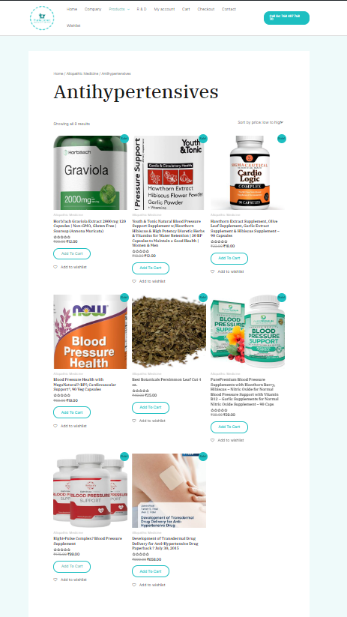
A. Allopathic Medicines
1 . Antihypertensives

Slide 7
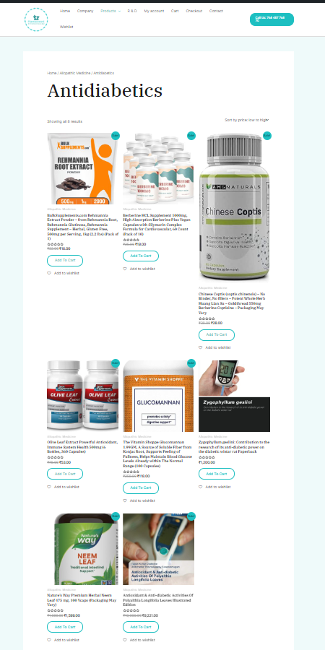
A. Allopathic Medicines
2 . Antidiabetics

Slide 8
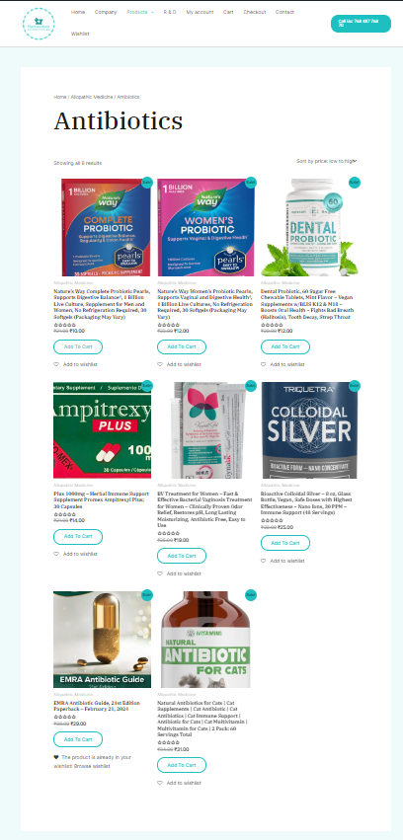
A. Allopathic Medicines
3 . Antibiotics

Slide 9
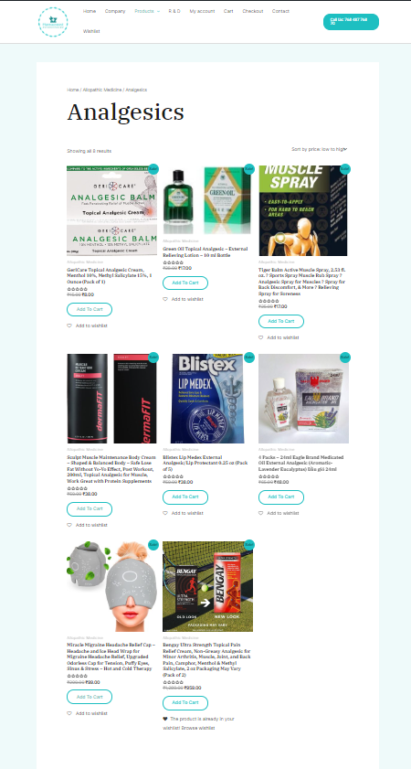
A. Allopathic Medicines
4 . Analgesics

Slide 10
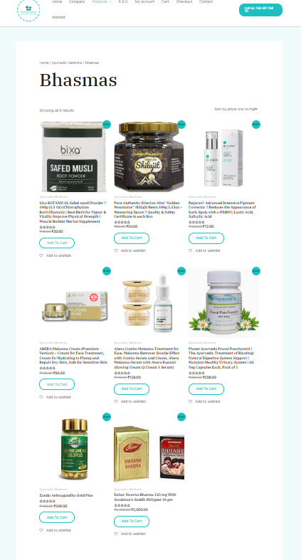
B. Ayurvedic Medicines
5 . Bhasmas

Slide 11
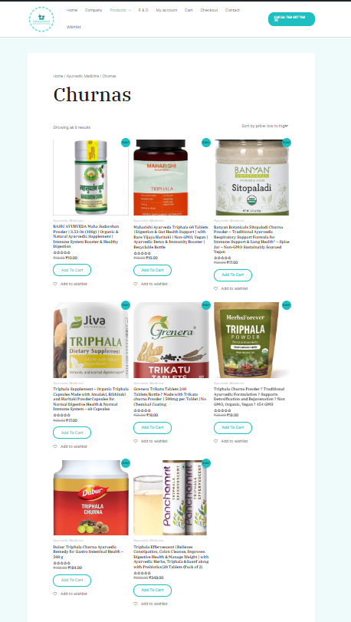
B. Ayurvedic Medicines
6 . Churnas

Slide 12
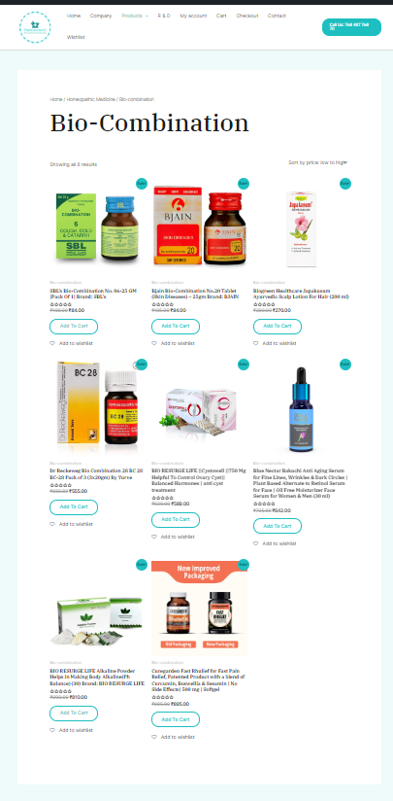
C. Homeopathic Medicines
7 . Bio-Combinations

Slide 13
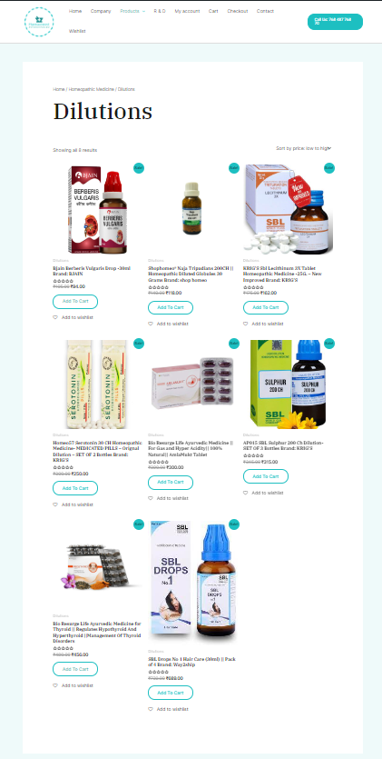
C. Homeopathic Medicines
8 . Dilutions

Slide 14
C. Homeopathic Medicines
8 . Mother Tinctures

Slide 15
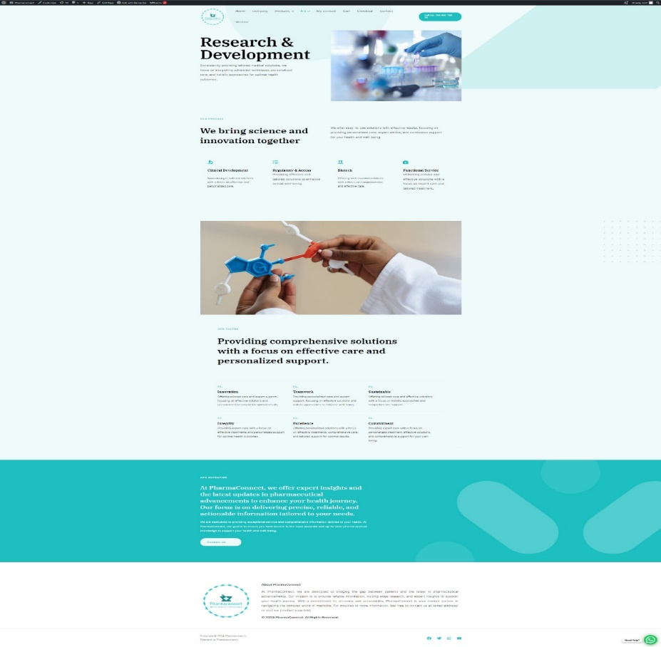
Research & development

Slide 16
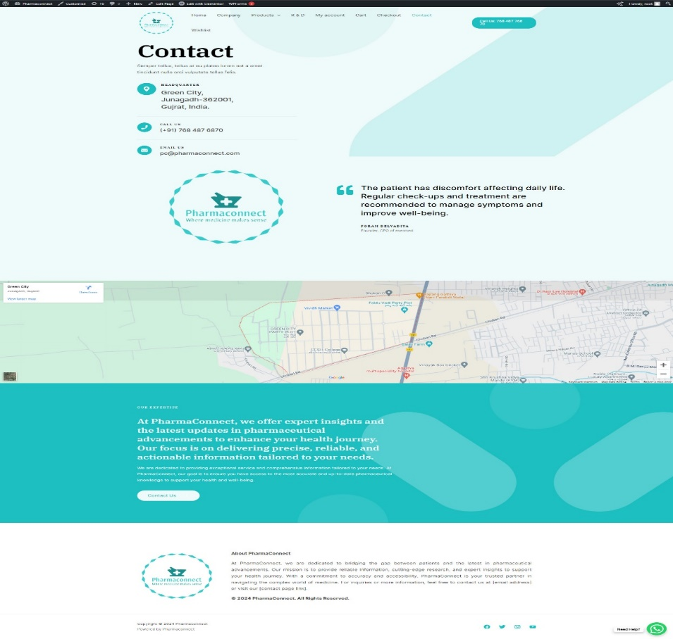
Contact

Slide 17
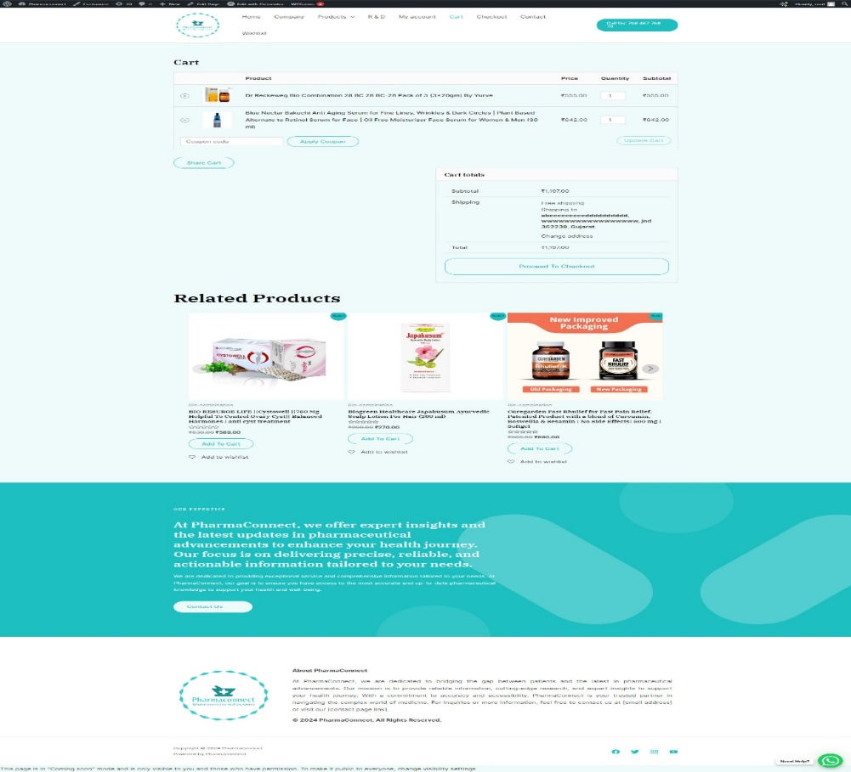
Add to cart

Slide 18
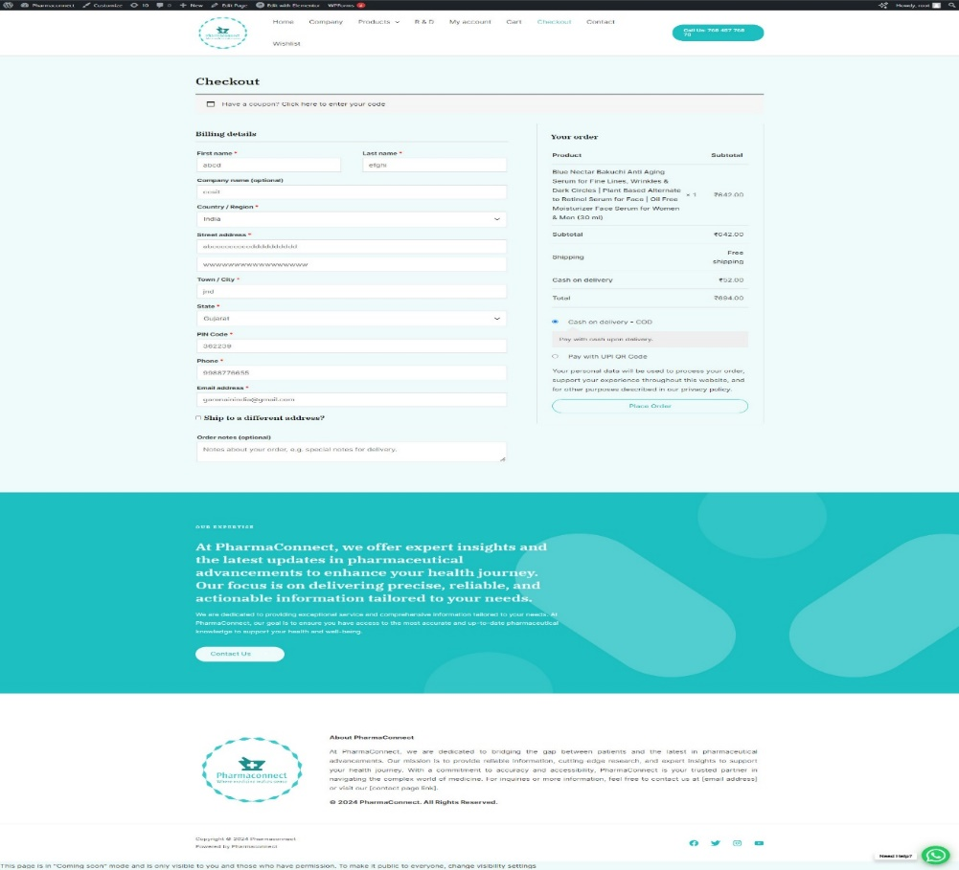
Checkout

Slide 19
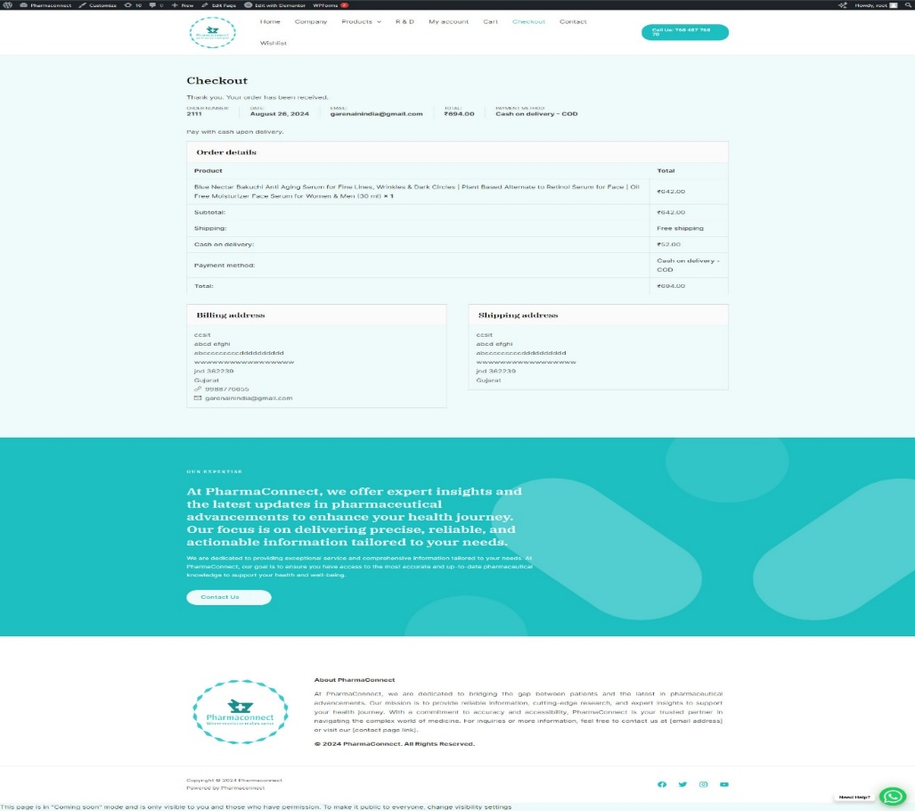
Order bill

Slide 20
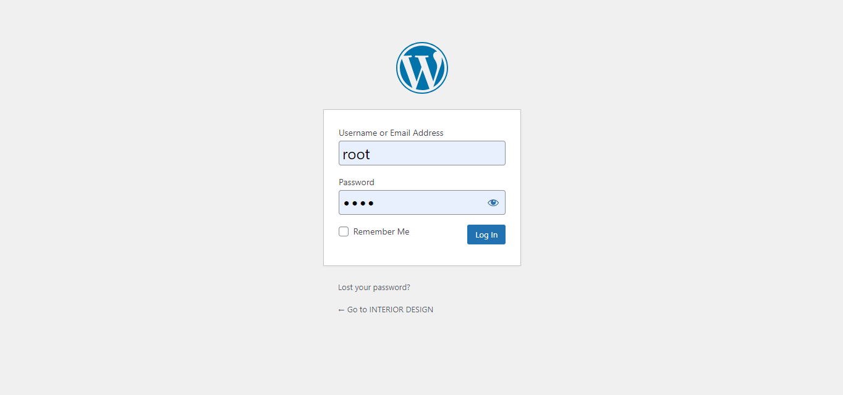
Admin side work

Slide 21
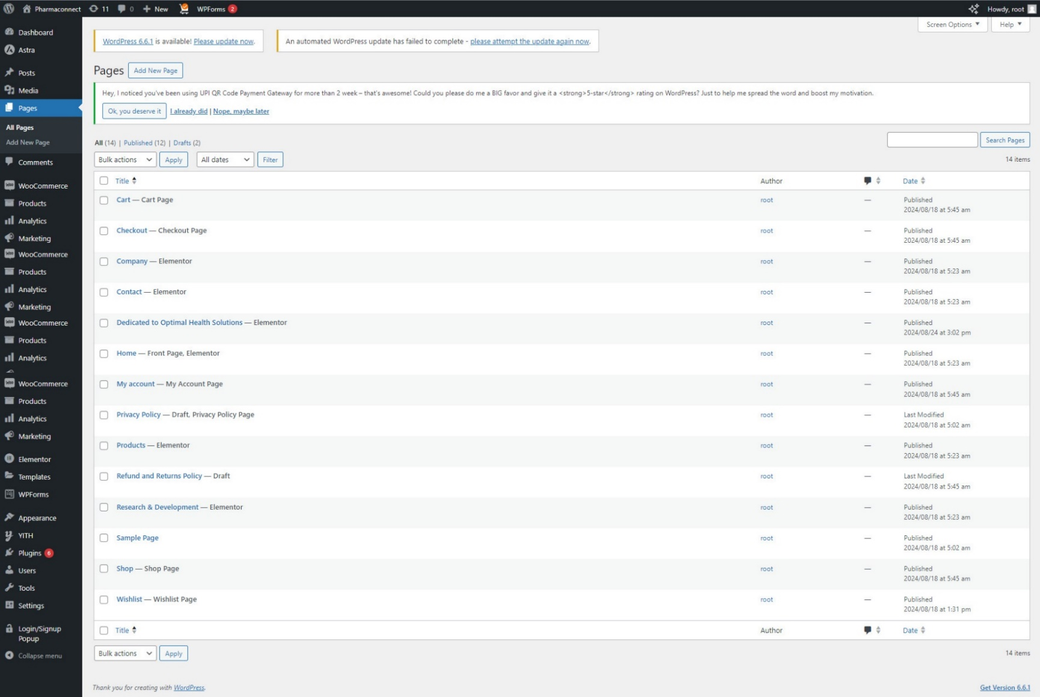
Pages

Slide 22
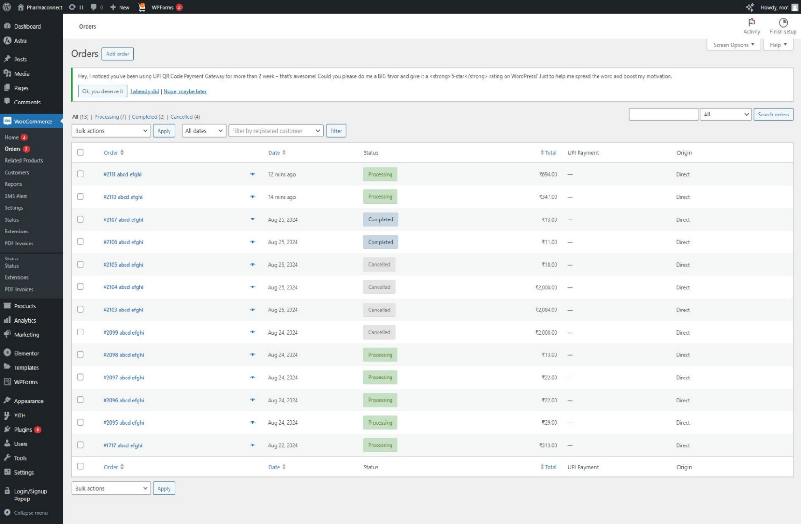
Order

Slide 23
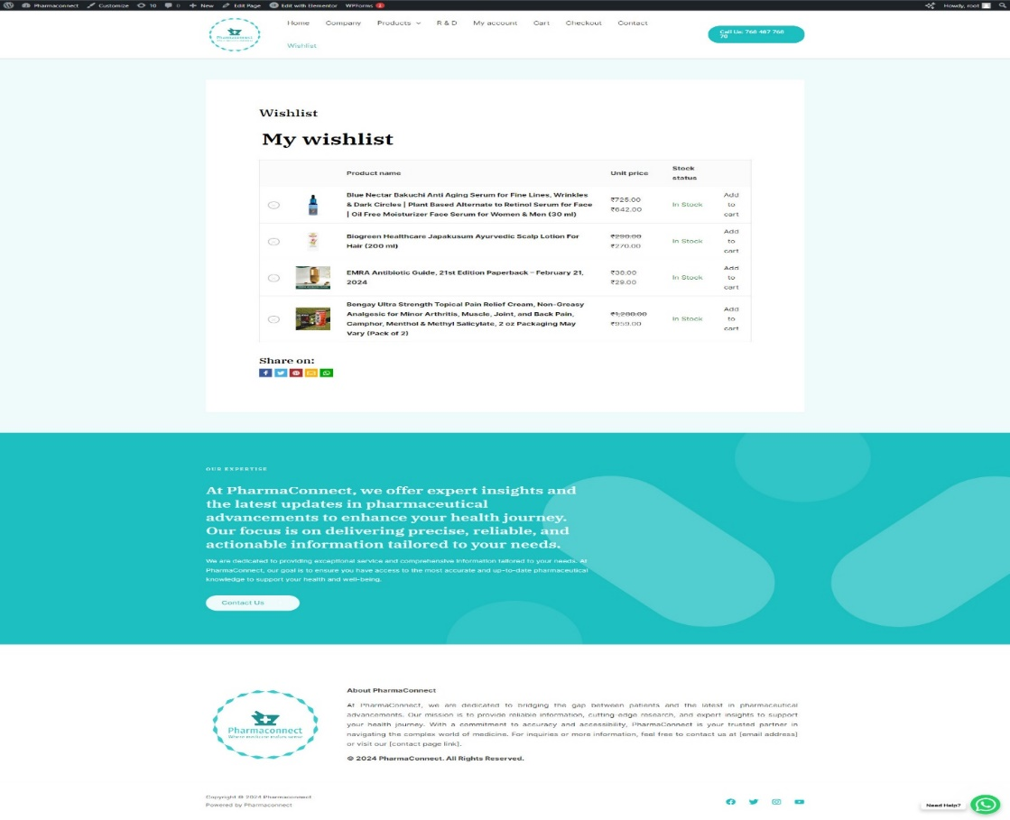
wishlist

Slide 24
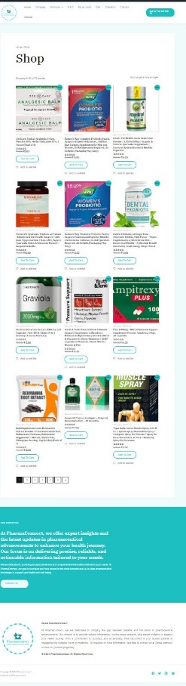
shop

Slide 25

Thank you !
Present By :

