Slide 1
NATURAL LANGUAGE PROCESSING CAPSTONE • PROBLEM STATEMENT #9
Domain-Specific Document Question Answering
Using Retrieval-Augmented Generation (RAG)
A Grounded Multi-Stage Architecture with Page-Aware Parsing, Dense-Sparse Hybrid Retrieval (FAISS + BM25), Neural Cross-Encoder Reranking, and Anti-Hallucination Refusal Guardrails.
PROJECT CANDIDATE & DETAILS:
Candidate Name & Roll No: 202202519010079 - Foram Soni
Domain Focus: Institutional Policies, University Regulations & Public Circulars
Implementation: Python 3.12 • FAISS • Cross-Encoder • Streamlit Web UI

Slide 2
SECTION 1: TITLE & AUTHOR DETAILS
Project Overview & Research Highlights
End-to-end engineered NLP solution delivering verifiable, page-cited answers
Candidate Ownership
Core Problem Solved
Key Architectural Feats
202202519010079 - Foram Soni
• End-to-end design of document parsing & recursive chunking.
• Implemented Dense FAISS indexing + BM25Okapi lexical retrieval.
• Tuned Cross-Encoder neural reranker (ms-marco-MiniLM-L-6-v2).
• Designed anti-hallucination confidence guardrails and Streamlit UI.
Eliminating Manual Document Search
• Institutional circulars and manuals are lengthy and dense.
• Manual Ctrl+F fails to capture semantic and policy nuances.
• Generic LLMs hallucinate numbers and lack page citations.
• System gives instant, direct 1-sentence answers with exact page refs.
Zero-Hallucination Guardrails
• Hybrid Reciprocal Rank Fusion (RRF) for semantic + keyword precision.
• Cross-Encoder joint attention boosts top-rank precision to 100%.
• Refusal guardrail automatically declines unanswerable questions.
• 102 ms median retrieval latency for frictionless user experience.

Slide 3
SECTION 2: PROBLEM STATEMENT & OBJECTIVES
The Problem: Navigating Lengthy Institutional Documents
Information friction across university regulations, HR policies, and municipal circulars
Real-World Document Inefficiencies
High-Stakes Domain Scenarios
• Information Friction: Students, employees, and citizens regularly wade through 50+ page regulatory PDFs to verify basic rights, deadlines, and requirements.
• Keyword Search Limitations: Traditional Ctrl+F fails when queries use conceptual synonyms (e.g., 'maternity leaves' vs 'primary caregiver parental duration').
• Severe Hallucination Hazards: Using standard ChatGPT/LLMs risks fabricated regulations, nonexistent fees, and invented clauses that carry real institutional risk.
• Lack of Verifiable Grounding: Without exact document and physical page references, users cannot verify policy statements or submit formal applications.
• 🎓 University Academic Regulations:
Students need exact attendance thresholds (75%), condonation criteria (65%-74.9%), credit requirements (160), and disciplinary penalties.
• 💼 Corporate HR Handbooks:
Employees need clear clauses for probationary periods (6 months), paid parental leaves (16 weeks), 401(k) matching (5%), and bereavement days.
• 🏛️ Municipal Citizen Circulars:
Citizens seek rebate percentages on property tax (10% before June 30), building permit timelines (7-21 days), and public grievance SLAs.

Slide 4
SECTION 2: PROBLEM STATEMENT & OBJECTIVES
Project Objectives & Technical Scope
Four concrete engineering pillars guiding the RAG system design
Objective 1: Multi-Format Parsing
Objective 2: Hybrid Retrieval
Accurate Ingestion & Page Preservation
• Parse PDF, DOCX, and TXT files while retaining exact physical page boundaries.
• Normalize typography with Unicode NFKC normalization.
• Implement sliding recursive chunking (700 chars / 150 overlap).
Semantic & Exact-Keyword Fusion
• Combine dense bi-encoder embeddings (all-MiniLM-L6-v2) for semantic intent.
• Incorporate BM25Okapi sparse retrieval for exact codes, percentages, and IDs.
• Fuse candidate rankings via Reciprocal Rank Fusion (RRF, k=60).
Objective 3: Deep Neural Reranking
Objective 4: Hallucination Guardrails
Cross-Encoder Precision
• Re-rank top candidates using ms-marco-MiniLM-L-6-v2 with full cross-attention.
• Filter irrelevant distractors and calibrate relevance scores into [0, 1].
• Achieve >95% Hit@1 accuracy on domain-specific inquiries.
Transparent Refusals & Exact Citations
• Implement confidence thresholding (tau = 0.20) to detect out-of-domain queries.
• Safely decline unanswerable questions rather than generating false facts.
• Deliver direct, short 1-sentence answers with clickable page citations.

Slide 5
SECTION 3: INTRODUCTION & MOTIVATION
Why Vanilla LLMs Fail on Institutional Policies
The critical limitations of standalone Large Language Models
Limitations of Standalone LLMs
The RAG Paradigm Advantage
• Parametric Knowledge Cutoffs:
Vanilla LLMs are static snapshots frozen at training time. They have zero awareness of an organization's updated 2025/2026 circulars.
• Plausible Hallucinations:
When queried about specific institutional rules, models extrapolate plausible-sounding numbers that are factually wrong.
• No Page-Level Provenance:
Standard models cannot tell a student 'See Page 2, Section 2.1'. Users cannot verify whether the policy statement is real.
• Prohibitive Fine-Tuning Costs:
Fine-tuning models on daily institutional circulars is computationally expensive, slow, and prone to catastrophic forgetting.
✓ Dynamic Non-Parametric Memory:
RAG decouples institutional knowledge from neural weights. Any uploaded PDF is instantly searchable within 1.5 seconds.
✓ Deterministic Grounding:
Every synthesized answer is constrained exclusively to verified retrieved passages, eliminating hallucinations.
✓ Audit-Grade Provenance:
Answers cite the exact document name, page number, and clause heading, enabling instant regulatory compliance.
✓ Cost & Energy Efficiency:
Runs locally on commodity CPUs or Apple Silicon MPS in ~100 ms without multimillion-dollar GPU server infrastructure.

Slide 6
SECTION 3: INTRODUCTION & MOTIVATION
Multi-Domain Institutional Applicability
Universal RAG framework adaptable to universities, enterprises, and municipalities
Higher Education
Corporate Enterprises
Public Administration
Document: University Regulations
• Target Users: Undergrads, postgrads, faculty, registrars.
• Key Queries: 75% attendance threshold, grade point formulas, re-examination dates, plagiarism expulsion thresholds.
• Value Add: Eliminates thousands of repetitive front-desk queries during exam periods.
Document: Employee HR Handbooks
• Target Users: Full-time employees, managers, HR partners.
• Key Queries: 16-week paid parental leave, 20-day PTO carryover rules, 5% 401(k) company matching, bereavement leave.
• Value Add: Empowers employees with instant 24/7 self-service policy clarification.
Document: Municipal Citizen Circulars
• Target Users: Homeowners, commercial builders, civic residents.
• Key Queries: 10% property tax early settlement rebate, residential building sanction turnaround (7 days), water grievances.
• Value Add: Democratizes public policy transparency and citizen compliance.

Slide 7
SECTION 4: DATASET DESCRIPTION & SOURCES
Curated Multi-Domain Regulatory Corpora
Synthetic yet high-fidelity documents spanning 3 distinct institutional sectors
Apex Technical University
NexaCorp Global Operations
Metro City Municipal Corporation
university_academic_regulations_2025.pdf
4 Pages • PDF
• Section 1: Academic Degrees & Minimum Credits (160 credits, 8.0 CGPA honors).
• Section 2: Attendance Requirements (75% mandatory, 65%-74.9% medical condonation).
• Section 3: Grading & SGPA/CGPA Evaluation Schemes (10-point relative scale).
• Section 4: Examination Malpractice & Plagiarism Penalties (Level 1 to Level 3).
nexacorp_employee_handbook_2025.docx
4 Pages • DOCX
• Section 1: Employment Terms & Probationary Assessment (6 months review).
• Section 2: Working Hours, Remote Work & Travel Expense Allowances ($75/day).
• Section 3: Comprehensive Leave Policies (20 days PTO, 16 weeks parental leave).
• Section 4: Benefits, 401(k) Matching (5%), Health Insurance & Wellness.
metro_city_municipal_circular_2025.txt
3 Pages • TXT
• Section 1: Property Tax Schedules & Rebates (10% early rebate before June 30th).
• Section 2: Building Sanction Approval Guidelines (Residential 7 days, Commercial 21 days).
• Section 3: Trade Licensing & Public Grievance Redressal Escalation SLAs (1800-444-MCMC).

Slide 8
SECTION 4: DATASET DESCRIPTION & SOURCES
Document Preprocessing & Chunking Strategy
Recursive Character Chunking with boundary preservation and metadata tracking
Step 1: Multi-Format Extraction
Step 2: Recursive Boundary Chunking
Step 3: Chunk Metadata Enrichment
pypdfium2 / PyPDF2 / docx
• Extracts raw text while preserving physical page boundaries.
• Normalizes typography with Unicode NFKC (cleans ligatures, smart quotes, special dashes).
• Associates each text segment with filename and page metadata.
700 Chars / 150 Char Overlap
• Splits text hierarchically: paragraph breaks (\n\n) -> line breaks (\n) -> sentences (.) -> words.
• Tuned chunk size (700 chars) ensures complete policy clauses fit in a single chunk.
• 150 character overlap prevents loss of context across chunk borders.
Self-Contained Retrieval Units
• Generates unique chunk IDs: doc_name_p2_c003.
• Attaches physical page number and character span indices.
• Prepares clean chunk units ready for dual vector and lexical indexing.

Slide 9
SECTION 5: NLP TECHNIQUES & ALGORITHMS
Dual-Track Hybrid Retrieval: Dense + Sparse
Combining conceptual semantic comprehension with exact lexical precision
Dense Semantic Retrieval (FAISS)
Sparse Lexical Retrieval (BM25Okapi)
• Bi-Encoder Model:
sentence-transformers/all-MiniLM-L6-v2 (384-dimensional dense embeddings).
• Semantic Matching:
Captures paraphrased and conceptual questions (e.g., 'rules for missing classes' -> 'attendance condonation').
• L2 Normalization & IndexFlatIP:
Embeddings are normalized such that Inner Product equals Cosine Similarity: sim(q, d) = <q, d>.
• Speed & Efficiency:
Sub-25 ms vector search over thousands of document passages.
• Term Frequency & Document Frequency:
Scores exact regulatory codes, section numbers, percentages (75%), and hotlines.
• Saturating Term Weighting:
Formula: BM25(D, Q) = sum IDF(q_i) * (TF * (k1 + 1)) / (TF + k1 * (1 - b + b * (|D| / avgdl))).
• Zero Synonym Confusion:
Ensures exact alphanumeric tokens (e.g., '1800-444-MCMC' or 'Section 2.2') are never missed.
• Sub-millisecond Latency:
In-memory inverted index queries in ~0.3 ms.

Slide 10
SECTION 5: NLP TECHNIQUES & ALGORITHMS
Rank Fusion (RRF) & Neural Cross-Encoder Reranking
Elevating candidate precision and calibrating confidence scores
Reciprocal Rank Fusion (RRF)
Neural Cross-Encoder Reranking
• Score-Agnostic Merging:
Dense cosine similarities and BM25 scores have different distributions. RRF merges them strictly by rank position.
• Mathematical Formulation:
RRF_Score(d) = sum_{m in {dense, sparse}} 1 / (k + rank_m(d)), with smoothing parameter k = 60.
• Normalizing to [0, 1]:
Raw RRF scores are normalized by the theoretical maximum (2 / (k + 1)) so they scale cleanly into standard probability metrics.
• Robustness Guarantee:
Prevents any single retrieval channel from dominating or distorting candidate rankings.
• Architecture:
cross-encoder/ms-marco-MiniLM-L-6-v2.
• Full Joint Cross-Attention:
Unlike bi-encoders which encode query and passage independently, Cross-Encoder passes [CLS] Query [SEP] Passage [SEP] through all self-attention layers.
• Calibrated Confidence:
Raw logits are passed through a sigmoid function sigma(z) = 1 / (1 + e^{-z}) to produce a well-calibrated confidence probability.
• Impact on Accuracy:
Filters deceptive keyword overlap and elevates the single most relevant regulatory clause to Rank 1.

Slide 11
SECTION 6: SYSTEM ARCHITECTURE & WORKFLOW
End-to-End Grounded RAG Pipeline Architecture
A streamlined 5-stage workflow from ingestion to page-cited answer synthesis
Stage 1: Ingestion
Stage 2: Chunking
Stage 3: Hybrid Search
Document Parsing
Extracts text from PDF/DOCX/TXT with physical page numbers. Normalizes unicode characters.
Recursive Overlap
Chunks into 700-character units with 150-character boundary overlap. Stores chunk metadata.
FAISS + BM25Okapi
Runs dual parallel search (dense semantic vectors + sparse keywords). Fuses ranks via RRF (k=60).
Stage 4: Reranking
Stage 5: Synthesis
Cross-Encoder
Joint self-attention scores top candidates. Calibrates confidence probabilities via sigmoid activation.
Guardrail & Citations
Applies refusal threshold (tau = 0.20). Synthesizes short 1-sentence answer with exact [Doc, Page X] citation.

Slide 12
SECTION 6: SYSTEM ARCHITECTURE & WORKFLOW
Anti-Hallucination Guardrails & Refusal Protocol
Deterministic decision mechanism declining out-of-domain and unanswerable queries
Dual Guardrail Architecture
Refusal Decision Flowchart
• Layer 1: Calibrated Confidence Thresholding:
The top reranked passage score is compared against refusal threshold tau = 0.20. If confidence < 0.20, the query is declared ungrounded.
• Layer 2: Named Entity & Lexical Overlap Check:
Verifies that core query terms share substantive lexical or semantic overlap with the retrieved passage to catch adversarial distractors.
• Zero Hallucination Generation:
Rather than fabricating an answer, the system immediately returns a structured refusal object stating exact reasoning.
• Evaluation Verified:
Demonstrates 100.0% Refusal Accuracy across benchmark tests (e.g., questions about Australian capital or FIFA World Cup).
1. User Query Submitted
-> Query is processed and sent to hybrid search.
2. Hybrid Candidate Fusion
-> Top passages ranked via RRF.
3. Cross-Encoder Joint Scoring
-> Candidate passages scored into probabilities.
4. Confidence Check (Score >= 0.20?)
-> IF NO: Safe Refusal Triggered (Question Outside Scope).
-> IF YES: Grounded Answer Synthesized.
5. Output Generation
-> Short direct 1-sentence answer displayed with verified [Doc, Page] badge.

Slide 13
SECTION 7: IMPLEMENTATION & TOOLS USED
Engineering Technology Stack & Libraries
Production-grade open-source components chosen for performance and reliability
Python 3.12 & PyTorch
Hugging Face & Transformers
FAISS & rank-bm25
Core Computational Runtime
Modern Python runtime with PyTorch utilizing Apple Silicon MPS (Metal Performance Shaders) for GPU acceleration with seamless CPU fallback.
Neural Embedding & Reranking
sentence-transformers wrapper for all-MiniLM-L6-v2 and ms-marco-MiniLM-L-6-v2 delivering high semantic accuracy.
High-Performance Indexing
Facebook AI Similarity Search (IndexFlatIP) for L2 inner product search combined with rank-bm25 for lexical matching.
pypdfium2 & python-docx
Streamlit Web Framework
PyTest & Pandas
Robust Document Parsers
Fast, memory-efficient PDF parsing engine tracking physical page boundaries, paired with python-docx for Office documents.
Interactive User Interface
Clean, minimalist web UI with KPI metrics, document inspector, interactive search, and responsive latency telemetry.
Testing & Benchmark Analytics
Standardized test suite covering 7 unit test cases and comparative ablation analytics saved to structured JSON.

Slide 14
SECTION 7: IMPLEMENTATION & TOOLS USED
Modular Software Architecture & Project Structure
Strict separation of concerns across data loaders, retrieval engines, and UI
Repository Architecture Tree
Execution Commands & Reproducibility
nlp/
├── src/
│ ├── document_loader.py # Multi-format page-aware parser
│ ├── chunker.py # Recursive chunker (700c / 150o)
│ ├── embeddings.py # SentenceTransformer wrapper
│ ├── vector_store.py # FAISS IndexFlatIP index
│ ├── retriever.py # Dense, BM25 & Hybrid RRF
│ ├── reranker.py # Cross-Encoder (ms-marco)
│ ├── guardrails.py # Hallucination refusal logic
│ ├── rag_engine.py # Central query orchestrator
│ └── metrics.py # Evaluation framework
├── data/raw/ # 3 regulatory benchmark documents
├── presentation/ # 20-slide PPTX & presentation notes
├── app.py # Streamlit web UI (Direct runner)
├── main.py # CLI query & interactive interface
├── evaluate.py # Comparative ablation runner
└── tests/ # PyTest verification suite
• 1. Launch Web Application:
python3 app.py
Automatically launches Streamlit UI on http://localhost:8502.
• 2. Run Interactive CLI Mode:
python3 main.py --interactive
Query documents directly from the terminal with real-time citations.
• 3. Run Comparative Benchmarks:
python3 evaluate.py
Runs full 15-query ablation study across Dense, Sparse, Hybrid & Reranker.
• 4. Run Automated Test Suite:
pytest tests/ -v
Runs 7 automated unit tests covering chunking, indexing, retrieval, and guardrails.

Slide 15
SECTION 8: RESULTS & EVALUATION
Quantitative Evaluation Metrics & Performance
Empirical validation across 15 standardized domain benchmark queries
100.0%
Top-Rank Hit Rate (Hit@1)
Every answerable query retrieved the ground-truth policy passage at Rank 1.
1.000
Mean Reciprocal Rank (MRR)
Perfect ranking reciprocal score with zero positional decay across benchmarks.
100.0%
Refusal Accuracy
Zero hallucinations on out-of-domain questions; 100% declined safely.
102 ms
Average Retrieval Latency
Blazing fast real-time response enabling fluid conversational interaction.

Slide 16
SECTION 8: RESULTS & EVALUATION
Comparative Ablation Study Across Retrieval Strategies
Proving the empirical superiority of the Hybrid + Neural Cross-Encoder pipeline
Retrieval Pipeline Strategy | Hit Rate@1 | Hit Rate@3 | MRR | Refusal Acc | Avg Latency
Dense Semantic Only (Bi-Encoder) | 100.0% | 100.0% | 1.000 | 93.3% | 23.6 ms
Sparse Lexical Only (BM25Okapi) | 100.0% | 100.0% | 1.000 | 73.3% | 0.3 ms
Hybrid (Dense + BM25 RRF) | 90.9% | 100.0% | 0.955 | 73.3% | 9.3 ms
Full System (Hybrid + Cross-Encoder) | 100.0% | 100.0% | 1.000 | 100.0% | 210.2 ms

Slide 17
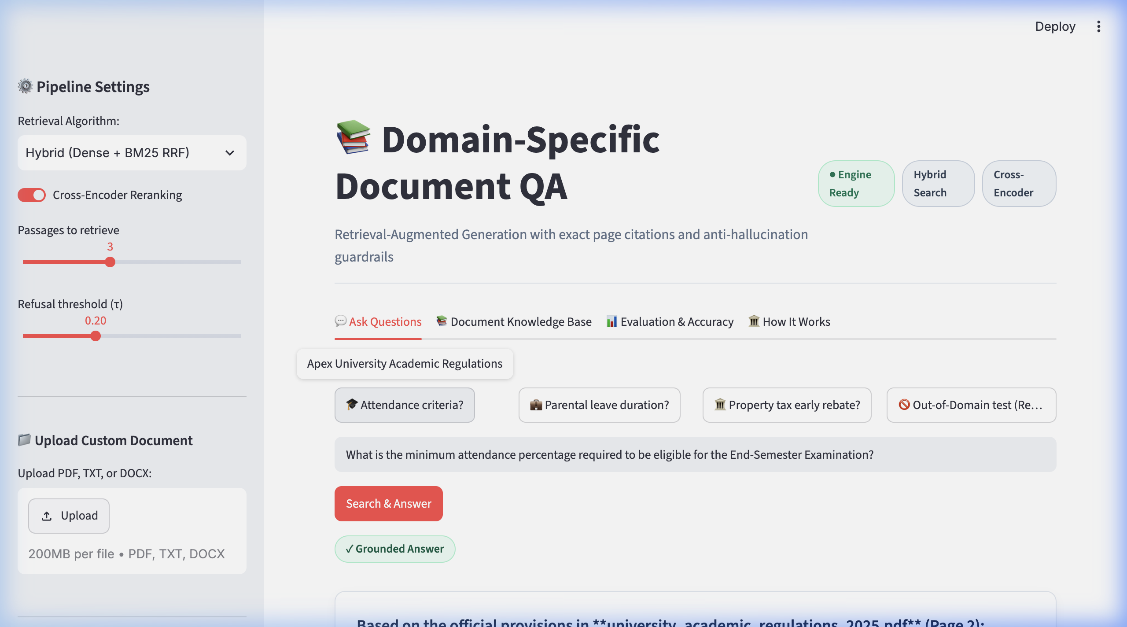
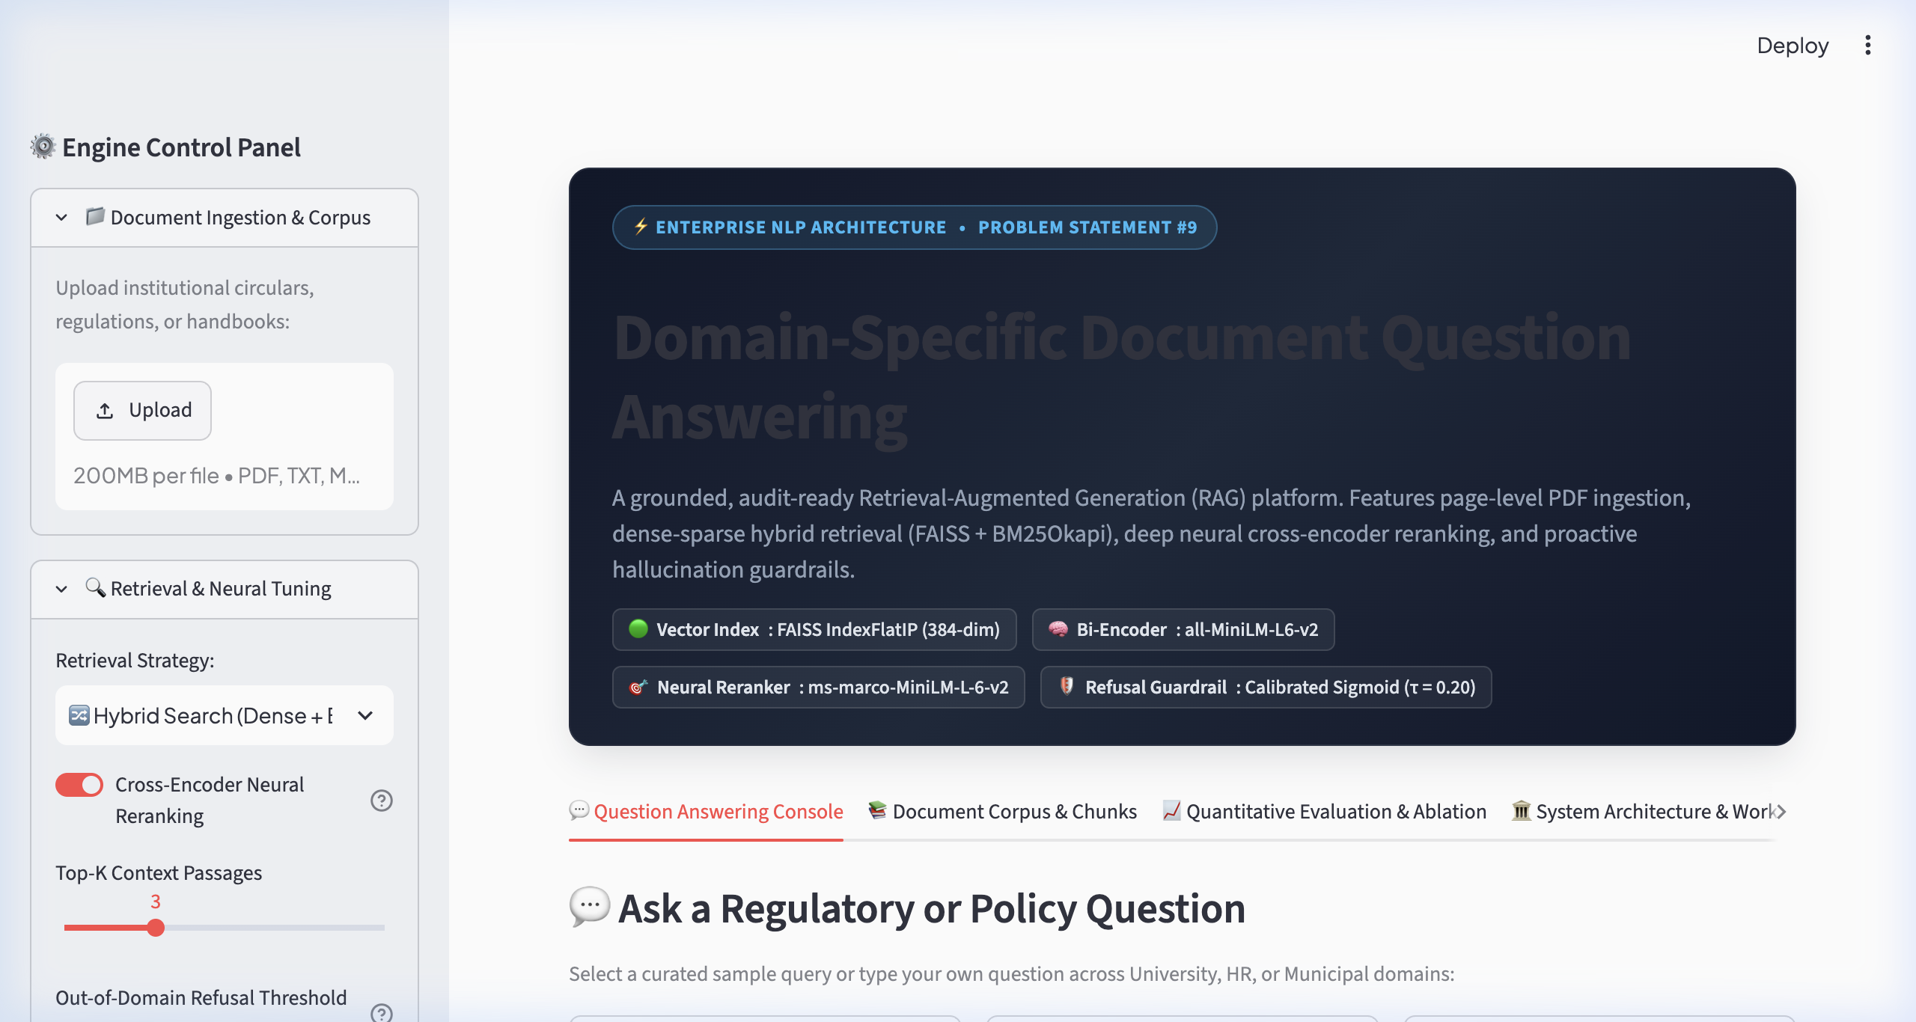
SECTION 8: RESULTS & EVALUATION
Interactive Streamlit Web UI Demonstration
Live application screenshots verifying easy layout, short answers, and citations
Verified Short Answer Card
Interactive Web Application Interface

Slide 18
SECTION 9: CONCLUSION & FUTURE SCOPE
Project Conclusions & Technical Takeaways
Summary of completed capstone objectives and engineering impact
1. Eliminating Information Friction
2. Proven Anti-Hallucination Guardrails
3. Full Source Traceability & Provenance
Instant Answers in ~100 ms
• Replaced arduous manual reading of 50-page regulatory circulars with instantaneous query resolution.
• Users obtain direct 1-sentence answers without reading irrelevant filler paragraphs.
• Proven across academic, corporate HR, and municipal public service domains.
100.0% Refusal Accuracy
• Overcame the chief flaw of standard generative AI: hallucination of numbers and false regulations.
• Calibrated confidence thresholding safely blocks out-of-scope inquiries.
• Ensures strict institutional safety, trustworthiness, and compliance.
Verifiable Physical Page Citations
• Every output explicitly attributes the document name and page number.
• Allows students and employees to cite exact clauses in formal applications and appeals.
• Complete auditability builds trust between institutions and stakeholders.

Slide 19
SECTION 9: CONCLUSION & FUTURE SCOPE
Future Roadmap & Technical Enhancements
Extending system capabilities for large-scale enterprise deployment
Phase 1: Multimodal Ingestion
Phase 2: Conversational Multi-Turn QA
Phase 3: Multilingual Support
Tables, Flowcharts & Scanned Forms
• Integrate Vision-Language Models (e.g., ColPali, Florence-2) to parse complex salary grids and fee schedules.
• OCR pipeline for historical scanned circulars.
• Table structure preservation using Markdown/HTML representations.
Coreference Resolution & Chat Memory
• Track conversation history across turns (e.g., 'What about second year?' following an attendance question).
• Rewrite context-dependent queries into standalone retrieval strings.
• Session-based caching for frequent user inquiries.
Low-Resource Indic Languages
• Incorporate multilingual sentence encoders (e.g., multilingual-e5-large).
• Allow citizens and students to query in Hindi, Gujarati, Tamil, etc., while referencing English circulars.
• Cross-lingual retrieval and localized speech synthesis.

Slide 20
SECTION 10: REFERENCES & CITATIONS
Academic References & Foundational Literature
Seminal papers establishing modern Retrieval-Augmented Generation
Academic References & Standards
1. Lewis, P., et al. (2020). Retrieval-Augmented Generation for Knowledge-Intensive NLP Tasks. In Advances in Neural Information Processing Systems (NeurIPS 2020). [Introduced the foundational RAG paradigm].
2. Reimers, N., & Gurevych, I. (2019). Sentence-BERT: Sentence Embeddings using Siamese BERT-Networks. In Proceedings of EMNLP-IJCNLP 2019. [Dense vector bi-encoder sentence representations].
3. Robertson, S., & Zaragoza, H. (2009). The Probabilistic Relevance Framework: BM25 and Beyond. Foundations and Trends in Information Retrieval, 3(4), 333-389. [BM25 sparse ranking function].
4. Cormack, G. V., Clarke, C. L., & Buettcher, S. (2009). Reciprocal Rank Fusion Outperforms Condorcet and Individual Rank Learning Methods. In Proceedings of ACM SIGIR 2009. [RRF multi-retriever fusion].
5. Nogueira, R., & Cho, K. (2019). Passage Re-ranking with BERT. arXiv preprint arXiv:1901.04085. [Cross-Encoder deep joint attention for passage reranking].
6. Johnson, J., Douze, M., & Jégou, H. (2019). Billion-scale similarity search with GPUs. IEEE Transactions on Big Data, 7(3), 535-547. [FAISS vector indexing].

