Slide 1
Perturbative Neural Networks

Slide 2
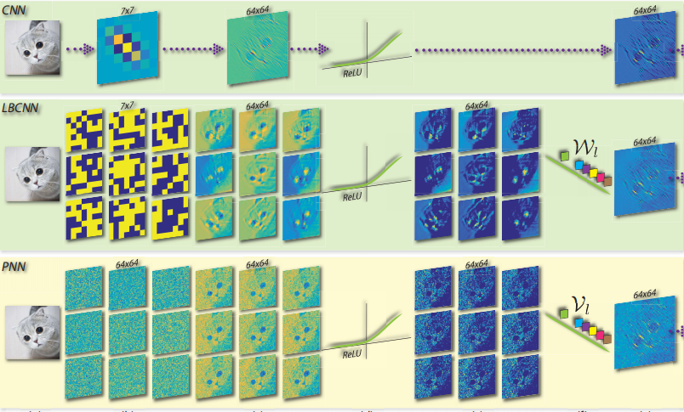

Slide 3


Slide 4



Relating PNN and CNN: A Macro View
R^{d×N}
d = N
d>N
Sherman–Morrison公式

Slide 5
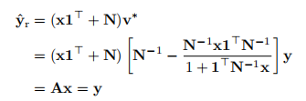
Relating PNN and CNN: A Macro View
PNN
CNN

Slide 6




Relating PNN and CNN: A Macro View
公式变形

Slide 7


Relating PNN and CNN: A Macro View
移项
Sylester方程

Slide 8

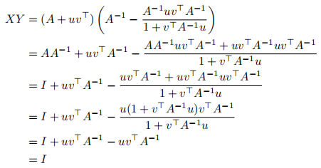
Sherman–Morrison公式
结论：
证明：
限制条件：

Slide 9
公式变形
(x1^{T} + N)[N⁻¹y - N⁻¹x1^{T}N⁻¹y/(1 + 1^{T}N⁻¹x)] = Ax
x1^{T}N⁻¹y - x1^{T}N⁻¹x1^{T}N⁻¹y/(1 + 1^{T}N⁻¹x) + y - x1^{T}N⁻¹y/ (1 + 1^{T}N⁻¹x) = Ax
x1^{T}N⁻¹y[1 - 1/(1 + 1^{T}N⁻¹x)]=x1^{T}N⁻¹x1^{T}N⁻¹y/(1 + 1^{T}N⁻¹x)
x1^{T}N⁻¹y1^{T}N⁻¹x/(1 + 1^{T}N⁻¹x)=x1^{T}N⁻¹x1^{T}N⁻¹y/(1 + 1^{T}N⁻¹x)
x1^{T}N⁻¹y1^{T}N⁻¹x = x1^{T}N⁻¹x1^{T}N⁻¹y

Slide 10
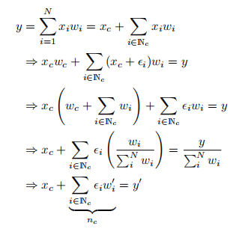
Relating PNN and CNN: A Micro View

Slide 11
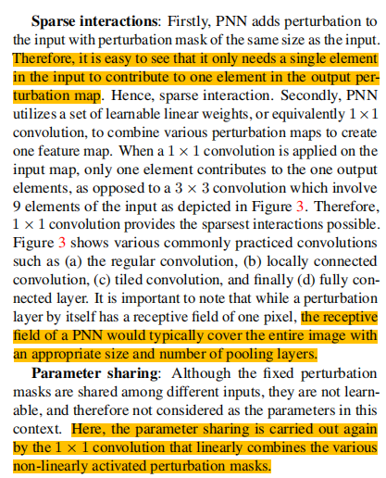
Properties of PNN

Slide 12
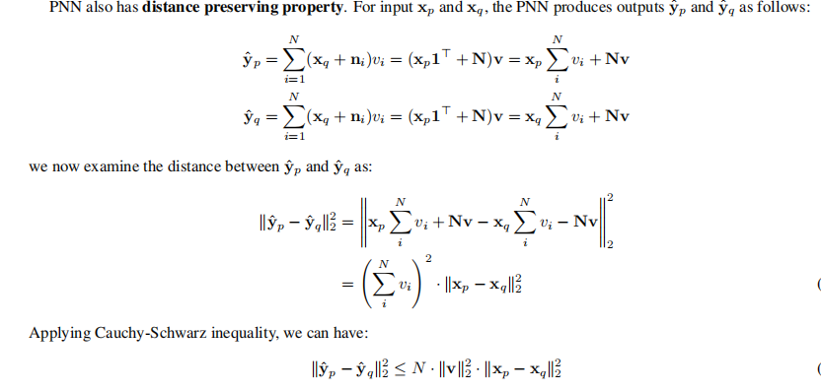

Properties of PNN

Slide 13

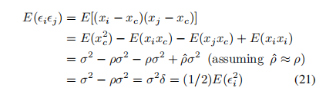

Properties of PNN
assuming:

Slide 14
Computational Complexity
(1) transforms the NCHW data into NHWC format.
(2) performs a matrix-matrix multiplication.
(3) transforming the data from NHWC back to NCHW.

Slide 15
Computational Efficiency
input image size: k×m×n CNN filter size: k×3×3
PNN乘法运算次数：k×m×n
CNN乘法运算次数：3×k×m×n

Slide 16


